Slide 1
The Higher Education Landscape
A presentation to the USF Community, February 2020 Town Halls
Greg Dubrow, Director of Institutional Research,
San Francisco State University

Slide 2



About me:
Since November 2018, Director of IR at SF State
Director of Research & Policy Analysis/Enrollment Analytics at
UC Berkeley Office of Undergraduate Admissions, 2005 to 2018
Asst. Professor, Florida International Univ, Miami FL 2001 to 2005
Ph.D. in Higher Education, University of Pennsylvania
@greg_dubrow
Greg Dubrow
greg-dubrow

Slide 3
What are the major trends affecting the higher education landscape in the US today, particularly traditional liberal arts colleges?
Changing demographics impacting enrollments
How much is affordability a factor for liberal arts colleges?
The role of endowments in ensuring long-term financial security?
What social/political threats are on the horizon that colleges should start addressing?

Slide 4
California High School Graduates

Slide 5
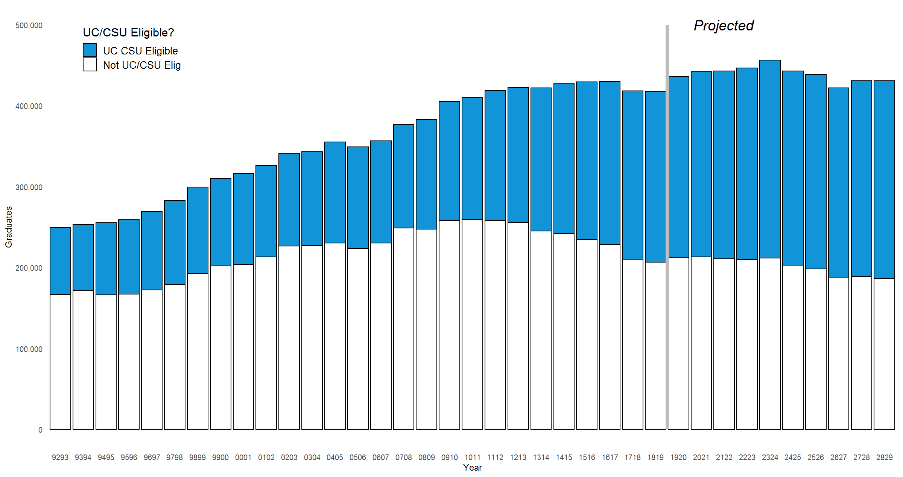
California Public High School Graduates
1993 to 2029 (projected)
Projected total enrollments 2019-20 onward from CA Dept of Finance
Projections based on migration/immigration & school-continuation rate models
UC/CSU eligibility projections by author using modest assumptions from most recent three year period

Slide 6
California Public High School Graduates
1993 to 2029 (projected)
67% increase in grads from 1993 to 2018
UC/CSU eligibility 33% in 1993, 50% in 2018
Data sources:
Actual: CA Dept of Education.
Projections: CA Dept of Finance
Grads expected to peak in 2023, then decline slightly

Slide 8
Factors affecting K-12 enrollment and graduation:
Birth rates
Immigration
Emigration in/out of state
Housing costs
More resources:
CA Department Ed Data & statistics: https://www.cde.ca.gov/ds/
National Center for Education Statistics: https://nces.ed.gov/
Public Policy Institute of California - https://www.ppic.org/

Slide 9
College Affordability

Slide 10
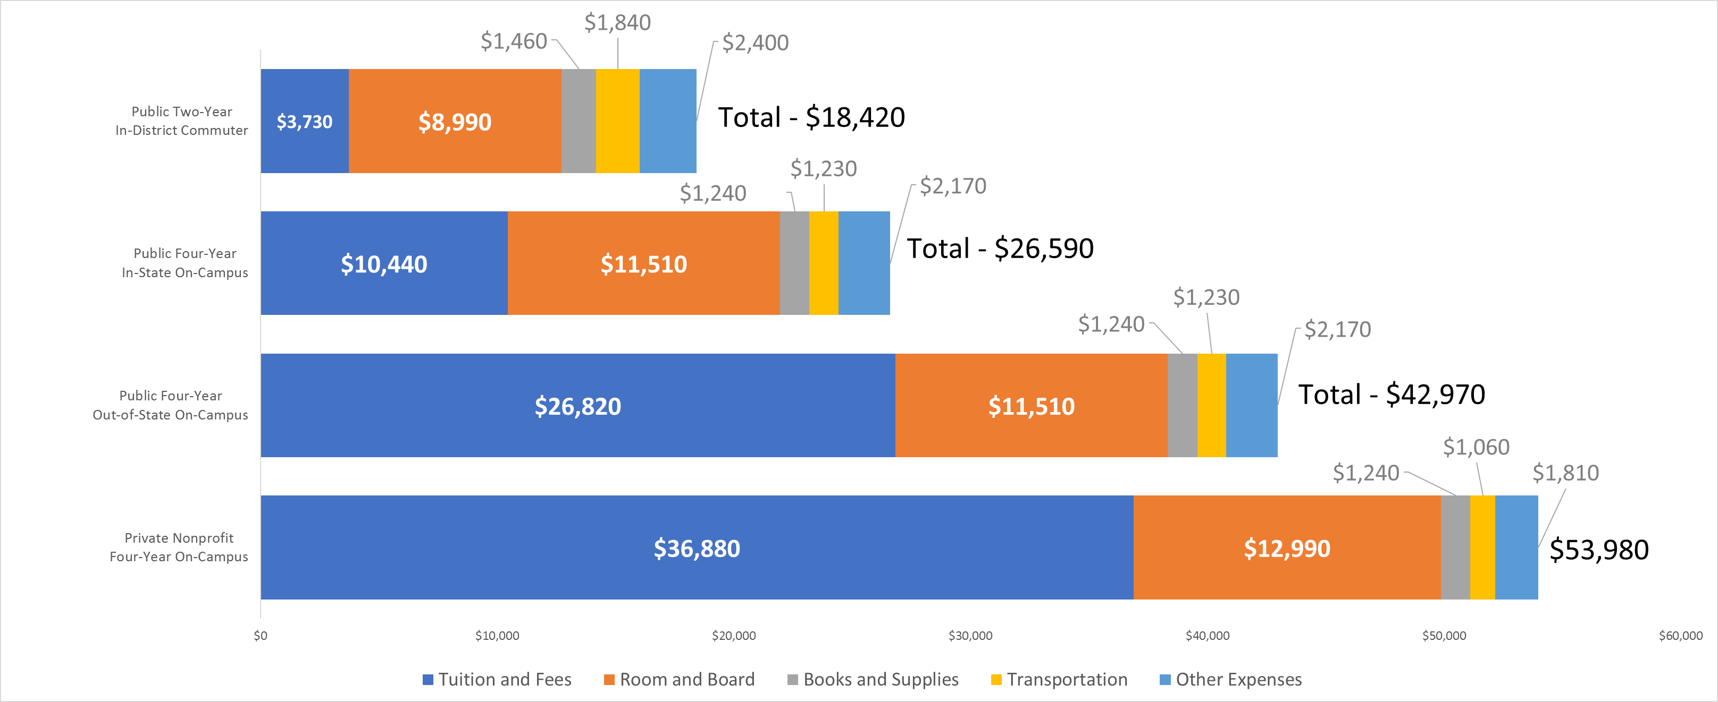
Average Estimated Full-Time Undergraduate Budgets (Enrollment-Weighted) by Sector, 2019-20
Source: College Board, NCES

Slide 11
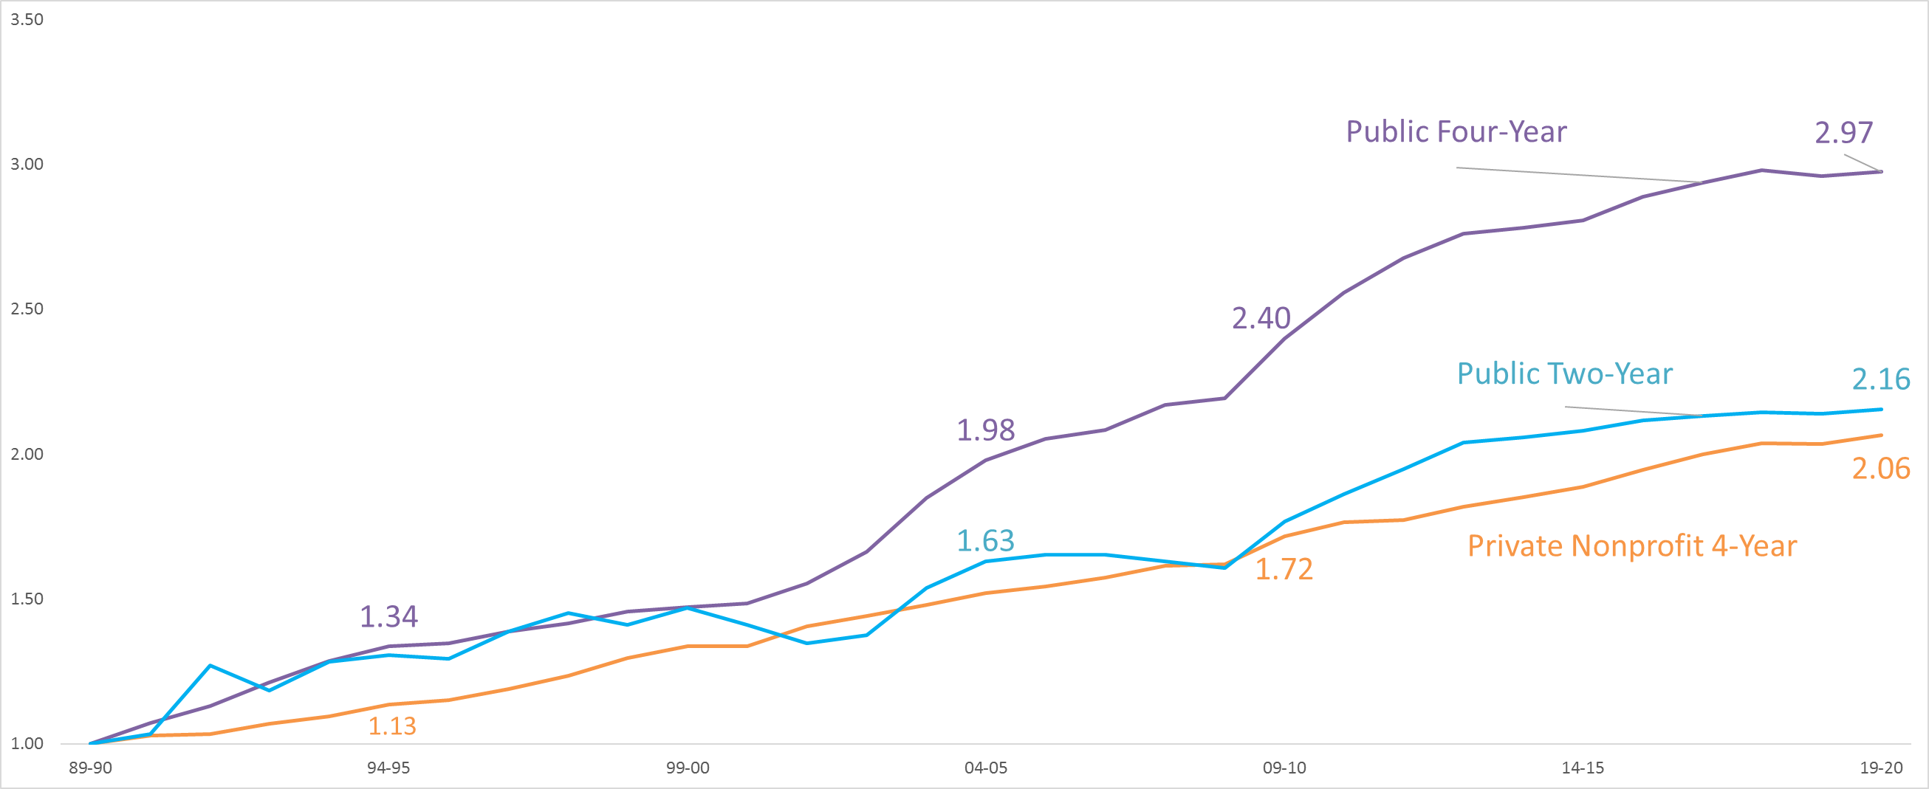
Inflation-Adjusted Published Tuition and Fees Relative to 1989-90, 1989-90 to 2019-20 (1989-90 = 1.0)
Source: College Board, NCES

Slide 12
Inflation-Adjusted Published Tuition and Fees Relative to 1989-90, 1989-90 to 2019-20 (1989-90 = 1.0)

Slide 13
What questions do you have?

Slide 14
Thank you!
@greg_dubrow
Greg Dubrow
greg-dubrow

