Slide 1
FSM Irrigation
May 15, 2026
Notes:
We’re here to learn how your team actually works in the field, where this helps, and where it breaks

Slide 2
Irrigation System Hierarchy
Property Account
└── System (Parent Asset)
├── Controller
├── Program
├── Zone 1
├── Valve
├── Distribution
├── Zone 2
├── Pump
└── Backflow Preventer
Where does this hierarchy match how your team actually thinks in the field?
Where does it break in real jobs, like shared assets, urgency, or incomplete data?
Which hierarchy details are too hard to maintain in daily operations?

Slide 3
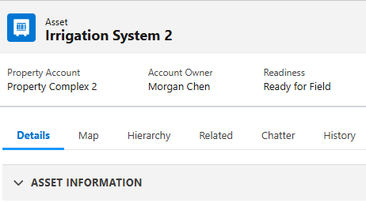
System Setup
Prototype demo…
What setup steps would your team skip under time pressure?
Which fields are realistically known at setup versus only known on-site?
Which errors currently hurt you most downstream?
Notes:
C:\Users\GEhrenberg\irrigation\prototype\desktop_map\desktop_prototype_with_map.html

Slide 4
Process
Planned work comes from the normal contract flow.
Emergency work starts as a simple field request and gets routed for action.
System information is set up before the visit so the tech has the right context.
The tech captures the visit results in one place.
Internal users see the details they need to decide next steps.
The customer gets a clear service confirmation or report.
The branch team can use the output to create a proposal or follow-up action.
Keep internal notes separate from customer-facing notes.
What would you trust the system to auto-assign on day one, and what must stay manual?
Where do handoffs fail today between AM, coordinator, and technician?
How is the system information set up today, and what has to be in place before a PMI, Assessment, or Repair visit can happen?
What part of the setup is field-owned versus office-owned?
Notes:
PMI = routine, fast inspection on existing systems.
Assessment = deeper review for new properties or revenue-oriented evaluation.
Repair = reactive work to fix a known issue.
This is the point where we want to understand how work is set up before the visit, who owns it, and what has to exist so a PMI, Assessment, or Repair can happen cleanly.
Help us separate the three work modes. PMI is the fast routine check, Assessment is the deeper review, and Repair is the reactive fix. We want to know where the boundaries really are in your world.

Slide 5
Inspection Question Library
Visit Context
Site Conditions
Water Source
Backflow
Controller
Program Schedule
Zone Inspection
Mainline – Distribution
Summary and Recommendations
Which sections are nationally mandatory versus region-variant?
Which questions belong to PMI, which belong to Assessment, and which only belong in Repair so the routine inspection stays fast?
Which answers must be structured for reporting integrity?
Which failed responses must always generate a suggested callout?
Notes:
https://vscode.dev/github/greg-e/irrigation/blob/devops/requirements/inspection_question_library.md

Slide 6
Mobile App Structure
Service Appointment
└── Work Order Line Item (Parent Asset)
├── Details
├── Related
├── Map
├── Hierarchy (Components)
├── Checklist (Questions)
├── Callouts
└ Location
└ Photos
├── Report
In a real job, what order would a tech use these sections?
Assume a rushed morning with weak signal and eight stops. What’s your first tap?
Which step feels unnecessary or out of sequence?
What must still work when connectivity is poor?

Slide 7
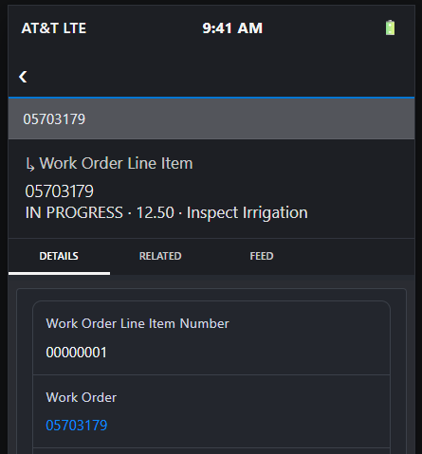
Service Appointment
Prototype demo…
If a tech is in PMI, Assessment, or Repair mode, what should feel different in the app, and where should the workflow split?
What feels intuitive immediately versus requiring retraining?
Where would a tech likely abandon or bypass the intended flow?
What one change would most increase adoption in your branch?
Notes:
C:\Users\GEhrenberg\irrigation\prototype\mobile\mobile_prototype_map.html

Slide 8
Output
From completed inspection to
Report
Management action queue
Customer update
What report output helps you take action fastest today?
What information is missing when management receives field output now?
What customer-facing output creates trust vs confusion?

Slide 10

Our Services
Mina opeles eliqua verundias entorpor aut etmoni exceprest, acepele stestibus fel coreste mpossimenia valle nectotatem con beliquos sam idis aut liste porat.
Maintenance
Tree Care
Deritaest lea corporp ostrumelle ante qui ape voloni
Deritaest lea corporp ostrumelle ante qui ape voloni
Development
Sports Turf
Deritaest lea corporp ostrumelle ante qui ape voloni
Deritaest lea corporp ostrumelle ante qui ape voloni
Water Management
Golf
Deritaest lea corporp ostrumelle ante qui ape voloni
Deritaest lea corporp ostrumelle ante qui ape voloni

Slide 12


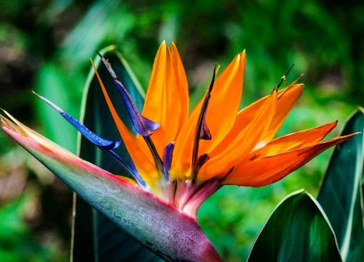
Picking the Right Plants
Ecessita sperrorae pa quasite porpos molorei catioriora volori dem que nus, si aborionsende vero tem a voluptati conserro magnit estis quis magnia aut modis sum quodis utem et qui ommoluptate nus et fuga.
Image
Add some additional information here like photo captions or a specific call out.
First bullet point
Second bullet point
Third bullet point
Fourth bullet point

Slide 14


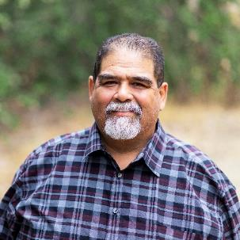
Meet Your BrightView Team
Some information about the team goes here.
Jane Doe
Jason Andrews
Miguel Fuentes
Landscape Specialist
Landscape Specialist
Arborist
Mina opeles eliqua verundias entorpor aut etmoni exceprest, acepele stestibus fel coreste mpossimenia valle nectotatem con beliquos fasane.
Mina opeles eliqua verundias entorpor aut etmoni exceprest, acepele stestibus fel coreste mpossimenia valle nectotatem con beliquos fasane.
Mina opeles eliqua verundias entorpor aut etmoni exceprest, acepele stestibus fel coreste mpossimenia valle nectotatem con beliquos fasane.

Slide 16

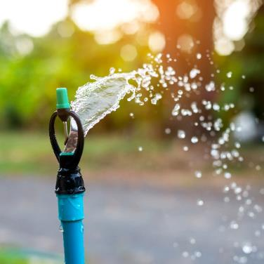

Water Management
Ecessita sperrorae pa quasite porpos molorei catioriora volori dem quenus
Topic 1
Topic 2
Topic 3
Epeles aliquis erundias entorpor aut et exceprest, acepele stestibus
Epeles aliquis erundias entorpor aut et exceprest, acepele stestibus
Epeles aliquis erundias entorpor aut et exceprest, acepele stestibus

Slide 18


Adding Color to Your Landscape
Topic 1
Ecessita sperrorae pa quasite porpos molorei catioriora volori dem que nus
Topic 2
Ecessita sperrorae pa quasite porpos molorei catioriora volori dem que nus
Topic 3
Ecessita sperrorae pa quasite porpos molorei catioriora volori dem que nus
Topic 4
Ecessita sperrorae pa quasite porpos molorei catioriora volori dem que nus

Slide 20
What We Offer
Topic
Topic
Topic
Topic
Ecessita sperrorae pa quasite porpos molorei catioriora volori dem
que nus
Ecessita sperrorae pa quasite porpos molorei catioriora volori dem
que nus
Ecessita sperrorae pa quasite porpos molorei catioriora volori dem
que nus
Ecessita sperrorae pa quasite porpos molorei catioriora volori dem
que nus
Topic
Topic
Topic
Topic
Ecessita sperrorae pa quasite porpos molorei catioriora volori dem
que nus
Ecessita sperrorae pa quasite porpos molorei catioriora volori dem
que nus
Ecessita sperrorae pa quasite porpos molorei catioriora volori dem
que nus
Ecessita sperrorae pa quasite porpos molorei catioriora volori dem
que nus

Slide 21
Slide Title

Slide 22
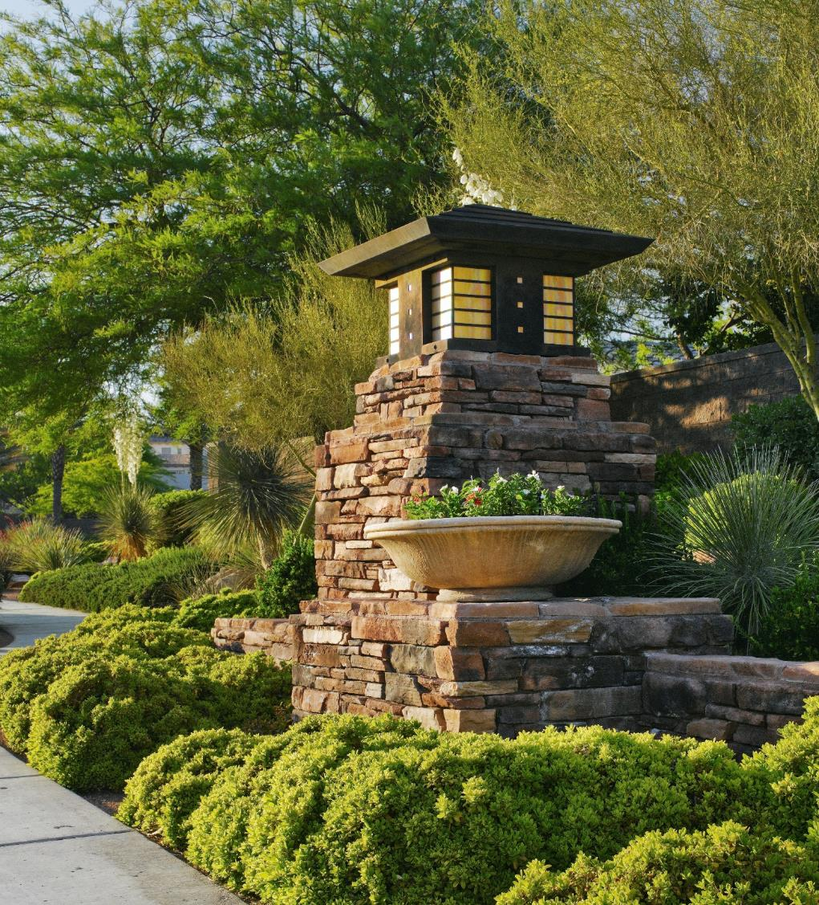
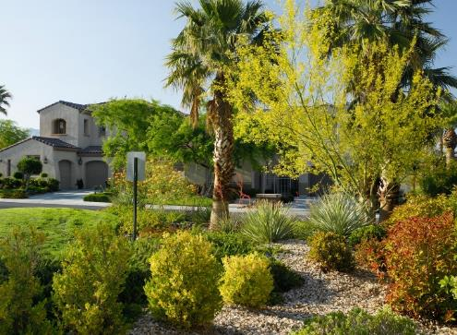
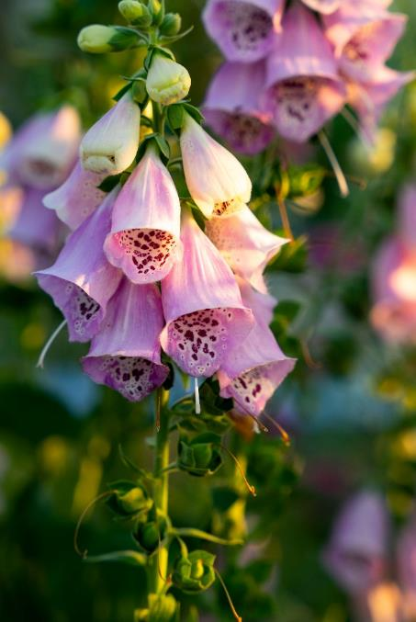
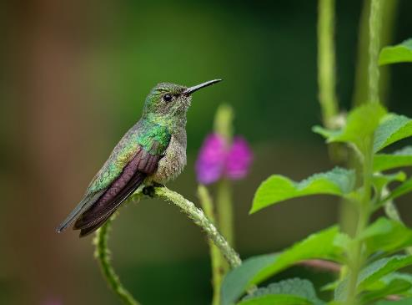
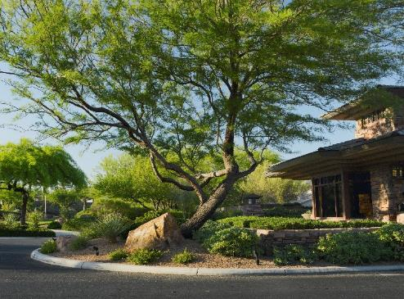
Red Rock Country Club
Las Vegas, NV

Slide 24
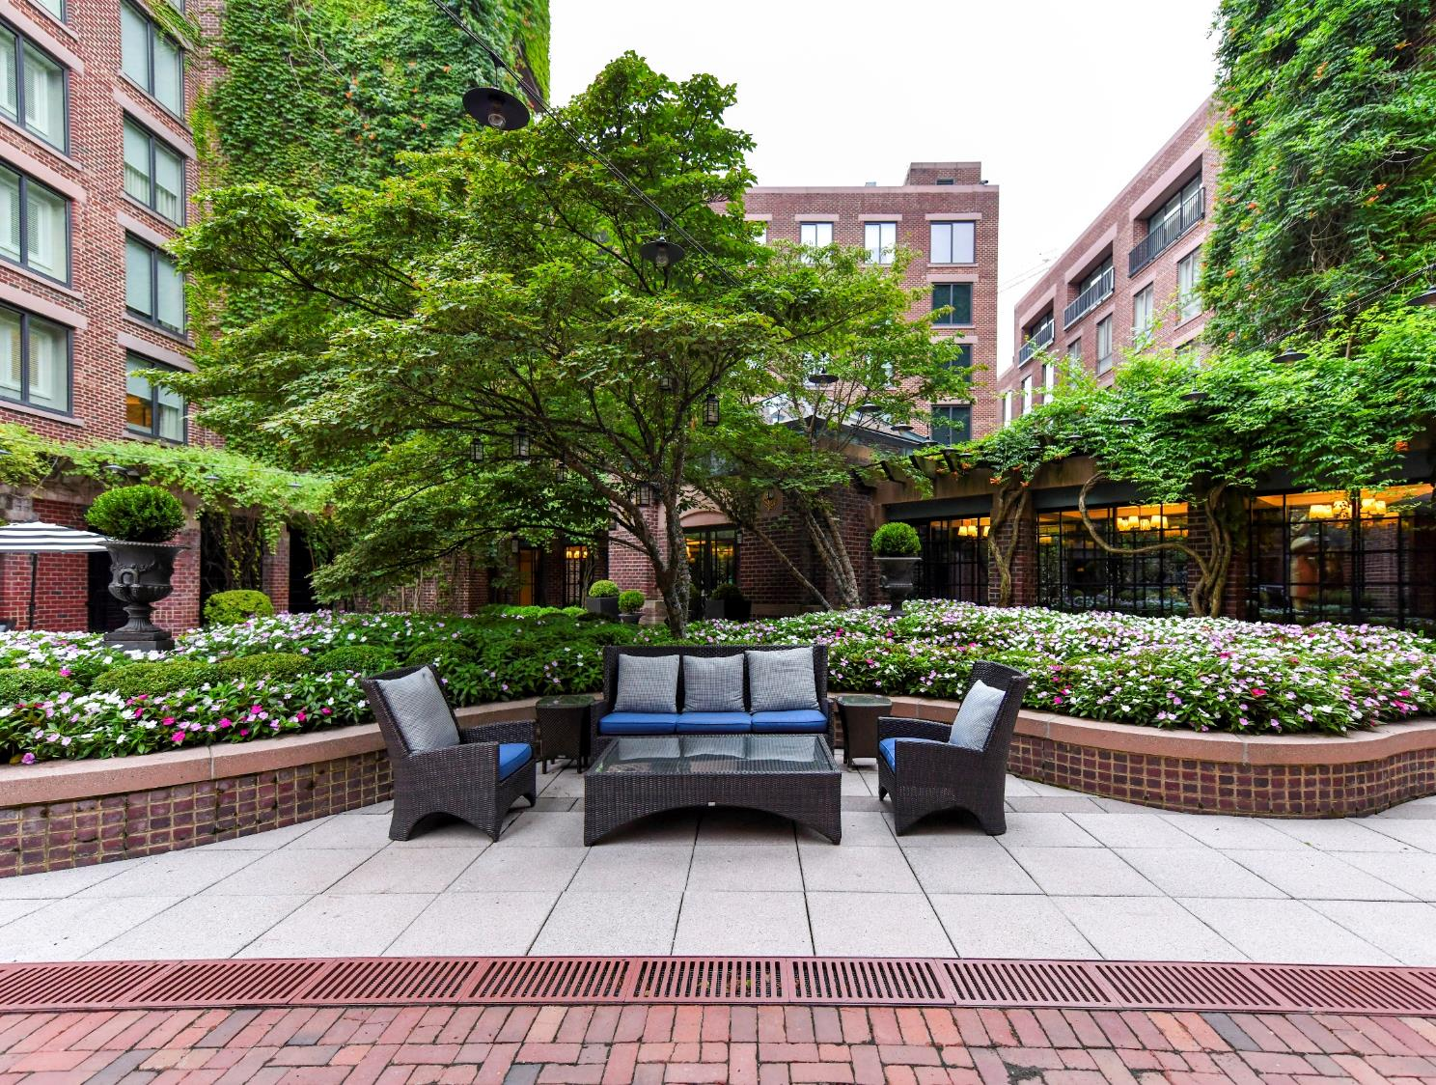
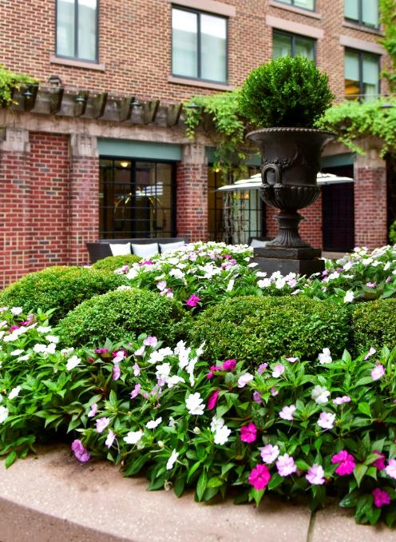
Four Seasons Hotel
Washington D.C.

Slide 26
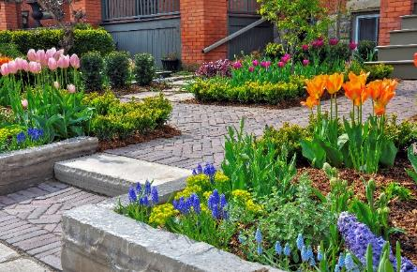
Nurturing Your Landscape
Ecessita sperrorae pa quasite porpos molorei catioriora volori dem que nus, si aborionsende vero tem a voluptati conserro magnit estis quis magnia aut modis sum quodis utem et qui ommoluptate nus et fuga. Drescipit plique sustrum quas seditem quia cus esequo quae dipieni taquam aliquis.
Epeles entorpor aut et exceprest, acepele stestibus, tet, coreste possimenia nectotatem veliquos sam idis aut liste porat.
Add some additional information here like a specific call out or a quote to accompany the body copy.

Slide 28

Nurturing Your Landscape
Ecessita sperrorae pa quasite porpos molorei catioriora volori dem que nus, si aborionsende vero tem a voluptati conserro magnit estis quis magnia aut modis sum quodis utem et qui ommoluptate nus et fuga. Drescipit plique sustrum quas seditem quia cus esequo quae dipieni taquam aliquis.
Epeles entorpor aut et exceprest, acepele stestibus, tet, coreste possimenia nectotatem veliquos sam idis aut liste porat.
Add some additional information here like a specific call out or a quote to accompany the body copy.

Slide 30
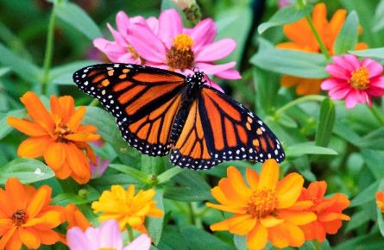
Nurturing Your Landscape
Ecessita sperrorae pa quasite porpos molorei catioriora volori dem que nus, si aborionsende vero tem a voluptati conserro magnit estis quis magnia aut modis sum quodis utem et qui ommoluptate nus et fuga. Drescipit plique sustrum quas seditem quia cus esequo quae dipieni taquam aliquis.
Epeles entorpor aut et exceprest, acepele stestibus, tet, coreste possimenia nectotatem veliquos sam idis aut liste porat.
Add some additional information here like a specific call out or a quote to accompany the body copy.

Slide 32

Some Statistics
~70%
Maintenance Revenue
Ecessita sperrorae pa quasite porpos molorei catioriora volori dem que nus, si aborionsende vero tem a voluptati conserro magnit estis quis magnia aut modis sum quodis utem et qui ommoluptate nus et fuga. Drescipit plique sustrum quas seditem quia cus esequo quae dipieni taquam aliquis.
Epeles entorpor aut et exceprest, acepele stestibus, tet, coreste possimenia nectotatem veliquos sam idis aut liste porat.
30%
Development Revenue

Slide 34
Thank You

