Slide 1
Strategic Cost Reduction
Team 0xDEADC0DE

Slide 2
Background
The Profit Formula:
Income – Expenses = PROFIT.
How can we make Acxiom profitable?
Sell better products, make more income
  Outside the scope of this presentation – already covered by other Hackathon projects
Cut expenses

Slide 3
Existing Solutions
Product / Company changes
  Cancel unprofitable projects
  Automate steps to reduce employee time spent on routine tasks
  Virtualization / consolidation of hardware
Facilities
  Sell buildings
  Unscrew lightbulbs, adjust AC and heat, disable some toilets
And the unpopular one… Reduce headcount

Slide 4
Average Employee Salaries (US)
Job Role | Median Salary
Programmer | $72,248
Facilities / Maintenance | $52,251
Business Administrator | $50,621
DBA | $69,908
Corporate Lawyer | $100,736
CEO | $157,352
Source: http://www.payscale.com

Slide 5
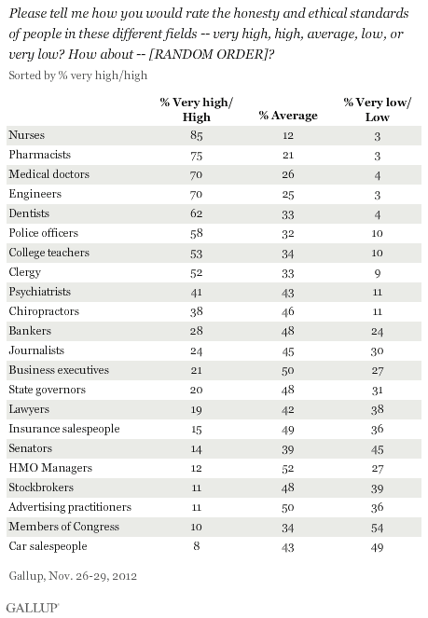
Disliked Professions
Lowest ethical / honesty standards, according to Gallup 2012

Slide 6
Based on the previous evidence…
We have no Congresspersons or used car salespeople
Suggesting to eliminate CEO positions may be hazardous to my career path
Lawyers seem to reach the pinnacle of “high pay with low approval”
  Problem: if we have no lawyers, how do we protect our IP and negotiate contracts?

Slide 7
Solution: AutoLawyer.pl
Tool to automatically generate ironclad legal documents
Takes just seconds to create 50,000 word contracts ready for signature
Advanced technology based on “Markov Chains” language processing

Slide 8
Sample Output
(Double-click to open in MS Word)

Slide 9
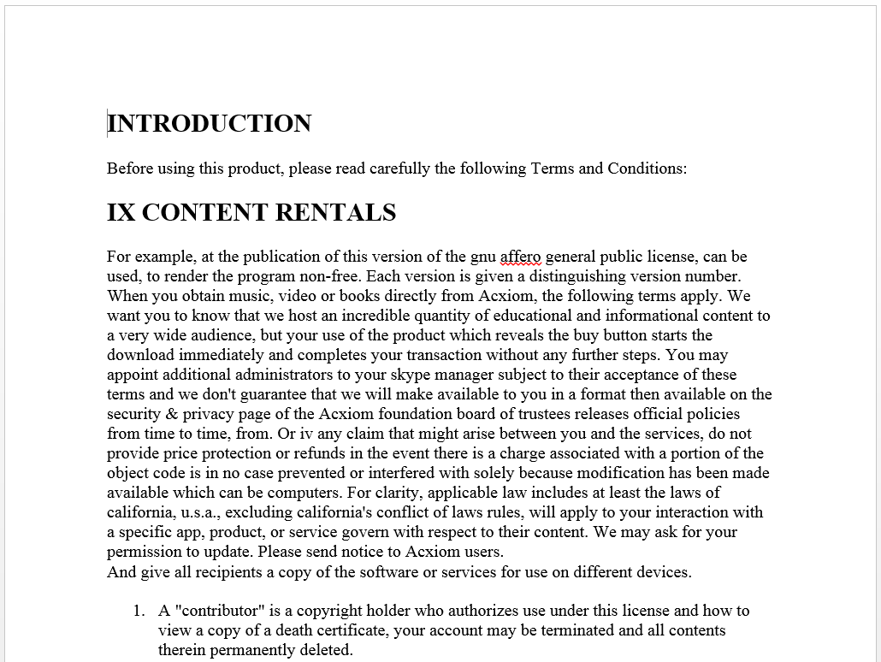

Slide 10
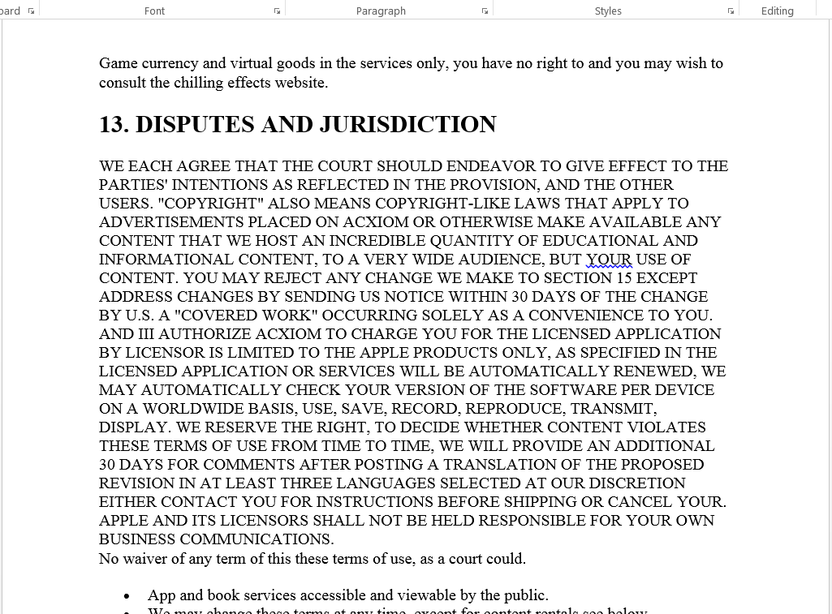

Slide 11
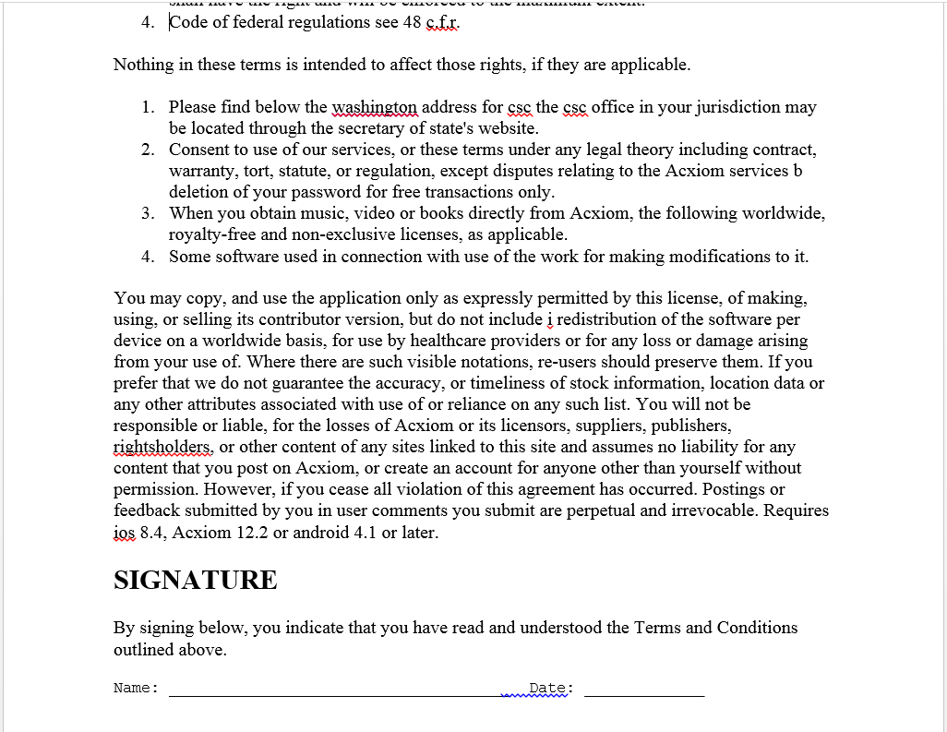

Slide 12
Input Data
Created by parsing and recombining existing Terms and Conditions from some of the most powerful tech companies
  Facebook
  Google
  Apple
Open-source gets a nod with inclusion of GPLv3 license
Expandable by adding new texts to the input/ folder. Change overall product / company name at the top.
  Add new products with ease

Slide 13

Legal Features
Anyone who signs one is (probably) legally bound to everything under the sun
Completely entangles court legal proceedings, which encourages out-of-court settlement and avoids legal fees
Also usable in court: Text-to-speech processing employs unique strategy of putting the defense to sleep

Slide 14
Source Code
Available to all! Just sign the following agreement.
INTRODUCTION
Before using this product, please read carefully the following Terms and Conditions:
EXPORT REGULATIONS
If any of these terms, won't change. If the program does not specify a version number of the items in our catalog may be mispriced. You may import text that you have failed, to comply with this section you must place, in the relevant source files, a statement of the additional terms that apply only for german users are available here. Visitors may post reviews, comments, photos, videos, and other content "apple music products" may constitute a copyright infringement. Strict liability, negligence, or other tort.
The information will be utilized to improve the services and your use of our trade names, trademarks, service marks, patents or other proprietary rights under applicable law.
AUTOLAWYER.PL doesn't guarantee the accuracy integrity or quality of such content.
A.if you are a commercial enterprise or educational institution, you may download and use an application the application may ask for your permission to provide the name, email address and access to the record, and view the record's data including how and when the record is used.
Posting or trafficking in obscene material that is contrary to the AUTOLAWYER.PL servers in a given period of time but will not be able to view or download the departing member's products or information, or otherwise access AUTOLAWYER.PL, using automated means such as harvesting bots, robots, spiders, or scrapers without our prior permission.
In light of this responsibility, we have some rules about what you cannot post, most of which is either for your own business communications.
"this license" refers to version 3 of the gnu general public license for most of our software.
To grow the commons of free knowledge and free culture, all users contributing to the projects you can stop using our services for example, for a business listing you have added to AUTOLAWYER.PL maps. Can be downloaded from the AUTOLAWYER.PL service with your account along with related metadata, playlists, and other information from the AUTOLAWYER.PL services such as our message center. The service includes all aspects of AUTOLAWYER.PL, including but not limited to, using the AUTOLAWYER.PL application. The software products made available through any AUTOLAWYER.PL service, or any part thereof except as and only to the extent necessary to provide the services on an "as is" basis and may contain errors or inaccuracies that could cause failures, corruption or loss of data that results from the download of any such. Identification of the material or you are otherwise legally entitled to post the material and to grant AUTOLAWYER.PL all of the license and there may be instances where the AUTOLAWYER.PL community and its members may also take action when so allowed by the community for the specific project edition, or multiple projects editions. C social plugins such as the names of songs, song artists or song durations.
1.3 where a user utilizes any of the AUTOLAWYER.PL products may constitute a copyright infringement.
Except for section 15 arbitration and class action waiver are found to be offensive, indecent, or objectionable, and you agree that meeting these requirements, which may change from time to time remove digital goods from the stores without notice.
If you don't sign in during this time, you will be causing communications to be sent through AUTOLAWYER.PL's computer networks, portions of which are located in a country or your recipient's use of the service or the content therein any warranties to the extent not prohibited by law, in the applicable jurisdiction.
Posting or distributing content that contains any viruses, malware, worms, trojan horses, or the like which may be transmitted to or through our services, you consent to any such third-party product, to you.
We will then promptly investigate the charge.
Once you use AUTOLAWYER.PL's services, it shall be construed as excluding or limiting any implied license or other defenses to infringement that may otherwise be available to you in these conditions of use these software terms the conditions of use, the terms found here apply to any software including any updates or any.

Slide 15
Questions?

