Slide 1
Bayesian Updating of Soil Parameters for Pile Design
Greg Kurzepa

Slide 2
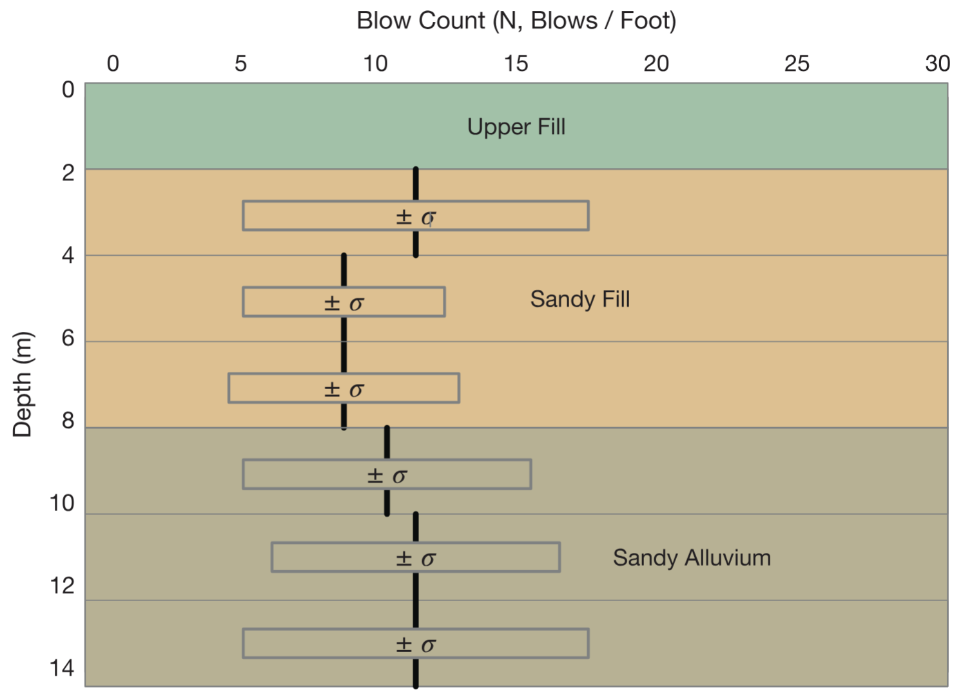
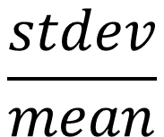
Uncertainty
$$\frac{stdev}{mean}$$
can be 30% or more
Measurement error can be 75% of soil parameter variance
Baecher, 2021
Notes:
Uncertainty leads to overdesign
If we can improve soil understanding, we can reduce overdesign and that has benefits for cost, time, material use, climate.

Slide 3
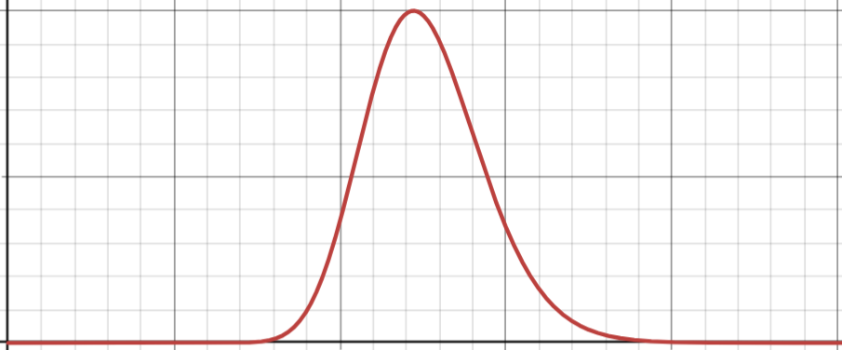
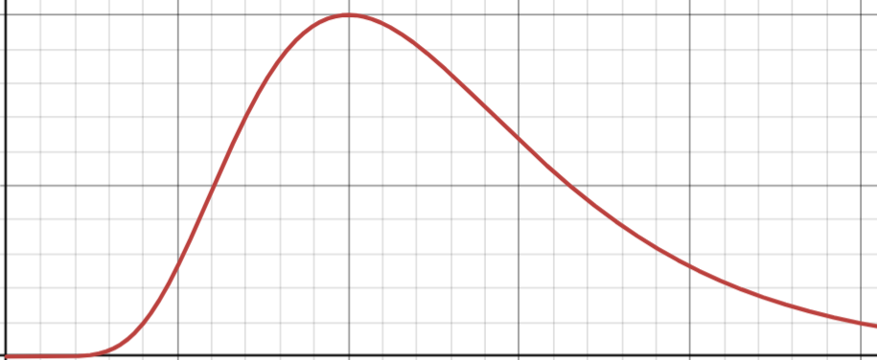
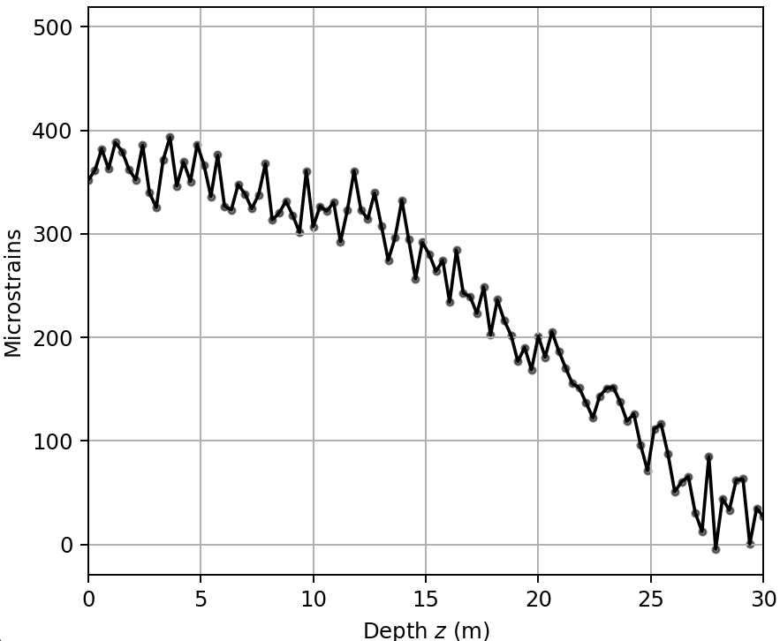





Learning From Data: Bayesian Updating
Bayesian Update:
Physical Model With Noise
Soil Parameters Prior
Posterior Distribution
$$p(θ)$$
$$p(θ|ε^{∗})$$
$$θ→ε(z)$$
$$θ=[γ_{d}, τ_{cap},…]$$
Observed Strains
$$ε^{∗}$$
“Today’s posterior is tomorrow’s prior”
Baecher, 2021
Notes:
Bayesian inference: use evidence in the form of data to update a prior understanding of soil parameters
Exploiting the fact that the strain observations contain information about the soil.
But the prior also contributes. If the prior or the evidence is much stronger (prior=narrow, data=low noise), it will dominate the posterior.
The posterior is the reduced-uncertainty estimate of the soil parameters. It can be used to explicitly understand risk.
Multiple pieces of data can be used to repeatedly update the soil parameter pdf
So we need 3 ingredients: A physical model, some observations, and a prior.

Slide 4
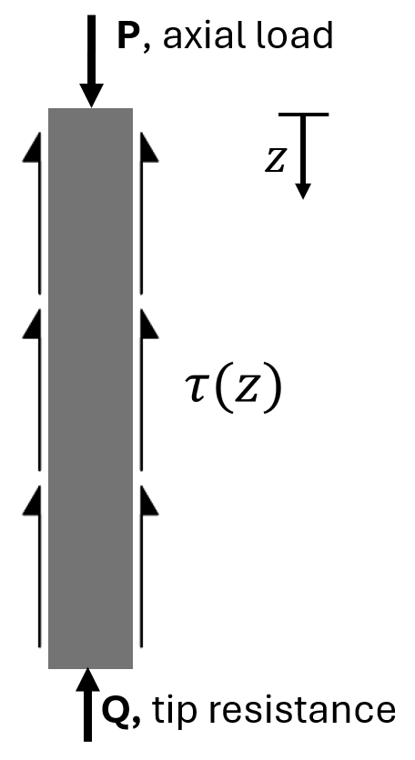

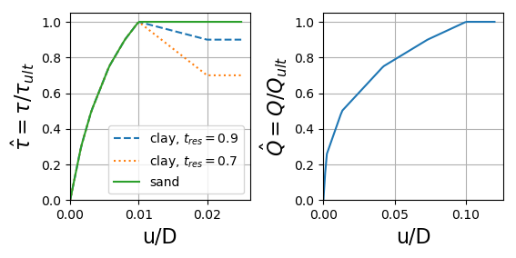


Deterministic Soil-Pile Model
Solve for displacement profile
$$τ=min⁡(τ_{ult} \hat{τ}, τ_{cap})$$
$$τ_{ult}=1.25βσ_{eff}$$
+ white noise term
American Petroleum Institute, 2021
Notes:
Pile under axial load is resisted by a shaft friction in the walls and an end bearing friction at the base
Pile is linear-elastic, soil is nonlinear according to API t-z q-z curves
There is a limit on the shear stress that can be mobilised, this is an example of a model parameter that can be inferred. So is the shaft friction factor.
Soil is divided into layers, each with their own set of parameters.

Slide 5
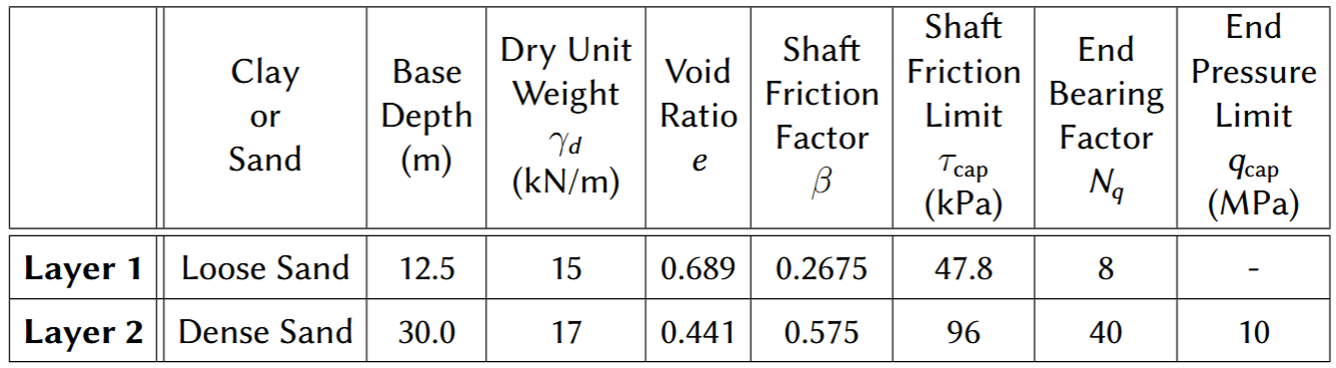
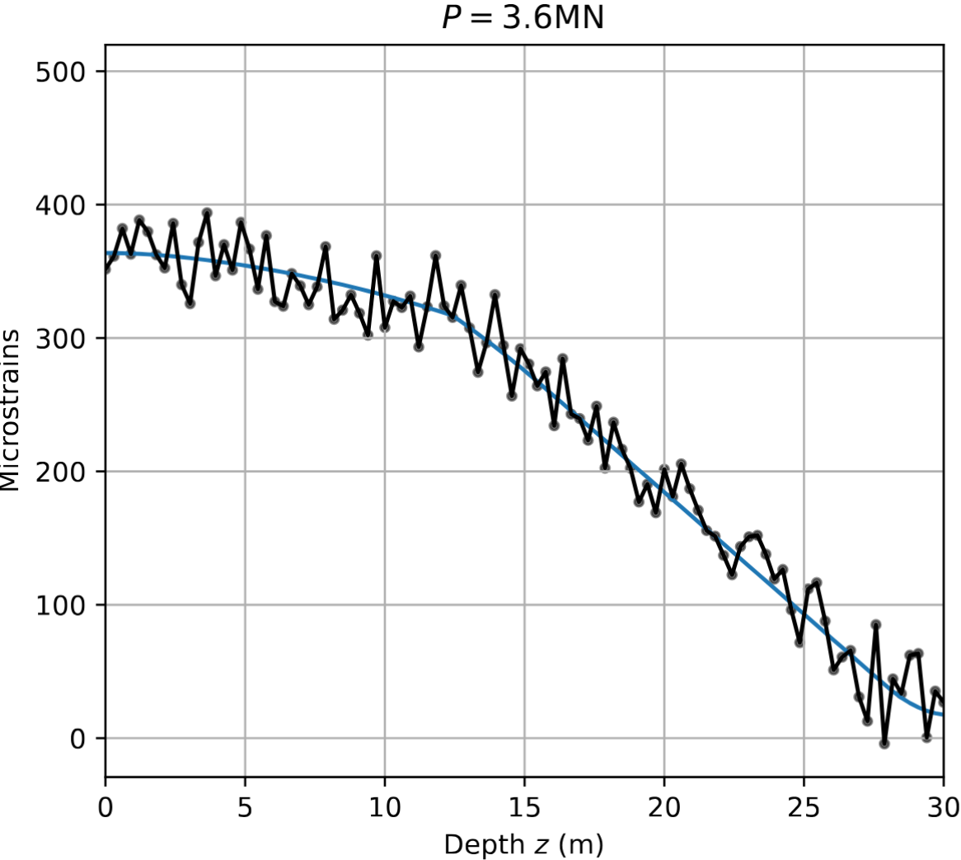
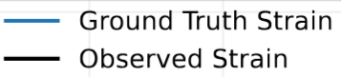
Observations
Ground Truth Parameters
Uniform within one layer
Noise standard deviation 20 microstrains
Layer Boundary
Notes:
Ground truth parameters are used to generate the ground truth strain profile in blue.
Noise with 20 microstrains standard deviation is added. This is representative of strain gauge measurement error. It is modelled to account for all inherent uncertainties, including soil variability within layers, as we saw earlier this is the same order of magnitude.
So now we have the physical model and the observations. Just need the priors now.

Slide 6
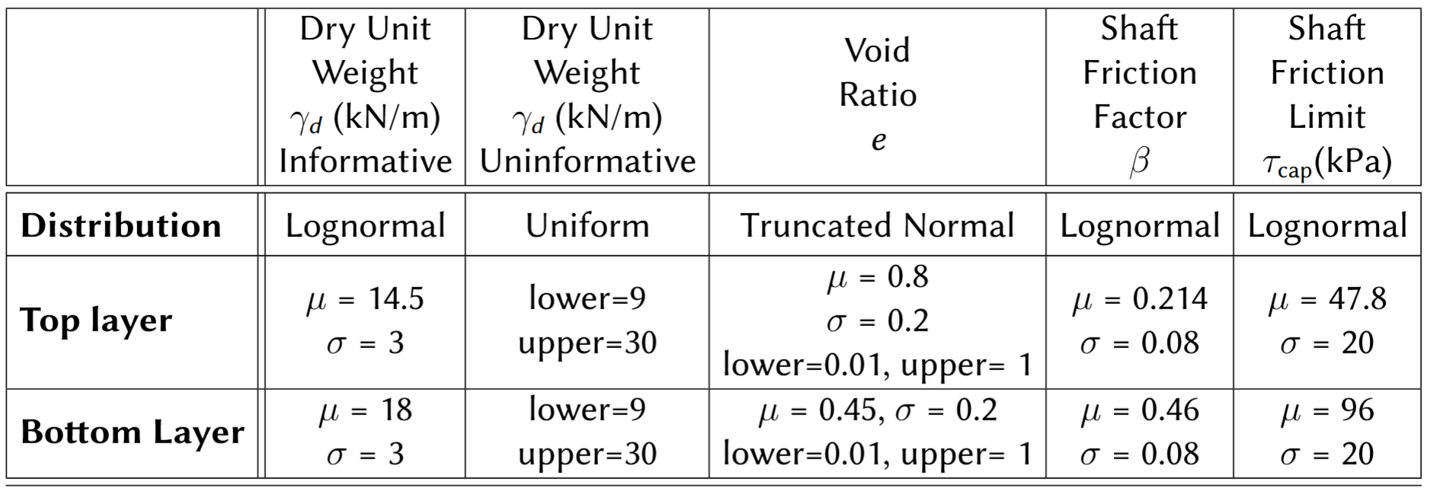
Priors
Priors: rough soil category is known
Notes:
- Chosen priors to reflect the soil category, interpreted from API tables for sand.

Slide 7
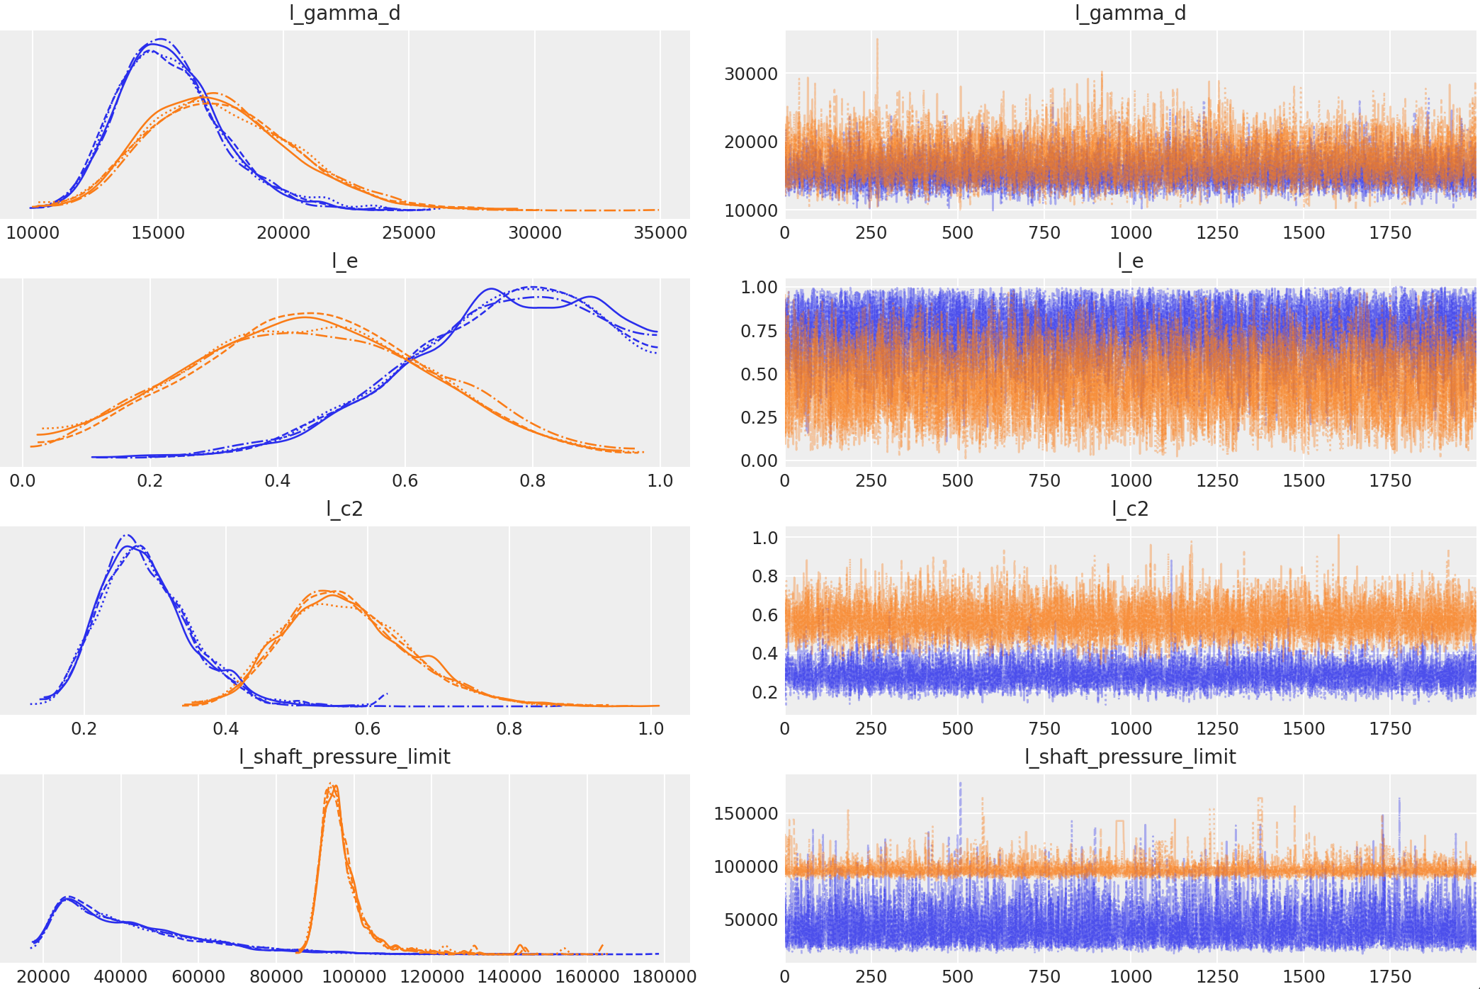
Markov Chain Monte Carlo (MCMC)
Take many samples from soil parameter priors
Compute likelihood and posterior value for each sample
Sequential Monte Carlo (SMC)
Convergence: 4 chains
2000 samples each
Implementation using PyMC for Python

Slide 8
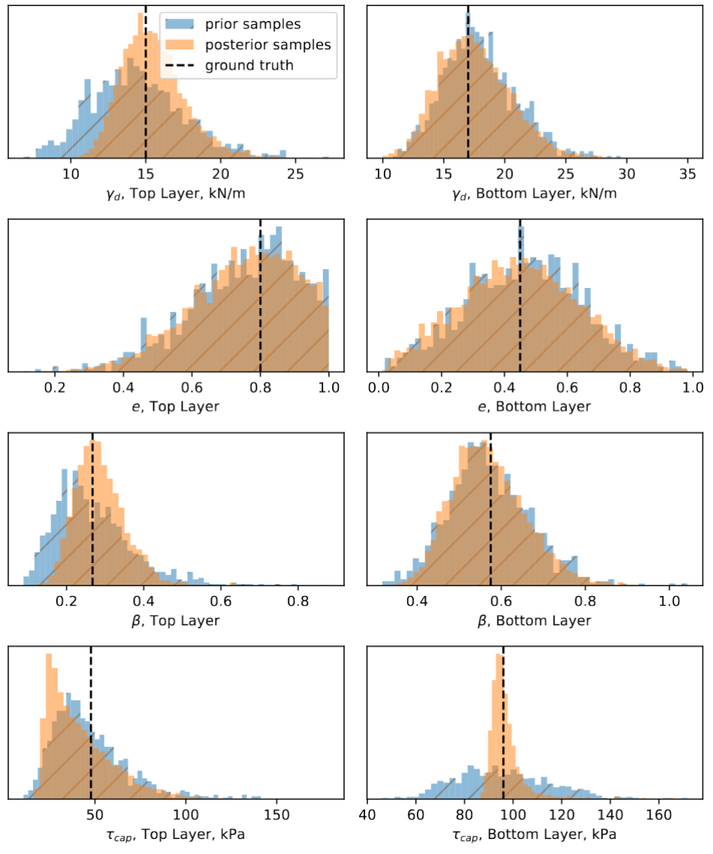
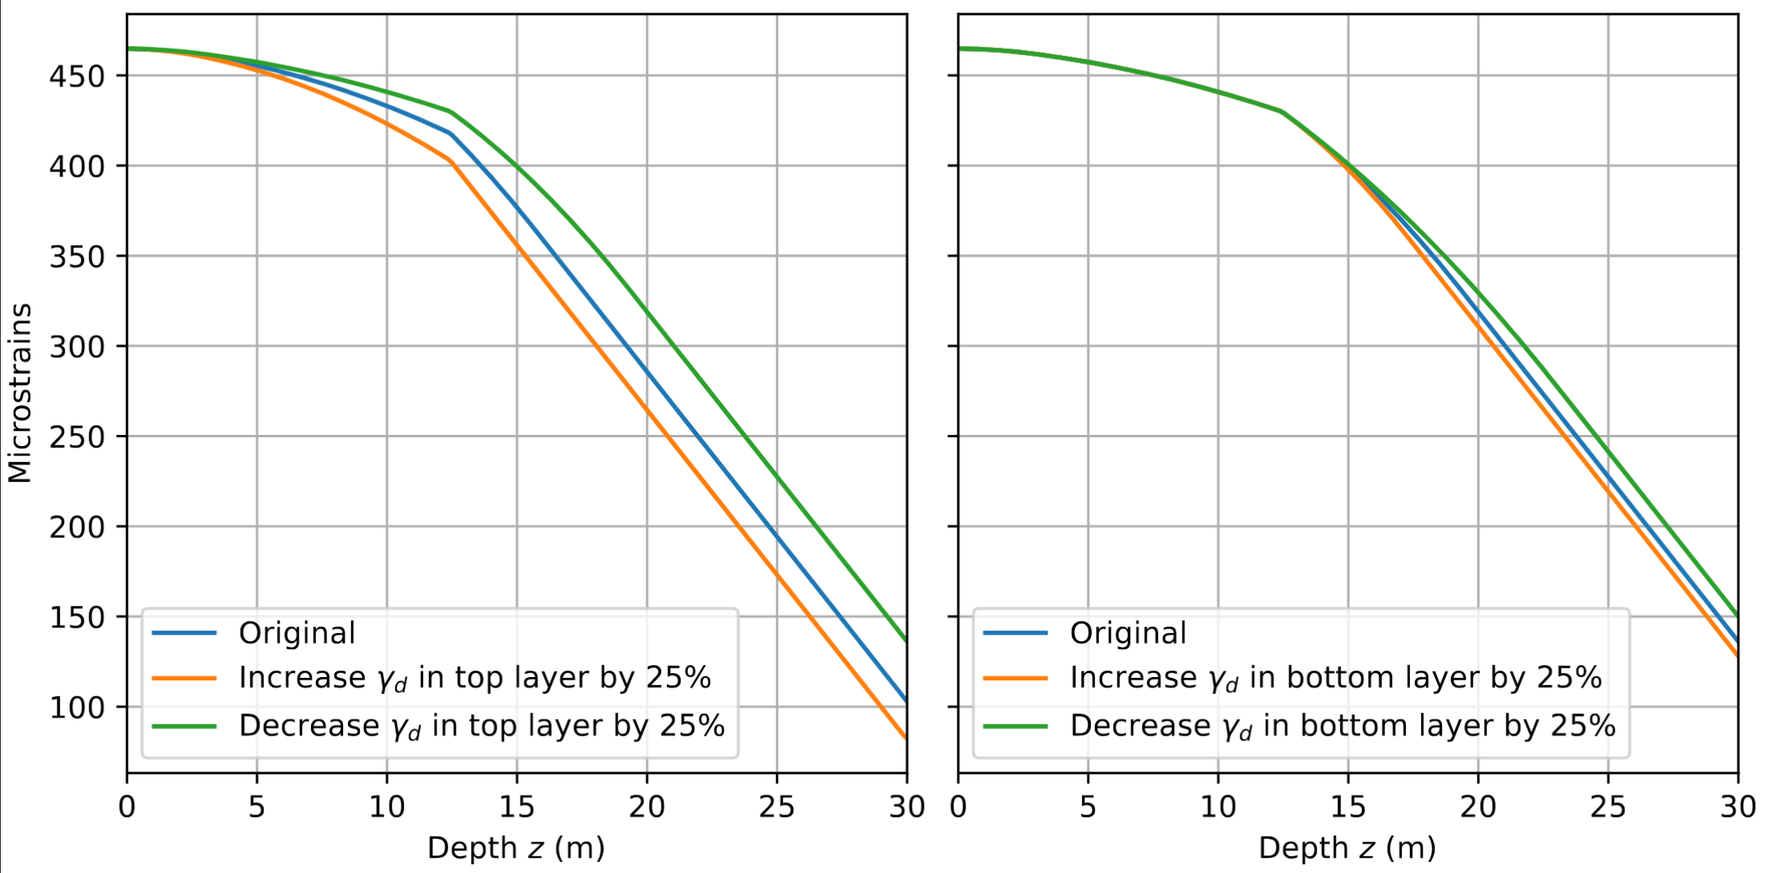
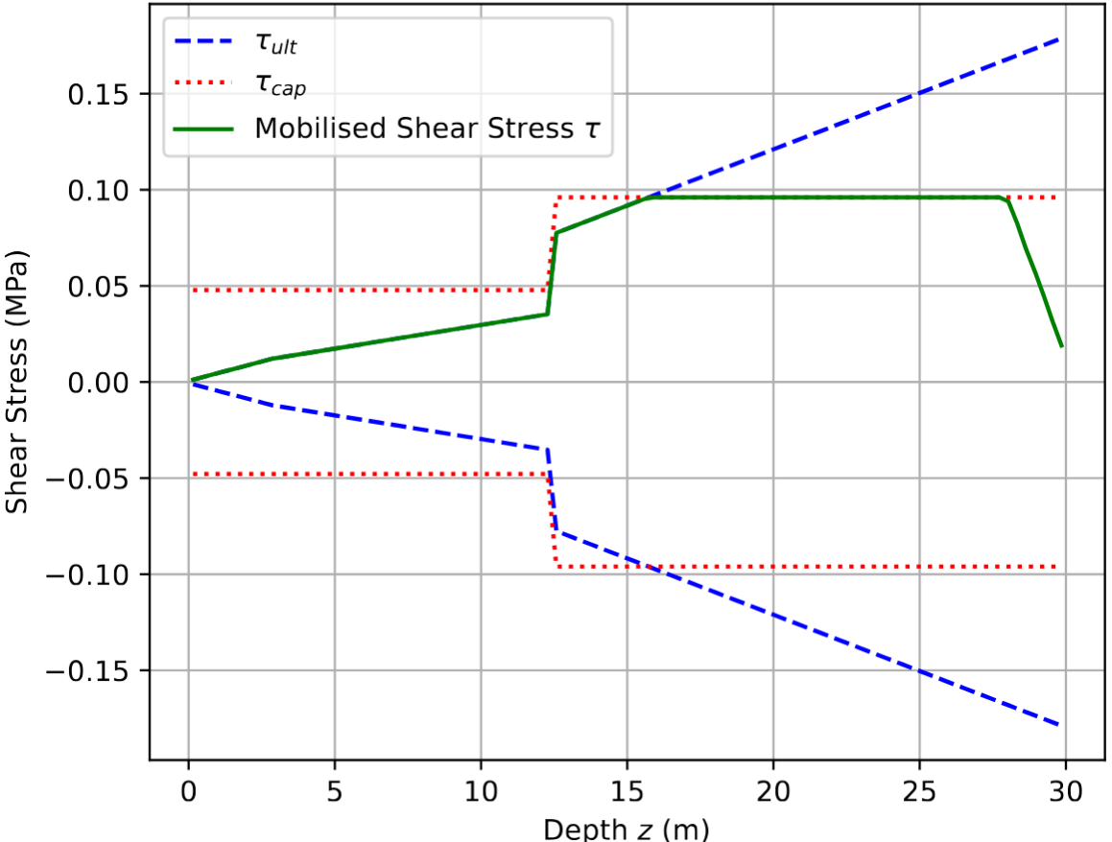
Multi-Variable Updating Results

Slide 9
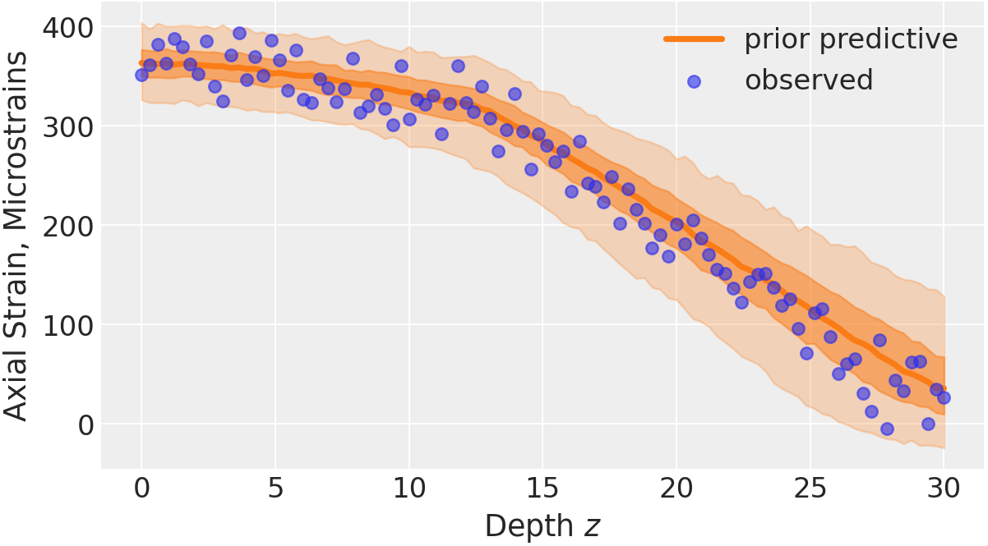
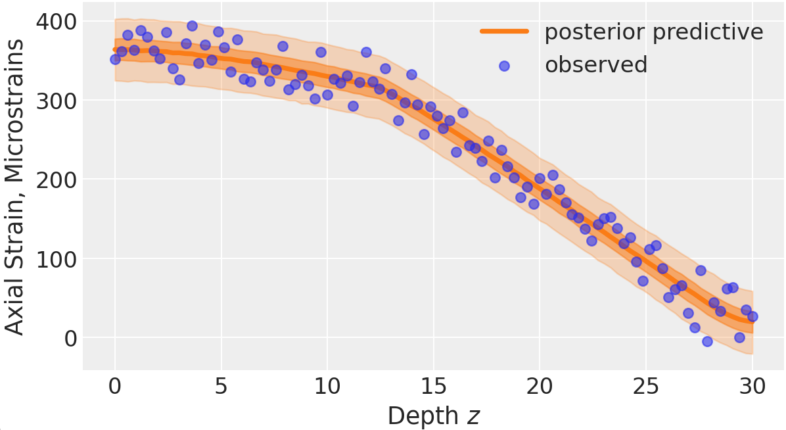
Multi-Variable Updating Results

Slide 10
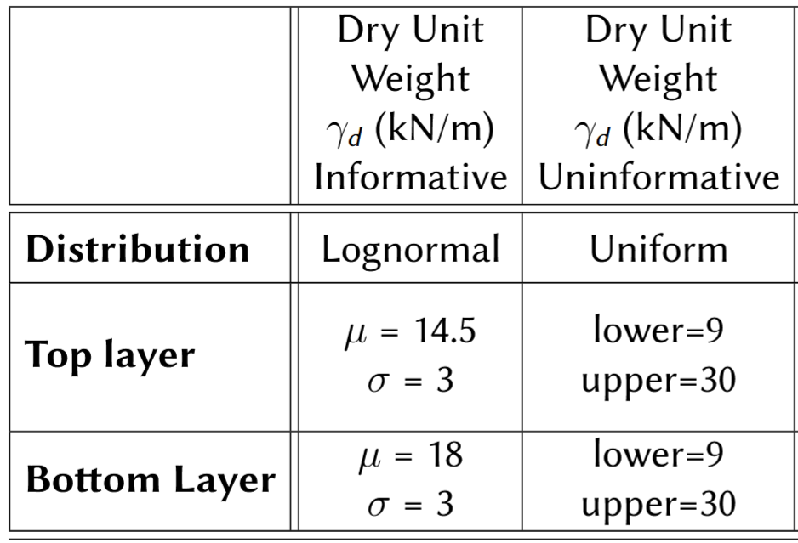
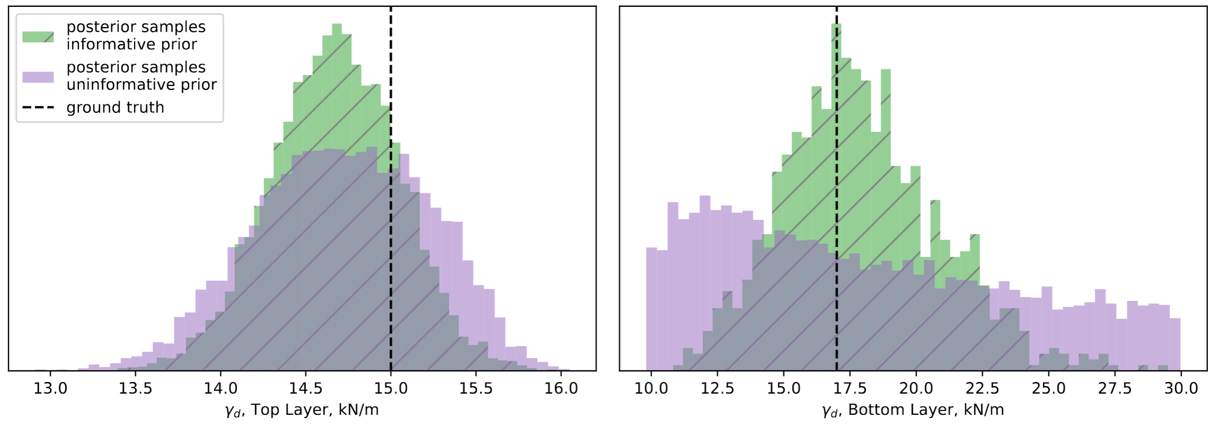
Choice of Prior

Slide 11
Conclusion
Bayesian Updating:
Learn from observations
Reduce uncertainty on soil parameters
Reduce uncertainty on pile and soil loading
Enable leaner design
Flaws/Further work:
More effects (pile-soil slip; ground heave)
Test with a real-world dataset (challenges!)

Slide 12
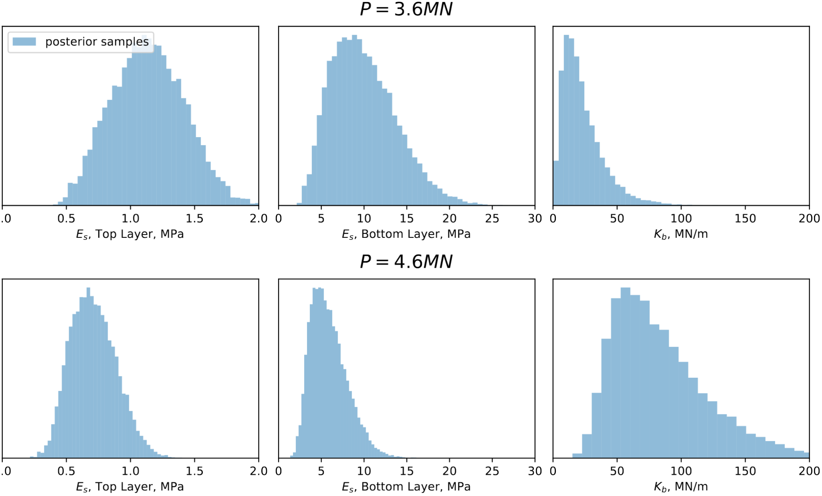
Appendix: Choice of Model
Define a “flawed” model: linear-elastic t-z and q-z curves
Inconsistent posteriors for different loading cases

