Slide 1

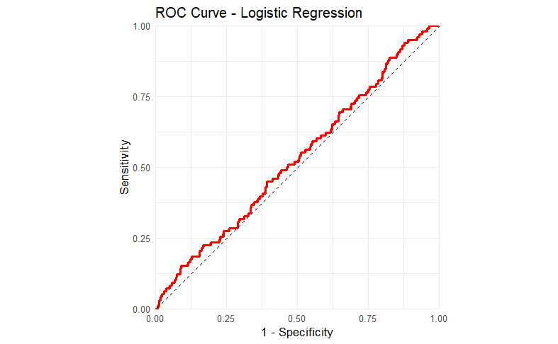
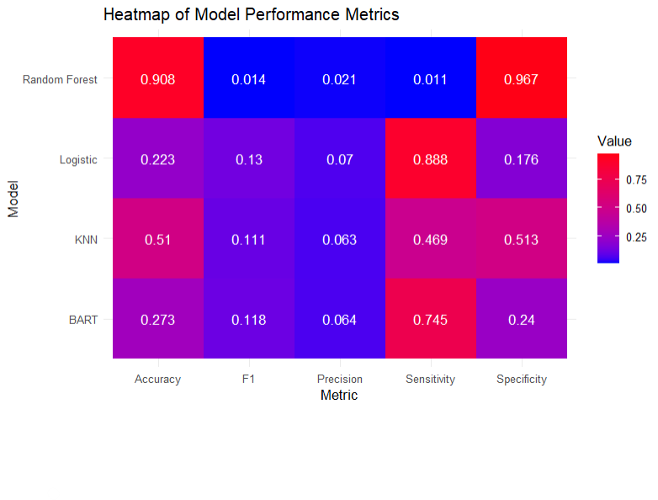
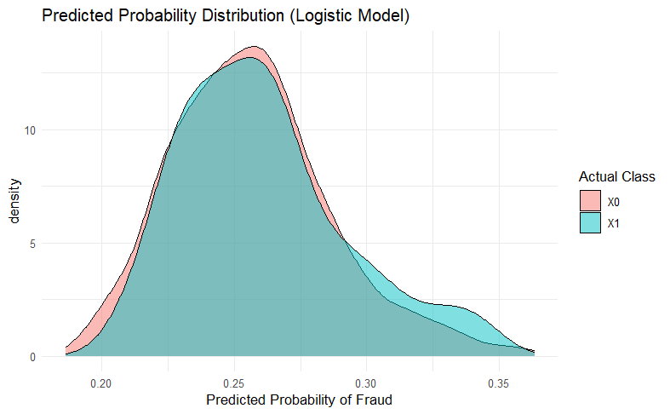
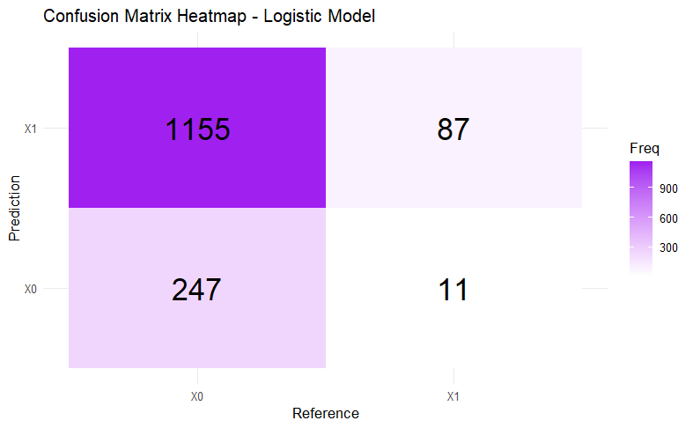
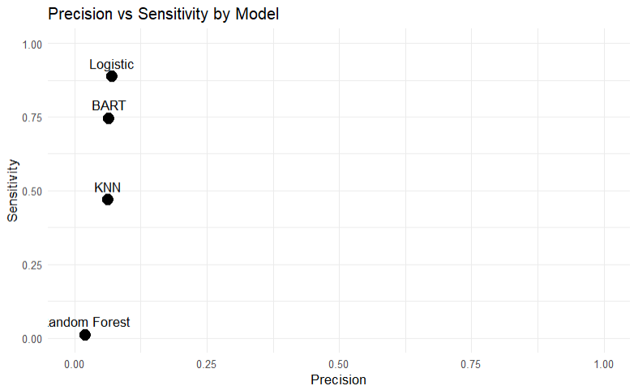
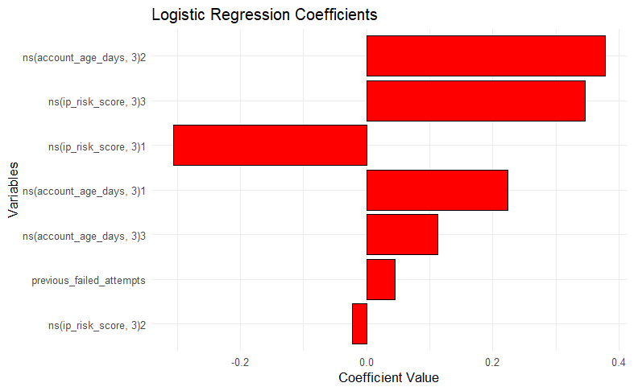
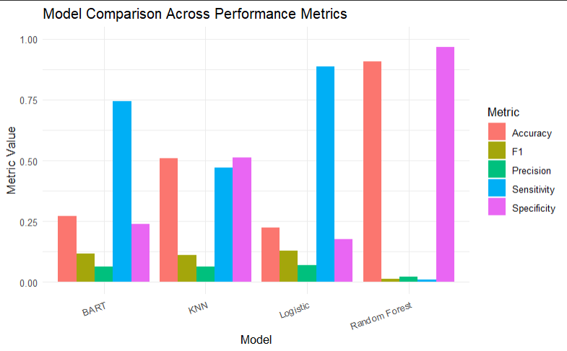
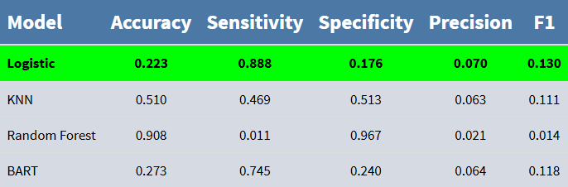
Title: Detecting Online Transaction Fraud with Classification Algorithms
^{Name: Greg Pologruto}
Advisor: Thilini Jayasinghe, Ph.D.
Department of Mathematics, University of Dayton
Abstract
Results
This study presents the development and evaluation of a machine-learning based approach to address the problem of detecting fraudulent online transactions. The objective of this research is to design a predictive classification model capable of improving accuracy, efficiency, and scalability compared to traditional methods.
Introduction
The dataset is 7500 synthetic digital payment transactions labeled as either fraudulent or legitimate.
Each row represents a single transaction and contains features about behavior, finance, device, and risk-related features..
The goal is to find which model can most accurately detect a fraudulent transaction.
Methodology
Conclusion
Identify key variables and patterns through exploratory data analysis.
Create classification models of various types (Logistic Regression, KNN, Random Forest, BART).
Utilize validation methods, resampling, optimizing thresholds, data transformation techniques, stratification, and more to finely tune models.
Select best model based on performance metrics (Accuracy, F-1, Specificity), provide clear logical reasoning why model is considered the best.
Best model is Logistic with a sensitivity of 0.888 and F1 of 0.130
Future studies may implement more sophisticated models (Neural Networks or Advanced Gradient Boosting)
References:
James, Gareth, et al. An Introduction to Statistical Learning: with Applications in R. 2nd ed., Springer, 2021.
R Core Team. “ns: Generate a Basis Matrix for Natural Cubic Splines.” RDocumentation, version 3.6.2,
https://www.rdocumentation.org/packages/splines/versions/3.6.2/topics/ns
“Deciding Threshold for GLM Logistic Regression Model in R.” GeeksforGeeks, 23 July 2025,
https://www.geeksforgeeks.org/machine-learning/deciding-threshold-for-glm-logistic-regression-model-in-r/
.

