Slide 1

My romantic relation with Powershell generally and DBATools especially
Magnus Ahlkvist | @Transmokopter | magnus@tsql.nu | www.tsql.nu | github.com/transmokopter/Presentations
Presenting for QCPASS April 15th 2020.

Slide 2

About Magnus
Magnus Ahlkvist
Transmokopter SQL AB – database consultant
Community speaker, Community organizer
#DataWeekender May 2nd Call for speakers: https://sessionize.com/data-community-weekender-europe/ Follow @DataWeekender on Twitter Meetup: https://www.meetup.com/Data-Community-Weekender-Europe/events/269951016/
Go Niners
Covid-19 made me scout troop leader
Football coach
Picking up running – Look me up on strava.com
Abbreviations
This picture licensed according with CC BY-SA

Slide 3
Session contents
My powershell journey
DBATools
Migration – log shipping and more with DBATools

Slide 4
Why did I make this presentation?
Sharing is caring
Powershell, so much more than bash
Everyone should use DBA Tools.

Slide 5

My Powershell journey
This picture from unknown author licensed according with CC BY-NC-ND

Slide 6
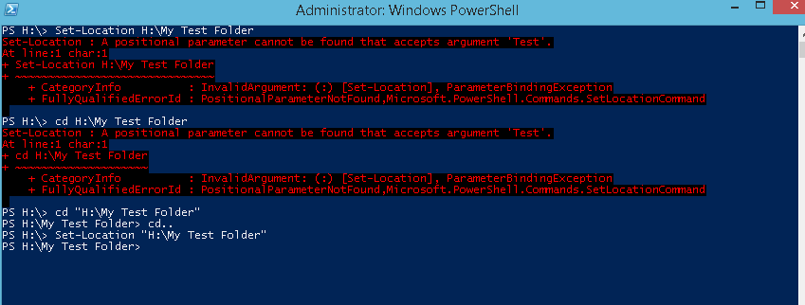
My Powershell journey, first iteration
This picture from unknown author licensed according with CC BY-SA

Slide 7


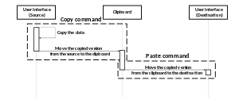
My Powershell journey, second iteration
This picure from unknown author licensed according with CC BY-SA
This picture from unknown author licensed according with CC BY-NC-ND
This picture from unknown author licensed according with CC BY-SA

Slide 8

My powershell journe, Nth iteration
Used with permission from Chrissy LeMaire

Slide 9
What is DBATools
Powershell module
Available on PowershellGallery
Command reference on dbatools.io/commands
Community driven
Use it
Contribute
Write code
Report bugs
Suggest features
Donate $$$

Slide 10
DBATOOLS Demo

Slide 11
Lets’s get down to business
Setup servers for backing up to and restoring from Azure blob storage
Install a new SQL Server instance
Automate patching of SQL Server
Log shipping when there’s no common file share

Slide 12
DBATOOLS Demo

