Slide 1

My romantic relation with Powershell generally and DBATools especially
Magnus Ahlkvist | @Transmokopter | magnus@tsql.nu | www.tsql.nu
Presenting for QCPASS April 15th 2020.

Slide 2

About Magnus
Magnus Ahlkvist
Transmokopter SQL AB – database consultant
Go Niners
Covid-19 made me scout troop leader
Football coach
Picking up running – Look me up on strava.com
Abbreviations
This picture licensed according with CC BY-SA

Slide 3
Session contents
My powershell journey
DBATools
Restore testing with DBATools
Migration – log shipping and more with DBATools

Slide 4
Why did I make this presentation?
Sharing is caring
Powershell, so much more than bash
Everyone should use DBA Tools.

Slide 5

My Powershell journey
This picture from unknown author licensed according with CC BY-NC-ND

Slide 6
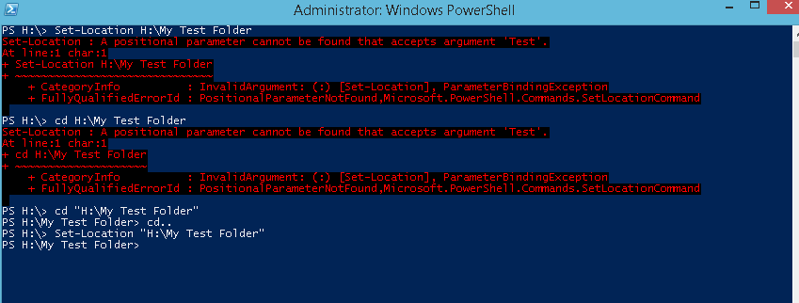
My Powershell journey, first iteration
This picture from unknown author licensed according with CC BY-SA

Slide 7


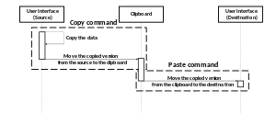
My Powershell journey, second iteration
This picure from unknown author licensed according with CC BY-SA
This picture from unknown author licensed according with CC BY-NC-ND
This picture from unknown author licensed according with CC BY-SA

Slide 8

My powershell journe, Nth iteration
Used with permission from Chrissy LeMaire

Slide 9
DBATOOLS

Slide 10

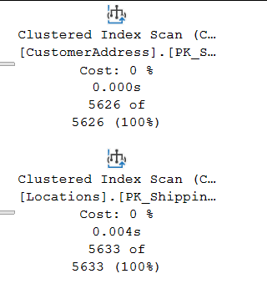
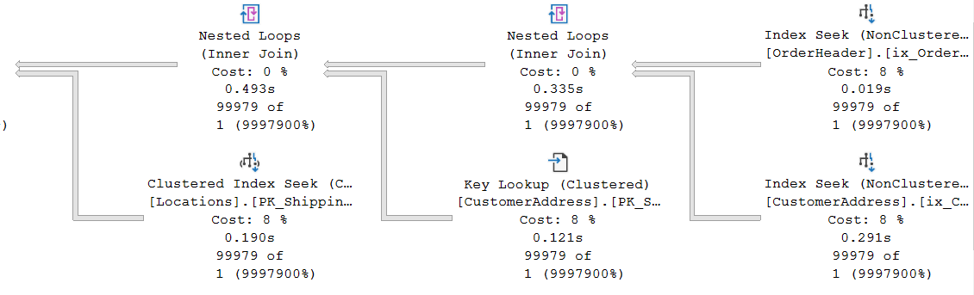
Some plan characteristics
OK
Awful

Slide 11
Hey Mr DBA
Ola Hallengren’s maintenance solution, run nightly

Slide 12
DBCC SHOW_STATISTICS
DEMO

Slide 13
Statistics histogram
RANGE_HI_KEY | RANGE_ROWS | EQ_ROWS | DISTINCT_RANGE_ROWS | AVG_RANGE_ROWS
Upper limit of a bucket (sqlvariant). A distinct value from the leading column in the index/statistics object. | Number of rows in the bucket, smaller/lower than the value of RANGE_HI_KEY | Number of rows in the bucket with value exactly RANGE_HI_KEY | Number of unique values for the leading column of the index/statistics object in the bucket | Average rows per distinct value within the bucket

Slide 14
Density vector
Density of leading column, then two leading columns in combination, then three leading columns…
Density = NoDistinctValues / NoRows
Gender = High density, SSN = Low density
Low Selectivity = High Density

Slide 15
Ascending Key Problem
Can also be missing key-in-the-middle problem

Slide 16
Suggestions?
Notes:
Parameterize
Get the value from a table in the DB
Trace Flags handling ascending key problem
Update statistics and/or rebuild index
Upgrade
Partition
Optimize for unknown

Slide 17
Let’s try to fix it
DEMO

Slide 18
Is there a silver bullet?
…or is it ”It depends”?

