Slide 2
My romantic relation with Powershell generally and DBATools especially

Slide 3

Magnus Ahlkvist
Consultant, Transmokopter SQL AB
https://www.tsql.nu
https://twitter.com/transmokopter
SQL Server specialist, trainer, community organizer, speaker, football coach, scout leader, city council member, (slow) runner.

Slide 4
Session contents
My powershell journey
DBATools
Migration – log shipping and more with DBATools

Slide 5
Why did I make this presentation?
Sharing is caring
Automation => Focus on fun stuff
”Let’s spend half a day automating a 15 minute manual task”

Slide 6
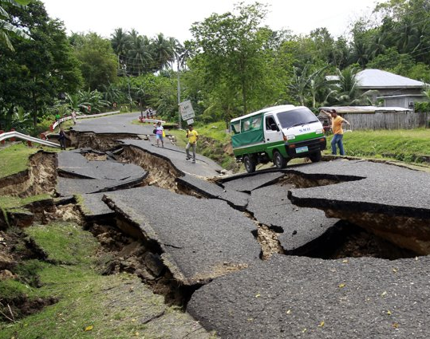
My Powershell journey
Det här fotot av Okänd författare licensieras enligt CC BY-NC-ND

Slide 7
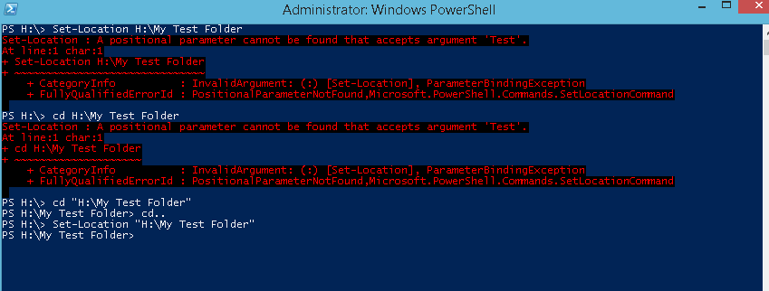
My Powershell journey, first iteration
This picture from unknown author licensed according with CC BY-SA

Slide 8


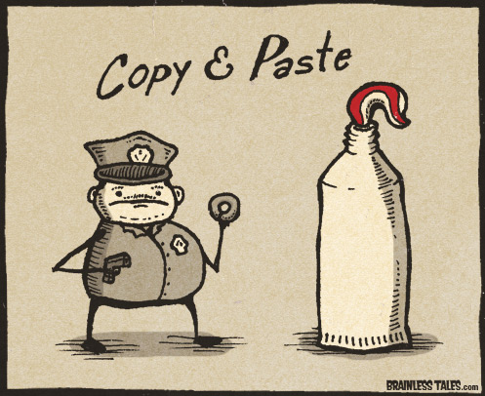
My Powershell journey, second iteration
This picure from unknown author licensed according with CC BY-SA
This picture from unknown author licensed according with CC BY-NC-ND
Det här fotot av Okänd författare licensieras enligt CC BY-SA-NC

Slide 9

My powershell journey, Nth iteration
Used with permission from Chrissy LeMaire

Slide 10
What is DBATools
Powershell module
Available on PowershellGallery
Command reference on dbatools.io/commands
Community driven
Use it
Contribute
Write code
Report bugs
Suggest features
Donate $$$

Slide 11
DBATOOLS First demo

Slide 12
Lets’s get down to business
Setup servers for backing up to and restoring from Azure blob storage
Install a new SQL Server instance
Automate patching of SQL Server
Migrate logins and jobs, setup log shipping

Slide 13
DBATOOLS Demo

Slide 14
Famous last words
Thank you GroupBy!
❤❤❤❤❤❤❤Thank you contributors of DBATools ❤❤❤❤❤❤❤
Automation replaces random mistakes with consistent errors.
That you can fix once.

