Slide 1






Thank you to our Global Sponsors and Supporters

Slide 2










Thank you!!!

Slide 3


Slide 4

Statistics, an Unreliable Friend
Magnus Ahlkvist

Slide 5
About Magnus
Magnus Ahlkvist
Transmokopter SQL AB – database consultant
Abbreviations.
Community organiser

Slide 6
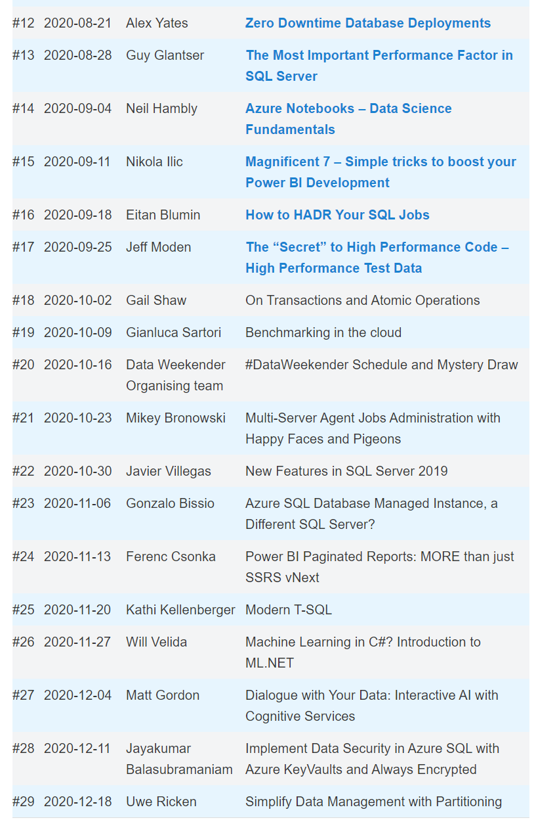


www.sqlfriday.net
Powered by
Transmokopter SQL AB
www.transmokopter.se

Slide 7

SQL Friday Q1 and Q2 2021 Call for Speakers
Sessionize.com/Sql-Friday
Open September 15 – November 5
CC BY-NC-ND

Slide 8

October 17th
#DataWeekender #TheSQL
Meetup.com/DataWeekender

Slide 9
Statistics, an Unreliable Friend
Magnus Ahlkvist

Slide 10
"There are three kinds of lies: lies, damned lies, and statistics."
Not Mark Twain

Slide 11
Why did I make this presentation?
System for reporting financial statistics
Tight deadline
Bad performance on reporting day => Reporting done late => ECB unhappy => DBA being yelled at => DBA unhappy

Slide 12
Session scenario
Order system
Ship orders to warehouse system
All good. Until not good.

Slide 13
Problem specifics
Getting orders for yesterday and before => Fast
Getting today’s orders => Not fast

Slide 14
DEMO

Slide 15

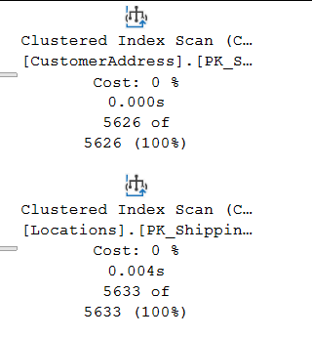
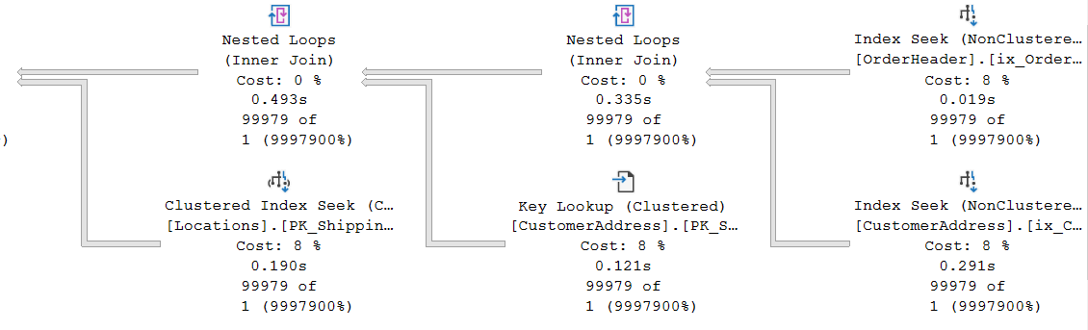
Some plan characteristics
OK
Awful

Slide 16
Hey Mr DBA
”Your database is super slow exactly when we need it to be fast. Fix it!”
Ola Hallengren’s maintenance solution, run nightly
What more can I do?
This was before the days of Query Store

Slide 17
Yay, I know why it’s slow!
It’s the statistics. They’re lying

Slide 18
Statistics (or lies) in SQL Server
Distribution of values within an index or statistics object
Histogram or Density vector
DEMO

Slide 19
Statistics histogram
RANGE_HI_KEY | RANGE_ROWS | EQ_ROWS | DISTINCT_RANGE_ROWS | AVG_RANGE_ROWS
Upper limit of a bucket (sqlvariant). A distinct value from the leading column in the index/statistics object. | Number of rows in the bucket, between RANGE_HI_KEY and the previous RANGE_HI_KEY | Number of rows in the bucket with value exactly RANGE_HI_KEY | Number of unique values for the leading column of the index/statistics object in range between RANGE_HI_KEY and previous RANGE_HI_KEY | Average rows per distinct value between RANGE_HI_KEY and previous RANGE_HI_KEY

Slide 20
Statistics density vector
Density of leading column, then two leading columns in combination, then three leading columns…
Density = 1 / NoDistinctValues
Gender = High density, SSN = Low density
Low Selectivity = High Density

Slide 21
Estimated number of rows
With histogram
OrderDate = 2016-08-24: 12496
OrderDate = 2016-08-25: 0 (Optimizer will estimate 1)
With Density Vector
D = Density for column(s) involved in equality predicate.
Example: OrderDate = 2020-08-25. Density for OrderDate = 0,004
RC = Total number of rows in the table
Estimated number of rows for equality predicate: D * RC
2020-08-24: 0,004 x 3 124 374 = 12497
2020-08-25: 0,004 x 3 124 374 = 12497
Then came New Cardinality Estimation. More on that later…

Slide 22
Ascending Key Problem
Can also be missing key-in-the-middle problem
Can also be bad estimates even with perfect statistics ☹

Slide 23
Ok Magnus. It’s broken. Can we fix it?
DEMO

Slide 24
Other causes of bad guessing on Optimizer part
Statistics updated with low sample rate and skewed data
Bad cardinality estimation due to complex predicate and join logic
SQL 2014 and later addresses Ascending Key (with varying success)
But introduce a new cardinality estimator
DEMO

Slide 25
SQL Server 2014
Ascending Key problem, kind of fixed. Use Density Vector when value is outside of the statistics Histogram. Sometimes. And sometimes use SQRT(Rowcount). Very confusing.
New Cardinality Estimation
Assume columns in the same table are related (BrandName related to ModelName and Color)
Assume non-join predicates in different tables are NOT related.
Same Auto Update Stats as ”always”:
20% of the rows have been changed (inserted, updated or deleted)
For our 5 million row table, that means 1 million rows
Traceflag 2371 changes behaviour

Slide 26
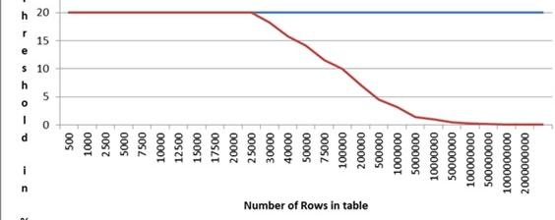


SQL Server 2016
Same cardinality estimation as SQL Server 2014
Auto Update Stats percent threshold gets lower as the table grows bigger
Up to 25k rows, 20% threshold is used
With more than 25k rows, threshold is dynamically decreased in relation to rowcount of table.
https://blogs.msdn.microsoft.com/saponsqlserver/2011/09/07/changes-to-automatic-update-statistics-in-sql-server-traceflag-2371/

