Slide 1
Statistics – an Unreliable Friend
Magnus Ahlkvist
SQL Server specialist, Data Platform MVP
Transmokopter SQL AB

Slide 2
About Magnus
Magnus Ahlkvist
44 years old, worked with SQL Server more than 20 years
Transmokopter SQL AB
SQL Server consultant, Microsoft Certified Trainer, Data Platform MVP
Community Organiser
SQLUG Sweden, SQL Friday, Data Weekender
Contact details
Twitter: @transmokopter
Github: transmokopter
E-mail: magnus@transmokopter.se

Slide 3
"There are three kinds of lies: lies, damned lies, and statistics."
Not Mark Twain

Slide 4
Why this presentation?
System for reporting financial statistics
Tight deadline
Performance issues
Bad performance on reporting day
Reporting done late
ECB unhappy
DBA yelled at
DBA unhappy ☹

Slide 5
Session scenario
Order system
Ship orders to warehouse system
OK performance mostly, getting today’s orders gives bad performance
We will start in the age of SQL Server 2008

Slide 6
The problem
Characteristics of our performance issue

Slide 7

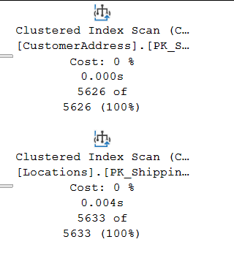
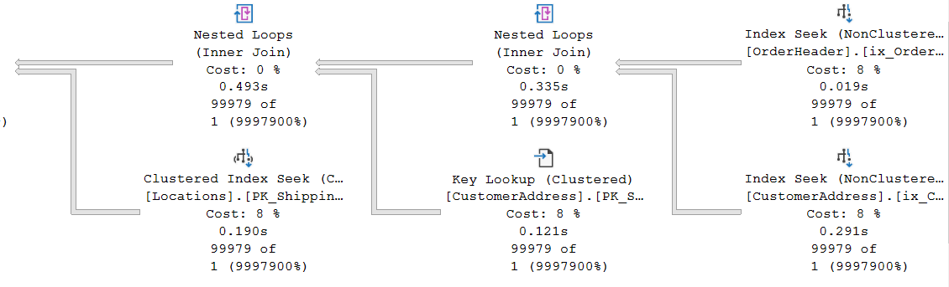
Execution plan characteristics

Slide 8
Hey mr DBA!
”Your database is super slow exactly when we need it to be fast. Fix it!”
Ola Hallengren’s maintenance solution, run nightly
What more can I do?
This was before the days of Query Store

Slide 9
Yay, I know why it’s slow
It’s the statistics, it’s all lies!

Slide 10
Statistics histogram
RANGE_HI_KEY | RANGE_ROWS | EQ_ROWS | DISTINCT_RANGE_ROWS | AVG_RANGE_ROWS
Upper limit of a bucket (sqlvariant). A distinct value from the leading column in the index/statistics object. | Number of rows in the bucket, between RANGE_HI_KEY and the previous RANGE_HI_KEY | Number of rows in the bucket with value exactly RANGE_HI_KEY | Number of unique values for the leading column of the index/statistics object in range between RANGE_HI_KEY and previous RANGE_HI_KEY | Average rows per distinct value between RANGE_HI_KEY and previous RANGE_HI_KEY

Slide 11
Statistics density vector
Density of leading column, then two leading columns in combination, then three leading columns…
Density = 1 / DistinctValuesCount
Gender = High density, SSN = Low density
Low Selectivity = High Density

Slide 12
Estimated rowcount
With histogram
OrderDate = 2016-08-24: 12496
OrderDate = 2016-08-25: 0 (Optimizer will estimate 1)
With density vector
D = Density for column(s) involved in equality predicate.
Example: OrderDate = 2020-08-25. Density for OrderDate = 0,004
RC = Total number of rows in the table
Estimated number of rows for equality predicate: D * RC
2020-08-24: 0,004 x 3 124 374 = 12497
2020-08-25: 0,004 x 3 124 374 = 12497
Then came New Cardinality Estimation. More on that later…

Slide 13
Ascending Key Problem
Can also be missing key-in-the-middle problem
Can also be bad estimates even with perfect statistics ☹

Slide 14
Suggested solutions
Parametrization
Hints
Trace Flags
Upgrade
“Voldemort” solution

Slide 15
Other causes of bad guessing on Optimizer part
Statistics updated with low sample rate and skewed data
Bad cardinality estimation due to complex predicate and join logic
SQL 2014 and later addresses Ascending Key (with varying success)
But also introduce new cardinality estimator

Slide 16
SQL Server Cardinality Estimation
How will SQL Server guess rowcount?
Simple predicates
More complex predicates

Slide 17
The end

Slide 18




Special Thanks To
for supporting
DataPlatformGeeks & SQLServerGeeks
Community Initiatives

Slide 19

Thank You
Three Ways to Win Prizes
Post your selfie with hash tag #DPS2020
Give Session & Conference Feedback
Visit our Sponsors & Exhibitors
Follow us on Twitter @TheDataGeeks @DataAISummit

