Slide 1

Artificial Intelligence
Bonus
Beam Search
Presented By: Gregory Wagonblast
Notes:
Earth from Space: Southern Tip of Florida
This image, captured by the Copernicus Sentinel-3 mission, shows at the top the southern tip of Florida, the circular Lake Okeechobee down through the Everglades and the curved archipelago of islands known as the Florida Keys all the way to Key West. The surrounding turquoise and deep-blue waters create a striking reminder of the beauty and diversity of our planet, making this a fitting scene to celebrate a thousand views of Earth from space.
At the bottom of the image lies Cuba, partially veiled by clouds. The darker cloud-free area along the island’s southern coast is the Zapata Swamp, Cuba’s largest wetland, spanning the Zapata Peninsula and surrounding the Bay of Pigs. The peninsula stretches into the turquoise waters of the Gulf of Batabanò, which separates the Cuban mainland from the circular Isla de la Juventud.
Between Florida and Cuba is the Cay Sal bank, appearing as a small area of turquoise water in the dark blue Straits of Florida.
To the east, we can see the Bahamas, which consist of a chain of islands and shallow-water banks. The largest island, Andros, lies on the eastern edge of the Great Bahama Bank, a shallow-submerged water platform. The contrast between the bank’s shallow green and turquoise waters and the darker Atlantic waters clearly marks the abrupt transition to deeper waters.
Reference: European Space Agency. (n.d.). Earth from space: Southern Tip of Florida. ESA - Earth from Space image collection

Slide 2
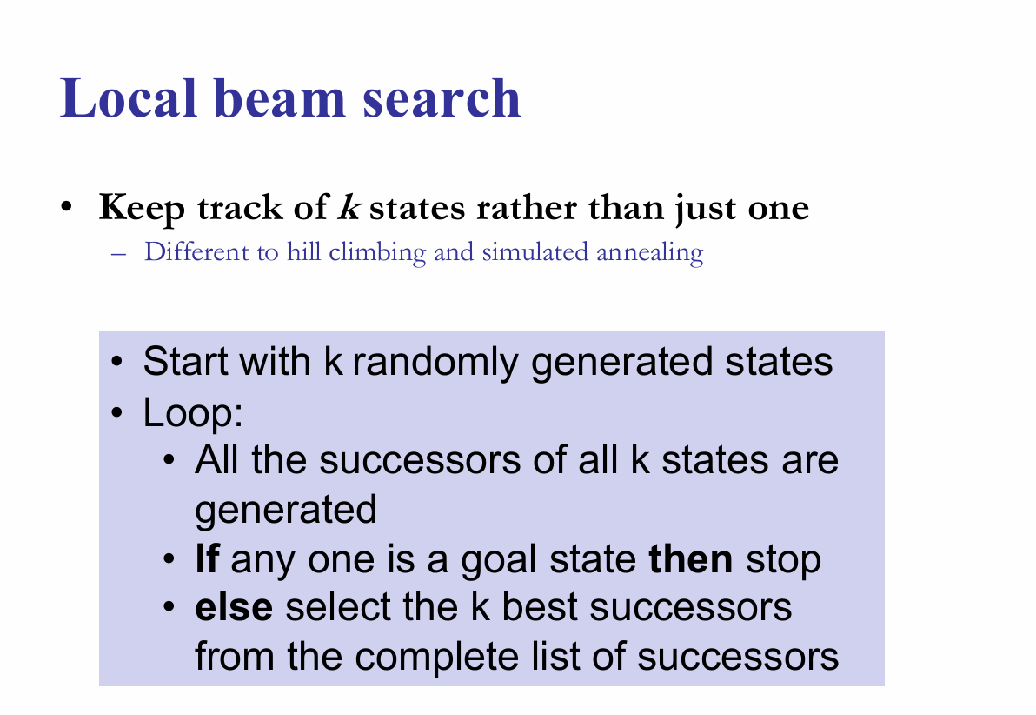
Beam Search
Notes:
By starting with agents, we establish the system architecture first. Search and logic are simply the algorithms running inside the agent's execution loop (or brain) to help it decide what to do next. There is a misconception that if a system doesn't use machine learning, it isn't AI. By looking at agents, we can discuss a more academically rigorous definition of AI, rational agency.
“An agent is anything that can be viewed as perceiving its environment through sensors and acting upon that environment through actuators.” (Russell & Norvig, 2010)
“This leads to a definition of a rational agent: For each possible percept sequence, a rational agent should select an action that is expected to maximize its performance measure, given the evidence provided by the percept sequence and whatever built-in knowledge the agent has.“(Russell & Norvig, 2010)
So, however it calculates that action, whether through a nested if statement or a neural network, is just an implementation detail. As we know, the industry is currently obsessed with Large Language Models. That architecture isn't new. It is the exact same Intelligent Agent framework from the 1970s, just swapped with a modern generative brain.
Reference: Russell, S., & Norvig, P. (2010). Artificial intelligence: A modern approach (3rd ed.). Prentice Hall.

Slide 3
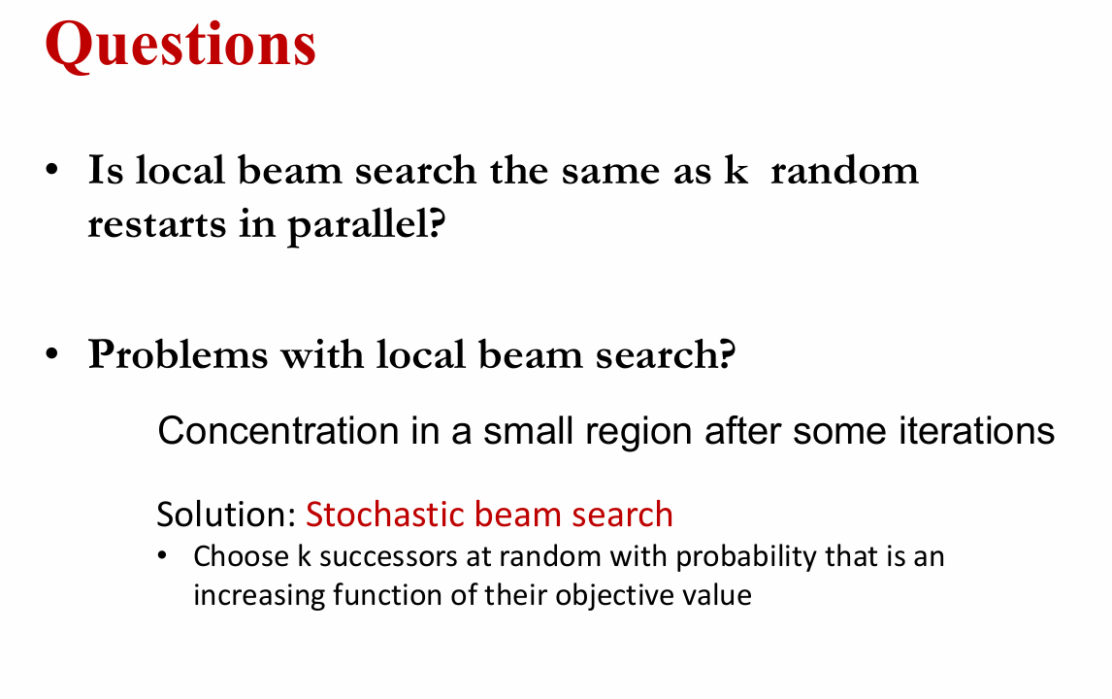
Beam Search
Notes:
By starting with agents, we establish the system architecture first. Search and logic are simply the algorithms running inside the agent's execution loop (or brain) to help it decide what to do next. There is a misconception that if a system doesn't use machine learning, it isn't AI. By looking at agents, we can discuss a more academically rigorous definition of AI, rational agency.
“An agent is anything that can be viewed as perceiving its environment through sensors and acting upon that environment through actuators.” (Russell & Norvig, 2010)
“This leads to a definition of a rational agent: For each possible percept sequence, a rational agent should select an action that is expected to maximize its performance measure, given the evidence provided by the percept sequence and whatever built-in knowledge the agent has.“(Russell & Norvig, 2010)
So, however it calculates that action, whether through a nested if statement or a neural network, is just an implementation detail. As we know, the industry is currently obsessed with Large Language Models. That architecture isn't new. It is the exact same Intelligent Agent framework from the 1970s, just swapped with a modern generative brain.
Reference: Russell, S., & Norvig, P. (2010). Artificial intelligence: A modern approach (3rd ed.). Prentice Hall.

Slide 4
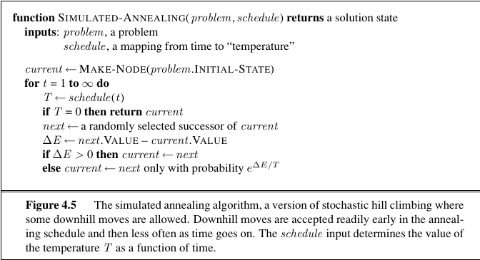
Beam Search
Notes:
Keeping just one node in memory might seem to be an extreme reaction to the problem of memory limitations. The local beam search algorithm3 keeps track of k states rather than just one. It begins with k randomly generated states. At each step, all the successors of all k states are generated. If any one is a goal, the algorithm halts. Otherwise, it selects the k best successors from the complete list and repeats.
At first sight, a local beam search with k states might seem to be nothing more than running k random restarts in parallel instead of in sequence. In fact, the two algorithms are quite different. In a random-restart search, each search process runs independently of the others. In a local beam search, useful information is passed among the parallel search threads. In effect, the states that generate the best successors say to the others, “Come over here, the grass is greener!” The algorithm quickly abandons unfruitful searches and moves its resources to where the most progress is being made.
In its simplest form, local beam search can suffer from a lack of diversity among the k states—they can quickly become concentrated in a small region of the state space, making the search little more than an expensive version of hill climbing. A variant called stochastic beam search, analogous to stochastic hill climbing, helps alleviate this problem. Instead of choosing the best k from the pool of candidate successors, stochastic beam search chooses k successors at random, with the probability of choosing a given successor being an increasing function of its value. Stochastic beam search bears some resemblance to the process of natural selection, whereby the “successors” (offspring) of a “state” (organism) populate the next generation according to its “value” (fitness).
Reference: Russell, S., & Norvig, P. (2010). Artificial intelligence: A modern approach (3rd ed.). Prentice Hall.

Slide 5
End

