Slide 1

Artificial Intelligence
Module 0
Intelligence
Presented By: Gregory Wagonblast
Notes:
Earth from Space: Mississippi River Delta
This Landsat image of 3 October 2011 shows the Mississippi River Delta, where the largest river in the United States empties into the Gulf of Mexico.
In this false-colour image, land vegetation appears pink, while the sediment in the surrounding waters are bright blue and green. The delta is known as the 'bird-foot' delta because of the shape created by the channels extending outward.
The size of the Mississippi River Delta built over millions of years owing to sediment deposition. The tons of sediment carried by the river system created the wetlands in southern Louisiana, which are home to many endangered species and help to protect the mainland from hurricane winds by acting like speed bumps.
Over the last several decades, however, the delta’s sediment load has been drastically reduced by natural and man-made factors. Extensive oil and gas extraction causes the subsidence of the delta and wetlands, and rising sea levels increase erosion as the fresh water vegetation dies due to the influx of salt water.
Currently, a chunk of land the size of a football field is lost about every half an hour.
In 2005, Hurricane Katrina destroyed much of the wetlands, while the 2010 Deepwater Horizon oil spill affected natural wildlife and the fishing industry.
This area is of significant economic importance, providing about 17% of the oil supply in the US, and 16% of fisheries harvest, such as shrimp, crabs and crayfish. A third of the nation’s oysters come from the Mississippi River Delta.
Reference: European Space Agency. (n.d.). Earth from space: Mississippi River Delta. https://www.esa.int/Applications/Observing_the_Earth/Earth_from_Space_Mississippi_River_Delta

Slide 2
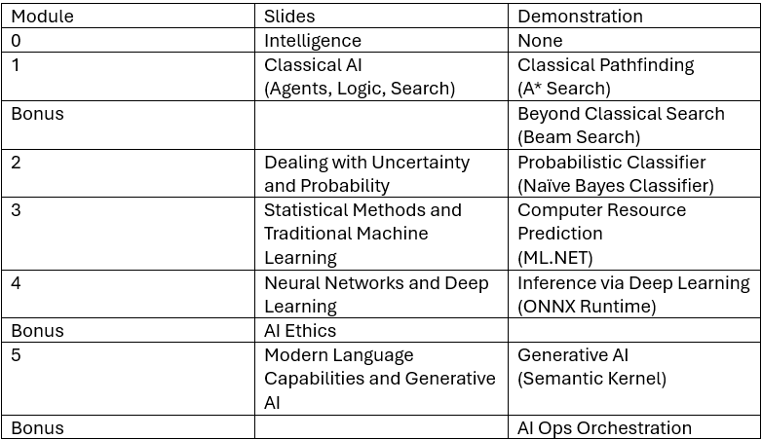
The Proposed Plan

Slide 3
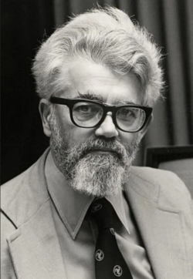
Q. what is artificial intelligence? A. It is the science and engineering of making intelligent machines, especially intelligent computer programs. It is related to the similar task of using computers to understand human intelligence, but AI does not have to confine itself to methods that are biologically observable. Q. What is intelligence? A. Intelligence is the computational part of the ability to achieve goals in the world. Varying kinds and degrees of intelligence occur in people, many animals and some machines. Q. Isn't there a solid definition of intelligence that doesn't depend on relating it to human intelligence? A. Not yet. The problem is that we cannot yet characterize in general what kinds of computational procedures we want to call intelligent. We understand some of the mechanisms of intelligence and not others. Reference: McCarthy, J. (2007, November 12). What is artificial intelligence? Basic questions. Formal Reasoning Group, Stanford University. http://www-formal.stanford.edu/jmc/whatisai/node1.html
What is Artificial Intelligence?
John McCarthy
Notes:
John McCarthy was an American computer scientist and cognitive scientist. He coined the term “Artificial Intelligence”, led the development of the programming language Lisp, popularized time-sharing, and created garbage collection.
McCarthy points out that we don't have a universal definition of intelligence yet, and this remains true to today. We call things intelligent when they solve tasks that used to require a human brain (like translating languages, playing chess or go, or driving a car), but as soon as a machine masters a task, we often stop calling it true intelligence and just call it software. This is a phenomenon known in computer science as the AI Effect.
May this remind us that AI is an engineering discipline aimed at solving problems, rather than a quest to build an exact mechanical copy of a human being.
Reference: Wikipedia. (2026, June 05). John McCarthy (computer scientist). John McCarthy (computer scientist) - Wikipedia

Slide 4
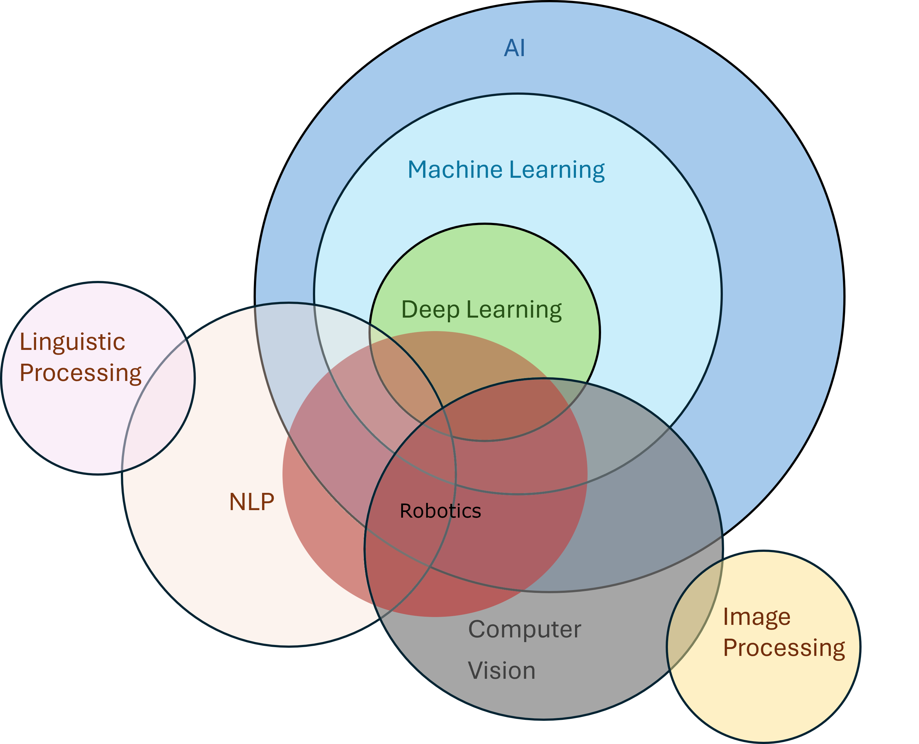

Slide 5
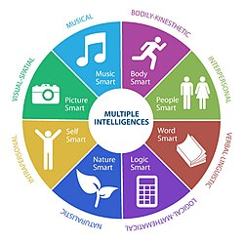
Human intelligence is, generally speaking, the mental quality that consists of the abilities to learn from experience, adapt to new situations, understand and handle abstract concepts, and use knowledge to control an environment. However, the question of what, exactly, defines human intelligence is contested, particularly among researchers of artificial intelligence, though there is broader agreement that intelligence consists of multiple processes, rather than being a single ability. Reference: The Editors of Encyclopedia Britannica. (2025, March 13). What is human intelligence? Encyclopedia Britannica. https://www.britannica.com/question/What-is-human-intelligence
What is Human Intelligence?
Reference: Gardner, H. (1983). Frames of mind: The theory of multiple intelligences. Basic Books.
Notes:
This slide, alongside McCarthy's views, creates an interesting parallel. McCarthy noted that we cannot yet fully characterize what makes a computational procedure intelligent. Gardner’s framework may offer an explanation: human intelligence isn't a monolith. When engineers build AI, they often tackle one sliver of Gardner's wheel at a time. For instance, we train symbolic and statistical models to be "word smart" (like Stanford CoreNLP), or transformer models paired with diffusion processes to be "music smart" (like Suno AI). We even train robots using computer vision and behavior cloning to achieve "body smart" autonomy. Today, modern LLMs demonstrate the greatest diversity of application, bridging multiple domains simultaneously by proving to be language smart, logic smart, and picture smart.

Slide 6
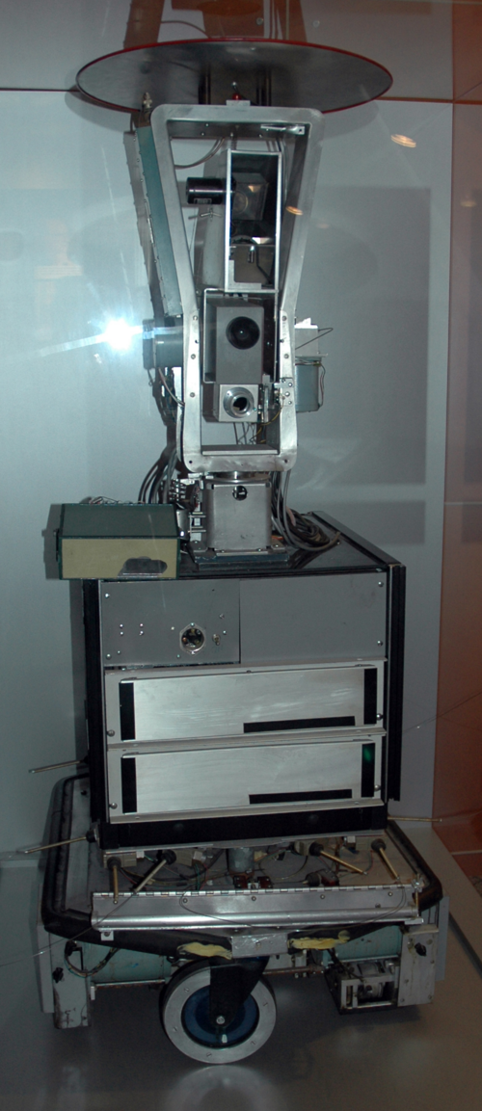
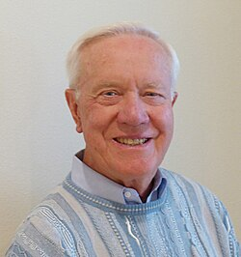
Artificial Intelligence (AI), broadly (and somewhat circularly) defined, is concerned with intelligent behavior in artifacts. Intelligent behavior, in turn, involves perception, reasoning, learning, communicating, and acting in complex environments. Reference: Nilsson, N. J. (1998). Artificial intelligence: A new synthesis. Morgan Kaufmann Publishers.
What is Intelligent Behavior?
Shakey
Nils John Nilsson
Notes:
Nils John Nilsson was an American computer scientist, and he was one of the founding researchers in the field of artificial intelligence. He is known for leading a team in the construction of a robot named Shakey. Shakey constructed a model of its environment from sensor data, reasoned about that environment to arrive at a plan of action, then carried that plan out by sending commands to its motors. Nilsson's group was the first to embody it in a complete agent, along the way inventing the A* search algorithm and founding the field of automated planning and scheduling.
Reference: Wikipedia. (2026, June 05). Nils John Nilsson. https://en.wikipedia.org/wiki/Nils_John_Nilsson
This brings us to a crucial realization; intelligent behavior is not distinct to artificial intelligence or human intelligence. When Nils Nilsson defines intelligent behavior, he doesn't limit it to humans or machines. Instead, he describes a universal loop; an entity must perceive its environment, reason through ambiguity, learn from its experiences, and take flexible action.
Ultimately, AI isn't about simulating human consciousness; it's about engineering systems that exhibit these exact same adaptable, problem-solving behaviors.

Slide 7
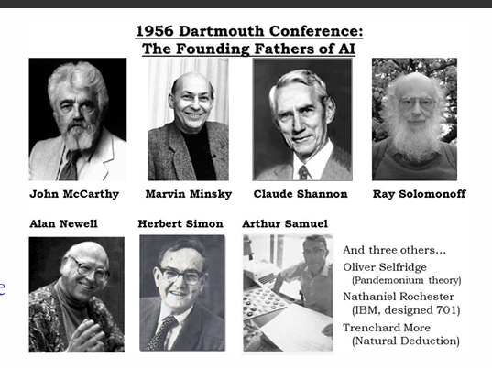
Approaches to Intelligent Behavior
Notes:
If we look back at the 1956 Dartmouth, we can understand that the founding fathers of AI didn't agree on a single path to intelligence.
1. Arthur Samuel: The Checkers Player (Machine Learning)
Instead of trying to program every possible move and strategy into a computer, Arthur Samuel wrote a program that taught itself how to play checkers.
How it worked: He programmed the computer to play games against itself and keep track of which board positions most frequently led to a win.
The Significance: This was the first operational demonstration of Machine Learning. It proved that a machine could dynamically learn from experience and eventually outperform its own creator, laying the exact foundation for how we train modern models via reinforcement learning and behavior cloning.
2. Allen Newell & Herbert Simon: The Logic Theorist (Symbolic Logic)
Newell and Simon wanted to prove that machines could mimic the "Logic Smart" dimension of human thought. They created a program called the Logic Theorist.
How it worked: They fed the program the foundational axioms of mathematics and instructed it to find proofs for complex geometric and algebraic theorems.
The Significance: It successfully found, step-by-step logical proofs for 38 theorems from Bertrand Russell’s Principia Mathematica and even found a proof for one theorem that was shorter and more elegant than the one Russell had written himself. It was a massive milestone for rule-based, symbolic AI.
3. Marvin Minsky: The Stochastic Neural-Analog Reinforcement Calculator (SNARC)
Before he focused heavily on symbolic cognitive frameworks, a young Marvin Minsky built the world's very first artificial neural network simulator in 1951.
How it worked: Using 3,000 vacuum tubes, motors, and clutches, Minsky built a physical machine that simulated a network of 40 interconnected neurons. He used it to simulate a "rat" navigating through a maze. When the machine made a correct turn toward the exit, it was rewarded with an electrical signal that strengthened those specific physical connections.
The Significance: This was the primitive ancestor to modern Deep Learning. Minsky physically demonstrated that a network of simple, non-intelligent components could adjust its internal weights to learn a complex physical behavior.
4. John McCarthy: Advice Taker & LISP (Goal-Achieving Logic)
True to his definition that AI should be free to use non-biological computational methods, John McCarthy created LISP (List Processing) in 1958, the programming language that became the standard for AI research for decades.
How it worked: He designed a proposed system called the Advice Taker. It was a program designed to search through a database of formal declarations and make logical deductions to achieve a real-world goal (e.g., deducing that to get to the airport, it must drive a car, and to drive a car, it needs keys).
The Significance: McCarthy showed that intelligence could be modeled as a pure search and optimization problem over logical statements, giving birth to classical AI pathfinding and decision-making algorithms.
Reference: Gemini. (2026, June 12). [AI-generated summary of foundational milestones in artificial intelligence history] [Large language model]. Google. https://gemini.google.com/

Slide 8
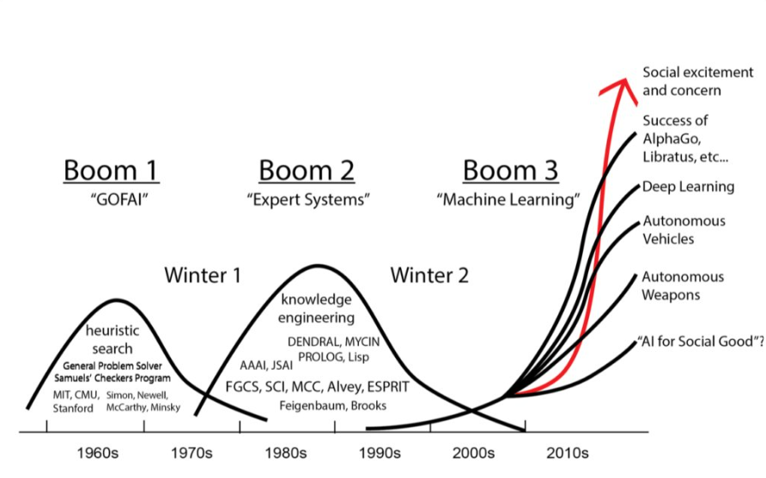
Intelligent Behavior in the Market
Notes:
Boom 1 (1960s) "GOFAI" (Good Old-Fashioned AI):
Centered on heuristic search and early logic programs. This era includes the work of the founders we just discussed.
Winter 1 (Mid-1970s):
Triggers: Overhyped symbolic AI, disappointing early language translation, slow/expensive hardware, and algorithms failing to handle real-world ambiguity or scale.
Recovery: The late 1970s brought specialized expert systems and microprocessors that enabled niche corporate successes.
Boom 2 (1980s) "Expert Systems":
Shifted focus toward knowledge engineering and corporate-focused, rule-based software like DENDRAL and MYCIN, alongside languages like Prolog and Lisp.
Winter 2 (Late 1980s – Mid-1990s):
Triggers: The expert systems bubble burst because they proved brittle and costly to maintain. Specialized AI hardware (such as "LISP machines") became obsolete, leading to corporate R&D pullbacks and economic downturns.
Recovery: A shift in the mid-to-late 1990s toward statistical machine learning and data mining, combined with significantly more powerful computers.
Plateau (Early 2000s):
Triggers: Not always classified as a full winter, this was a plateau where early neural networks stalled due to limited datasets, causing funding to shift elsewhere.
Recovery: The breakthrough in Deep Learning architectures, fueled by GPUs and big data.
Boom 3 (2010s+) "Machine Learning":
The massive explosion of modern Deep Learning, Autonomous Vehicles, and landmark gaming victories like AlphaGo and Libratus, culminating in massive social excitement and concern.
Winter 3 (?):
Potential Triggers: Overpromising near-human capabilities, slower-than-expected return on investment (ROI) for enterprise businesses, and increasing friction from safety, ethics, and regulatory pushback.
Prescription for Prevention: To potentially avoid a massive crash, maybe set realistic goals and timelines, delivering measurable value on actual production use-cases, and invest heavily in system reliability, safety, and interpretability.

Slide 9
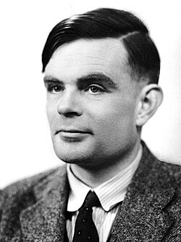
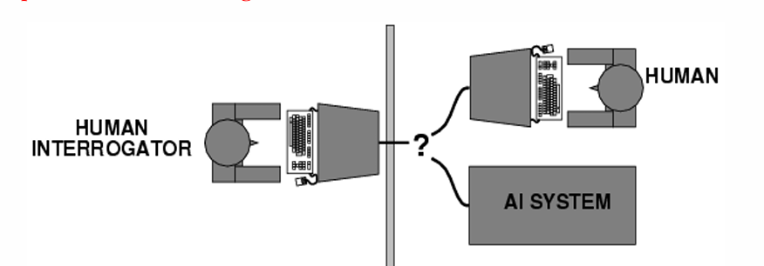
Identifying Intelligent Behavior
The Imitation Game
Strengths
Simplicity
Breadth of subject matter
Include emotional and aesthetic intelligence
Weaknesses
Some human behavior is unintelligent
Some intelligent behavior is inhuman
Searle’s Chinese room
Alan Turing
Notes:
Alan Turing was an English mathematician, computer scientist, logician, cryptanalyst, philosopher and theoretical biologist. He created the foundational concept of the modern programmable computer and is also know for designing an electromechanical machine called Bombe to decrypt the German Enigma messages during WW2. He was also treated like shit by his government.
Reference: Wikipedia. (2026, June 12). Alan Turing. Alan Turing – Wikipedia
The Thought Experiment:
“The new form of the problem can be described in terms of a game which we call the ‘imitation game’. It is played with three people, a man (A), a woman (B), and an interrogator (C) who may be of either sex. The interrogator stays in a room apart from the other two. The object of the game for the interrogator is to determine which of the other two is the man and which is the woman. He knows them by labels X and Y, and at the end of the game he says either ‘X is A and Y is B’ or ‘X is B and Y is A’. The interrogator is allowed to put questions to A and B…”
“We now ask the question, ‘What will happen when a machine takes the part of A in this game?’ Will the interrogator decide wrongly as often when the game is played like this as he does when the game is played between a man and a woman? These questions replace our original, ‘Can machines think?’”
Reference: Turing, A. M. (1950). Computing machinery and intelligence.
This measures linguistic output and can validate intelligent behavior.

Slide 10
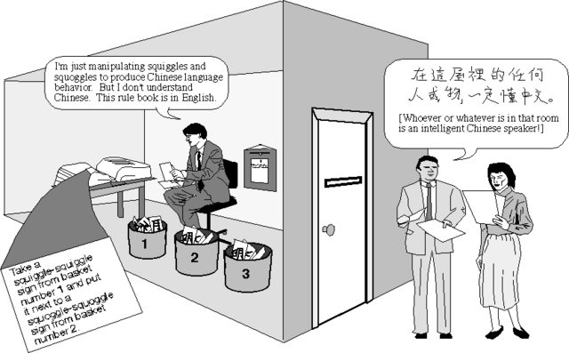
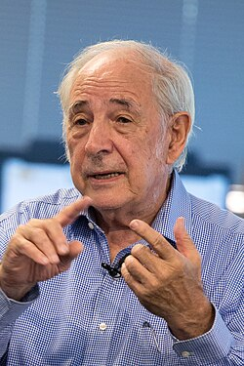
An Attack on Intelligent Behavior
The Chinese Room
John Searle
Notes:
John Searle was an American philosopher widely noted for contributions to the philosophy of language, philosophy of mind, and social philosophy.
The Thought Experiment:
– Searle cannot understand any Chinese.
– He is in a room with input/output windows, and a comprehensive list of rules about manipulating Chinese characters.
– Chinese questions come in from the input window, Searle manipulates the characters and produces an answer by following rules, then the answers are sent out via the output window.
– The answers that Searle produces are very good, no one can tell that he is not a native Chinese speaker!
Consequences:
Searle’s Chinese Room passes the Turing Test. It functions like an intelligent person. But Searle does not understand the Chinese symbols in the question, the answer, or the rules, so Searle has only conducted symbol manipulation. Therefore, passing the Turing Test does not ensure understanding. In other words, although Searle’s Chinese Room functions like a mind, it is not a mind. By analogy, computers only manipulate the symbols that it interacts with (input, output, program code, data), so computers passing the Turing Test does not ensure understanding, it only demonstrates intelligent behavior.
Strong AI (also known as AGI): A theoretical form of machine intelligence that possesses the ability to understand, learn, and apply knowledge across any intellectual task just like a human being. So, something that doesn’t just simulate a mind but literally is a mind.
Searle’s Conclusion Against Strong AI: Real understanding “is a biological phenomenon” and “only something with the same causal powers as brains can have [understanding]”.
Reference: Searle, J. R. (1980). Minds, brains, and programs.
This measures functional output vs internal meaning proves that intelligent behavior can exist without understanding.
This raises the question, how does intelligent behavior emerge without understanding?

Slide 11
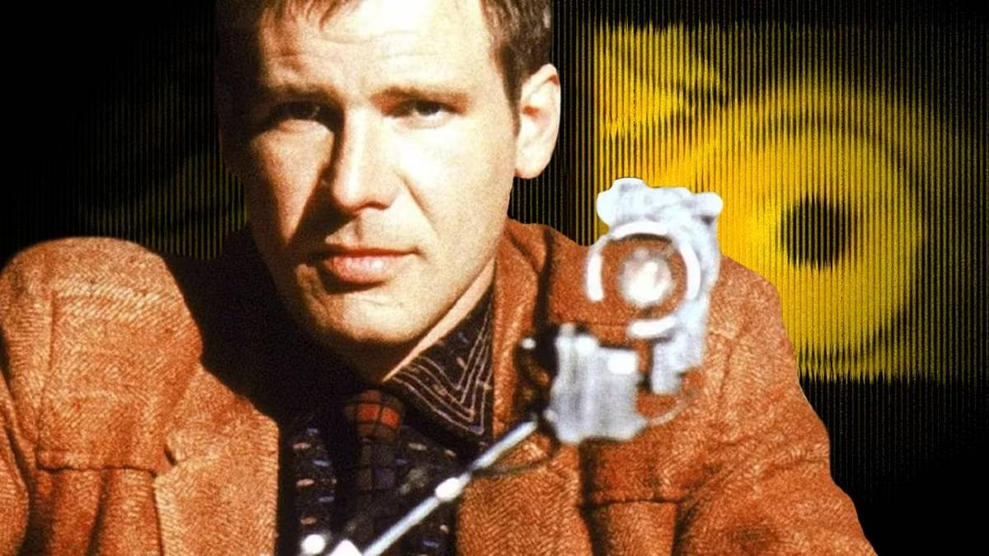

Identifying Other Than Intelligent Behavior
The Voight-Kampff Test
The Voight-Kampff test is used primarily by Blade Runners to determine if a suspect is truly human by measuring the degree of empathic response through carefully worded questions and statements.
Notes:
This is an interesting fictional test from the 1982 movie Blade Runner. This movie is set in a dystopian, cyberpunk future. The story follows Rick Deckard, a specialized police officer known as a Blade Runner. His job is to track down and "retire" (execute) Replicants. Replicants are bioengineered synthetic humans created by the Tyrell Corporation.
The Conflict: Replicants are physically and intellectually superior to humans, built to do dangerous off-world labor. However, they are entirely illegal on Earth.
The Problem: Replicants are so advanced that they develop their own emotions, memories, and a fierce desire for survival. They become virtually indistinguishable from natural-born humans, passing as human in everyday society.
This measures subconscious empathy and biology. The test assumes intelligent behavior already exist and tests for emotional authenticity.
This raises an interesting question, if an artificial being acts perfectly human, does it possess a soul, or is it just a sophisticated machine?

Slide 12
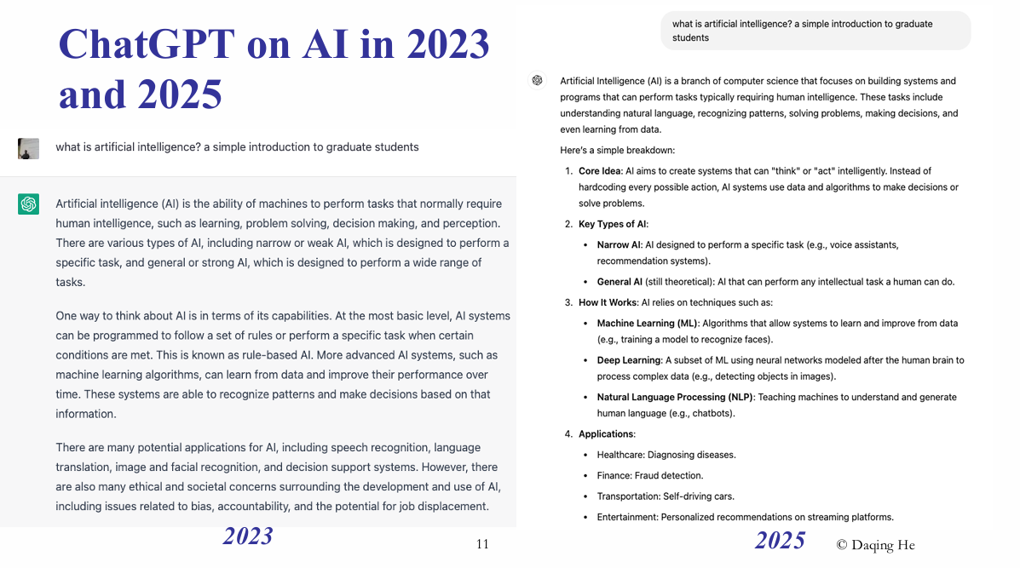
Notes:
An example of how intelligent behavior has progressed.

Slide 13
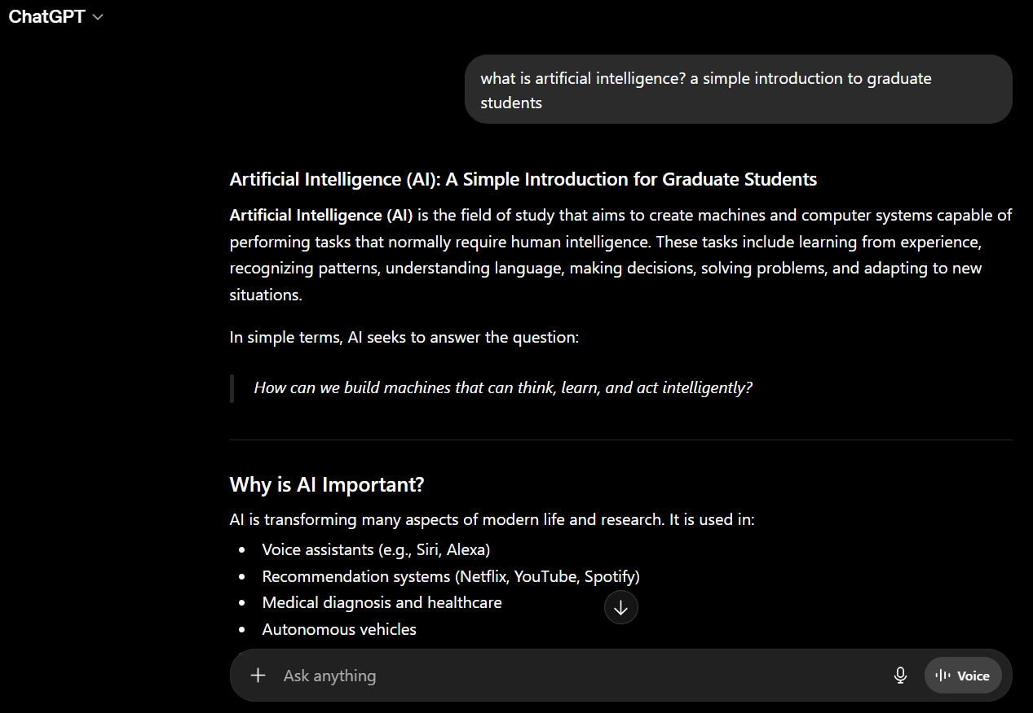
2026
Notes:
Continue.

Slide 14
End

