Slide 1

Artificial Intelligence
Module 1
Classical AI
(Agents, Logic ,Search)
Presented By: Gregory Wagonblast
Notes:
Earth from Space: Southern Tip of Florida
This image, captured by the Copernicus Sentinel-3 mission, shows at the top the southern tip of Florida, the circular Lake Okeechobee down through the Everglades and the curved archipelago of islands known as the Florida Keys all the way to Key West. The surrounding turquoise and deep-blue waters create a striking reminder of the beauty and diversity of our planet, making this a fitting scene to celebrate a thousand views of Earth from space.
At the bottom of the image lies Cuba, partially veiled by clouds. The darker cloud-free area along the island’s southern coast is the Zapata Swamp, Cuba’s largest wetland, spanning the Zapata Peninsula and surrounding the Bay of Pigs. The peninsula stretches into the turquoise waters of the Gulf of Batabanò, which separates the Cuban mainland from the circular Isla de la Juventud.
Between Florida and Cuba is the Cay Sal bank, appearing as a small area of turquoise water in the dark blue Straits of Florida.
To the east, we can see the Bahamas, which consist of a chain of islands and shallow-water banks. The largest island, Andros, lies on the eastern edge of the Great Bahama Bank, a shallow-submerged water platform. The contrast between the bank’s shallow green and turquoise waters and the darker Atlantic waters clearly marks the abrupt transition to deeper waters.
Reference: European Space Agency. (n.d.). Earth from space: Southern Tip of Florida. ESA - Earth from Space image collection

Slide 2
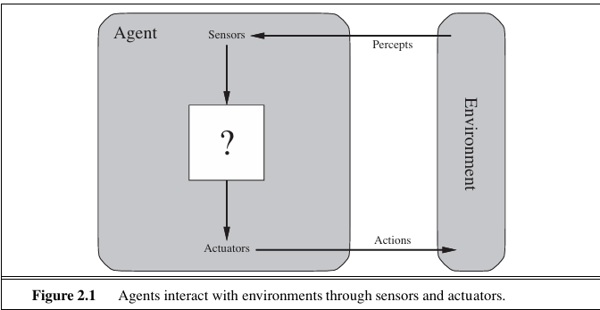
Agent Architecture
Notes:
By starting with agents, we establish the system architecture first. Search and logic are simply the algorithms running inside the agent's execution loop (or brain) to help it decide what to do next. There is a misconception that if a system doesn't use machine learning, it isn't AI. By looking at agents, we can discuss a more academically rigorous definition of AI, rational agency.
“An agent is anything that can be viewed as perceiving its environment through sensors and acting upon that environment through actuators.” (Russell & Norvig, 2010)
“This leads to a definition of a rational agent: For each possible percept sequence, a rational agent should select an action that is expected to maximize its performance measure, given the evidence provided by the percept sequence and whatever built-in knowledge the agent has.“(Russell & Norvig, 2010)
So, however it calculates that action, whether through a nested if statement or a neural network, is just an implementation detail. As we know, the industry is currently obsessed with Large Language Models. That architecture isn't new. It is the exact same Intelligent Agent framework from the 1970s, just swapped with a modern generative brain.
Reference: Russell, S., & Norvig, P. (2010). Artificial intelligence: A modern approach (3rd ed.). Prentice Hall.

Slide 3
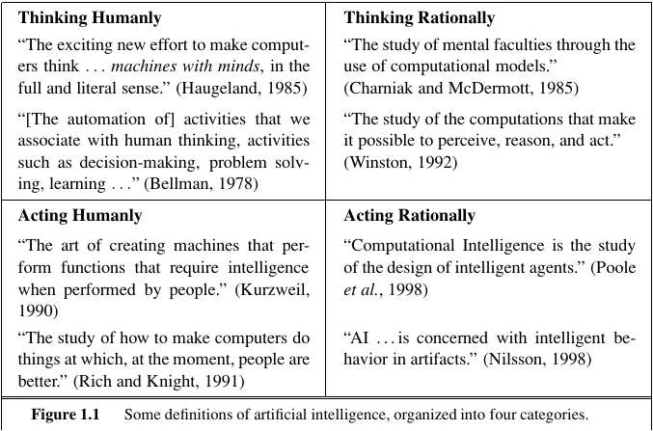
Back To Defining Artificial Intelligence
Notes:
“The definitions on the left measure success in terms of fidelity to human performance, whereas the ones on the right measure against an ideal performance measure, called rationality. A system is rational if it does the “right thing,” given what it knows.” (Russell & Norvig, 2010)
I think the overall goal of AI, as it’s been with computing in the past, is to generally optimize efficiency while maintaining rationality.
Reference: Russell, S., & Norvig, P. (2010). Artificial intelligence: A modern approach (3rd ed.). Prentice Hall.

Slide 4
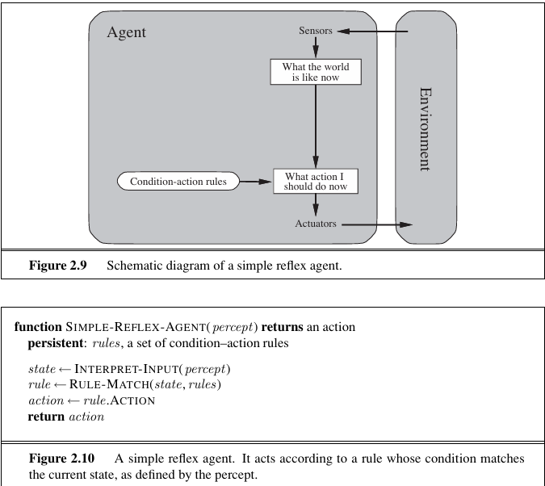
Simple-Reflex Agents
Notes:
“The simplest kind of agent is the simple reflex agent. These agents select actions on the basis of the current percept, ignoring the rest of the percept history.” (Russell & Norvig, 2010)
Example: A smart thermostat. If the current temperature drops below 68°F, turn on the heat. It doesn’t look at historical trends or care what the weather was like an hour ago.
Reference: Russell, S., & Norvig, P. (2010). Artificial intelligence: A modern approach (3rd ed.). Prentice Hall.

Slide 5
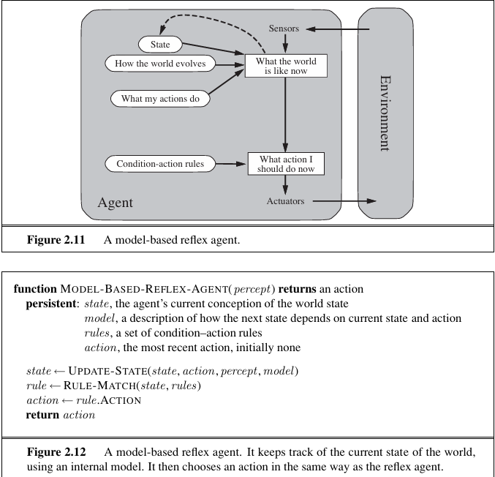
Model-Based Agents
Notes:
“The most effective way to handle partial observability is for the agent to keep track of the part of the world it can’t see now. That is, the agent should maintain some sort of internal state that depends on the percept history and thereby reflects at least some of the unobserved aspects of the current state.” (Russell & Norvig, 2010)
Now, if we have information about how the agent’s environment unfolds and how the agent’s actions may affect its environment, we can create a model. In turn, creating a model-based agent.
So, we are effectively adding memory to the agent.
Example: A robotic vacuum cleaner. If it bumps into a wall, it can't "see" behind itself, but its internal map logs where that wall is so it doesn't try to drive backward into it.
Reference: Russell, S., & Norvig, P. (2010). Artificial intelligence: A modern approach (3rd ed.). Prentice Hall.

Slide 6
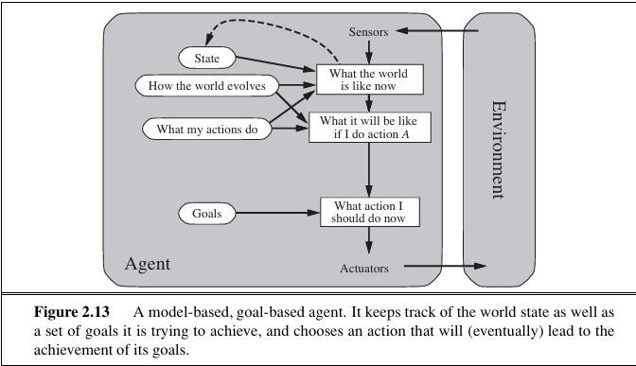
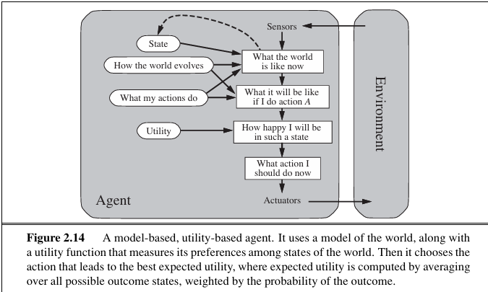
Goal-Based and Utility-Based Agents
Notes:
For a goal-based agent, “the agent needs some sort of goal information that describes situations that are desirable…” (Russell & Norvig, 2010). Additionally, to achieve that goal, searching and planning need to be implemented.
Example: A GPS navigation app finding a route. Its goal is a binary target (reaching Point B). It evaluates combinations of turns to find a viable path to that endpoint.
For a utility-based agent, “an agent’s utility function is essentially an internalization of the performance measure. If the internal utility function and the external performance measure are in agreement, then an agent that chooses actions to maximize its utility will be rational according to the external performance measure.” (Russell & Norvig, 2010)
Example: A self-driving car deciding how to navigate. It doesn’t just want to reach the destination (goal-based); it maps out paths that maximize passenger safety, minimize travel time, and optimize fuel efficiency simultaneously.
And from my understanding:
• Uninformed search is goal-based
• Informed search is utility-based
Reference: Russell, S., & Norvig, P. (2010). Artificial intelligence: A modern approach (3rd ed.). Prentice Hall.

Slide 7
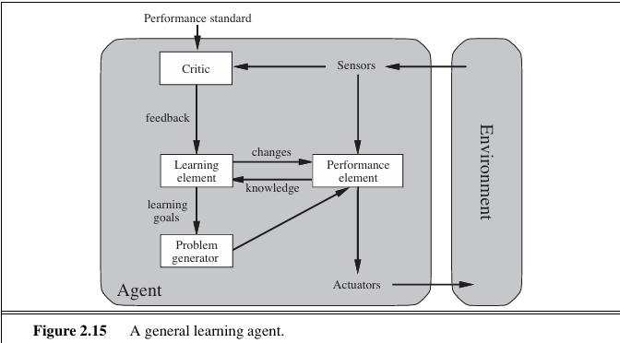
General Learning Agents
Notes:
“A learning agent can be divided into four conceptual components, as shown in Figure 2.15. The most important distinction is between the learning element, which is responsible for making improvements, and the performance element, which is responsible for selecting external actions. The performance element is what we have previously considered to be the entire agent: it takes in percepts and decides on actions. The learning element uses feedback from the critic on how the agent is doing and determines how the performance element should be modified to do better in the future… The last component of the learning agent is the problem generator. It is responsible for suggesting actions that will lead to new and informative experiences.” (Russell & Norvig, 2010)
Example: An AI algorithm trained via Reinforcement Learning to play chess or video games (like AlphaGo). It plays millions of games, receives scores on its performance, and shifts its entire internal logic to avoid making the same mistakes twice.
Reference: Russell, S., & Norvig, P. (2010). Artificial intelligence: A modern approach (3rd ed.). Prentice Hall.

Slide 8
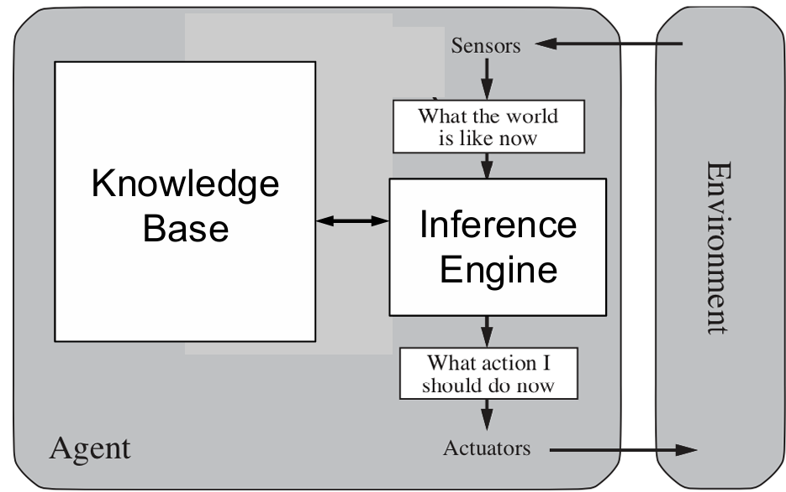
Knowledge-Based Agents
Notes:
• Facts about the environment and the task can be observed via inputs during the execution
– These facts are called knowledge
– Some knowledge already exist in the agent at the initiate state, but some knowledge is obtained via execution
• Knowledge, particularly new knowledge, is used to improve task performance
– Adopt to changes in the environment by updating the relevant knowledge
– New knowledge helps to define better utility-based decisions
• A knowledge base is the component for storing knowledge, and an inference engine is for generating new knowledge
• Central component of a knowledge-based agent
– A set of assertions, expressed by knowledge representation language
– Each assertion takes one piece of knowledge about the world
– Some assertions are called axioms: meaning they are taken without being derived from other assertions
• TELL adds new assertations
– Agent with knowledge base can gain knowledge by telling it what it needs to know
• ASK can query the content in the knowledge base
– Means asking about what is known in the knowledge base
• ACT can infer the answer
– Means taking actions based on it’s knowledge base
Example: Medical Diagnostic Expert Systems (like MYCIN) or and other expert mode systems. If the system is given the facts "Patient has symptom X" and "Symptom X implies Condition Y," it infers "Patient has Condition Y" and decides on a treatment plan.

Slide 9
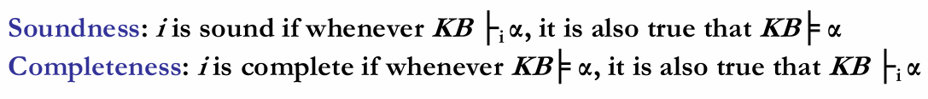
Knowledge-Based Agents
Notes:
I’m not going to discuss how a knowledge base is represented through logic systems, and I am not going to discuss inference rules. But here is a high-level summary.
• Knowledge-based agents can take the expandable KB to represent the environment, the task, and the best approaches.
– Knowledge is represented as logic sentences
• Logic can be propositional or first-order logic system
– syntax: formal structure of sentences
– semantics: truth of sentences w.r.t models
– entailment: necessary truth of one sentence given another
– Inference and proof: deriving sentences from other sentences
– soundness: derivations produce only entailed sentences
– completeness: derivations can produce all entailed sentences
• Pros: Explicit, human readable, reliable
• Cons: Not all knowledge can be easily represented as logic sentences. This could have too many logic sentences and no good way to select, so it’s inefficient. It cannot handle uncertainty.
Soundness (precision): Out of everything the model claims is true, how much of it actually is true?
Completeness (recall): Out of all the actual truths out there, how many did the model manage to find?
I want to stop and ask, can a probabilistic model ever be sound and/or complete? The short answer is no, these definitions were built for a deterministic model.
For an LLM to be sound, everything it outputs (derives) would have to be factually or logically true (entailed). LLMs hallucinate. They confidently generate false facts, invent fake citations, and produce flawed mathematical proofs.
For an LLM to be complete, it would need to be capable of finding or proving every valid logical truth that follows from its training data or prompt context. LLMs suffer from strict limitations like context window constraints, attention degradation over long texts, and systemic blind spots (such as failing at complex, multi-step logic or basic arithmetic with large numbers). They can easily miss or fail to derive a truth that is technically implicit in their data.
Note: Neuro-symbolic AI aims to solve these issues by using LLMs to solve problems, then using external systems designed around formal logic rules to verify the solution.
To be clear, LLMs aren’t knowledge-based agents. Although external systems for neuro-symbolic AI would be knowledge-based. At their core foundation, LLMs are fundamentally learning-based agents because they are trained on massive datasets to iteratively minimize prediction error. And thhe agentic framework of an LLM makes the performance elements goal-based or utility-based.

Slide 10
Formulating Problems and Problem-Solving Agents
Well-defined Problems
– Initial state: The agent starts from.
– Possible actions: Actions available to the agent. At a particular state, all possible actions are called applicable actions.
– Successor Function: What outcome each action does?
– Goal test: Determines a given state is a goal state or not.
– Path cost: A numeric cost to each path. For example, the distance accumulated so far from the initial state.
Problem-solving agents assume the problem environment is:
– Observable: Agent knows the current state.
– Discrete: Agent at a state only has finite number of actions to lead to next states.
– Deterministic: Agent can plan a sequence of actions such that each will lead to just one intermediate state.
– Static: The environment would not change unless the agent changes it.
Notes:
The right formulation makes a big difference to the size of the search space.
“We group all these under the heading of the task environment. For the acronymically minded, we call this the PEAS (Performance, Environment, Actuators, Sensors) description. In designing an agent, the first step must always be to specify the task environment as fully as possible.”
Reference: Russell, S., & Norvig, P. (2010). Artificial intelligence: A modern approach (3rd ed.). Prentice Hall.

Slide 11
Uninformed Search
Uninformed strategies uses only the information available in the problem definition. Also known as blind searching.
– Breadth-first search
– Uniform-cost search
– Depth-first search
– Depth-limited search
– Iterative deepening search

Slide 12
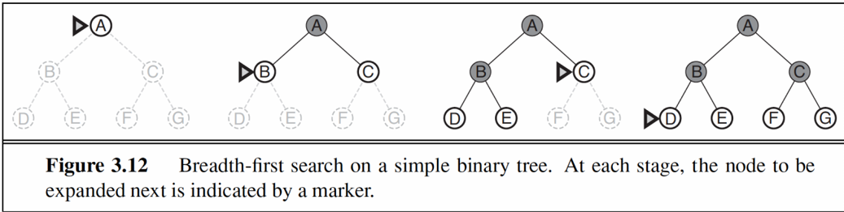
Breadth-First Search
Notes:
• Expand the shallowest unexpanded node
• Place all new successors at the end of a FIFO (First In First Out) queue
Reference: Russell, S., & Norvig, P. (2010). Artificial intelligence: A modern approach (3rd ed.). Prentice Hall.

Slide 13
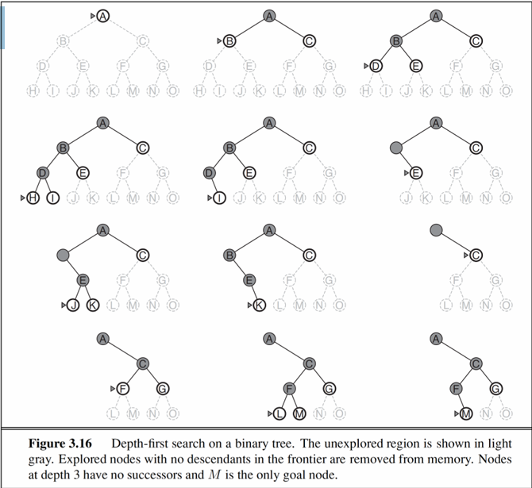
Depth-First Search
Notes:
• Expand the deepest unexpanded node
• Unexplored successors are placed on a LIFO (Last In First Out) stack until fully explored
Reference: Russell, S., & Norvig, P. (2010). Artificial intelligence: A modern approach (3rd ed.). Prentice Hall.

Slide 14
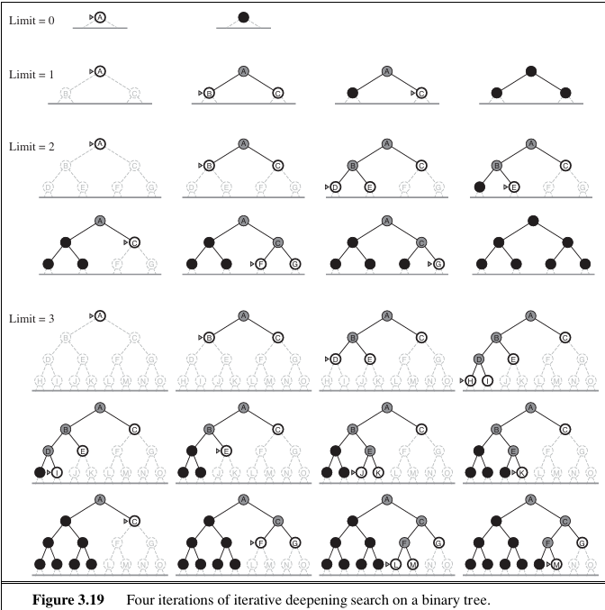
Iterative Deepening Search
Notes:
• Iterative deepening depth-first search
– Uses depth-first search
– Finds the best depth limit
• Gradually increases the depth limit; 0, 1, 2, … until a goal is found
Reference: Russell, S., & Norvig, P. (2010). Artificial intelligence: A modern approach (3rd ed.). Prentice Hall.

Slide 15
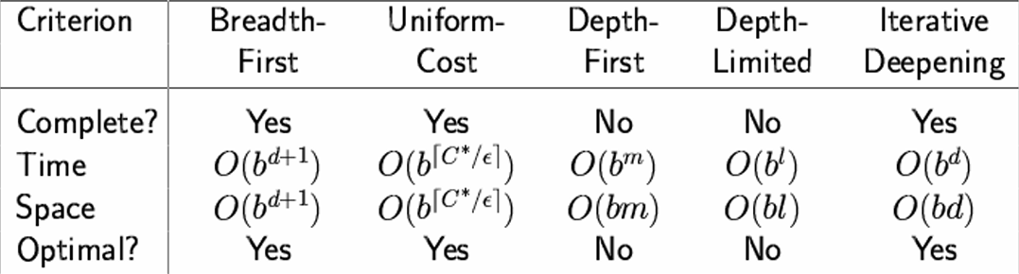
Measurements for Problem Solving Performance
Notes:
• Completeness: Is the algorithm guaranteed to find a solution when there is one?
• Time complexity: How long does it take to find a solution?
• Space complexity: How much memory is needed to perform the search?
• Optimality: Does the strategy find the optimal solution, i.e., lowest path cost?
• In general, iterative deepening search is the preferred uninformed search method when there is a large search space and the depth of the solution is not known
Reference: Russell, S., & Norvig, P. (2010). Artificial intelligence: A modern approach (3rd ed.). Prentice Hall.

Slide 16
Informed (Heuristic) Search
Informed Search uses problem-specific knowledge beyond the definition of the problem .
Greedy search {f(n) = h(n)}
A* search {f(n) = g(n) + h(n)}
Notes:
– Can find solutions more efficiently
– Problem-specific knowledge helps to establish evaluation criterion for selecting node(s) for next expansion: an evaluation function f(n).
– One example of f(n)
• Heuristic function h(n) = estimated cost of the cheapest path from the state at node n to a goal state
“Greedy best-first search tries to expand the node that is closest to the goal, on the grounds that this is likely to lead to a solution quickly. Thus, it evaluates nodes by using just the heuristic function; that is, f(n)=h(n).” (Russell & Norvig, 2010)
The evaluation function f(n) is the heuristic function → f(n) = h(n)
Ignores cost so far to get to that node
Expands the unexpanded node that appears closest to goal
“The most widely known form of best-first search is called A∗ search (pronounced “A-star A ∗ SEARCH search”). It evaluates nodes by combining g(n) ,the cost to reach the node, and h(n), the cost to get from the node to the goal: f(n)=g(n)+h(n).” (Russell & Norvig, 2010)
Minimizing the total estimated solution cost
Avoids expanding paths that are already expensive
Evaluation function f(n) combines the actual cost g(n) to reach node n and the estimated cost h(n) to get from node n to the goal → f(n) = g(n) + h(n)
Reference: Russell, S., & Norvig, P. (2010). Artificial intelligence: A modern approach (3rd ed.). Prentice Hall.

Slide 17
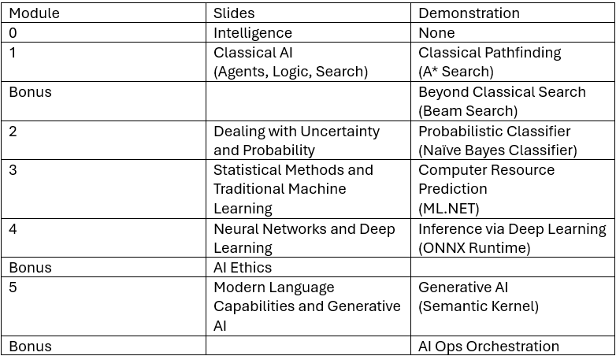
Future Modules

Slide 18
End

