Slide 1

Two-Dimensional Games Using DirectDraw
Presentation By Greg Buron
December 3, 2002

Slide 2
Presentation Topics
Overview of:
  2D games
  Various APIs
  DirectDraw Basics
Building a DirectDraw based engine
Demonstration of a 2D game developed with DirectDraw

Slide 3
An Overview of Developing 2D Games
A Tribute to “Old School” Gaming

Slide 4

Why Two-dimensional Games?
Good way to break into game development
2D games are simple versions of 3D games
  Use what you learn in 2D development and apply directly to other game development areas.
Fun to develop and play!

Slide 5
Are Two-dimensional Games Still Being Made in an Era of 3D?
Many of the most acclaimed computer games of all time were made in 2D
  Age of Empires
  StarCraft
  Diablo
  Fallout
Many games today are being made in 2D
  Strategy games
  Role-Playing games
  Platform style games

Slide 6
Which APIs Can Be Used for Developing 2D Games?
Windows GDI
SDL
OpenGL
DirectX

Slide 7
The Basics Of DirectDraw
Hooray for Deprecated APIs!

Slide 8
What Is DirectX?
DirectX is an API (Application Programming Interface).
Part of Microsoft’s development environment for Windows, as a means of developing applications that require direct access to a machine’s hardware.
Is a fast, device-independent way to incorporate multimedia into Windows applications which creates an abstraction away from the hardware (HAL).
If a particular feature of DirectX is not supported by a machine’s hardware, it is emulated in software by a hardware emulation layer (HEL).

Slide 9
Components of DirectX
DirectX is a collection of independent APIs for varying types of multimedia
  DirectDraw: used for 2D graphics
  Direct3D: used for 3D graphics
  DirectInput: manages input devices such as keyboard, mouse, game pads, etc.
  DirectSound: for sound effects (now part of DirectX Audio)
  DirectMusic: music that can change tempo sound depending on the mood or pace of the game (now part of DirectX Audio)
  DirectPlay: add networking components such as lobbies, chat rooms, or other multiplayer components to your game.

Slide 10

What Is DirectDraw?
Part of DirectX specifically designed for 2D applications for displaying graphics.
Uses the COM interface.
All future versions of DirectX will support DirectDraw.
Is not included as a separate API in DirectX beyond version 7.

Slide 11

What Can DirectDraw Do?
Render images to the screen, called “blitting”
Set transparency colors on bitmaps
Direct manipulation of video memory by “locking” surfaces.
Has direct access to video hardware, and bypasses the Windows GDI

Slide 12

What Can DirectDraw NOT Do?
Does not have built-in support for many things commonly found in 3D APIs
  Lighting
  Alpha blending
  Particle effects
Does not work on any operating systems other than Windows

Slide 13

Why Use DirectDraw?
DirectDraw is much easier to learn than Direct3D.
3D development in general is much more difficult than 2D development.
DirectDraw will always be supported by newer versions of DirectX.
Is a very powerful 2D API with a proven track record.
Direct access with the hardware for improved performance, as opposed to some other 2D APIs.

Slide 14
What API should you use?
Latest and Greatest vs. Tried and True
Go with what you know
Take the time to learn a new API
Whatever API you feel comfortable with using
Assess the strengths and weaknesses of each API and base your decision on good research
There are many APIs suitable for almost any project

Slide 15
Developing a DirectDraw Application
How to Set up a Visual Studio Project and Add the Necessary DirectX Components

Slide 16
How To Develop a DirectDraw Application
Download and install the latest version of DirectX SDK (Software Development Kit)
Create a Win32 workspace using Microsoft Visual C++ Version 6.0
Show Dev Studio where the SDK include files and library files are
  Tools Options Directories tab
  Add an entry for the SDK components.
  Make sure those entries are first in the list so older versions that come with Dev studio are not used.

Slide 17
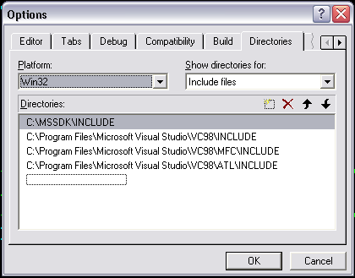
A Sample Dialog With the Correct Include Directory for the SDK

Slide 18
Link Your Project With the Appropriate DirectX Libraries
Getting lots of weird, random linking errors?
Showing Dev Studio the location of the libraries is not enough!
Make sure you add the appropriate libraries in your project for the linker
  Project Settings
  On the link tab, add the libraries you will use in your DirectX project

Slide 19
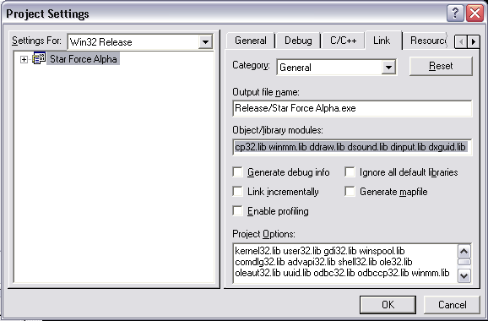
A Sample Project Settings Dialog for Including DirectX Libraries

Slide 20
Setting up the Win32 Components
You can ask Dev Studio to create a simple Win32 workspace for you.
There are vast numbers of tutorials on how to create a simple Win32 application.
When creating a DirectX application, you will only have to do minimal Win32 setup. Once a simple application is up and running, you can proceed directly with the setup of your DirectX components.

Slide 21
Getting DirectDraw Incorporated in Your Win32 Application
A DirectDraw object is essentially a display manager
  Controls the interaction between the system and DirectDraw surfaces
  Attach a back buffer to the DirectDraw object, onto which you will draw all of your graphics
Creating a DirectDraw object
  Set cooperative level with the hardware and operating system
  Set the display mode
  Set the number of back buffers (usually 1)

Slide 22
Drawing Bitmaps Onto the Back Buffer
DirectDraw uses surfaces to hold bitmaps.
A surface is a pointer to video memory.
Surfaces are placed onto the back buffer in an operation called “blitting”.
When all of the surfaces, which contain individual bitmaps, have been transferred to the back buffer, the back buffer is “flipped” with the primary buffer.
The primary buffer is the surface that is displayed on your monitor.

Slide 23
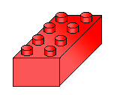
Putting the Pieces
Together to Create a
Rendering Loop
Rendering the surfaces consists of continually updating the back buffer and then flipping the back buffer with the primary buffer.
Construct a while loop that updates the back buffer, then flips the back buffer to achieve continuous rendering of your surfaces.

Slide 24
How Does the Rendering Process Get Incorporated Into a Win32 App As a “Game Loop”?
Most games have the same basic format
main( )
{
initializeWindow();
initializeGameVariables();
while(notDone)
{
updateGameVariables();
render();
}
}

Slide 25
Building a DirectDraw-based Engine
Abstracting Out the Basics of Drawing to Simplify Your Life

Slide 26
Building a DirectDraw Blitting Engine
It is convenient to wrap much of the functionality of DirectDraw into a single class.
“Componentizing” your game reduces cognitive load and helps reduce repetitive errors
Other DirectX components can be factored into classes in much the same way
Can also build components for the game engine to render.

Slide 27

Concept of a “Sprite”
For our discussion, a “sprite” is any 2D graphic; the most basic “renderable” quantity.
May or may not be animated
Should have some basic capabilities
  Contains a surface (duh)
  Should “know” its own dimensions
  Should be able to “clip” itself

Slide 28

Extending the Concept of a Sprite
You can construct a “Sprite Manager” to hold all the sprites that logically go together
  Tiles in a map
  Frames in an animation
A Sprite Manager could
contain a list of images
and a means of
determining which image
was next in the animation
sequence.

Slide 29
Drawing Sprites Using a DirectDraw Engine
After creating a DirectDraw engine, you can draw sprites to the screen in several different ways:
  Send all sprites to the DirectDraw engine
  All objects that have a sprite know how to draw themselves
Which one is better?
  Use the one that makes sense to you!

Slide 30
Cost / Benefit Analysis of Drawing Sprites With a Drawing Engine
If you send all the objects that contain a sprite to the engine for drawing, then the engine has to have a concept of what all of those objects are (less portable to other projects).
If you allow objects to draw themselves, then you must give the object the back buffer in order for it to draw itself (duplication of rendering code).
Notes:
Show SuperDefender code at this point, how you incorporate sprites and the DirectDraw engine, and how the Game map knows how to “render itself”

Slide 31
A Case Study of DirectDraw in a 2D scrolling shooter:
Star Force Alpha
Some basic ideas to think about when developing a tile-based scrolling game

Slide 32
Data Structures to Represent Objects In the Game
Break the game area into regions, or tiles.
Each region contains a list, or array(s), of all the object types in that region
Do not keep a large single array of all the objects on the current game area
  Slows performance when parsing for collisions, etc.
  Slows performance when determining what to draw on the screen

Slide 33
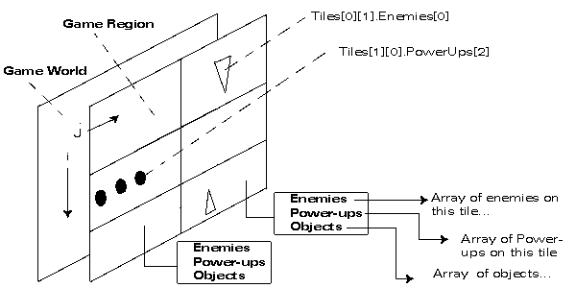
Diagram of Game World Broken Into a Tile-Based Representation

Slide 34
Use Pre-Existing Data Structures to Your Advantage!
Take the time to learn STL.
Lists and Vectors are highly optimized data structures, and reduce or eliminate the need for any home-made data structure manipulation routines.
STL Maps are good data structures, but have slightly more overhead than some other data structures.

Slide 35
Don’t be Afraid to Make Use of Many Global Data Structures
C and C++ rely heavily on global data and data structures.
You have no doubt been taught that global data structures are bad.
Many of your routines will require access to data for various reasons, so it’s not a sin to make them global.

Slide 36
Minimize Dynamic Allocation of Game Objects During Game Play
Dynamic allocation of objects requires the operating system to perform costly heap operations at runtime.
Try to allocate all of the memory you are going to require before the game starts or between “levels”.
Use either static or pre-allocated arrays of structs or class objects and use a “valid” member variable to weed out objects that are to be skipped over during parsing.

Slide 37
Load All of the Surfaces Before Game Play Begins
Creating surfaces during game play will dramatically reduce performance.
Load any surfaces and set color keys before the “level” is active for game play.
Release all the surfaces you no longer need during game play
  Release menu surfaces while playing the game
  Release game surfaces while navigating menus

Slide 38
Load Important Surfaces First
When creating surfaces, DirectDraw will first use the video memory for surface creation.
When video memory is full, system memory is used for creating new surfaces.
Video memory is much faster for blit operations than retrieving the surface from system memory.
Load any surfaces that are large or will be blitted many times early in the “loading surfaces” process.

Slide 39
Use Debug Information Whenever Possible
Outputting debug information directly to the screen using GDI text calls is an efficient and practical way to get a handle on the inner workings of your algorithms.
Use the TextOut GDI function call to print text to the screen:
TextOut(HDC, x, y, message, strlen(message));

Slide 40
Create Functions to Convert From World Space to Screen Space
Optimized functions for the conversion from world to screen space will enhance your blitting routines.
Try to keep all of your objects coordinates in world space, and convert them to screen space only for the blitting process.

Slide 41
Keep Bounding Boxes for All “Collidable” Objects
Use of a RECT structure for each object the player can collide with simplifies collision routines.
Upon creation of a game object, fill its bounding box rectangle with the objects world coordinate points.
Update the bounding box every time the object moves.

Slide 42
Detecting Collisions with RECT Structures is Simple
If you keep a RECT as a bounding box for all of your collidable objects, then detecting collisions in 2D is a snap.
Use the IntersectRect( ) function for detecting collisions
IntersectRect(RECT intersect,
RECT object1,
RECT object2);

Slide 43
Resolve Collisions With the Intersection of the Two Rectangles
When using the IntersectRect( ) call, the first parameter is used to store the “intersection” of the rectangles object1 and object2.
Create a “collision vector” out of that rectangle based on the corners of the intersection rectangle and the directions that the object1 and object2 are moving.
Apply the resulting collision vector to the appropriate object(s)

Slide 44
Scrolling Games as “Collision Simulators”
2D Scrolling games are in essence just a big collision simulation
  Player colliding with objects
  Player colliding with enemies
  Projectiles colliding with enemies
  Projectiles colliding with player
  Projectiles colliding with objects
  Enemies colliding with objects
  Objects colliding with objects
  You get the picture….

Slide 45
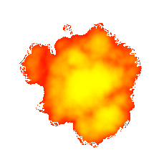
Focus First on Game Mechanics
Spend a lot of time getting your collision detection routines functional and optimized.
Once you have the physics of your game world finished, then focus on game play issues.

Slide 46
Empower the User
Do everything you can to let the user configure his/her game play experience.
Things you as the developer can do to empower the user:
  Allow user to set display size/color depth
  Allow user to set sound levels
  Windowed or full screen mode
  Give the user options on game play types, such as different characters or space ships, or game boards, etc.
Attention to detail and finishing the little things will make your project that much better.

Slide 47
Summary and Concluding Remarks

Slide 48
Two-Dimensional Games
A good launching point for your game career.
Many APIs are well-suited for 2D games.
Patience and determination will give you a product you can feel good about completing.
Most importantly, have FUN!

Slide 49
Resources, References and Credits

Slide 50
Resources and References
http://www.gamedev.net
http://www.ludumdare.org
http://www.flipcode.com
Andre LaMothe books:
  Tricks of the Windows Game Programming Gurus
  Isometric Game Programming with DirectX 7

Slide 51
Resources and References
You can find this presentation and code examples we went through at
http://www.wwu.edu/~burong/downloads.html

Slide 52
Credits
Major props go out to
  All of the folks who answer questions on game development forums
  David York, an inspiration to get into game development as a hobby
  Friends who seem to have infinite patience for my dorkiness
For Jenny, who is my muse, my support, and my best friend.

