Slide 1
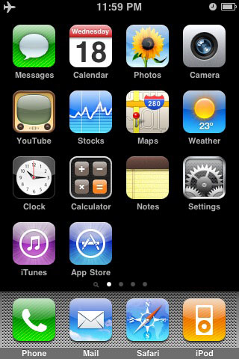

Home Screen
This is a default iPhone home screen to start your demos from.
In presentation mode, the red icon acts as a button that links to the 2nd slide, where your mockup loading screen should display.
You can replace the red button by your own 57x57 icon. Just don’t forget to hyperlink it to slide 2.
If you own photoshop this tutorial might be handy:
http://www.photoguides.net/photoshopping-iphone-icons
Caltrain RT

Slide 2

Launch screen (static)
iPhone OS displays this full-screen image instantly when the user taps your application icon on the Home screen as a placeholder for your app until it starts.
Apple recommends designing a launch screen that creates the illusion that your app has already started (even though it’s just an image). One great way to do that is to have a launch screen that looks just like the background of your app’s first screen (but without the data populated of course).
Loading…

Slide 3
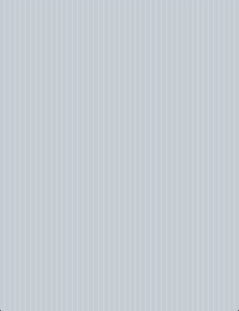
App Home Screen
This is where your app starts.
Feel free to delete the instructions on the iPhone screen and start pasting UI elements from the MockApp library file.
Have fun using MockApp!
From
Mountain View
To
San Francisco
Number | Departs | Arrives | Delta
365 | 16:37 | 17:24 | 0:47
267 | 17:03 | 18:02 | 0:59
369 | 16:58 | 17:44 | 0:46
373 | 17:37 | 18:24 | 0:47
275 | 17:46 | 18:39 | 0:53
277 | 18:03 | 19:02 | 0:59
379 | 17:58 | 18:44 | 0:46
383 | 18:37 | 19:24 | 0:47
!
Timetable
Notifications
Settings

Slide 4
App Home Screen
This is where your app starts.
Feel free to delete the instructions on the iPhone screen and start pasting UI elements from the MockApp library file.
Have fun using MockApp!
!
Timer
Notifications
Settings

Slide 5
App Home Screen
This is where your app starts.
Feel free to delete the instructions on the iPhone screen and start pasting UI elements from the MockApp library file.
Have fun using MockApp!
My Stations
Home
San Francisco
Work
Mountain View
I Leave For Work Between…
7 am
9 am
I Come Home Between…
4 pm
6 pm
Notifications
Major Delays
ON
ON
Minor Delays
OFF
!
Timer
Notifications
Settings

