Slide 1
Thermal Model Parameter Identification Algorithm
Greg Fiore
gregfiore@gmail.com
2/10/2012

Slide 2
Overview
Could the thermal properties of a building and its heating system be determined by a thermostat?
Approach
Turn heat on for a short period
Observe response
Compute thermal parameters based on a simple thermodynamic model
Potential advantages
New control algorithms
Reduced overshoot due to latent heating
Improved “time to temperature” estimates
Energy consumption predictions

Slide 3
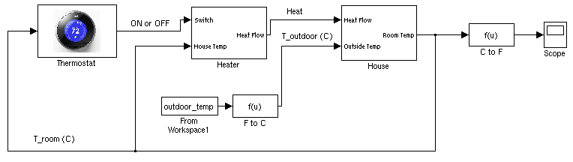
Model
Simple thermodynamic model with forced-air heating system
Simulink model

Slide 4
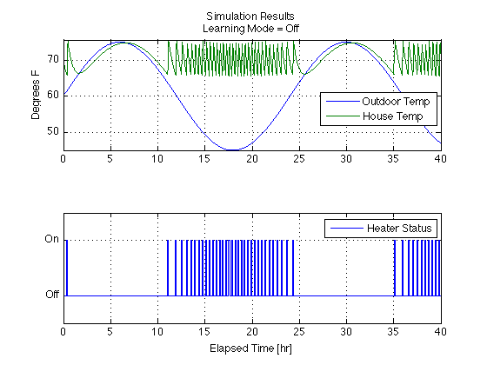
Normal Thermostat Operation
Set-point
Thermostat keeps house temperature within 4 degrees of set-point despite fluctuation in outside temperature.

Slide 5
Learning Mode Algorithm
Turn on Heater for X mins
Identify windows of thermal response:
Heat on, house warming
Heat off, house cooling
Estimate C₁ with data when heater is off and house is cooling
House temp.
Outdoor temp.
Estimate C₂ and T_{heater} data when heat is on using least squares fit of data

Slide 6
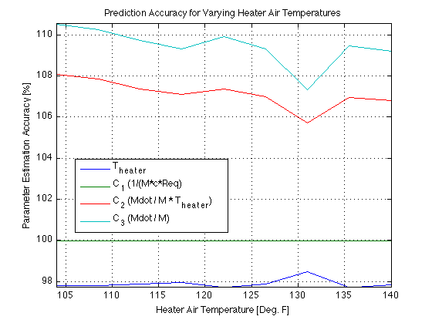
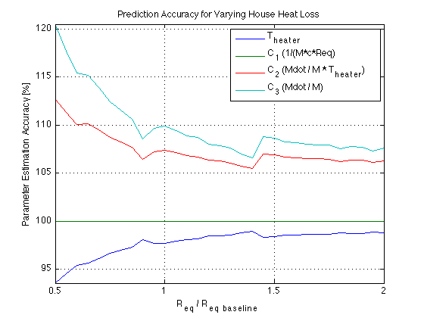
Prediction Accuracy
With little insulation, less heat retention results in poor estimate
All parameters estimated to within 20% for a broad range of heater temperatures and house heat loss coefficients
T_{heater} and R_{eq} estimated to within 6.5% accuracy

Slide 7
Conclusions
Accurate estimates of building heat parameters can be made using a learning algorithm
Further work
Increase model fidelity
Sensitivity testing
Develop new algorithms that make use of estimated parameters
Investigate feasibility of implementation on the Nest device

