Slide 1
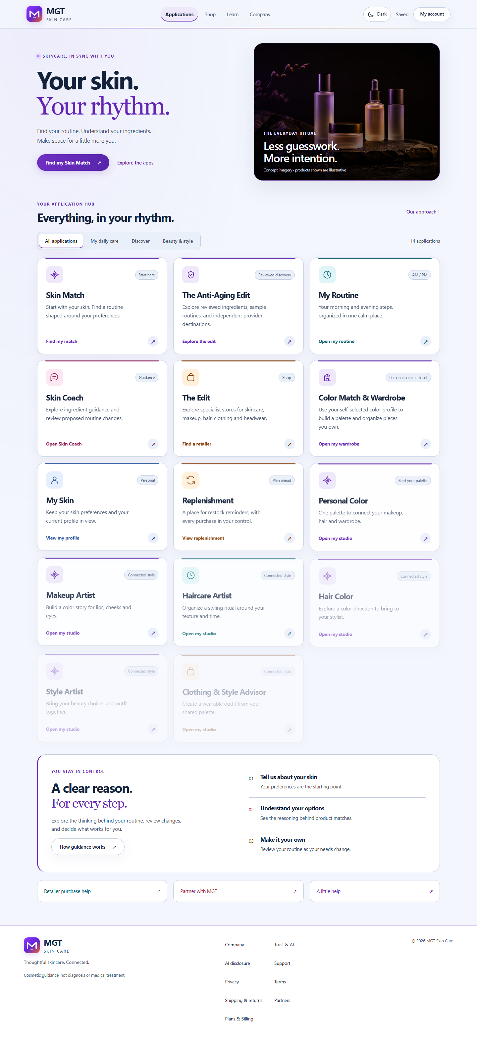
OWNER / APPROVER · GREGG CLARK
MGT Skin Care v2
Full product functions, intelligence engine, production infrastructure & launch plan
Evidence-backed portal blueprint · 3-tier commercial option · Google Cloud and Drive recovery model
MGT SKIN CARE · PRODUCT & PRODUCTION BLUEPRINT · 25 OCT 2026
01
Notes:
Local production-build capture dated 25 Oct 2026.
This deck is a decision and execution blueprint, not a launch authorization.

Slide 2
EXECUTIVE READOUT
Broad, coherent product surface; production is now an evidence problem
Remaining work centers on live configuration, qualification, operations and owner approvals—not another product redesign.
14
3
3
1
consumer + operator surfaces
hosted AI roles to qualify
suggested subscription tiers
accountable owner
Built
Must be proven
Decision
Portal shell; profile and consent; Skin Match; routines; Anti-aging; color/style/wardrobe; Retail Edit; account/images/support/admin; Stripe contracts; local-first AI gateway; delivery scaffolding.
Production identity/database; webhooks; model quality/cost; approved catalog and retailers; WCAG; restore; monitoring; legal copy; domain/TLS; support and incident drills.
Approve or reject the 3-tier test. Keep live enrollment closed until prices, secrets, end-to-end payment evidence and the signed launch packet are complete.
MGT SKIN CARE · PRODUCT & PRODUCTION BLUEPRINT · 25 OCT 2026
02

Slide 3
PRODUCT SYSTEM
One consented profile drives five connected loops
Outputs combine structured profile data, reviewed knowledge, deterministic rules and bounded AI synthesis.
DISCOVER
PLAN
TRACK
MANAGE
OPERATE
Skin Match
Anti-aging library
Retail Edit
AM/PM routine
Style palette
Wardrobe ideas
Check-ins
Regimen cycles
Saved images
Account/privacy
Membership
Support
Catalog review
AI quality
Launch gates
Shared profile + consent + entitlement + audit context
No AI output silently becomes a diagnosis, purchase, booking or account change.
MGT SKIN CARE · PRODUCT & PRODUCTION BLUEPRINT · 25 OCT 2026
03

Slide 4
OUTPUT SCREEN
Application hub
A progressive-disclosure front door to applications, saved state, commerce, learning and trust.
Intent first
Users begin with a goal rather than a model, provider or technical workflow.
Trust visible
Privacy, AI disclosure, support, accessibility, billing and the medical boundary are discoverable.
Fail closed
Sample data and unavailable integrations remain blocked until explicit production gates pass.
MGT SKIN CARE · PRODUCT & PRODUCTION BLUEPRINT · 25 OCT 2026
04

Slide 5
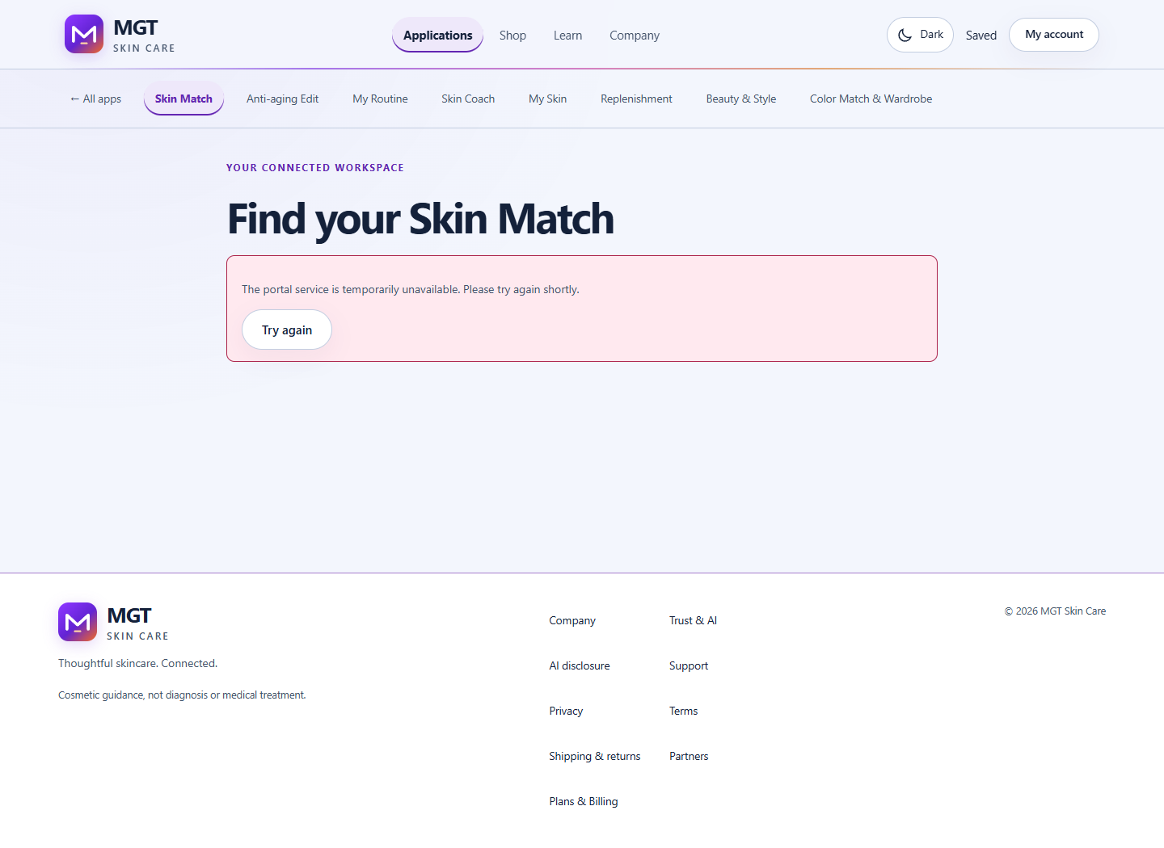
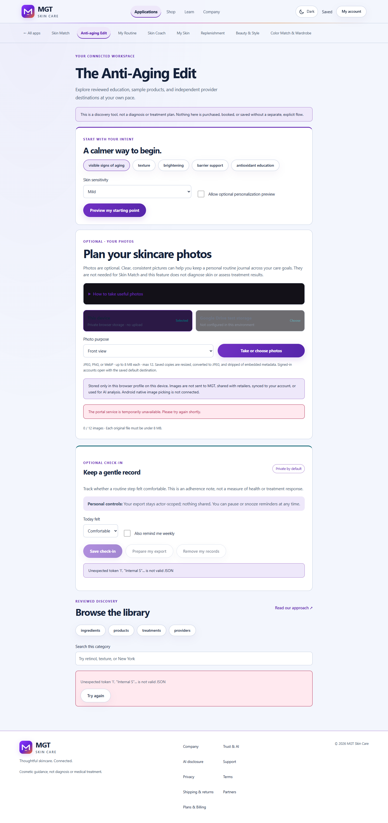
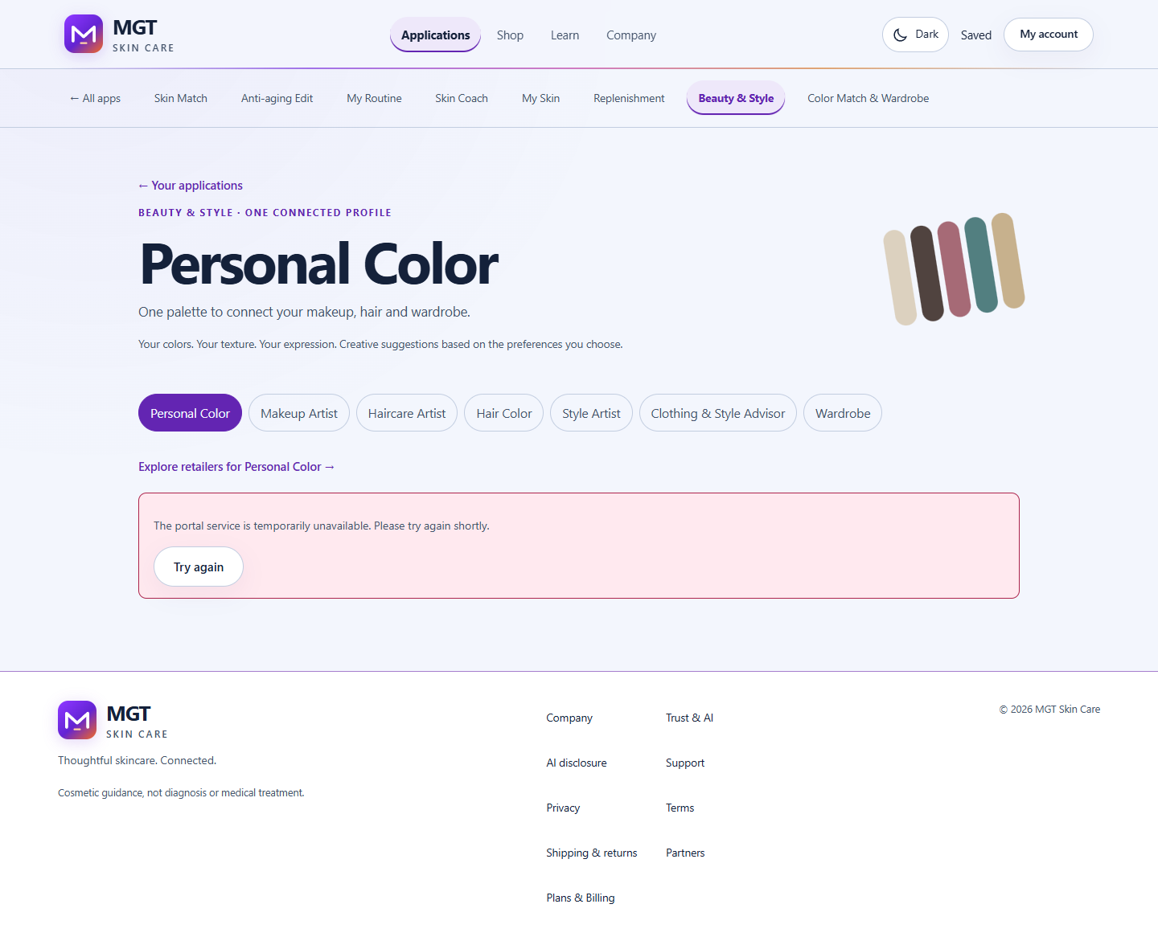
CORE JOURNEYS
Skin Match, Anti-aging, style and wardrobe
Each journey exposes structured input, explainable output and explicit save/export controls.
Skin Match → routine
Anti-aging boundary
Color + wardrobe
Validate profile; apply avoidances and sensitivity; score approved candidates; assemble AM/PM slots; explain why; persist version and provenance.
Reviewed ingredients/products/treatments/providers, routine preview, progress and reminders. Current first-load data integration remains a release gate.
User-confirmed appearance and comfort inputs produce a palette, explanation and exactly three practical outfit ideas—without protected-trait inference.
MGT SKIN CARE · PRODUCT & PRODUCTION BLUEPRINT · 25 OCT 2026
05

Slide 6
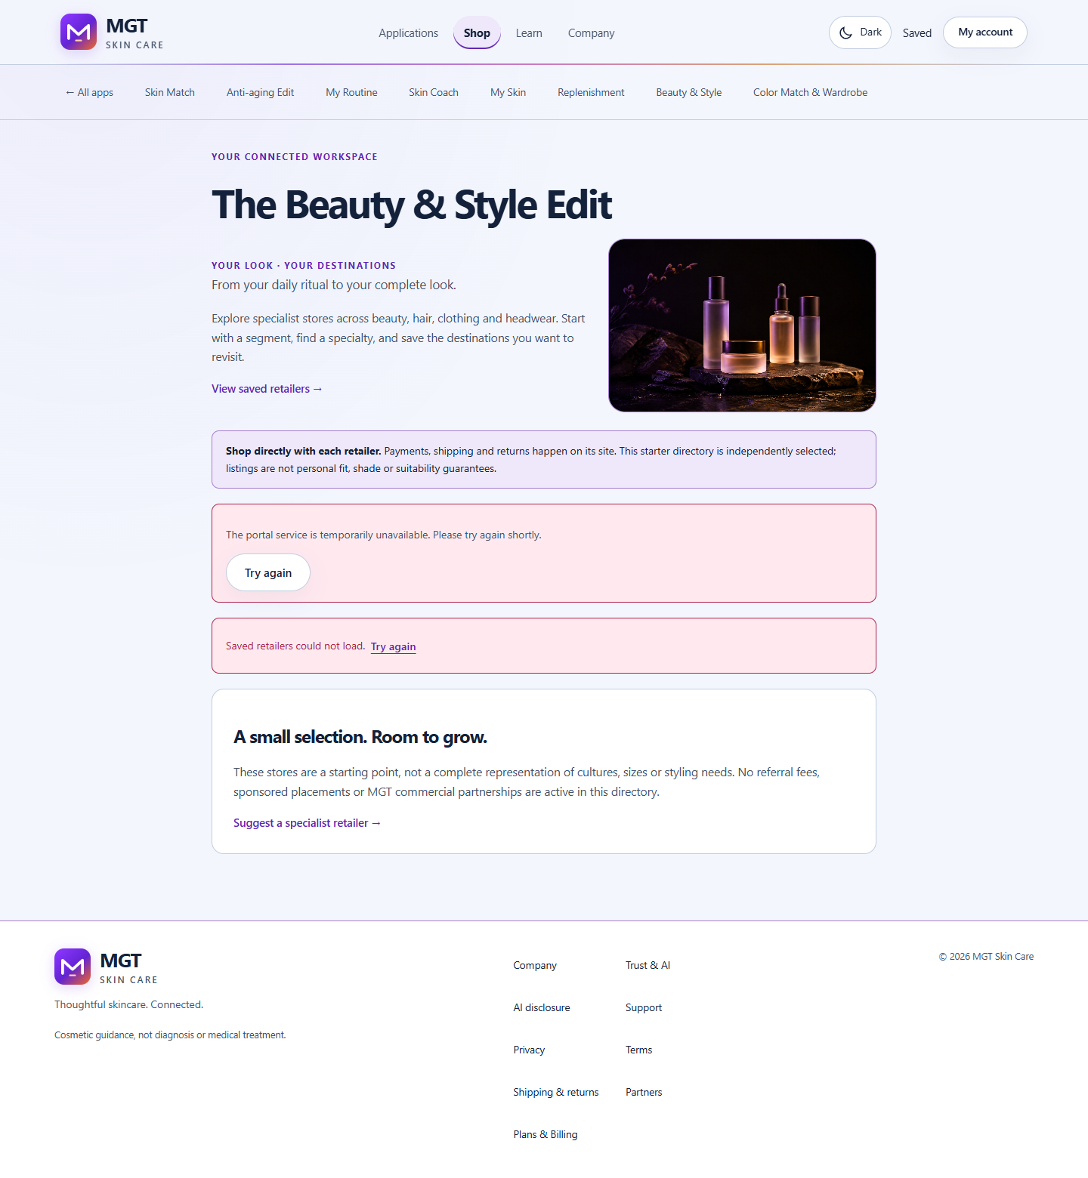
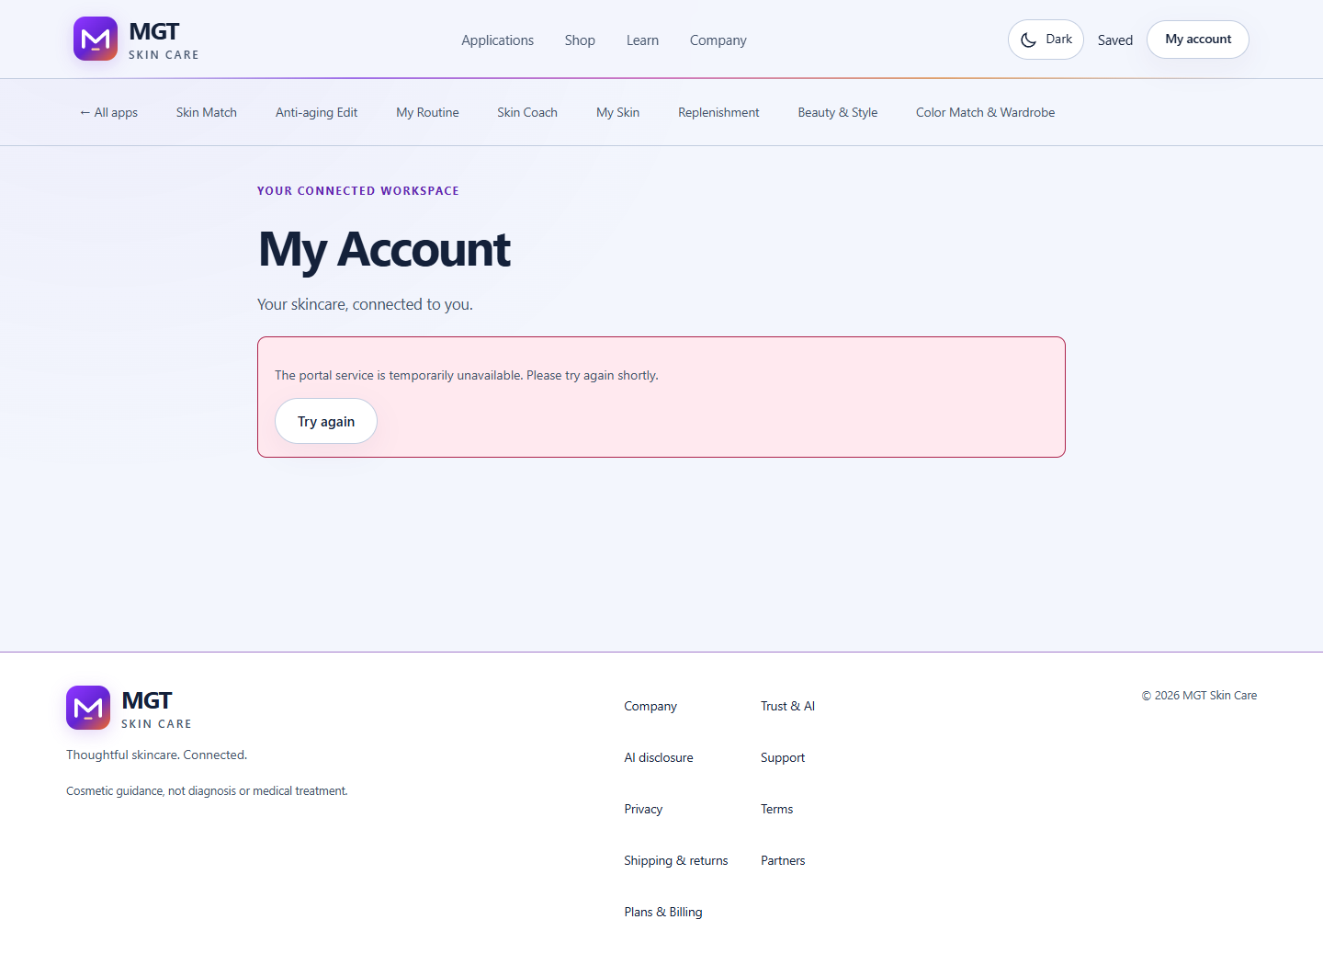
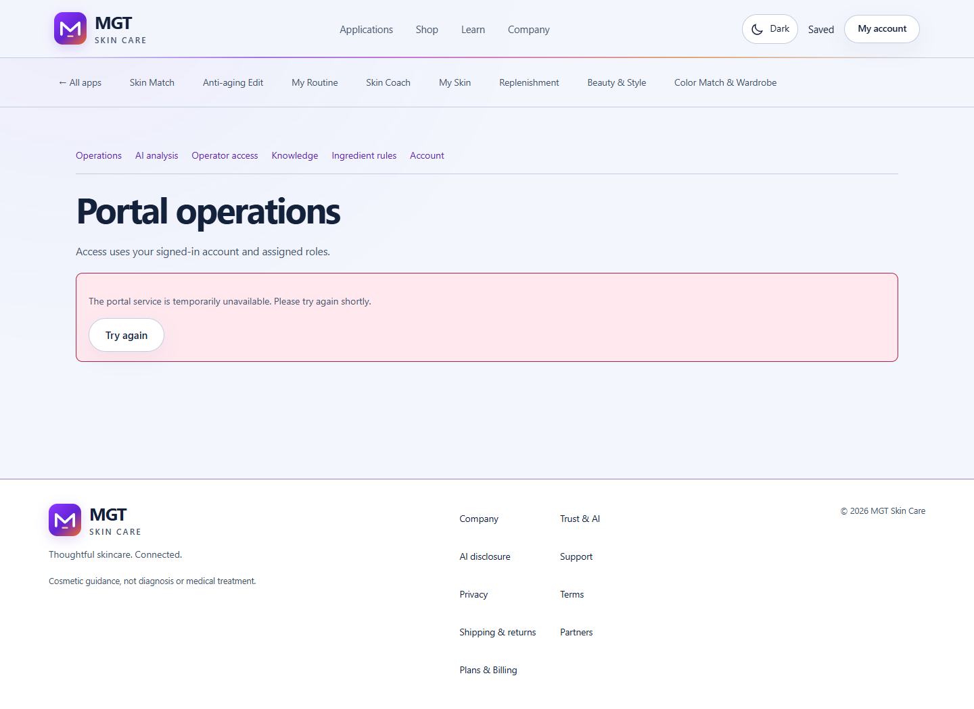
CONNECTED PORTAL
Retail, account, images and operator evidence
Retail stays external-commerce-only; personal data remains actor-scoped and consent-led.
Retail Edit
Account + images
Operator console
Allowlisted merchants, region/category filters, disclosure, saved retailers and outbound-link audit. MGT does not process product orders.
Communication/accessibility/storage defaults; explicit upload consent; derivative images; metadata stripping; export and deletion.
RBAC for catalog, knowledge, AI quality/budget, readiness, support and audit—with approval separation.
MGT SKIN CARE · PRODUCT & PRODUCTION BLUEPRINT · 25 OCT 2026
06

Slide 7
ENGINE DYNAMICS
Deterministic first; AI second; evidence always
Generative text cannot override policy, scoring, catalog state or entitlement.
1
CONTEXT
2
NORMALIZE
3
RETRIEVE
4
DECIDE
5
SYNTHESIZE
6
VERIFY
profile · consent
→
schema · version
→
approved sources
→
filter · rank
→
structured text
→
safety · audit
Integrity record
Profile version · policy/model route · prompt/template version · source IDs · confidence/uncertainty · safety flags · token/cost/latency · explicit feedback linkage.
MGT SKIN CARE · PRODUCT & PRODUCTION BLUEPRINT · 25 OCT 2026
07

Slide 8
DATAPOINT CATALOG · 1
Account, skin and care-profile inputs
Only data needed for the requested service should enter a model context.
Domain
Supported inputs
Validation / limits
Use
Account
preferred name; locale; timezone; measurement system
typed enums; change audit
language, units, reminders
Preferences
service interests; communications; accessibility; default storage
explicit and revocable
navigation, delivery and display
Skin profile
skin type; 1–3 concerns; sensitivity; age band
required structured values
matching and cautions
Routine
current routine; desired outcome; budget range
bounded choices
complexity, slots and price fit
Safety
ingredient avoidances; discomfort; optional notes
canonical IDs; length limits
hard excludes and escalation
Anti-aging
1–3 goals; sensitivity; consent; ≤6 products; ≤20 avoids
read-only boundary
preview, sources and progress
Images
purpose/category; metadata; upload consent
prepared derivative; metadata stripped; quotas
journal/reference unless separately approved
MGT SKIN CARE · PRODUCT & PRODUCTION BLUEPRINT · 25 OCT 2026
08

Slide 9
DATAPOINT CATALOG · 2
Style, retail, billing and operations
Store user facts separately from derived signals so outputs can be recomputed, explained and deleted.
Domain
Supported inputs
Validation / limits
Use
Color/style
palette, contrast, face shape, depth/undertone, hair, eyes
user-confirmed
palette and presentation ideas
Expression
occasion, texture, effort, hair, makeup, clothing
structured + short notes
bounded style brief
Access needs
coverage, headwear, climate, fastening, comfort, sensory
preference-led; revocable
filter impractical outputs
Wardrobe
item ID/name/category/color/notes; image reference
≤50 actor-scoped items
three-item combinations and gaps
Retail
region, category, merchant, saved retailer, outbound click
allowlist; no in-MGT order
discovery and disclosure audit
Billing
plan/cycle, Stripe IDs, status, period end
webhook authoritative; idempotent
entitlement and self-service
Operations
catalog approval/source/reviewer; route; latency/cost; feedback
role-separated audit
release gates and QA
MGT SKIN CARE · PRODUCT & PRODUCTION BLUEPRINT · 25 OCT 2026
09

Slide 10
OUTPUT CONTRACT
Maximize utility without sacrificing integrity
The best output is traceable, current, personalized and safely actionable—not merely long.
Profile vector
Match result
Routine / look
Versioned normalized features, missingness, user-vs-derived lineage.
Rank, score components, exclusions, alternatives, budget and availability.
Ordered steps or three ideas; timing, comfort and effort constraints.
Explanation
Safety packet
Evidence record
Rationale, source IDs, confidence, uncertainty and next question.
Cautions, out-of-scope detection and human escalation.
Model/prompt/catalog versions, cost, latency, checks and feedback.
Ask for missing high-impact fields → retrieve approved records → generate JSON-schema output → validate → show provenance/uncertainty → learn from explicit feedback.
MGT SKIN CARE · PRODUCT & PRODUCTION BLUEPRINT · 25 OCT 2026
10

Slide 11
BACKEND INFRASTRUCTURE
Current stack and production destination
Small logical services, isolated identities and fail-closed external dependencies.
Experience
Next.js 15 portal · Expo/Android contract · accessible design system
Edge & identity
Caddy / managed HTTPS · Supabase Auth + Google OAuth · CSRF · rate limits · RBAC
Application
Express + TypeScript API · domain/shared packages · worker · typed validators
Data
SQLite local/demo → PostgreSQL/Supabase or Cloud SQL prod · migrations · audit
Intelligence
AI gateway · deterministic match/style engines · retrieval · routing · eval telemetry
Commerce/integrations
Stripe Checkout/Portal/Webhooks · Drive test/evidence · retailer allowlist
Delivery/operations
Docker/Compose · GitHub Actions · immutable images · monitoring · backup/restore
MGT SKIN CARE · PRODUCT & PRODUCTION BLUEPRINT · 25 OCT 2026
11

Slide 12
CONFIGURED INTELLIGENCE
Current local-first registry; live qualification pending
The repository defines routes and fallbacks, but available credentials/model tags and representative evals are still required.
Role
Configured model
Workload
Strength
Status
Local volume
llama3.2:3b
classification, rewrite, FAQ
private; low marginal cost
model tag required
Local reasoning
deepseek-r1:8b
reasoning fallback
local control
model tag required
Local vision
llava:latest
consented image description
no hosted transfer
not skin diagnosis
Embeddings
nomic-embed-text
retrieval/vector search
local and inexpensive
index evidence required
Hosted synthesis
gpt-5.6-sol
premium consultation
structured synthesis
credential/live eval pending
Qualification
GPT-6 Luna / 6.1 Sol / Astra
volume / balanced / exceptional
capability-cost ladder
registered; no switch approved
MGT SKIN CARE · PRODUCT & PRODUCTION BLUEPRINT · 25 OCT 2026
12
Notes:
Current routes come from the repository configuration.
Official GPT-6 roles and list prices: https://developers.openai.com/api/docs/models and https://developers.openai.com/api/docs/pricing
No live qualification claim is made.

Slide 13
RECOMMENDED AI ALTERNATIVE
Use a measured router—not one universal model
Start hosted for operational simplicity; retain deterministic engines and add local inference only when scale/privacy economics justify it.
Route
Suggested model
Examples
Effort
Economics / guardrail
Fast path
GPT-6 Luna
classification, normalization, short variants
none / low
$0.10 in / $0.50 out per MTok; schema + audit
Core synthesis
GPT-6.1 Sol
profile, routine/style explanation, support
low / medium
$2 in / $10 out; default candidate after eval
Escalation
GPT-6 Astra
complex conflicts and operator investigation
medium / high
$10 in / $50 out; budget cap + review
Retrieval
local embedding + approved records
catalog and knowledge grounding
n/a
versioned index; no open-web medical synthesis
Vision
separate consented route
quality/non-diagnostic description
task-specific
redaction; short retention; no trait inference
Promote only when representative evals pass: task success · safety · p50/p95 latency · cost per successful task · refusal quality · schema validity.
MGT SKIN CARE · PRODUCT & PRODUCTION BLUEPRINT · 25 OCT 2026
13
Notes:
Model selection: https://developers.openai.com/api/docs/models
Pricing accessed 25 Oct 2026: https://developers.openai.com/api/docs/pricing
Deployment guidance: https://developers.openai.com/api/docs/guides/deployment-checklist

Slide 14
PAYMENTS & ENTITLEMENT
Stripe bills; MGT projects access
Never grant access from the redirect. Provision only after verified, idempotently processed server-side events.
1
2
3
4
5
Choose
→
Checkout
→
Webhook
→
Entitle
→
Portal
plan + cycle
hosted session + terms
signature + event ID
subscription → access
payment, invoice, cancel
Configured
3-tier change
Manual proof
Checkout Session, monthly/annual mapping, trial support, signed webhooks, billing activity, entitlement endpoint, retry and Customer Portal.
Add Guided and Studio monthly/annual price families, update entitlement matrix and define migration/downgrade behavior. Free is non-billable.
Live IDs in Secret Manager; webhook replay; test trial, payment failure, cancel, refund/dispute and plan change; retain evidence.
MGT SKIN CARE · PRODUCT & PRODUCTION BLUEPRINT · 25 OCT 2026
14
Notes:
Checkout: https://docs.stripe.com/payments/checkout/build-subscriptions
Subscriptions/webhooks: https://docs.stripe.com/billing/subscriptions/webhooks
Customer Portal: https://docs.stripe.com/customer-management

Slide 15
GOOGLE BACKUP & CLOUD RUN
Recovery first; Drive visibility second
A complete backup is a recoverable data/object system plus a readable evidence archive—not a single Drive folder.
Cloud runtime
Recovery plane
Drive evidence archive
1
Artifact Registry: immutable images
1
Choose Supabase or Cloud SQL primary
1
Launch packets and approvals
2
Cloud Run: web + API
2
PITR + automated snapshots
2
Redacted inventory + checksums
3
Job/worker: scheduled tasks
3
Versioned GCS object/export bucket
3
Restore reports; no raw prod DB
4
Secret Manager + service IDs
4
KMS + retention/immutability
4
PDF/PPTX and runbooks
5
Logging, Monitoring and alerts
5
Quarterly isolated restore drill
5
Gregg-owned access review
MGT SKIN CARE · PRODUCT & PRODUCTION BLUEPRINT · 25 OCT 2026
15
Notes:
Cloud Run: https://cloud.google.com/run/docs
Cloud SQL PostgreSQL PITR: https://cloud.google.com/sql/docs/postgres/backup-recovery/restore
Drive is a secondary human-readable archive, not the sole recovery mechanism.

Slide 16
MARKET ANCHORS
Price MGT as digital guidance—not prescription care or shipped product
Adjacent public offers are directional anchors, not direct like-for-like software comparables.
Offering
Public price
Cadence
Included value
MGT implication
Curology Custom Formula Rx
$29.95 / month
subscription
Rx formula + provider personalization
stay below Rx care unless clinical services added
Musely Anti-Aging Cream Rx
$35 / month
2-month supply
Rx product + doctor support
ceiling for non-clinical guidance
PROVEN Skincare System
$142.77 / shipment
45–60 days
personalized physical system
high value includes products
MGT proposed
$0 / $14.99 / $29.99
monthly + annual
software guidance, tracking, style, discovery
test willingness-to-pay and retention
Pricing requires owner approval, customer interviews and controlled conversion/retention testing.
MGT SKIN CARE · PRODUCT & PRODUCTION BLUEPRINT · 25 OCT 2026
16
Notes:
Curology accessed 25 Oct 2026: https://curology.com/products/custom-formula-acne/
Musely accessed 25 Oct 2026: https://www.musely.com/skinregeneration
PROVEN accessed 25 Oct 2026: https://support.provenskincare.com/en-US/what-is-the-difference-between-a-one-time-order-and-subscription-339597

Slide 17
SUGGESTED 3-TIER MODEL
Trust at Free; continuity at Guided; breadth and depth at Studio
Commercial alternative to the repository’s locked two-tier release contract—requires owner sign-off and code/config changes.
FREE
GUIDED
STUDIO
$0
$14.99/mo
$29.99/mo
Try
$149.99/yr
$299.99/yr
Skin profile; sample match; basic color; limited saves; retail discovery; privacy/export.
Full routine, anti-aging education, progress, wardrobe, images, history, standard AI and reminders.
Higher AI allowance, cross-domain synthesis, advanced exports, priority support, early features and guest access.
~2 months free annually
~2 months free annually
Test price × annual anchor × AI allowance × trial. Guardrails: support load, AI cost/member, refunds and safety incidents.
MGT SKIN CARE · PRODUCT & PRODUCTION BLUEPRINT · 25 OCT 2026
17

Slide 18
PRODUCTION COMPLETION TEMPLATE
Eight workstreams, each closed by reproducible evidence
No workstream is complete merely because a setting exists or a test passed once.
1. Product
scope, copy, catalog, retailers, benefits
2. Identity/privacy
prod tenant, OAuth, roles, consent, retention
Evidence: acceptance + screens
Evidence: access + privacy test
3. Data/backup
DB, migrations, RLS, PITR, GCS, Drive evidence
4. AI/quality
routes, prompts, evals, budget, red-team
Evidence: restore + checksum
Evidence: eval report + approval
5. Payments
products/prices, Checkout, Portal, webhooks, tax
6. Reliability
Cloud Run, scaling, SLOs, monitoring, on-call
Evidence: Stripe lifecycle proof
Evidence: load + alert drill
7. Access/support
WCAG, keyboard, screen reader, support mailbox
8. Release
CI/CD, digest, rollback, change log
Evidence: audit + ticket drill
Evidence: staging sign-off
MGT SKIN CARE · PRODUCT & PRODUCTION BLUEPRINT · 25 OCT 2026
18

Slide 19
MANUAL OWNER INPUTS
Gregg Clark is owner, approver and launch operator
Legal/business facts, secrets and external-console settings cannot be inferred from the repository.
System
Manual input
Evidence
Go / no-go
Business/legal
entity, address, support, terms/privacy, AI/medical disclosure
approved docs + dates
links live
Google Cloud
project, billing, region, domain, IAM, quotas
inventory + access review
least privilege + alerts
Data/storage
provider, retention, RPO/RTO, restore approver
backup + restore result
objective met
Stripe
verification, bank/tax, products/prices, portal, webhook
test + live receipts
paid state matches access
AI/models
API project/key, spend, allowed data, availability
golden eval + cost report
targets pass
Google Drive
folder, owner/group access, retention, folder IDs
upload + readback
no DB dump/secrets
Launch
price, benefits, trial, support, date, rollback authority
signed packet
Gregg approval recorded
MGT SKIN CARE · PRODUCT & PRODUCTION BLUEPRINT · 25 OCT 2026
19

Slide 20
LAUNCH SEQUENCE
Realistic six-week evidence path after decisions and accounts are available
Schedule is a planning proxy, not a promise; external verification remains on the critical path.
W1
W2
W3
W4
W5
W6
DECIDE
CONFIGURE
INTEGRATE
QUALIFY
REHEARSE
RELEASE
pricing, provider, data boundary, RPO/RTO, legal
identity, database, secrets, Stripe, Google projects
migrations, webhooks, Cloud Run, GCS/Drive
AI, accessibility, security, load and failure
restore, rollback, incident, support and billing
acceptance, signed packet, canary, observe
Compute allocation
Stop conditions
Product/legal 20% · cloud/data 25% · payments/identity 15% · AI qualification 20% · QA/accessibility/security 15% · operations 5%.
No restore evidence; unverified webhook; critical access/security defect; missing legal links; unapproved live catalog; AI regression; unsupported rollback.
MGT SKIN CARE · PRODUCT & PRODUCTION BLUEPRINT · 25 OCT 2026
20

Slide 21
LAUNCH AUTHORITY · GREGG CLARK
Move from build to controlled production qualification
Four explicit approvals start the final path
01
Commercial model
02
Data path
Keep two tiers or implement Free / Guided / Studio.
Supabase + Cloud Run, or Cloud SQL + Cloud Run—not both primary.
03
AI budget
04
Launch window
Authorize Luna, Sol and Astra evaluation and data boundary.
Name date, support, reviewers and rollback authority.
MGT SKIN CARE · PRODUCT & PRODUCTION BLUEPRINT · 25 OCT 2026
21
Notes:
Final approval remains with Gregg Clark.
This deck does not itself authorize production launch.

