Slide 1
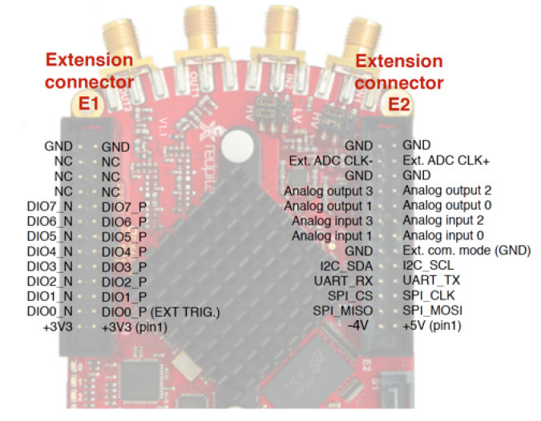
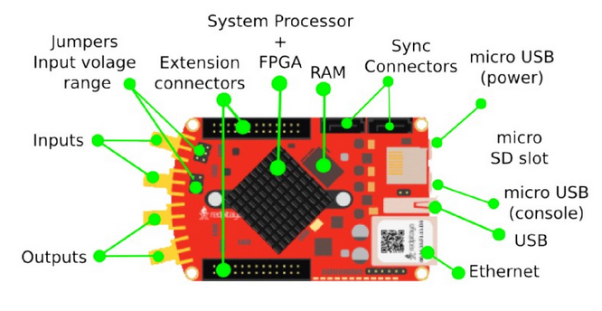
Figure 1 – Red Pitaya Components

Slide 2
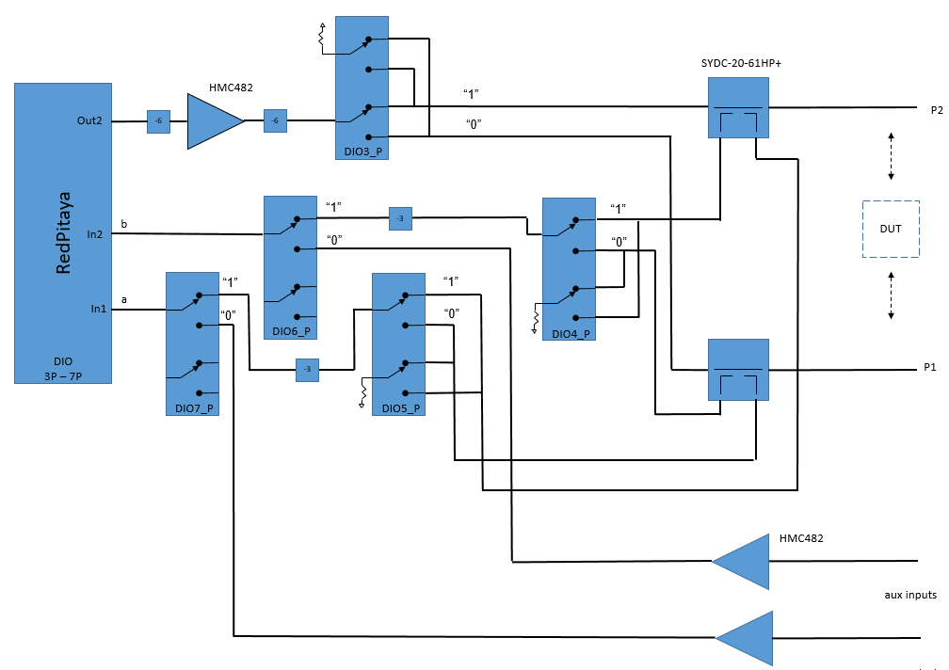
Figure 2 – VNA / Aux ADC Input PWB Block Diagram

Slide 3
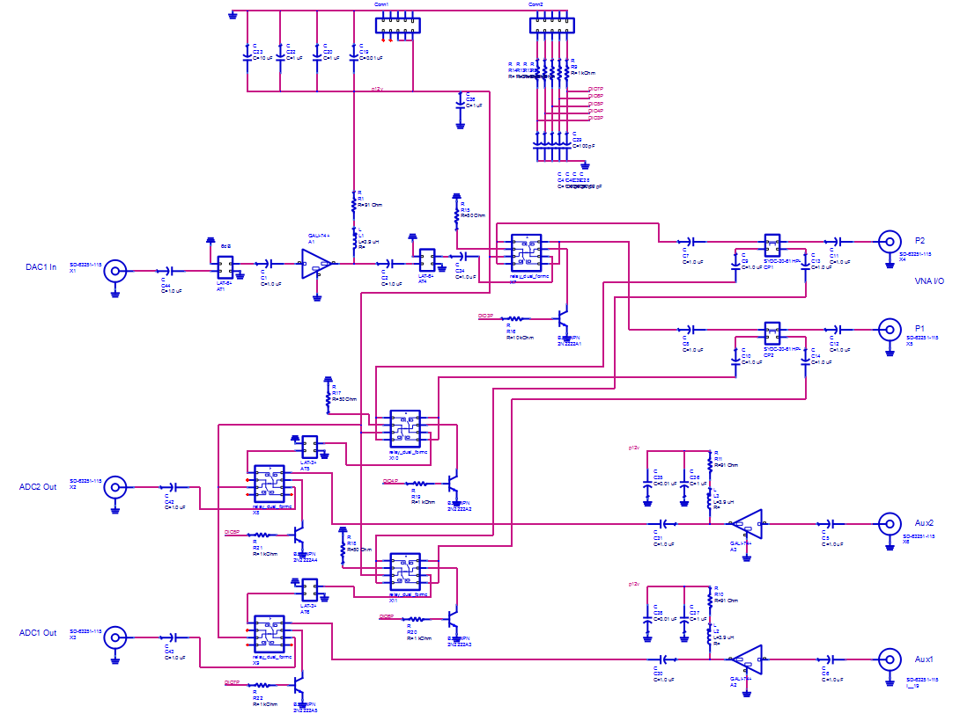
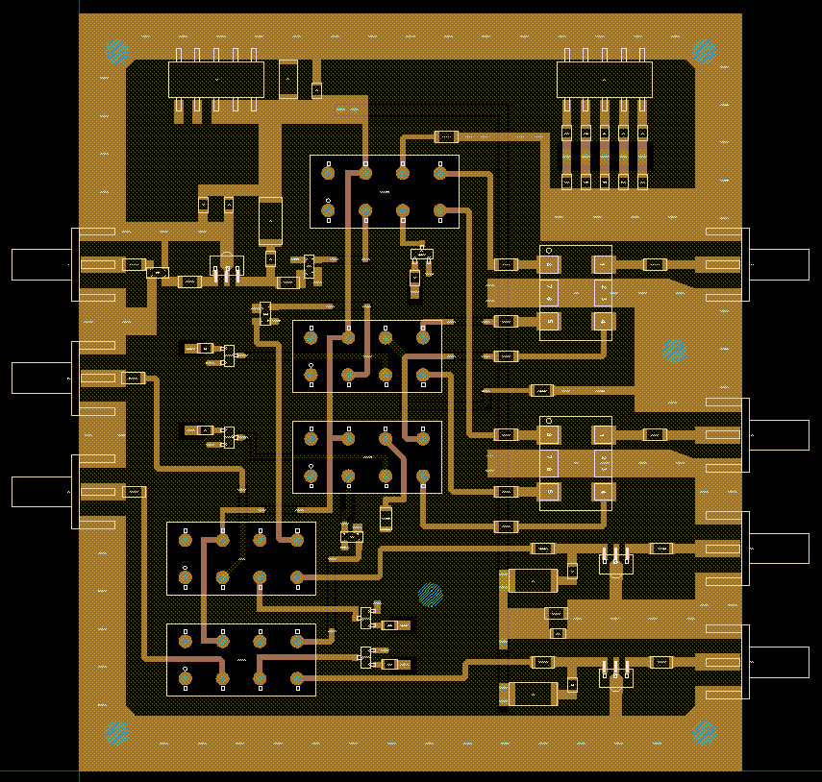
Figure 3 PWB Schematic / Layout

Slide 4
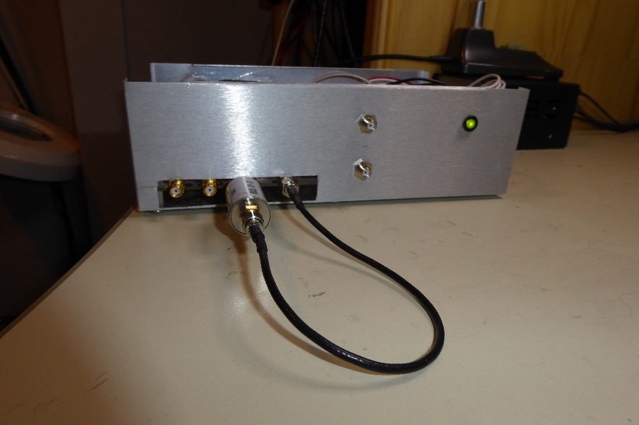
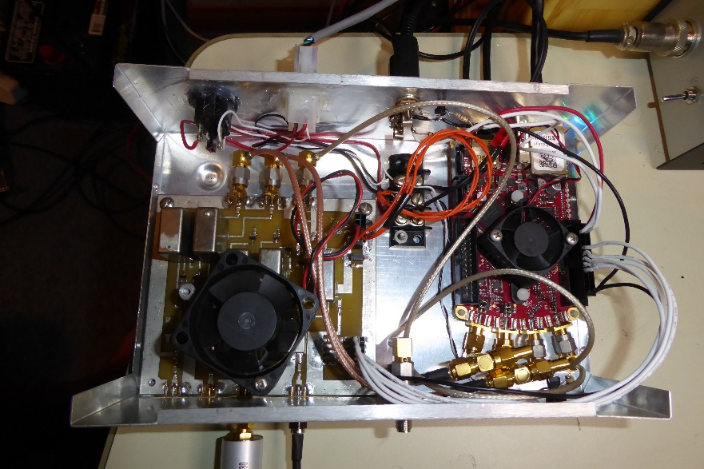
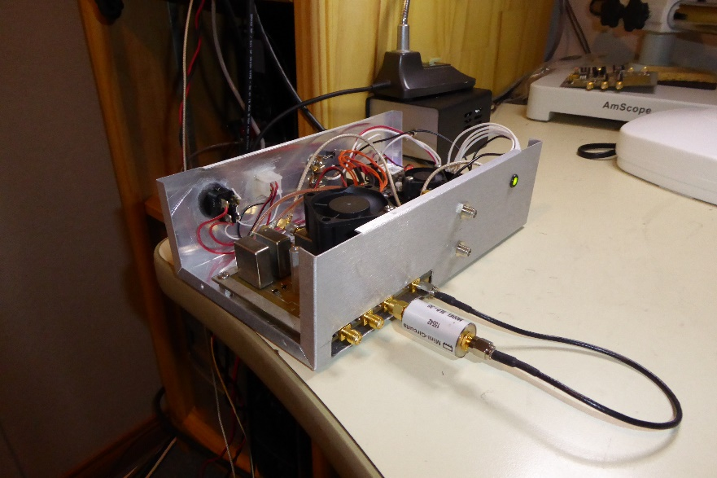
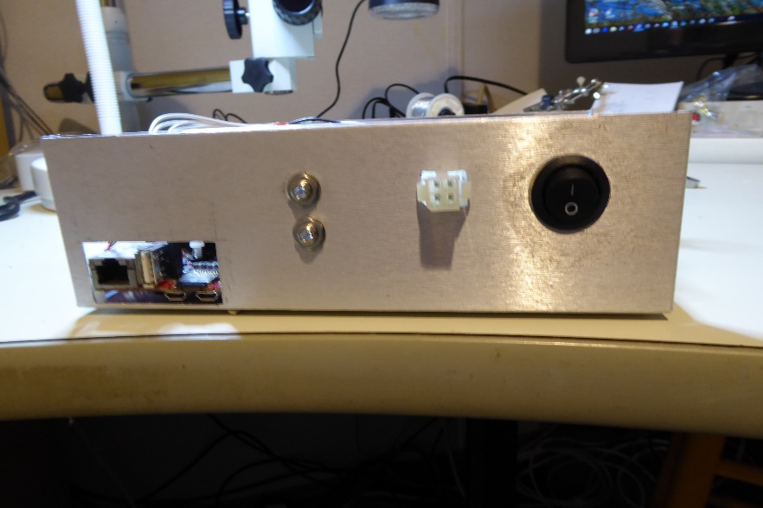
DAC1 Out
A1
A2
P1
P2
PTT In
RP I/O
+12V / +5V
PTT Out
Figure 4
Red Pitaya / PWB Enclosure

Slide 5
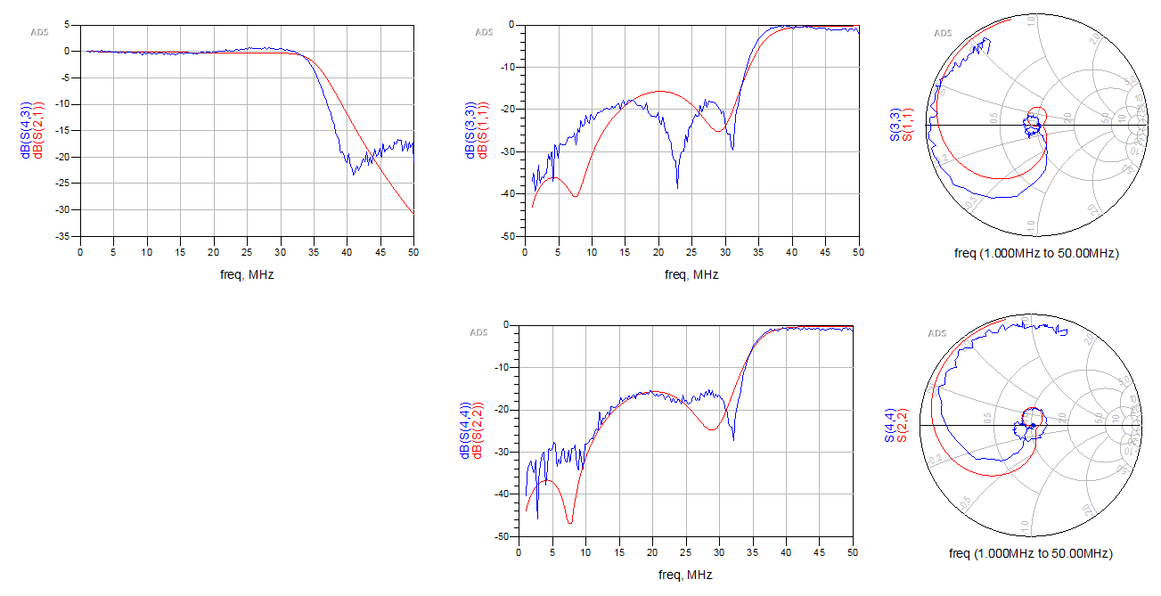
Figure 5
2-port VNA Example (MiniCircuits SLP-30 LPF)
Red = MiniCircuits s-parameters
Blue = RP VNA measured s-parameters

Slide 6
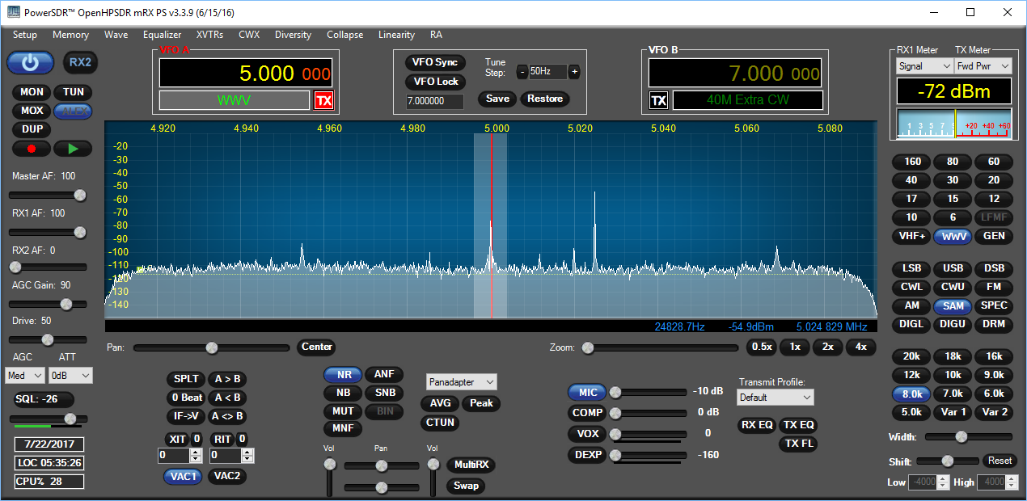
Figure 6
PowerSDR Application

Slide 7
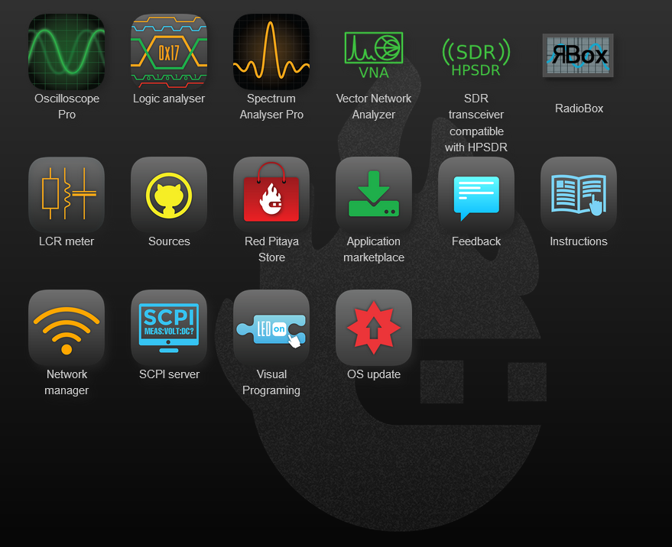
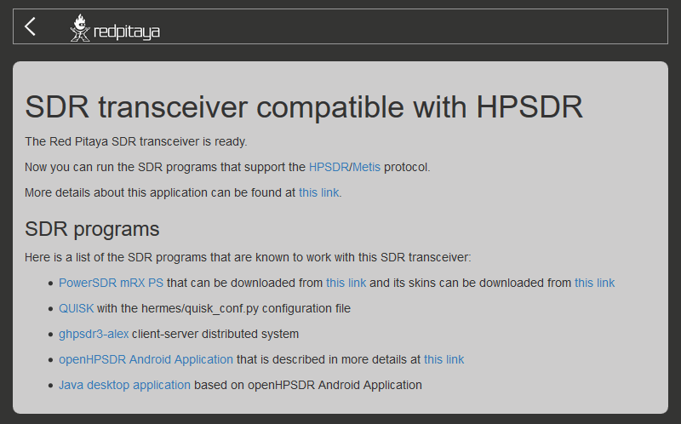
Figure 7
Red Pitaya Web Interface

