Slide 1
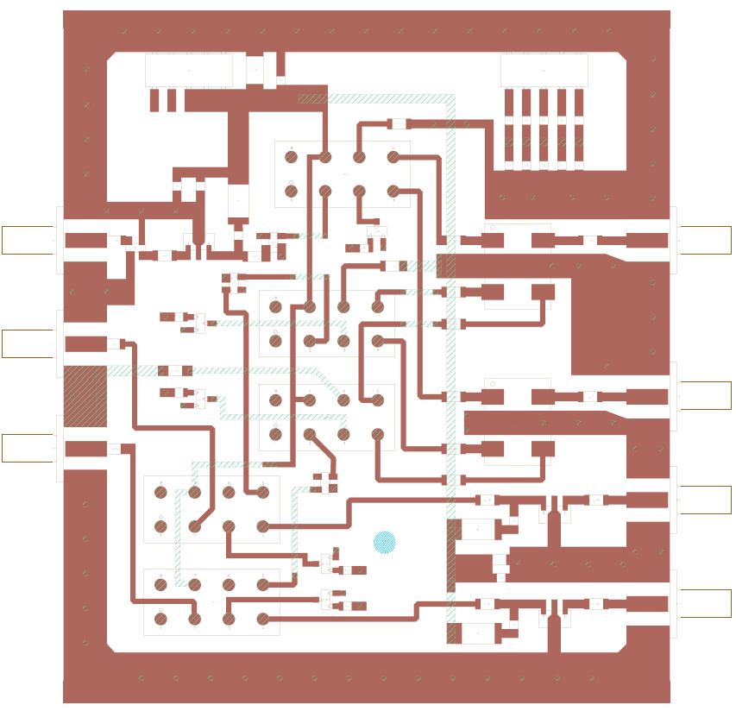
P1
C27
C18
P2
R9
R12-R16
RL1
C22-C26
C19
C20
R1
P3
C1
L1
AT2
R4
U4
HY1
C4
P6
C8
C16
AT1
U1
R10
AT3
RL2
C11
R5
U5
C12
P4
C2
R11
U6
C13
HY2
C5
P7
R6
RL3
P5
C3
C14
AT4
C15
C9
U2
C6
P8
RL4
L2
R2
U7
R7
C17
RL5
C21
U8
R8
C10
U3
C7
P9
R3
L3

Slide 2
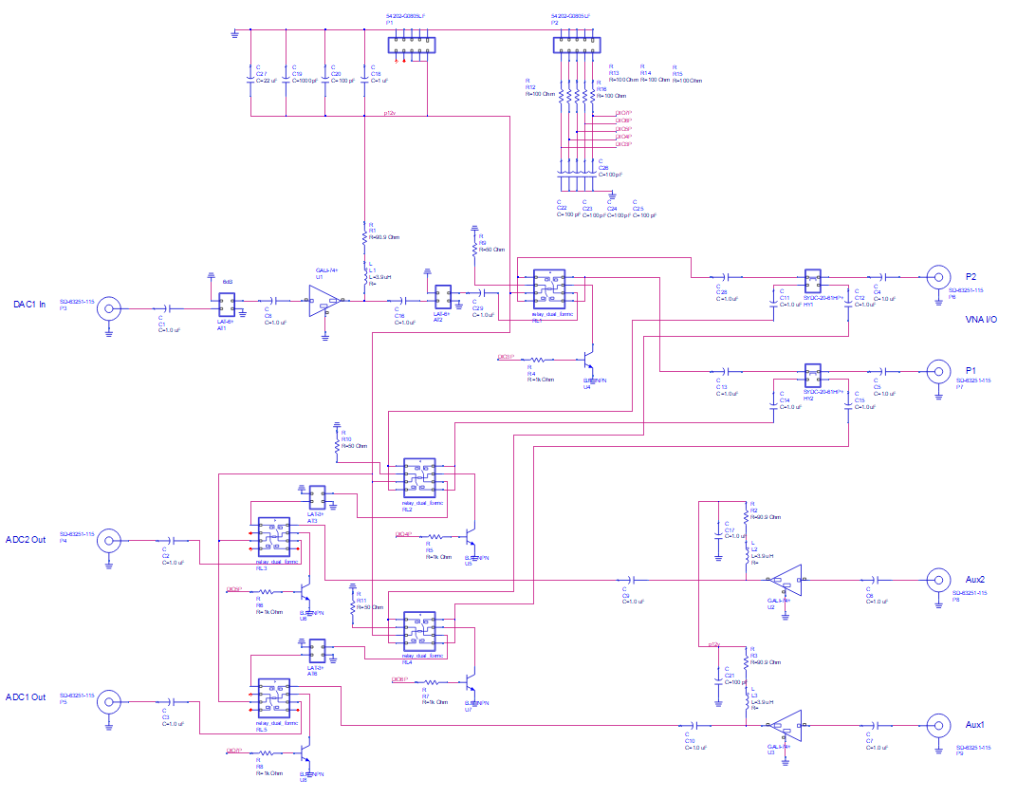

Slide 3
Ref Des | Part No | Vendor | Description
AT1, AT2 | LAT-6+ | MiniCircuits | 6dB Attenuator
AT3, AT4 | LAT-3+ | MiniCircuits | 3dB Attenuator
C1 – C18, C28, C29 | 399-1254-1-ND | DigiKey | 1uF (1206)
C19 | 399-1147-1-ND | DigiKey | 1000pF (0805)
C20 – C26 | 399-1122-1-ND | DigiKey | 100pF (0805)
C27 | 399-5119-1-ND | DigiKey | 22uF (Tant, 2312)
HY1 – HY2 | SYDC-20-61HP+ | MiniCircuits | Dual Dir Coup 1 – 60 MHz
P1 – P2 | 609-4723-ND | DigiKey | Header Dual 0.1” 10pos
P3 – P9 |  | Ebay | SMA Female Edge Mount 0.062”
R1 – R3 | 541-90.9AFCT-ND | DigiKey | 90.9Ω (1W, 2512)
R4 – R8 | 311-1.0KARCT-ND | DigiKey | 1KΩ (0805)
R9 – R11 | 311-49.9FRCT-ND | DigiKey | 50Ω (1206)
R12 – R16 | 311-100FRCT-ND | DigiKey | 100Ω (1206)
RL1 – RL5 | HFW1201601M |  | Signal Relay 12VDC
U1 – U3 | 1127-1421-1-ND | DigiKey | Amp (HMC482)
U4 – U8 | MMBT2222ALT1GOSCT-ND | DigiKey | NPN 2N2222 (SOT-23)

