Slide 1
Install Anaconda from http://www.anaconda.com/downolad
To enable detached plots within Spyder, perform: tools/preferences/IPython console/Graphics/Graphics Backend, Automatic.
Download and install Visual C++ 2015 Build Tools from http://landinghub.visualstudio.com/visual-cpp-build-tools.
Open an anaconda prompt shell
Execute conda install pandas
Execute conda install -c conda-forge geopandas
Execute pip install pyhamtools
Execute pip install paramiko
Figure 1 – Package Install Procedure

Slide 2
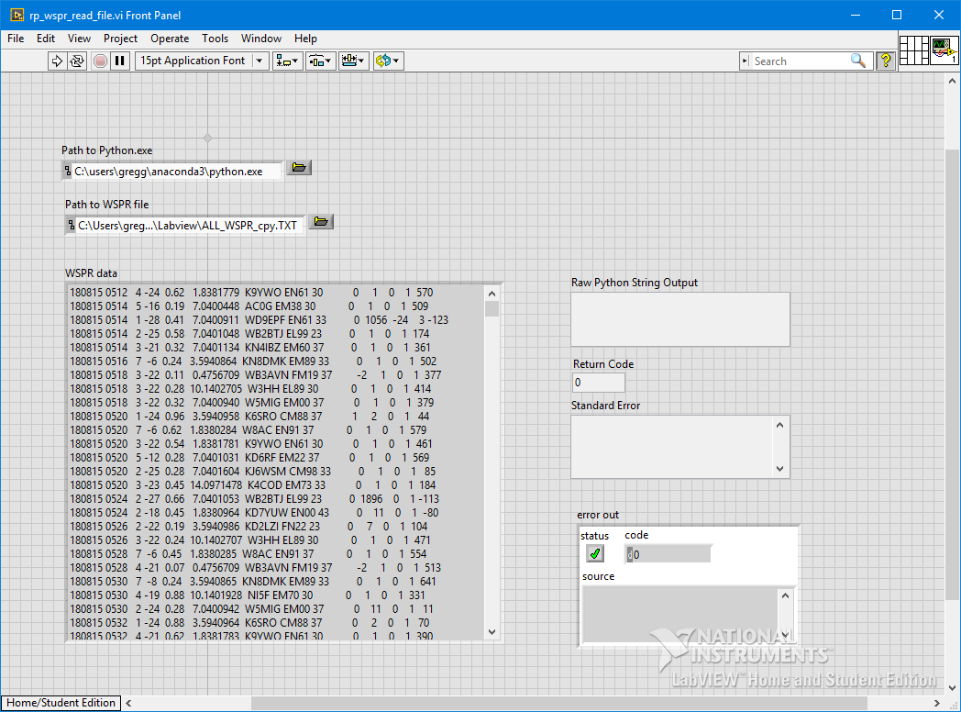
Figure 2 – Labview Front Panel (WSPR File Transfer / Read)

Slide 3
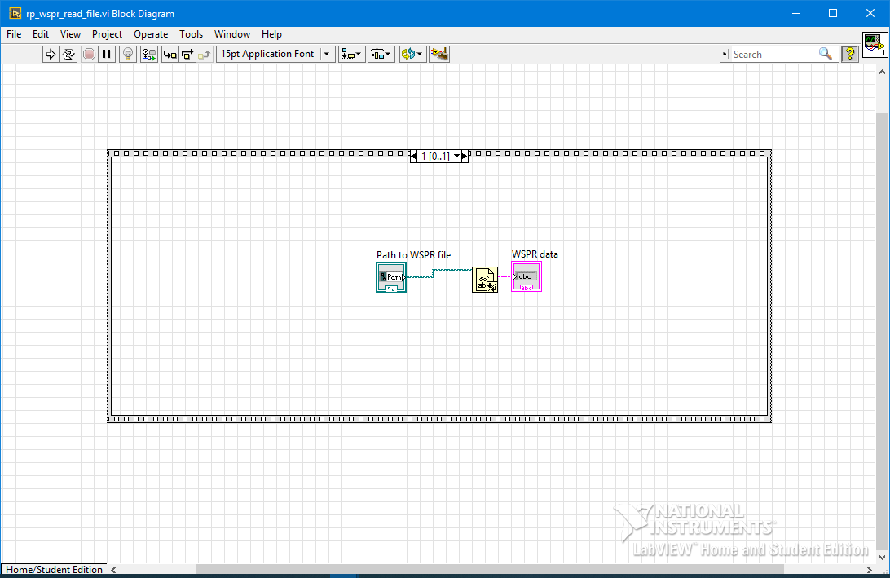
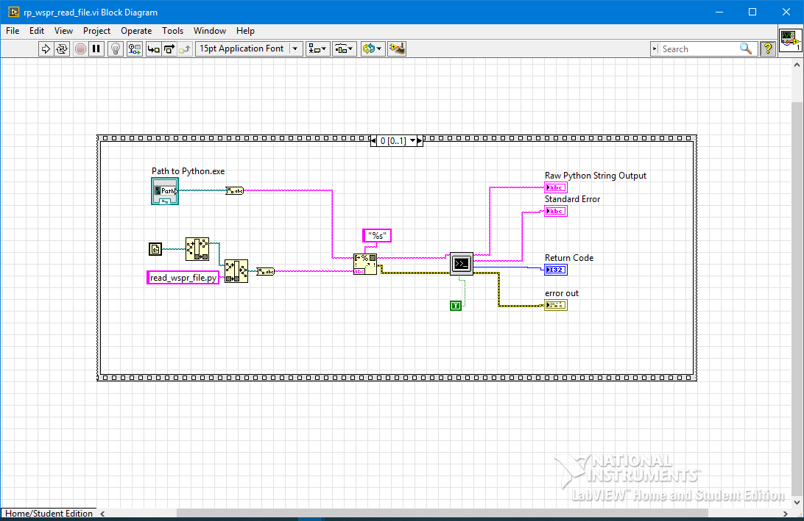
Figure 2 – Labview Block Diagram (WSPR File Transfer / Read)

Slide 4
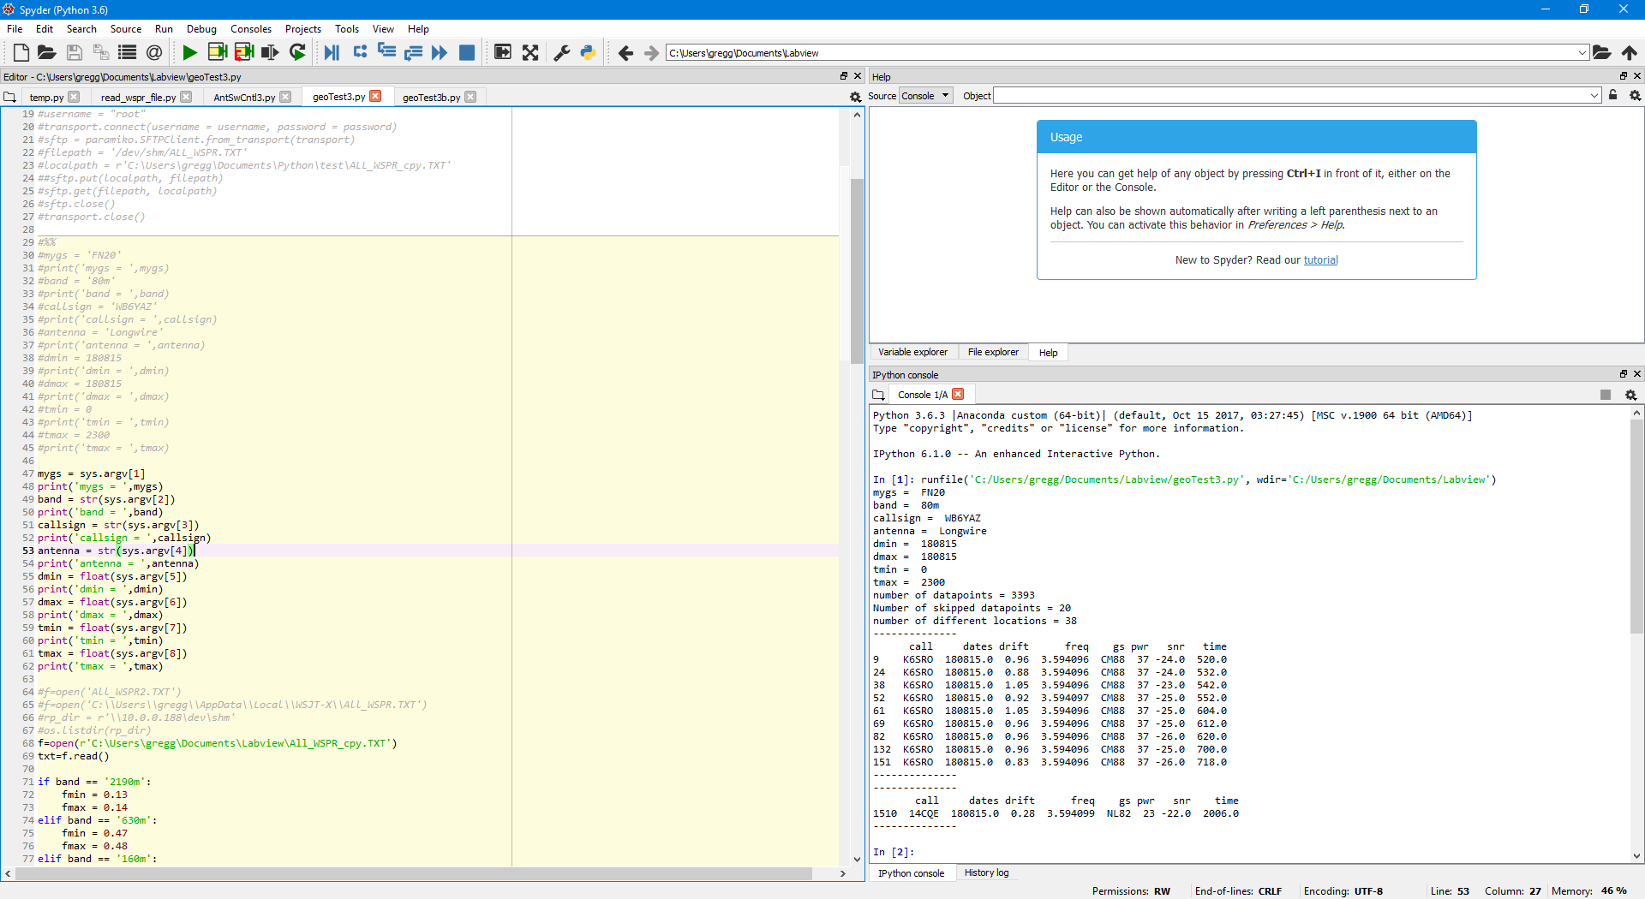
Figure 3 – Anaconda Spyder IDE

Slide 5
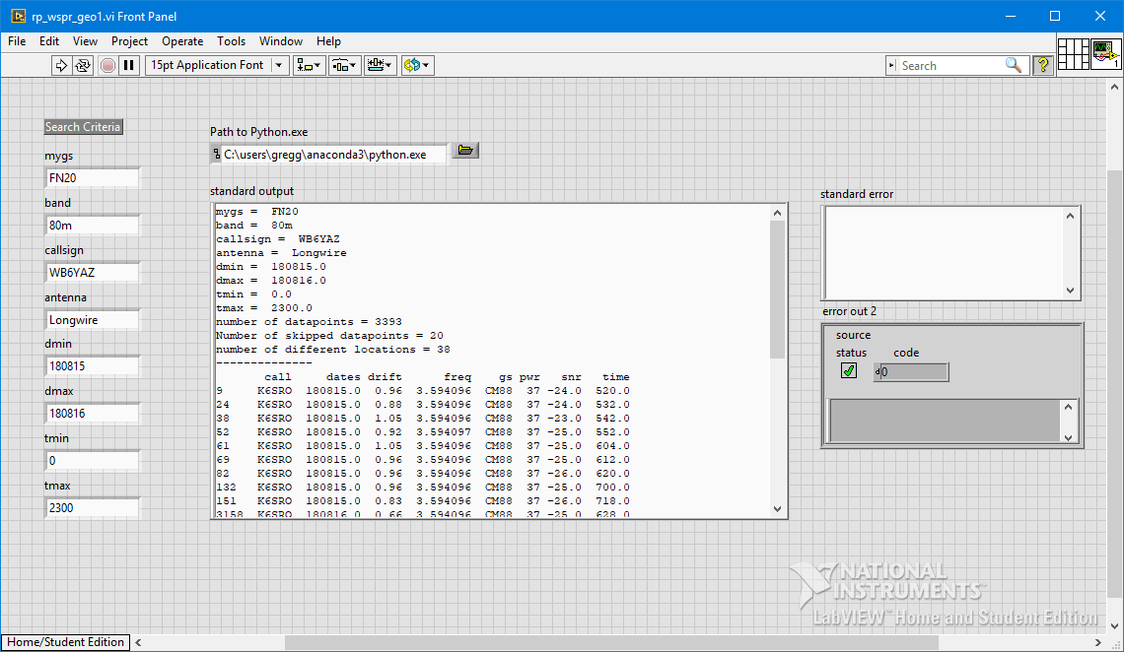
Figure 4 – Labview Front Panel (geoTest3.py)

Slide 6
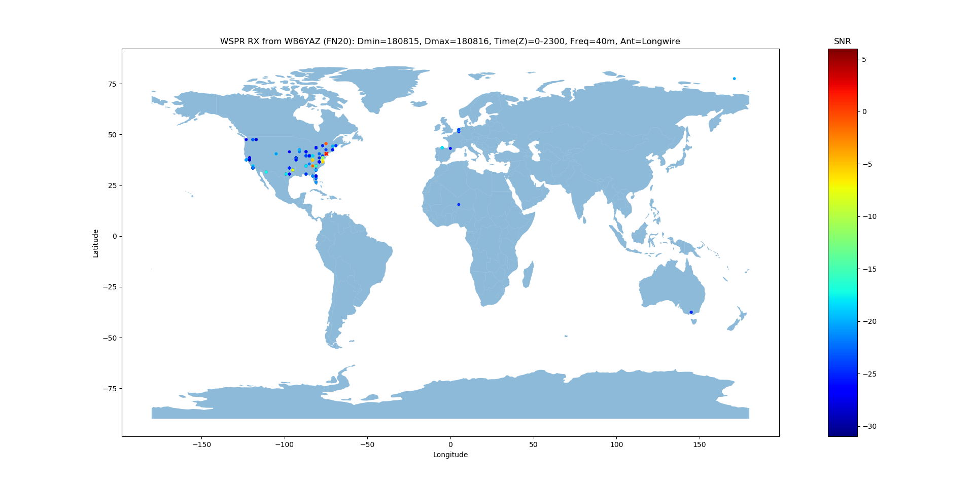
RX location
Figure 5 – WSPR World Plot (geoTest3.py)

Slide 7
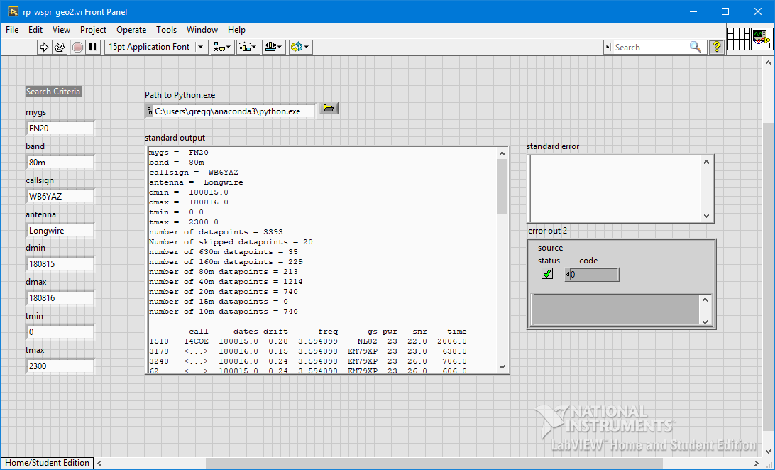
Figure 6 – Labview Front Panel (geoTest3b.py)

Slide 8
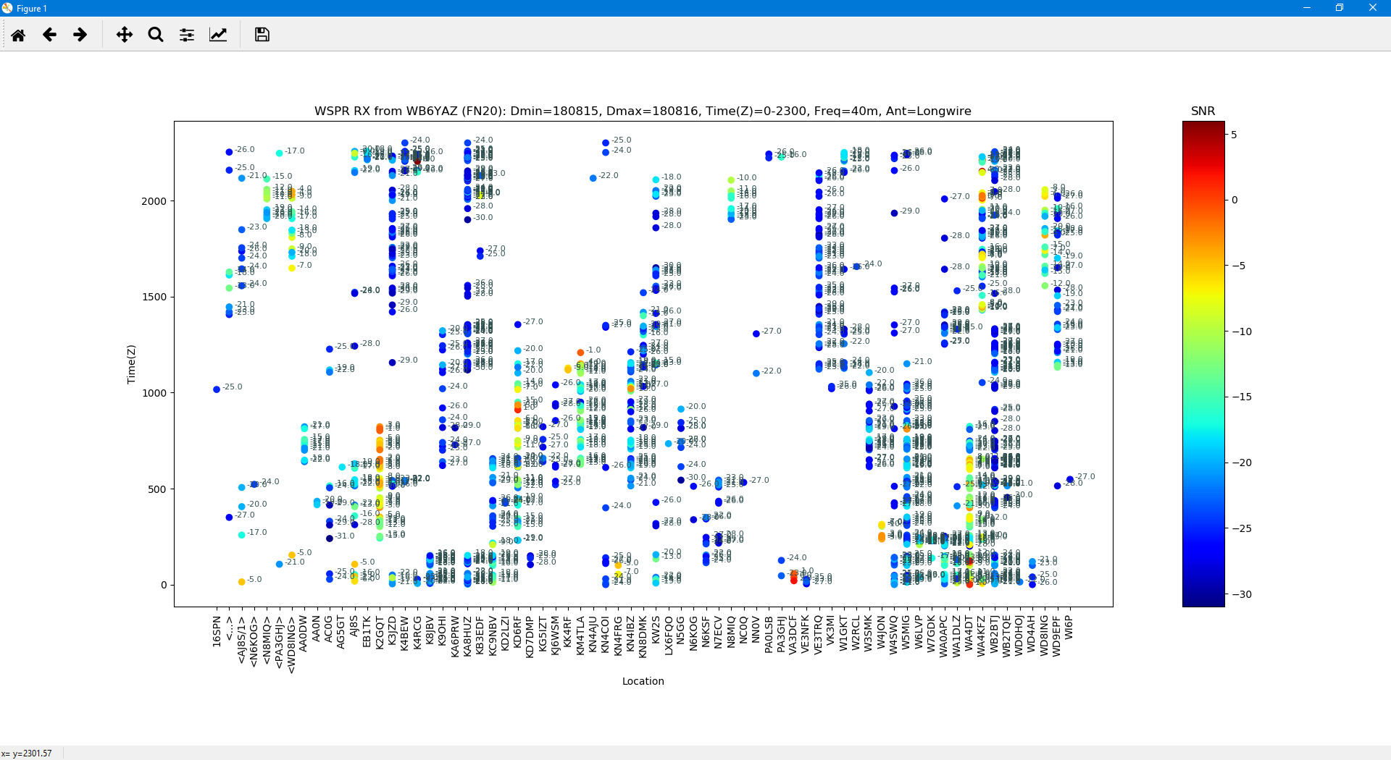
Figure 6 – WSPR Location vs Time (geoTest3b.py)

Slide 9
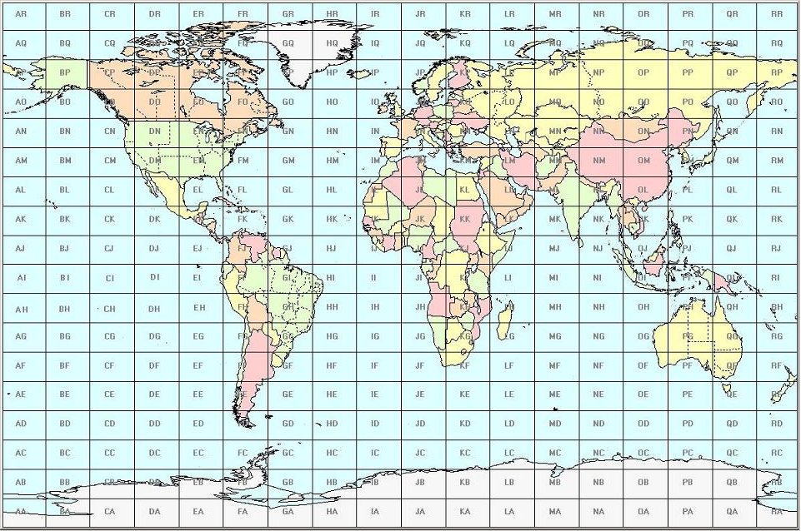
Figure 7 – Grid Square Map

