Slide 1
WSPR Analysis
For fans of WSPR, here are a few python routines for performing analyses of received spots.
wspr2Rx.py
wsprRx_by_band_and_call.py
wsprRx_by_freq_and_call.py
wsprRx_by_freq_and_grid.py
wsprRx_print_allspots_by_freq.py
wsprRx_snr_by_band_callsignplot.py
wsprRx_snr_by_band_geoplot.py
wsprRx_sort_by_us.py
wsprRx_sort_by_uszone(0-9).py
Examples of each routine are included below.
My analysis setup consists of a windows machine with Anaconda / Spyder.
My WSPR transceiver is a homebrew SDR rig based on a 14b Red Pitaya board and WSJT-X / piHPSDR running on a Raspberry Pi.
The file to be examined is copied from the Raspberry Pi to the windows machine. The ALL_WSPR.TXT file format consists of 17 fields (WSJT-X).
Additional packages must first be installed to enable the database and plotting functions.
pandas
geopandas
matplotlib
shapely
pyhamtools
G. Daugherty (WB6YAZ)
12/15/21

Slide 2
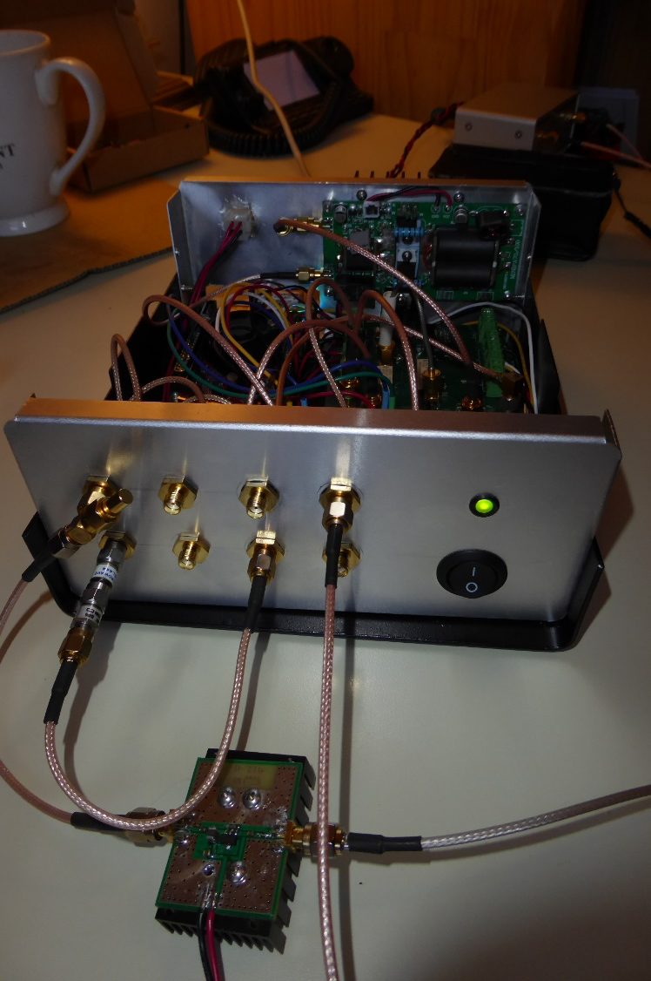
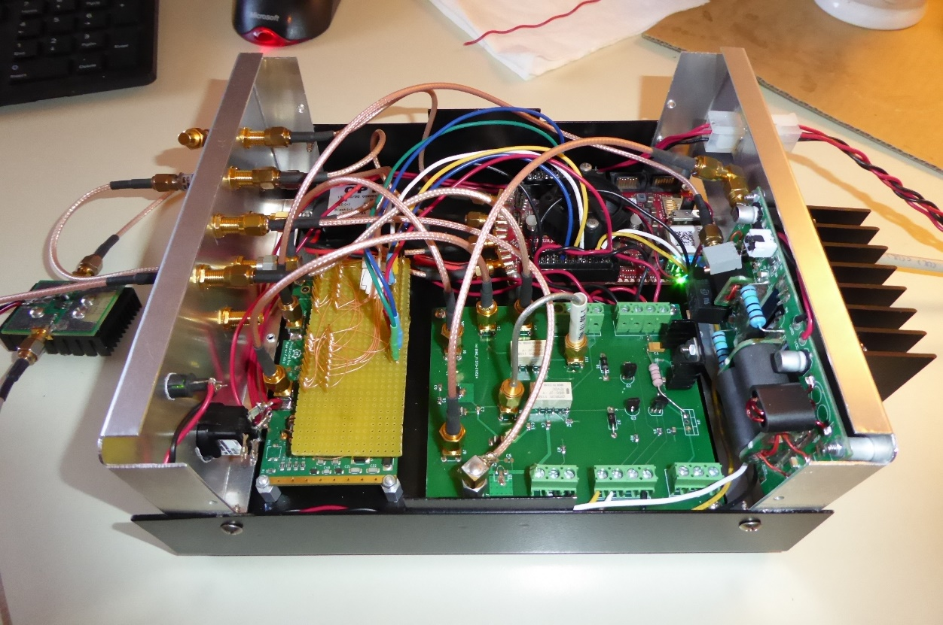
WSPR Analysis
Red Pitaya (14b)
IN1
IN2
LNA out
Ant
OUT1
OUT2
Ex In
Spare
N2ADR HL2 LP Filter
Alex SPI Interface
PA Driver
T/R Switch
HF PA
Red-Pitaya SDR QRP Transceiver
G. Daugherty (WB6YAZ)
12/15/21

Slide 3
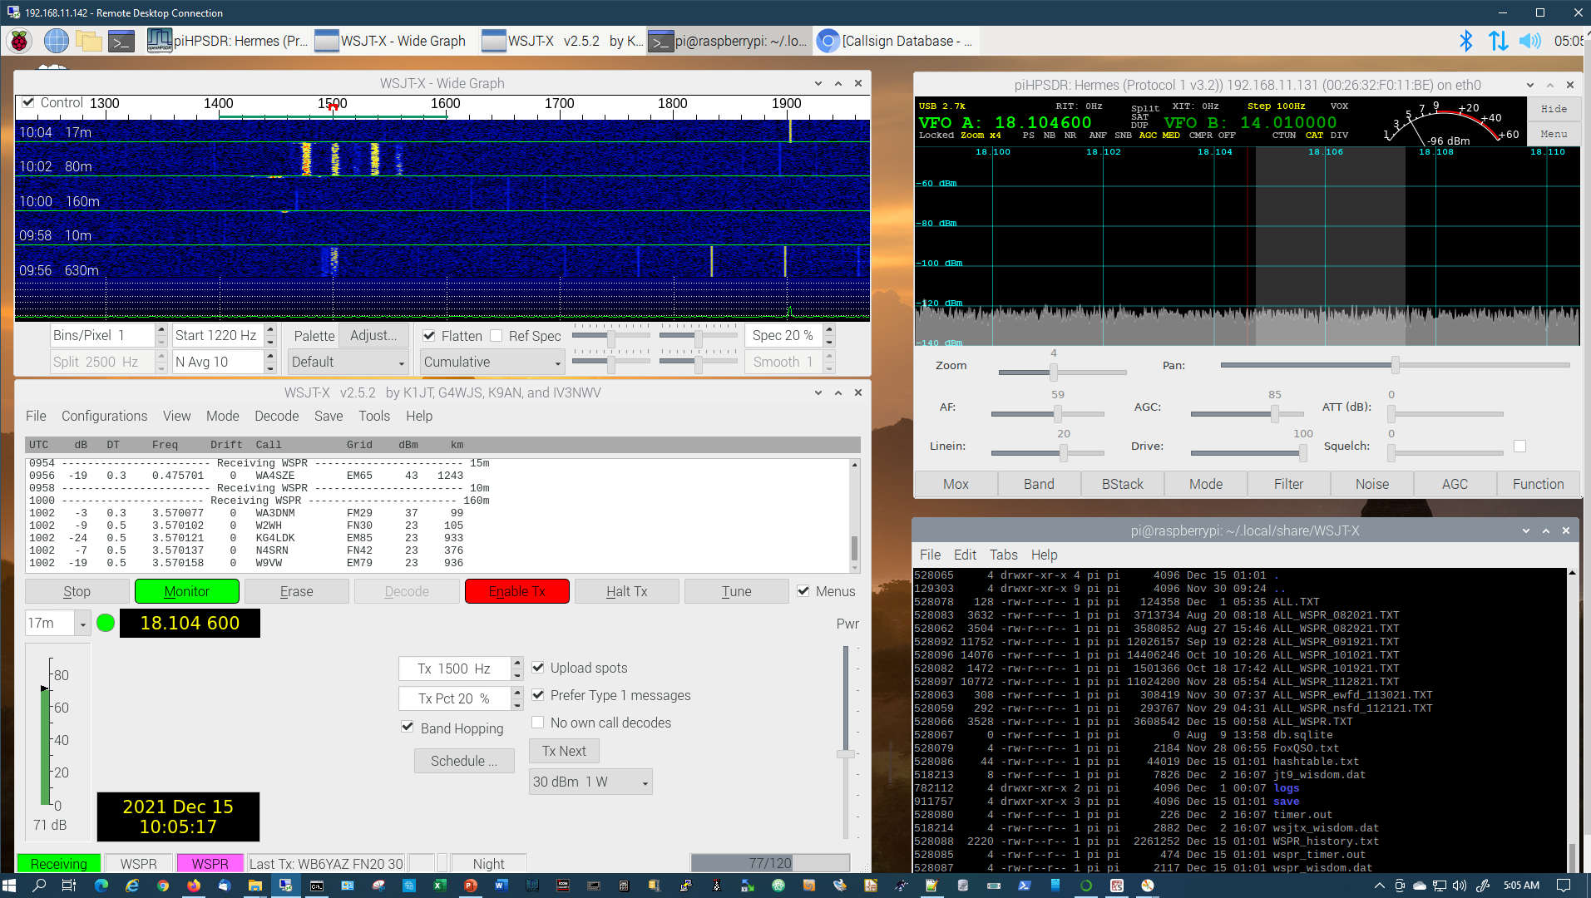
WSPR Analysis
Red-Pitaya SDR QRP Transceiver
G. Daugherty (WB6YAZ)
12/15/21

Slide 4
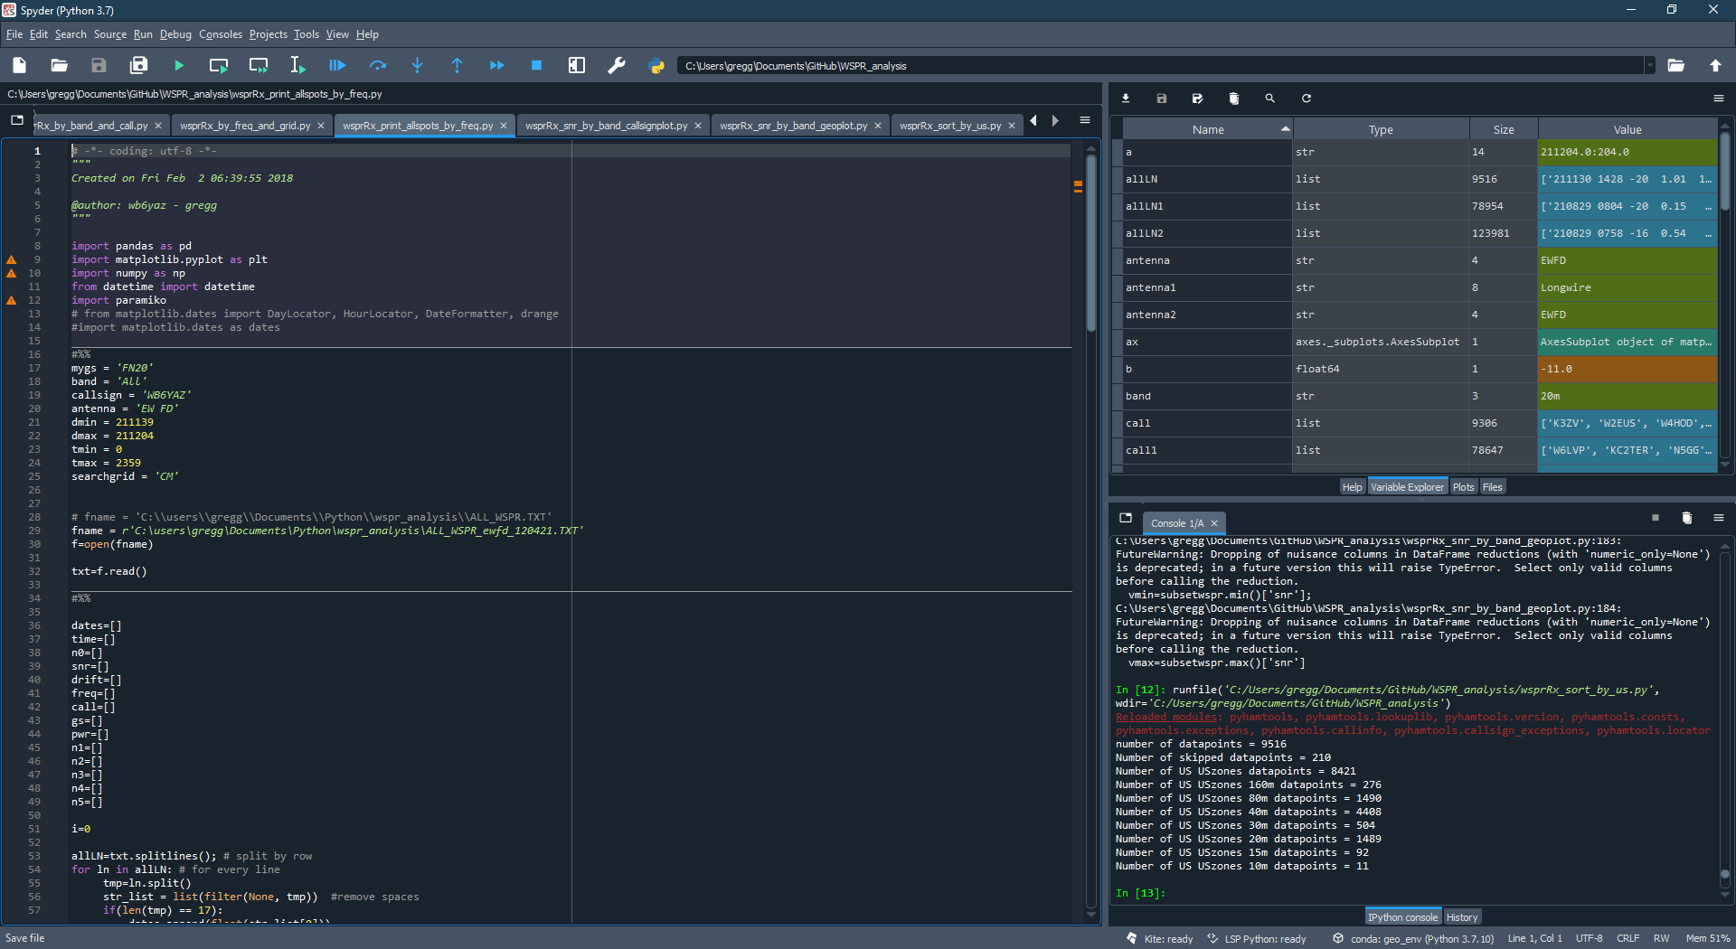
WSPR Analysis
parameter input
wspr file path
Spyder Console
G. Daugherty (WB6YAZ)
12/15/21

Slide 5
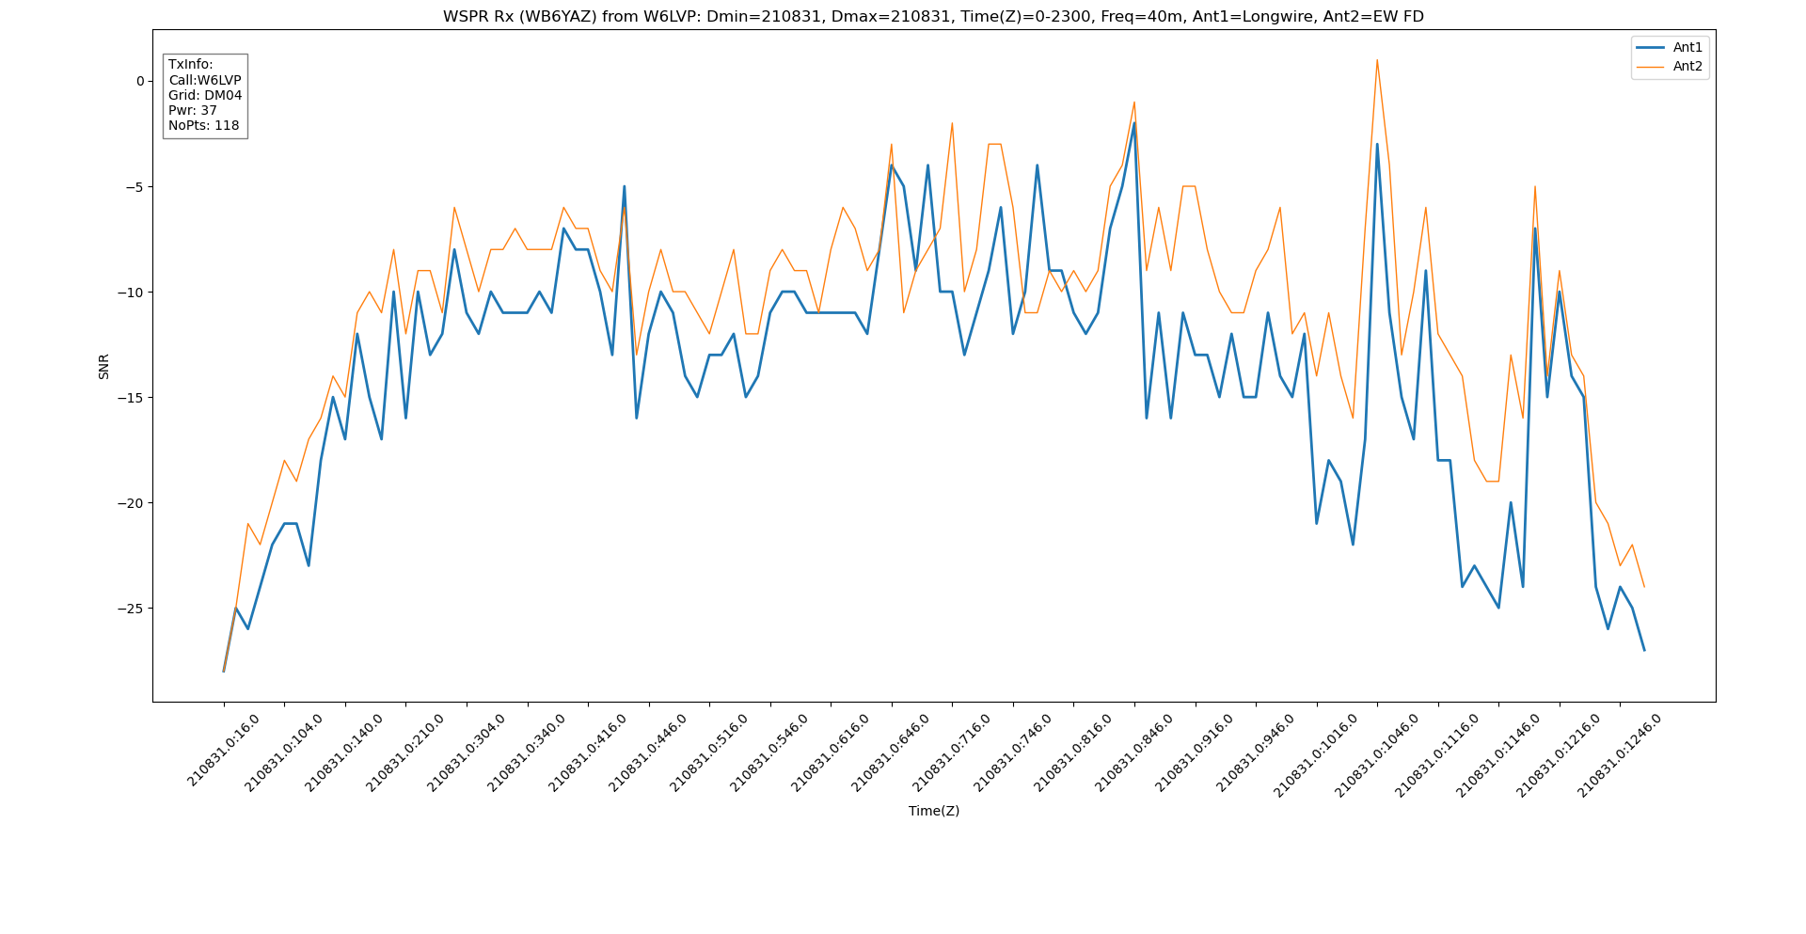
WSPR Analysis
wspr2Rx.py
G. Daugherty (WB6YAZ)
12/15/21

Slide 6
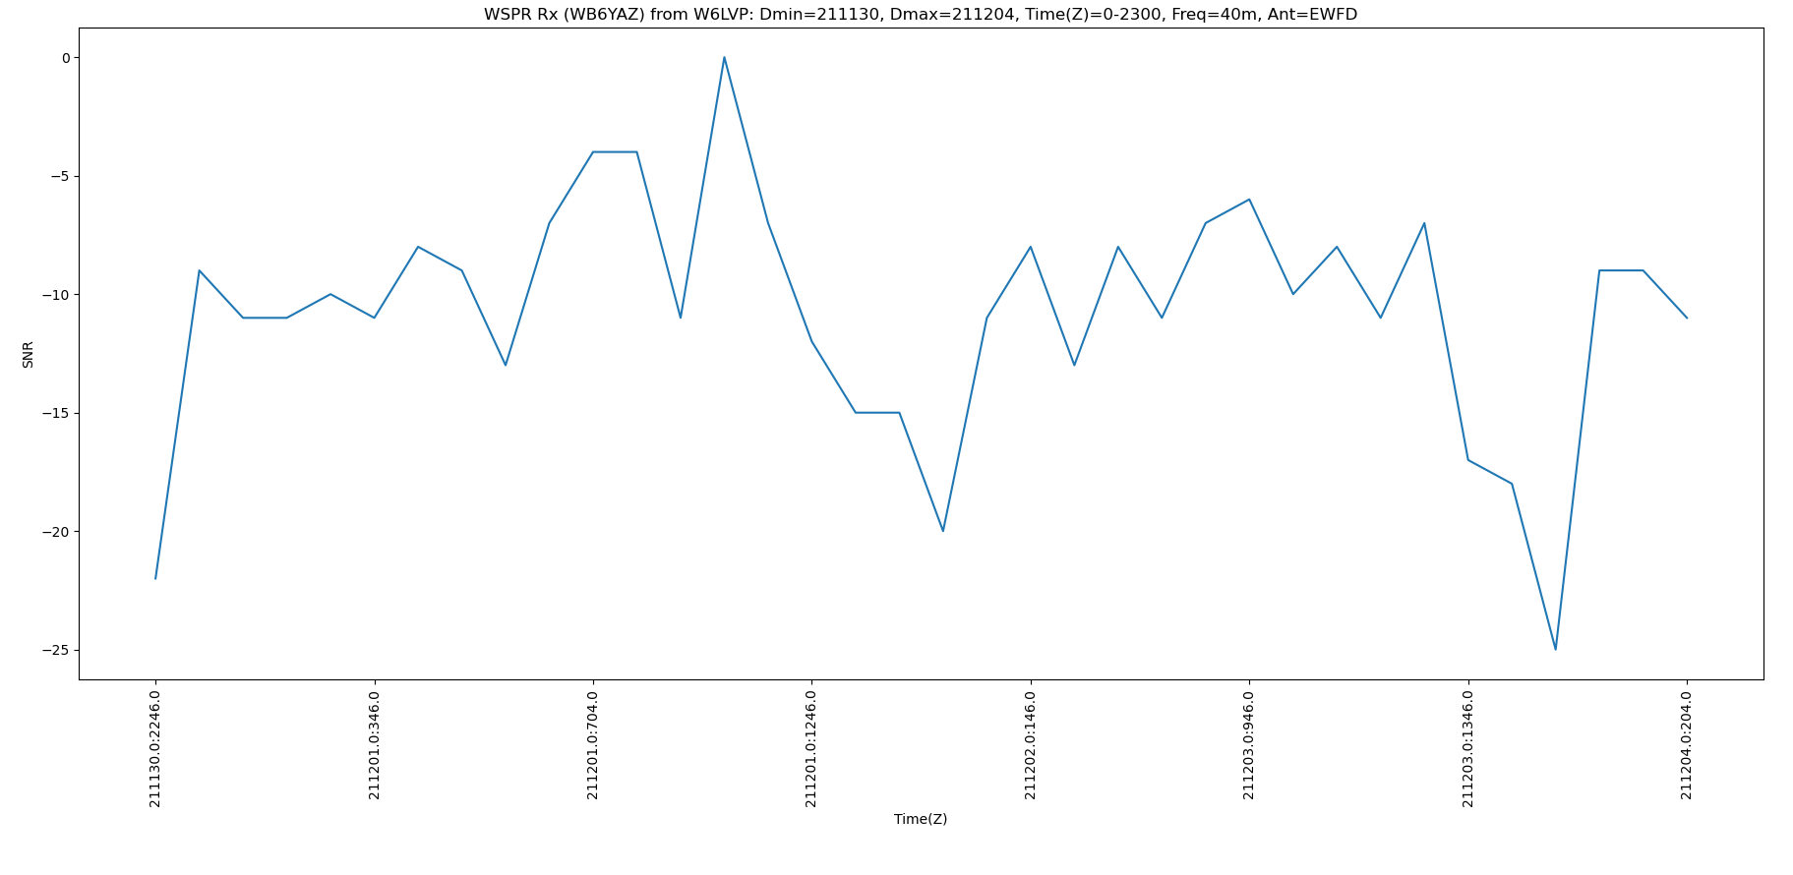
WSPR Analysis
wsprRx_by_band_and_call.py
G. Daugherty (WB6YAZ)
12/15/21

Slide 7
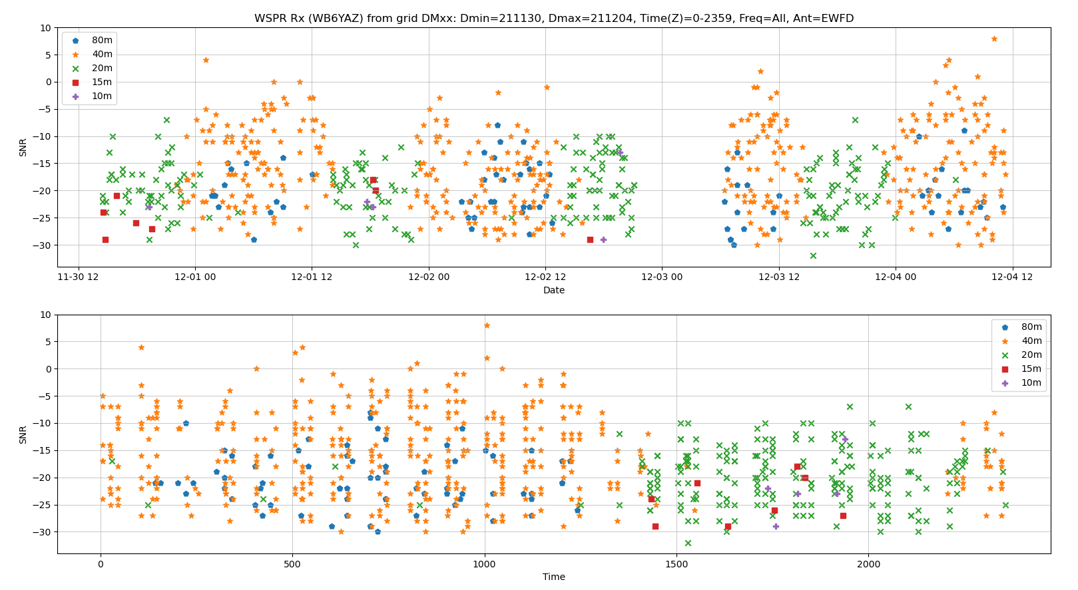
WSPR Analysis
wsprRx_by_freq_and_grid.py
G. Daugherty (WB6YAZ)
12/15/21

Slide 8
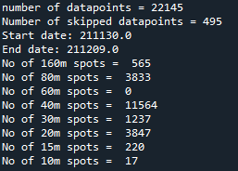

WSPR Analysis
wsprRx_print_allspots_by_freq.py
G. Daugherty (WB6YAZ)
12/15/21

Slide 9
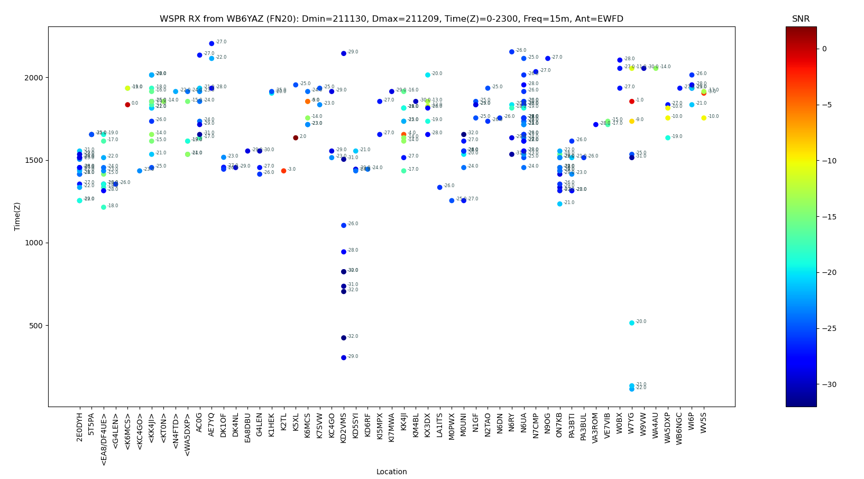
WSPR Analysis
wsprRx_snr_by_band_callsignplot.py
G. Daugherty (WB6YAZ)
12/15/21

Slide 10
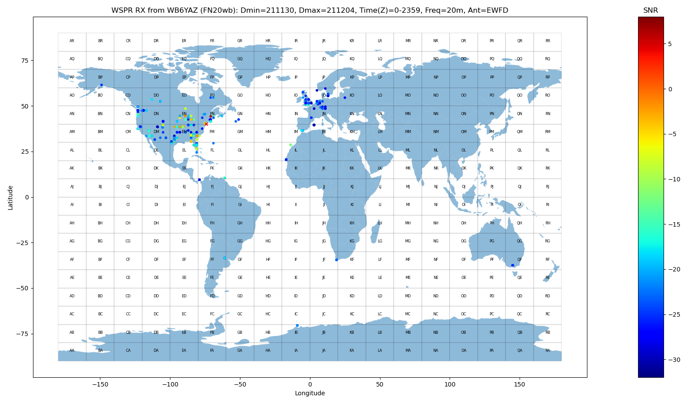
WSPR Analysis
wsprRx_snr_by_band_geoplot.py
Clicking on point displays spot data for location in spyder console window
G. Daugherty (WB6YAZ)
12/15/21

Slide 11
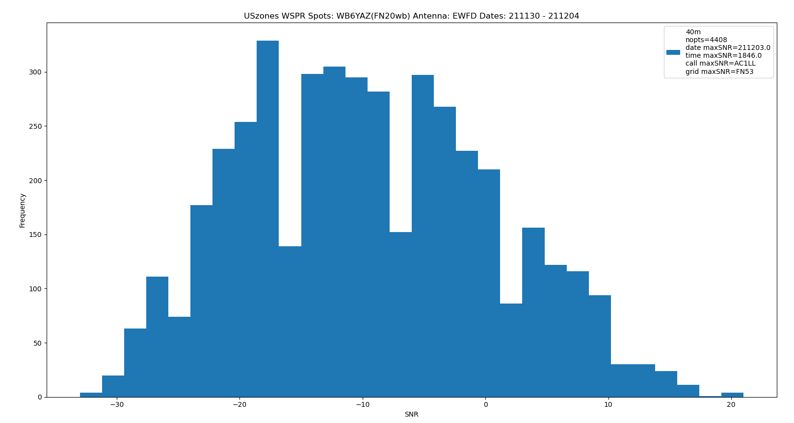
WSPR Analysis
wsprRx_sort_by_us.py
G. Daugherty (WB6YAZ)
12/15/21

