Slide 1
WSPR Analysis
For fans of WSPR, here are a couple of python routines for performing your own analysis of received spots.
The first displays a world plot containing SNR data for each received location over a chosen frequency and date / time interval.
The second shows SNR differences between two antenna / receiver combinations. For my case, I use a longwire / IC-7300 and a fence mounted east west folded dipole / RedPitaya SDR transceiver for the two systems.
My python IDE of choice is Spyder. Spyder is available for both Linux and Windows. To install on a Raspberry Pi, issue:
sudo apt-get install python3-spyder
For windows, spyder is part of the Anaconda install.
https://www.anaconda.com/products/individual-d
Additional packages must first be installed to enable the database and plotting functions.
pandas
geopandas
matplotlib
shapely
pyhamtools
To run the geo plot routine, modify wsprRx_snr_by_band_geoplot1.py to include your chosen date, time, file path and frequency parameters.
To run the antenna comparison routine, modify wspr2Rx.py to include your chosen date, time, antenna, file path and frequency parameters.
The saved WSJT-X WSPR spot file is named ALL_WSPR.TXT.
If you are using a linux system, the path to ALL_WSPR.TXT is:
???/.local/share/WSJT-X/ALL_WSPR.TXT
For windows, the default path is:
C:\Users\???\AppData\Local\WSJT-X
G. Daugherty (WB6YAZ)
9/12/21

Slide 2
WSPR Analysis
My setup uses two Raspberry Pis for transceiver control / WSJT-X and a windows machine for python. I copy the ALL_WSPR.TXT files to the windows directory that contains the .py files.
The figures below depict data for 40m over a 24 hour period from the two antenna systems.
I find HF propagation fascinating and am looking forward to compiling data over the next few years as sunspot cycle 25 peaks around 2025.
The python scripts as well as additional data are available on my github page at:
https://github.com/greggdaug/WSPR_analysis
G. Daugherty (WB6YAZ)
9/12/21

Slide 3
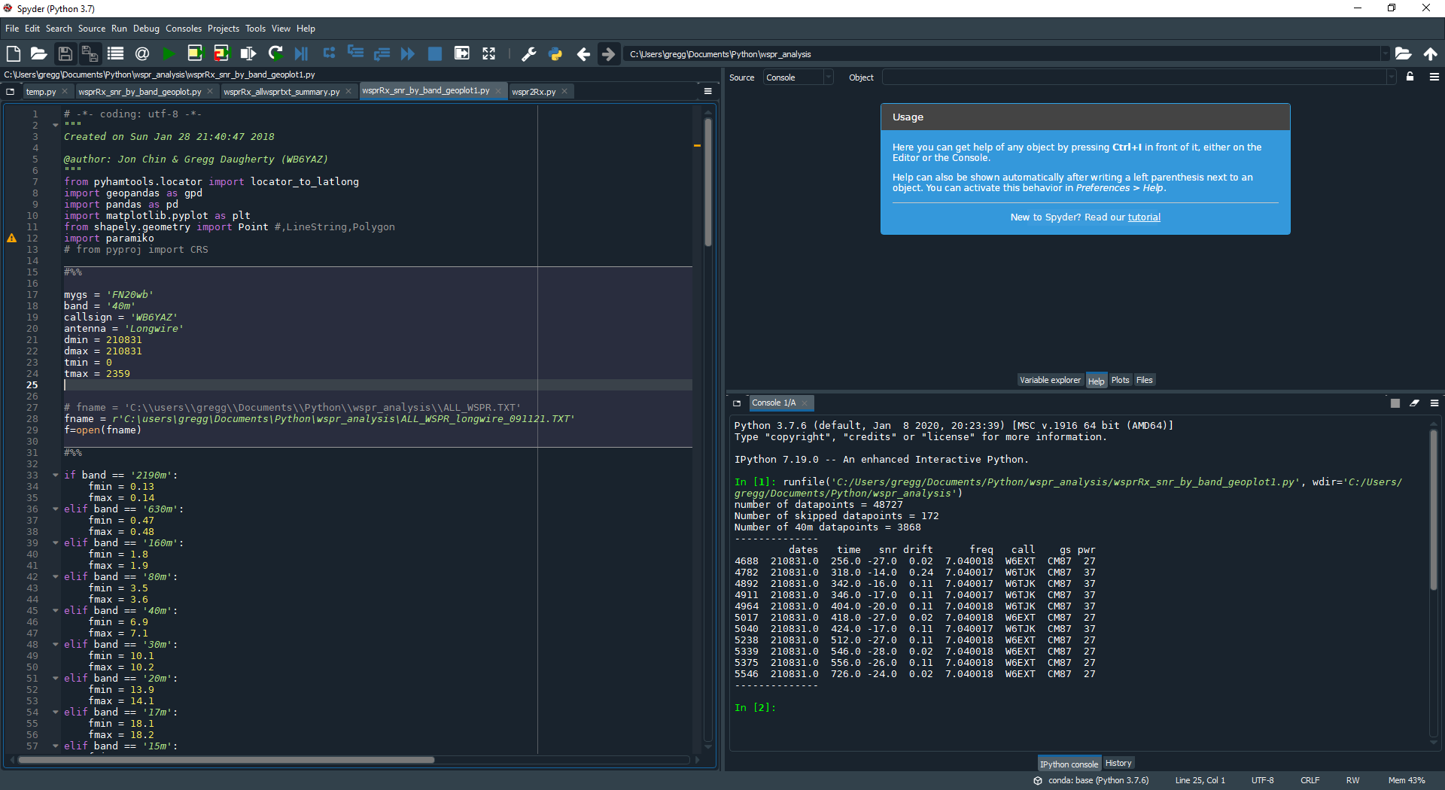
WSPR Analysis
geo plot setup parameters
wsprRx_snr_by_band_geoplot1.py
G. Daugherty (WB6YAZ)
9/12/21

Slide 4
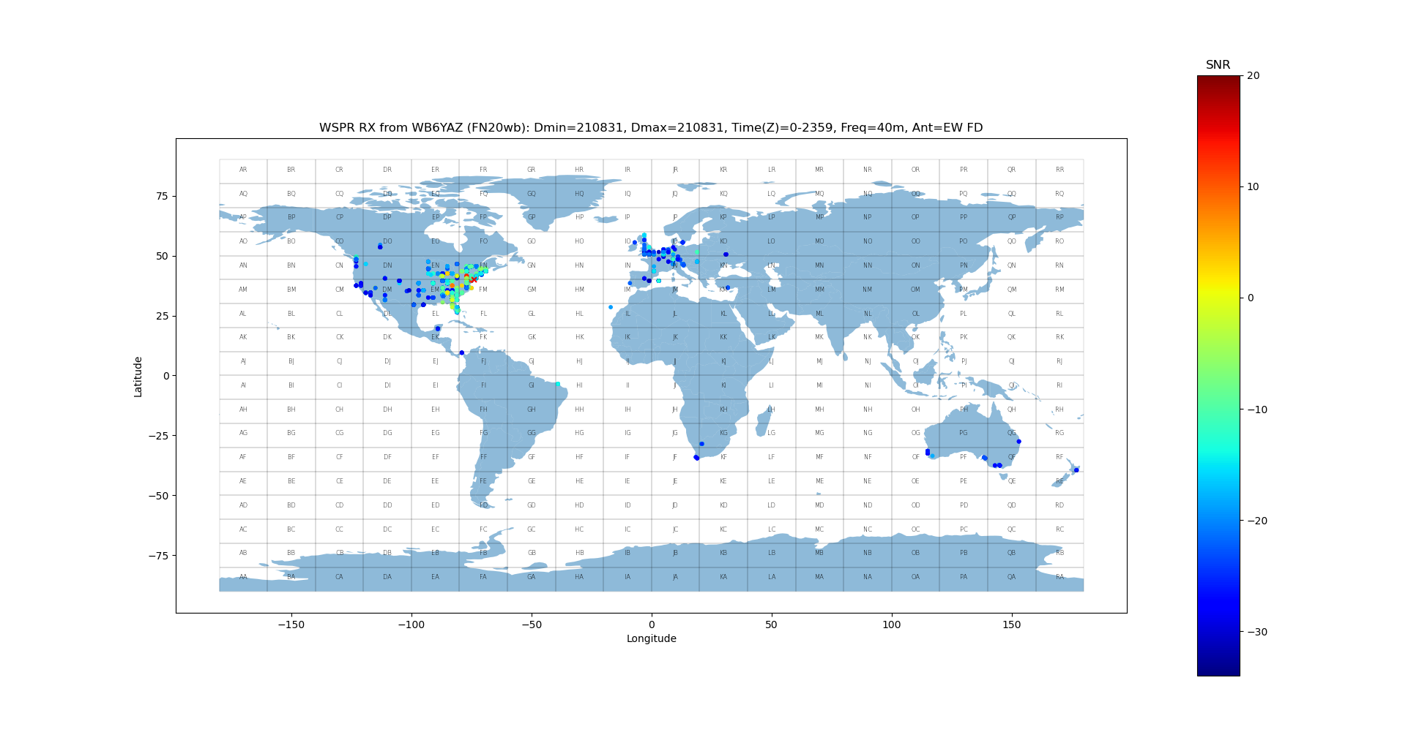
WSPR Analysis
Clicking on point displays receive data for location in spyder console window
G. Daugherty (WB6YAZ)
9/12/21

Slide 5
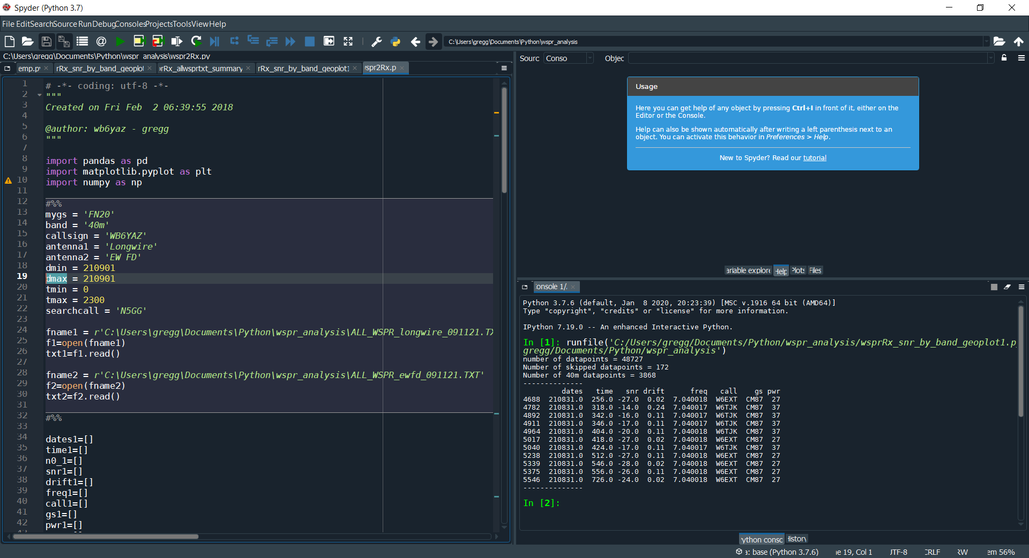
WSPR Analysis
two rx setup parameters
wspr2Rx.py
G. Daugherty (WB6YAZ)
9/12/21

Slide 6
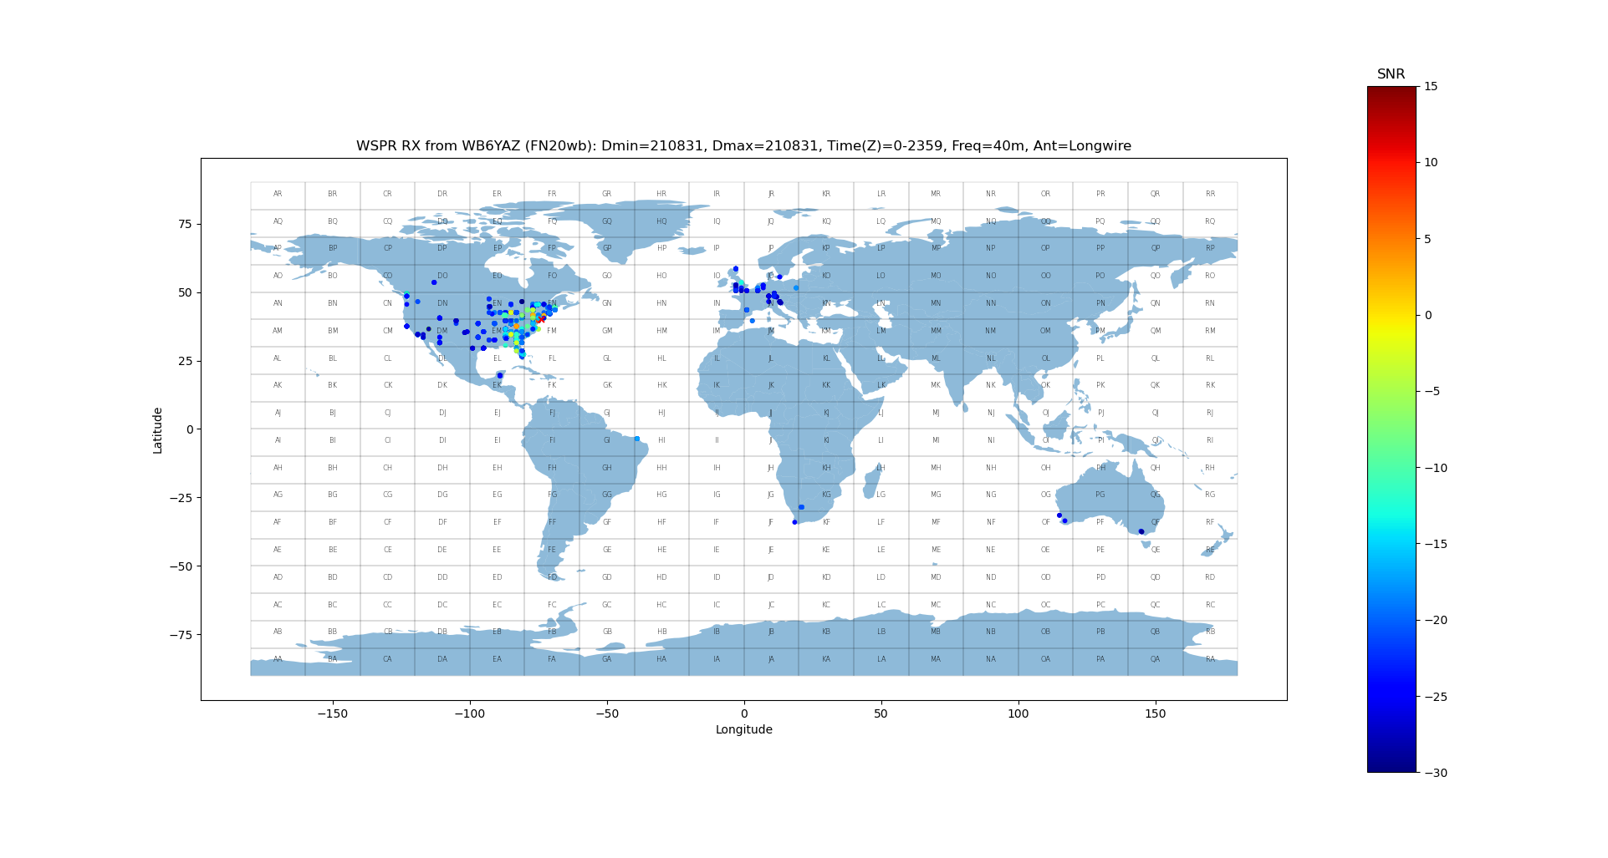
WSPR Analysis
G. Daugherty (WB6YAZ)
9/12/21

Slide 7
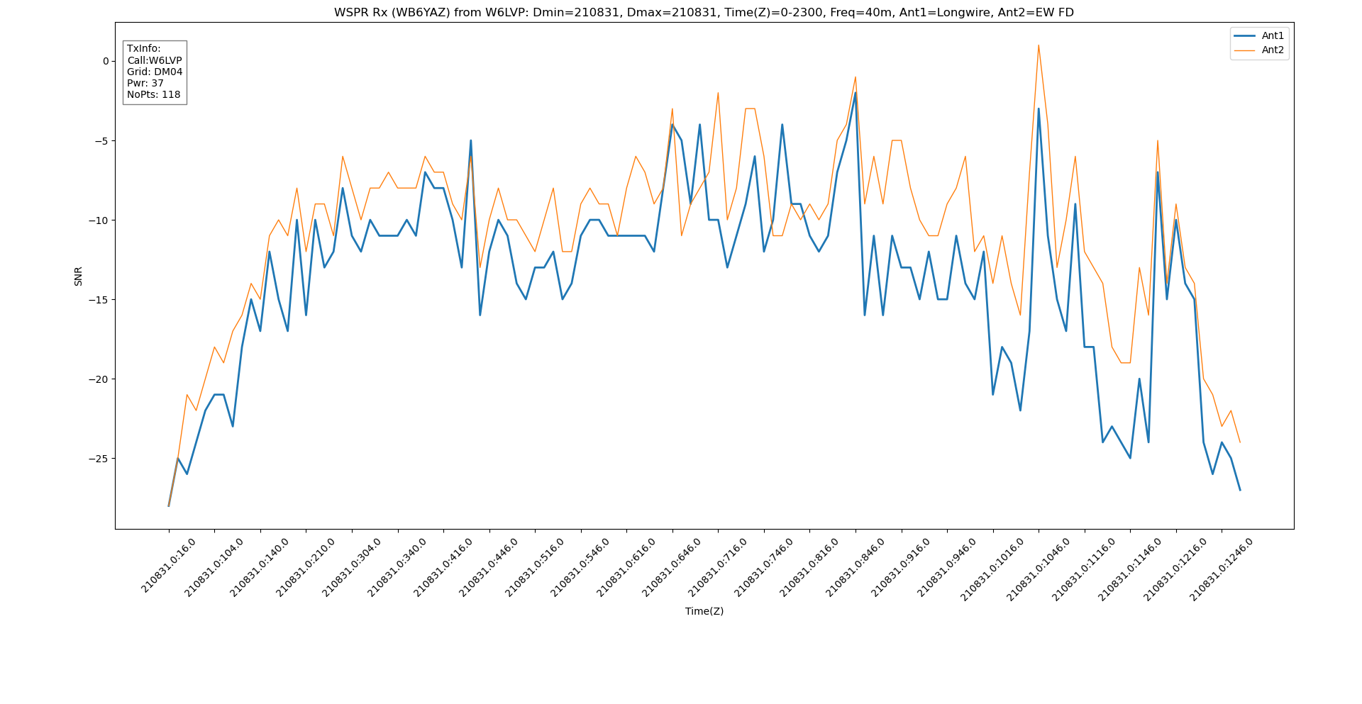
WSPR Analysis
G. Daugherty (WB6YAZ)
9/12/21

Slide 8
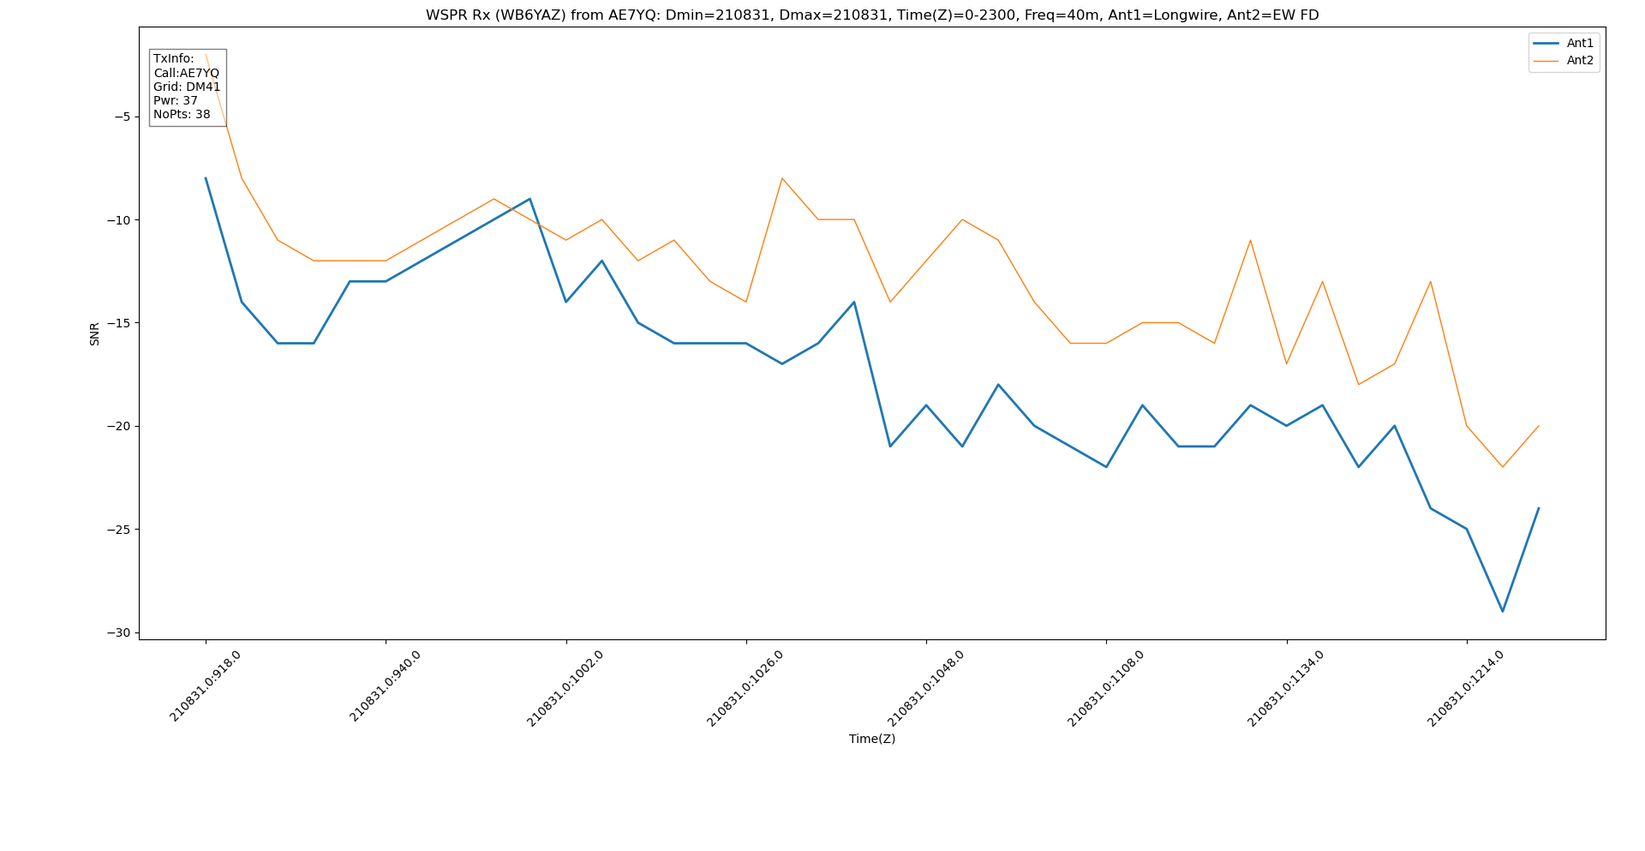
WSPR Analysis
G. Daugherty (WB6YAZ)
9/12/21

Slide 9
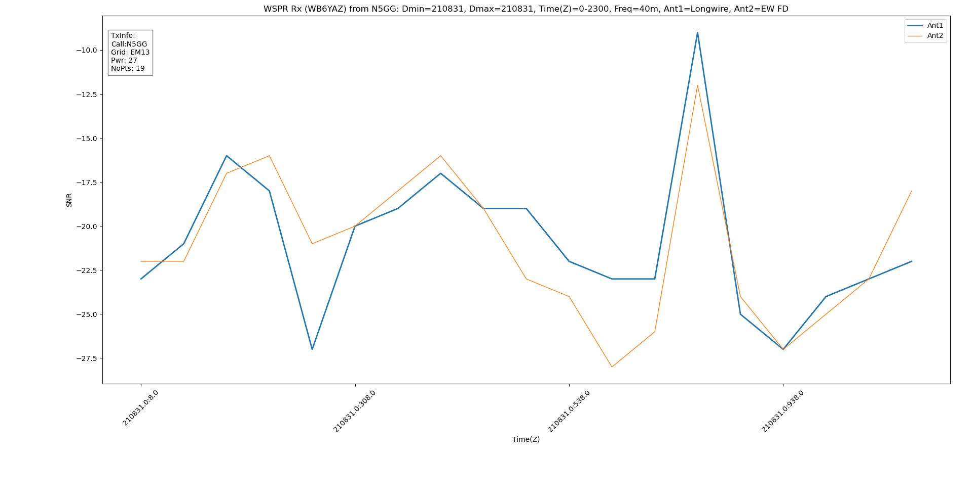
WSPR Analysis
G. Daugherty (WB6YAZ)
9/12/21

