Slide 1



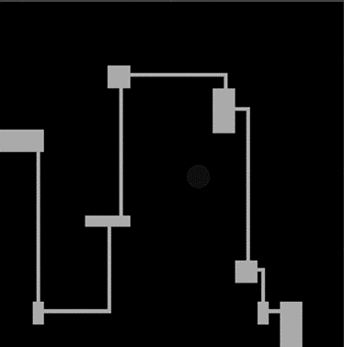
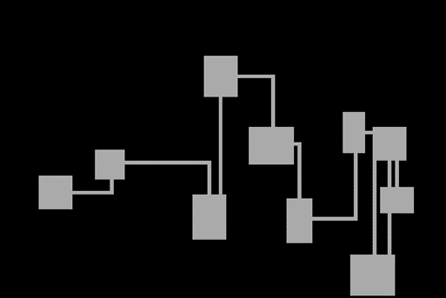

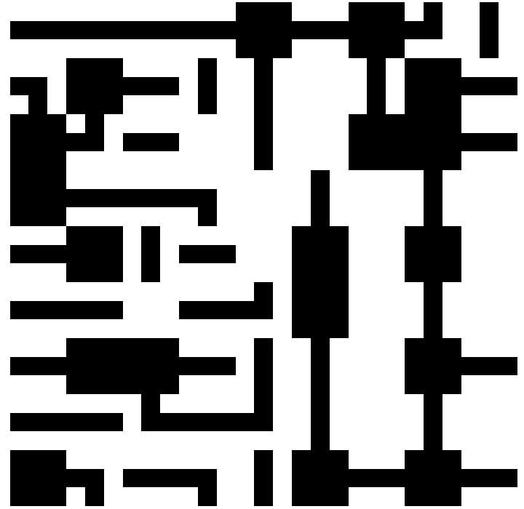
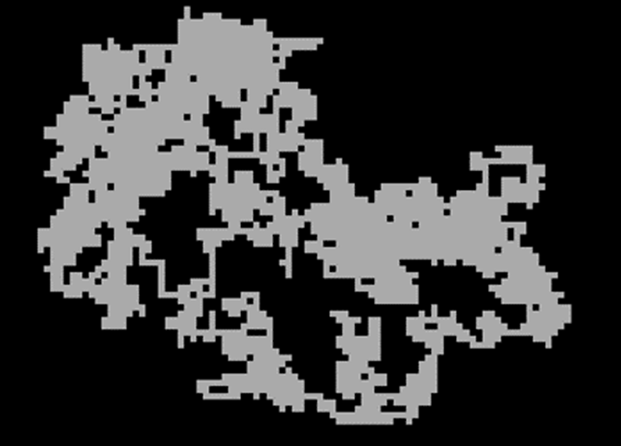
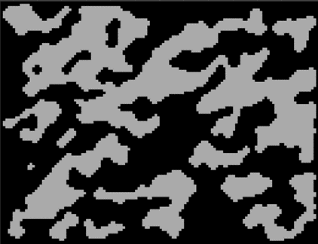
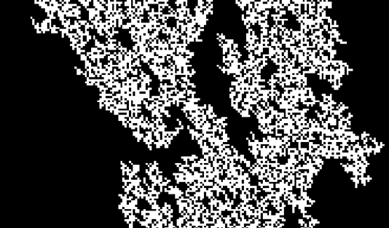
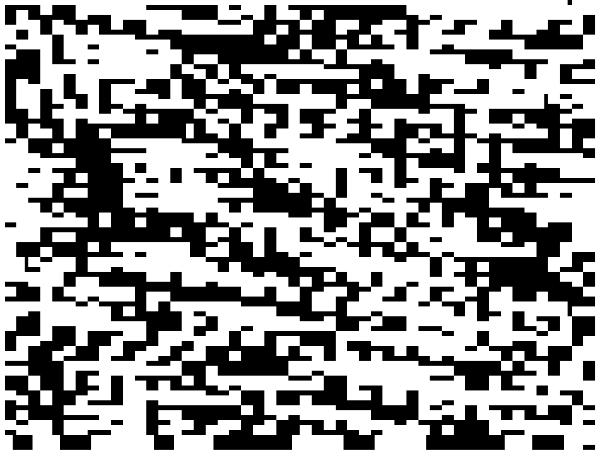
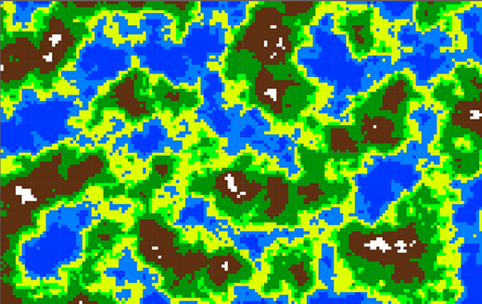
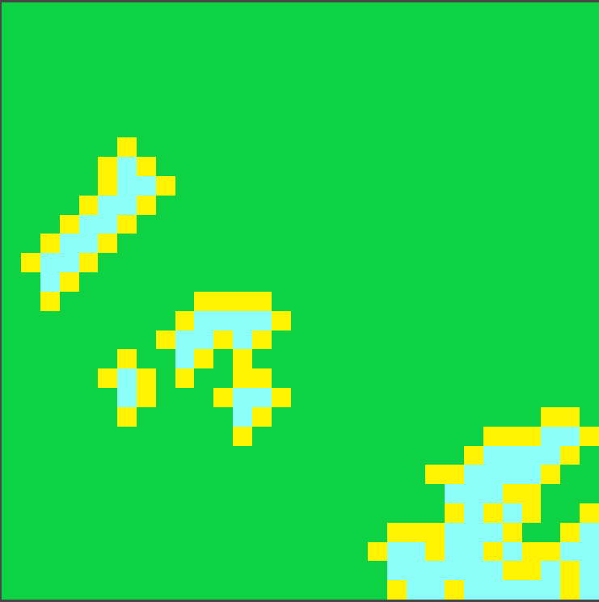
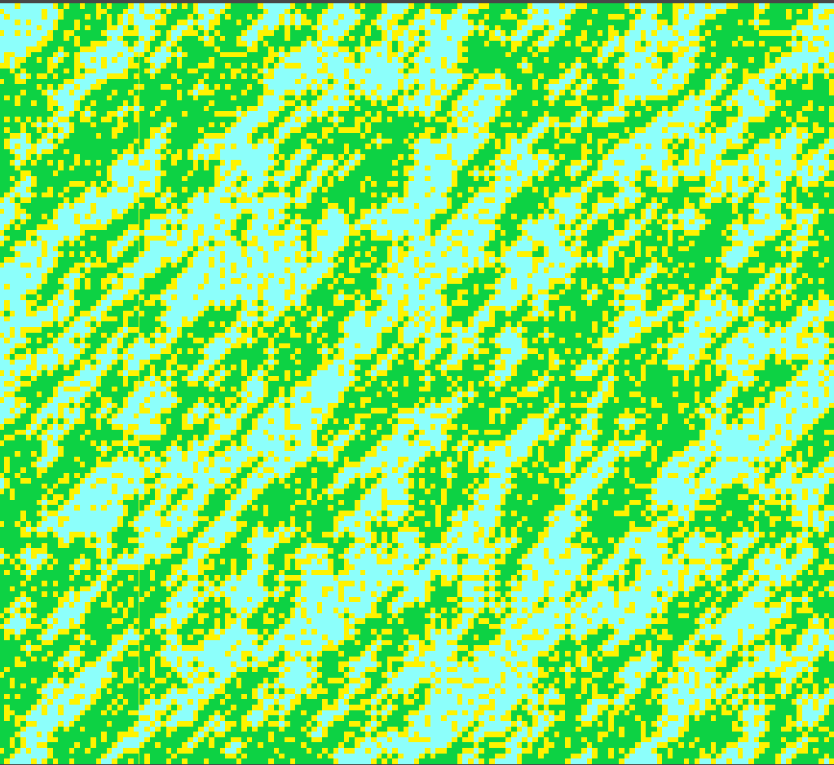
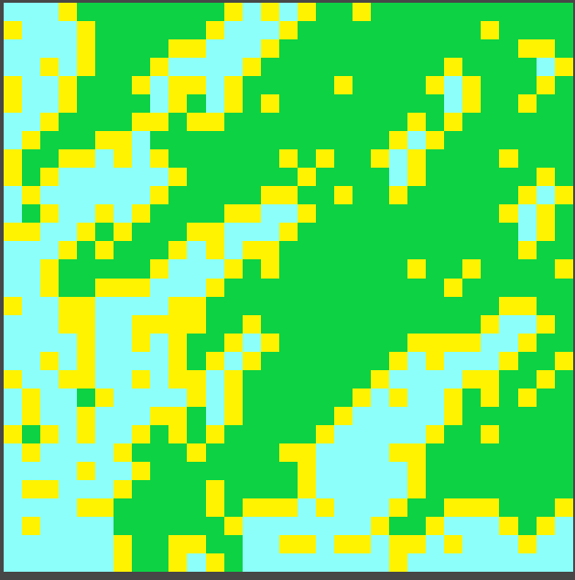
Matematica/Informatica
Gregorio Silvestri 07.09.2004
Liceo cantonale di Lugano 1
Abstract:
The maturity work studies the implementation of several techniques that permit to create maps for video games in an infinite and automatic way, the so-called procedural generation techniques. The study was carried out in two parts. The first part consists of implementing various algorithms, in order to create different types of maps. The second contains a proof of concept aiming at demonstrating the possibility of unifying the various algorithms into a single one, which permits to obtain maps similar to all the previous ones. This algorithm is Wave Function Collapse (WFC), a very flexible method based on a probabilistic approach . The objective of the second part of the work was therefore not to implement WFC several times in a complete way, but to develop prototypes that could demonstrate its potential in the modern videogame industry.
Classic dungeons generation
WFC dungeons generation
Classic caves generation
WFC caves generation
Classic open terrain generation
WFC open terrain generation
Discussion and results:
The maps obtained with the first method were more basic and primitive than the originals, but this is mainly due to poor quality implementations. However, the maps show that it is possible to reproduce the results obtained with the previous techniques. The results of the second method were more fruitful. The new dungeon-style map has surpassed one of the two techniques in quality, distinguishing itself with better traits and proportions. The simulation of the caves instead led to a result similar to that of Cellular Automata, but less natural. In general all the prototypes show that it is possible to implement WFC to replace the various previous techniques.
The results obtained show the potential of this technique and its use in industry. With a single algorithm we could create a large variety of maps suitable for any situation. The implementations of this work only have a demonstration purpose, so a future goal is to make them more efficient and functional for a large development. This will provide richer maps, which will be more interesting and fun to play, which is the ultimate purpose of any map generation for videogames. The work done therefore does not serve as a mere technical exercise, but is meant to frame and focus on the important aspects to take into consideration when developing a map for video games in general.

