Slide 1
Docker DEEP Hack

Slide 2
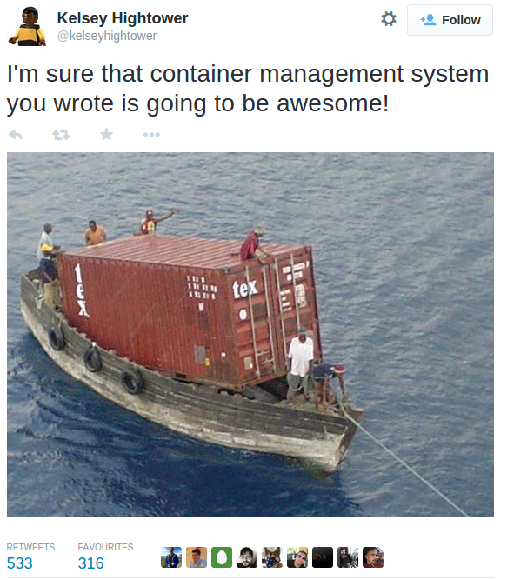

Slide 3
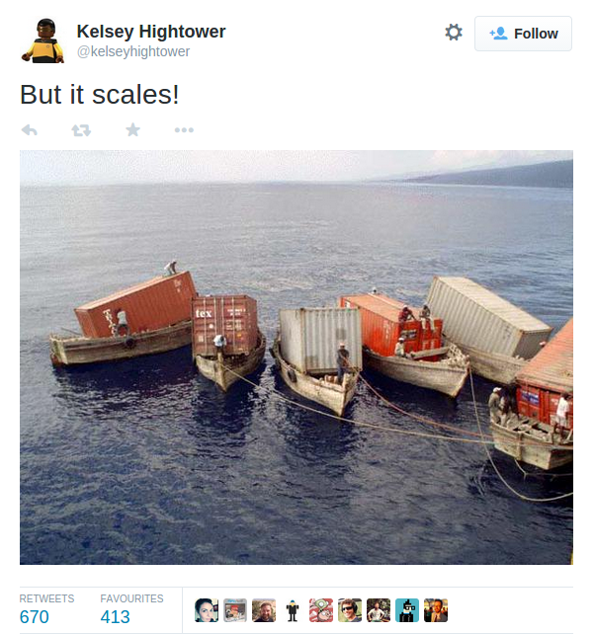

Slide 4
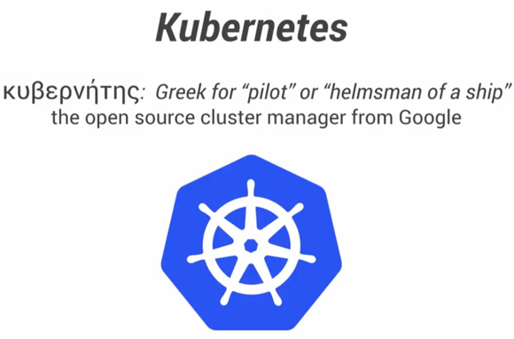


Slide 5
Pods: Co-located, ephemeral groups of containers. Public IP address. Arbitrary labels.
Replication Controller: Manages lifecycle of a selection of Pods
Services: Provides stable entry to selection of ephemeral Pods.

Slide 6
Service select: name=web env=prd
Replication Contoller
Template: container:web replicas: 3 selector: name=web env=prd
Pod
Name: web container: web label: env=prd
Replication Contoller
Template: container:db replicas: 1 selector: name=db env=prd
Service select: name=db env=prd
Pod
Name: db container: db label: env=prd

