Slide 1

tAlleyCat
Group or Individual training rides when you can’t be outdoors

Slide 2


tAlleyCat
vs.
Indoor Training.
Competition.
They meet here.

Slide 3
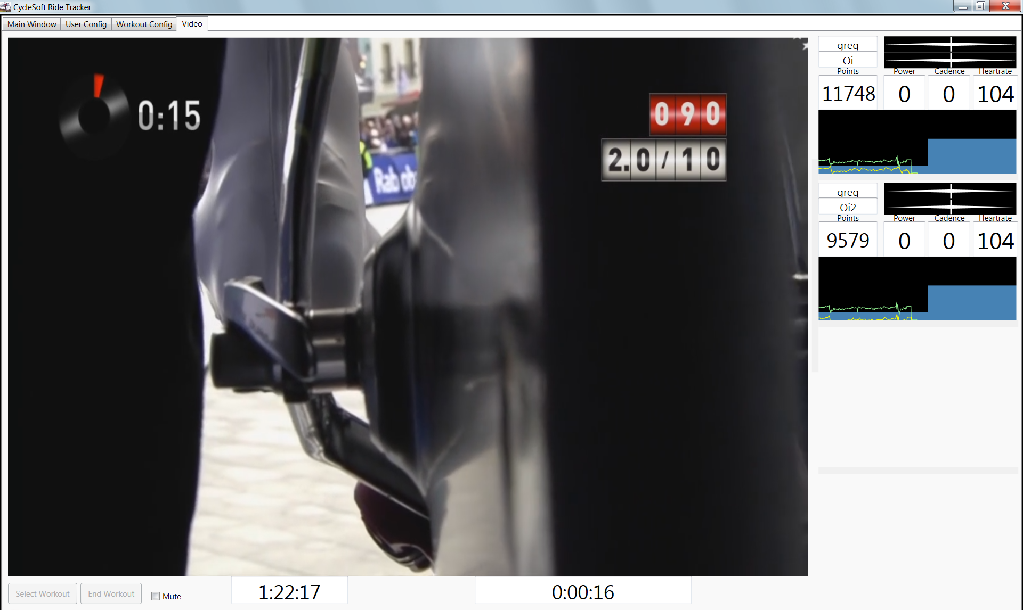
Main Screen – Video Mode
Usually run this screen on a laptop or computer screen. Bonus points for connecting to a projector or Big Screen TV!
Users Summary Data
Target v Actual Power
Target v. Actual Cadence
Points
Current Power
Current Cadence
Current Heart Rate
Power v. Target Graph
Example Screenshot shows active workout while synchronized with a Sufferfest video!
Pause / End / Mute
Workout Time
Segment Time Remaining

Slide 4
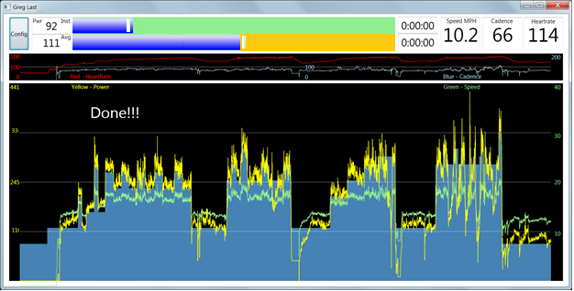
User Screen
One window is opened per user
Real time power and cadence bar w/ Target
Background color indicates if Points are being earned!
Workout Times and
User Summary Data
Real time
cadence and
heart rate
graph
Real time speed and power graph

Slide 5
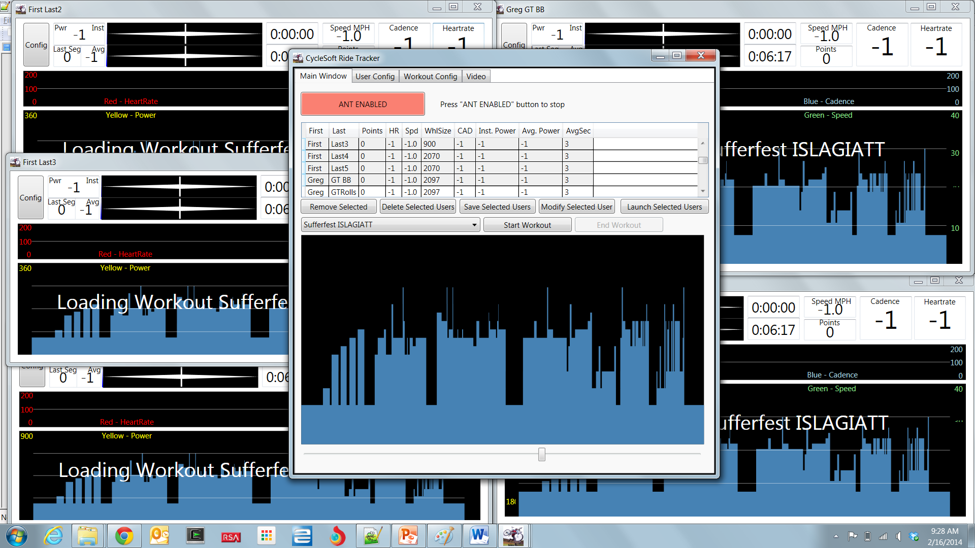
Users Summary Data
Target v Actual Power
Target v. Actual Cadence
Points
Current Power
Current Cadence
Current Heart Rate
Power v. Target Graph
Shown with 5 Riders Ready to Ride!

Slide 6
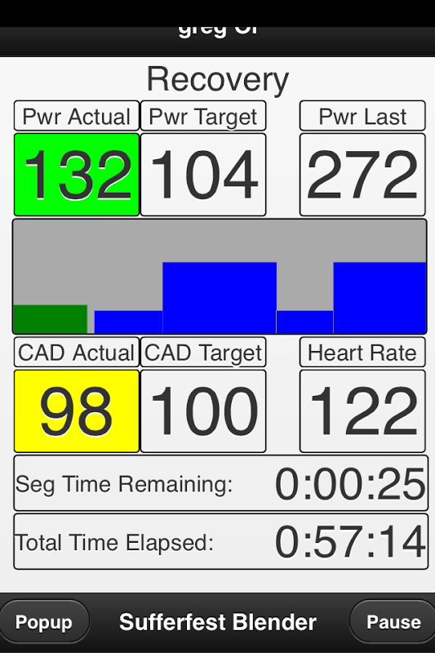
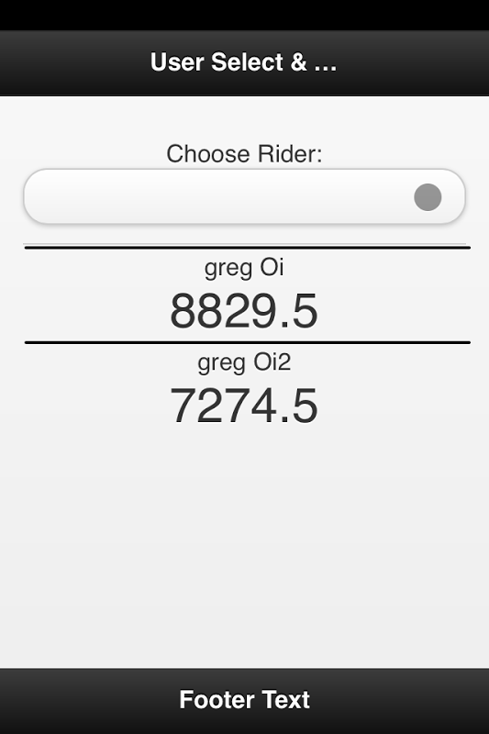
Swipe Back & Forth
Power Last Workout
Segment
Pull Down List
To select Rider
Scrolling View of
Upcoming Targets
Current Power
Graph
Rider Point
Summary
Actual Power and Cadence are Highlighted when you are earning points.
Green = Full Points Yellow = Half Points

Slide 7
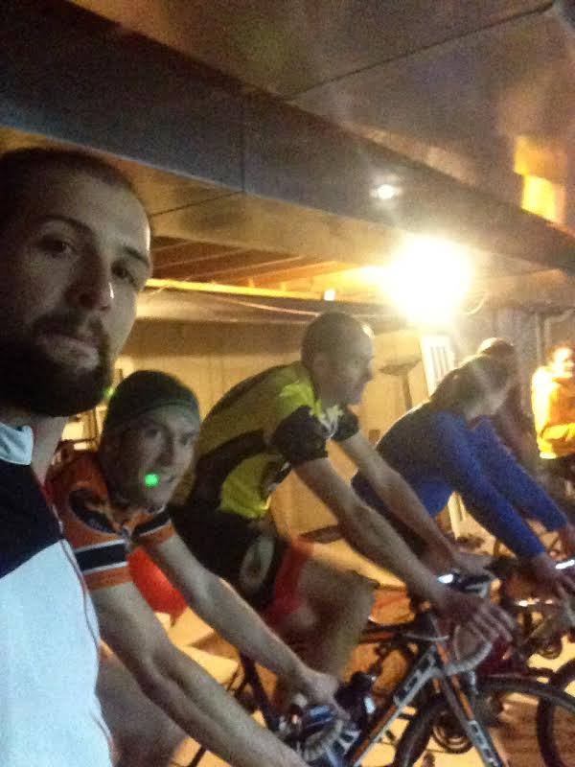

Slide 8
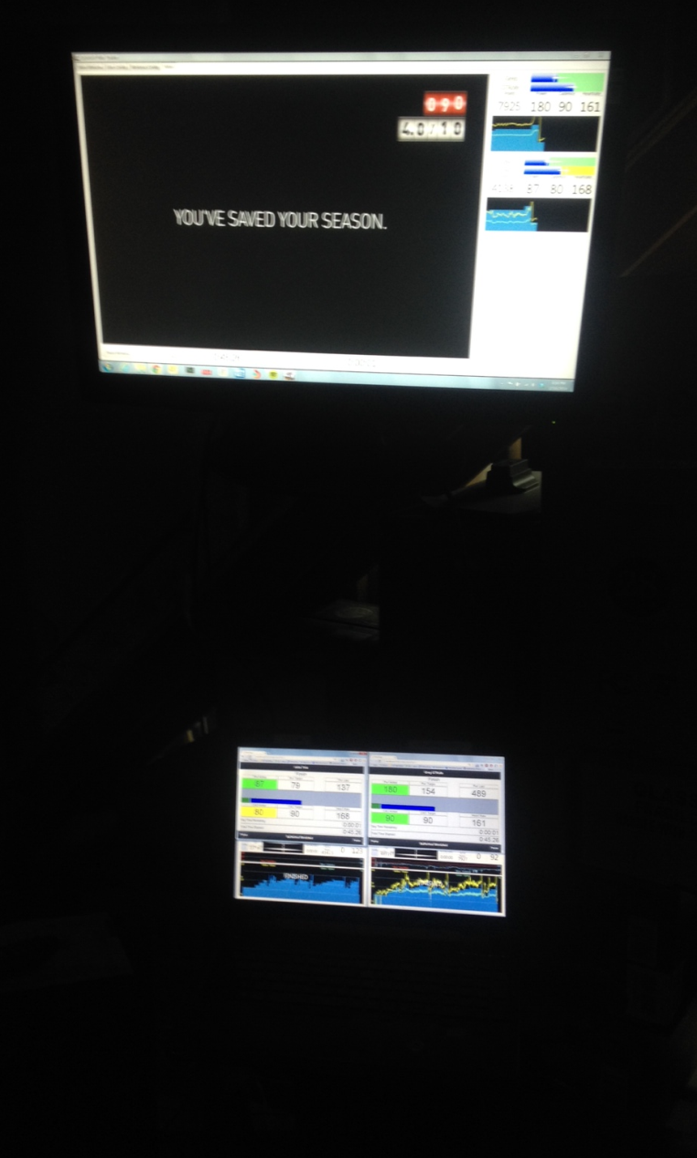
Connected TV – Showing Video
Laptop – Showing User Data

