Slide 1
Option Volatility Trading Strategies
MGT-411 Proposal
Team Members: Gregory Giordano, Vincent Cortese, Matthew Selvaggi, Scott Caratozzolo, John Tartaglia
Advisor: Hamed Ghoddusi

Slide 2
Research Questions
Is there a benefit of incorporating option volatility trading strategies into standard investor portfolios?
Can volatility strategies help produce uncorrelated returns?
How do volatility strategies perform in different market regimes (high vol vs low vol markets)?

Slide 3
Problem Background
Scope and Purpose
General investors are aware of the benefits standard puts/calls can provide their portfolio.
Can we expand on using vanilla puts/calls to more advanced vol trading strategies to help provide investors uncorrelated returns?
The option market provides opportunities to profit regardless of the direction of the overall market.
The case for trading volatility as another asset class is well documented in literature.

Slide 4
Literature Review
Prefatory Readings
Volatility Dispersion Trading: Qiang Deng
Dispersion trading is a hedged strategy designed to take advantage of relative value differences in implied volatility between an index and a basked of component stocks
This paper analyzes where dispersion profits are derived from and how to enhance them
Trading the Volatility Skew of the Options on the S&P Index: Juan Bueno
OTM Index puts can be overpriced due to investor’s wanting downside protection
Implied volatility on lower strike options can be inflated leading to trading opportunities
Trading Volatility: Colin Bennet
Textbook that outlines advanced options trading strategies including dispersion, skew, and exotics

Slide 5
Initial Ideas on Implementation
Software and Methodology
We plan to conduct most of the project in Python
We have a shared GitHub to allow group collaboration on any code we produce
Back test the strategies by simulating buys and sells of various options
Buy and sell underlying securities as well (hedging) and track the performance
Analyze the performance of strategies compared to the overall market/equity portfolios,
Run regressions and other statistical analysis to compare the option trading strategies to the equity market
The analysis will include cost-benefit scenarios that outline if investing in volatility as an asset class is worthwhile for diversification (or in what market regimes is it beneficial)

Slide 6
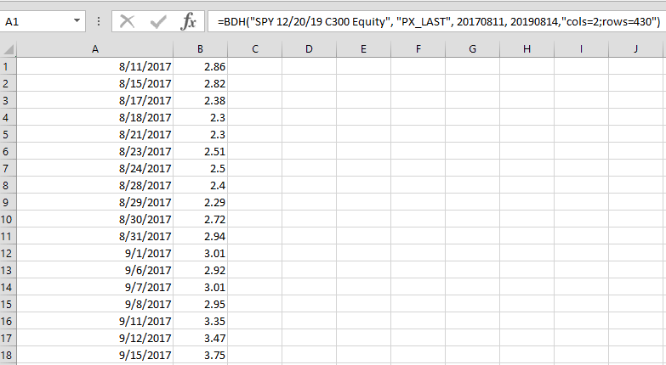
Introduction to Data Sources
We will be using Bloomberg to gather historical option pricing data
The Excel add-in gives us access to any historical option data
We will use a Python script to communicate with Excel to download the specific options we want and read back to Python

Slide 7
Project Outcomes
Initial Expectations
A determination of which trading strategies can be used to attain beta-neutral returns that are competitive with equity-only portfolios over a long timeframe.
A quantifiable risk-reduction from diversifying a typical portfolio by implementing various option strategies; treating volatility as an additional asset class.
Thorough backtesting analysis to determine which strategies consistently perform well out-of-sample.
A greater understanding of developing automated option trading strategies and incorporating them into a portfolio.

Slide 8
Work Plan
(Tentative)
First Semester
First steps are really considering what data we need to get, such as which assets we will consider for options
Another step is continuing to research the various strategies mentioned, as well as considering new ones that we see as viable and worth implementing
Important part is to develop the code to pull and clean the data we need from Bloomberg and other sources to give us neat data from various prices
Lastly, just be able to adapt to problems encountered
Second Semester
Now we will backtest our strategies, there are different ways we can approach this, so we need to discuss ways to construct portfolios/asset allocations
First step of backtesting is to test the various option strategies, once we find which ones are viable then we can implement those into typical investor portfolios
Wrap up conclusions and present our findings in a concise manner

Slide 9
Risk Analysis
Possible Challenges and Risks
Data Collection Issues
Missing data from Bloomberg (tickers, dates, strikes).
Difficulties automating data collection through python using the Bloomberg-Excel API (time/memory).
Unrealistic Backtesting Results
Observing unusual option prices due to illiquidity.
Large bid-ask spreads.
Poor Out-of-Sample Strategy Performance
Market regime changes (Covid, rapid growth of retail investor participation in option trading).
Overfitting our trading models.

Slide 10
Conclusion and Next Steps
Conclusions
Our senior design project will investigate volatility strategies, and then look to incorporate these strategies into investor portfolios
If we can do this effectively, demonstrating that we are providing uncorrelated returns to the portfolio, then we can investigate how these strategies perform in different market regimes
Ultimately, we are looking to improve upon investor’s portfolios with volatility treated as a separate asset class
Next Steps
Further research on volatility strategies
Tentative decision for what data we need for starters (ETFs options, individual stock options, etc.)
Find most effective ways to pull the data
Create code to extract the data and clean the data on a mass scale

