Slide 1
Option Volatility Trading Update 1
MGT-411
Team Members: Gregory Giordano, Vincent Cortese, Matthew Selvaggi, Scott Caratozzolo, John Tartaglia
Advisor: Hamed Ghoddusi

Slide 2
Current Updates
Goal: Using volatility as an asset class to help generate uncorrelated returns for an investor’s portfolio
We have decided on a volatility strategy to pursue
We have a working data collection prototype that utilizes python and the Bloomberg-excel API
Preliminary research on potential portfolio implementations
Planning our next steps

Slide 3


Dispersion Trading
Dispersion trading is designed to capitalize on the overpricing/underpricing of index options relative to individual options
Sell options on index and buy options on individual options (delta neutral straddles)
Can be implemented using market ETFs and sector ETFs
Strategy makes money when realized volatilities on individual stocks are high and realized vol on index is low (or vice versa)
Want to find times of high implied correlation or low implied correlation
High correlation indicates implied index vol is elevated (shown in index variance formula below)
Index Variance
Implied Avg. Correlation

Slide 4
Dispersion Trading Continued
Implementing dispersion trades can be done in a variety of ways:
Analyzing implied vs realized correlation changes
Looking for optimal subset of component stocks/ETFs to buy/sell
Different weighting combinations (vega neutral, gamma neutral, or theta neutral at start)
Profits are derived from the relationship between realized volatility and implied volatility
Must analyze the cost of implementing trades
Straddles are expensive
Dynamic delta hedging can increase price as well

Slide 5
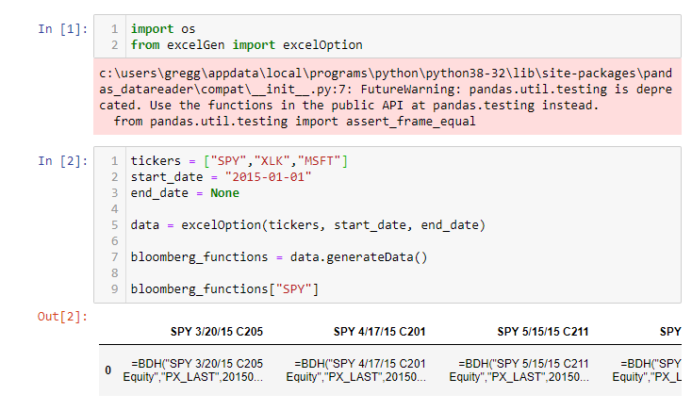
Data Collection Update
Currently, we have a Python class “excelOption” that can create the excel file we need to download any option data in Bloomberg
Next step is to download the generated data in Bloomberg to read back into Python to analyze trading strategies

Slide 6
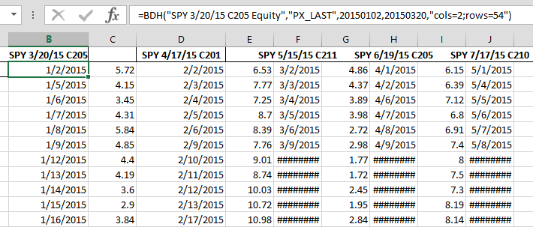
Data Collection Continued
When Excel file generated in Python is opened with Bloomberg Excel Add-In, historical option data for all tickers is generated

Slide 7
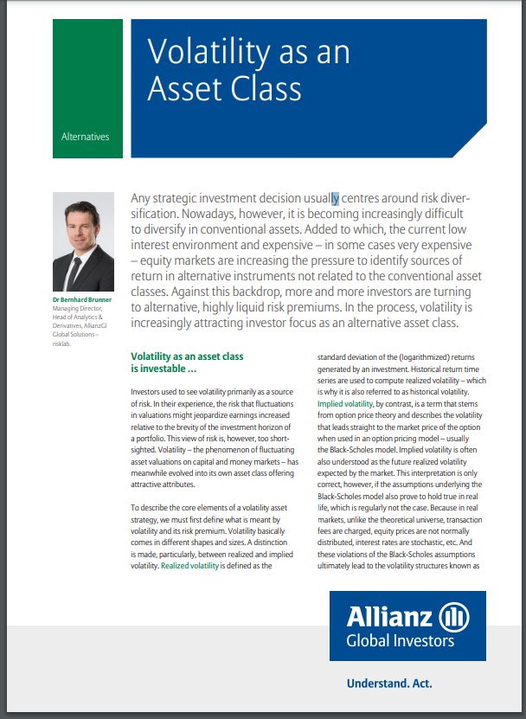
Portfolio Implementations
How can we implement a dispersion trading strategy in any investor’s portfolio?
Returns and diversification benefit
Shift focus to pitching an ETF or index that tracks the returns of a dispersion trading strategy.
Enables a lot of capital to implement the strategy
Access of dispersion to all types of investors
Need to consider annual ETF expenses
Allianz Global Investors created the VPT index that tracks selling volatility via variance swaps to give investors access to volatility as an asset class
Use Allianz’s model to create our own index/ETF

Slide 8
Next Steps
Possible Challenges and Risks
Begin implementing dispersion backtest
Build on class that generates Excel File
Try different dispersion implementation strategies
Work through cleaning data
Missing dates and illiquidity is an issue with option data
Incorporate volume into our model
Utilize bid/ask spreads if data is available through Bloomberg
Continue research on how volatility can add benefits to investor portfolios
How to compute/quantify diversification benefits
Explore further Skew Trading strategies to eventually implement
Notes:
Create a clear tree presentation to show why things are going to work, gives structure of which things are going to test.
Nov 9, touch base

