Slide 1

Introduction to Github
The basics of code collaboration and version control
Notes:
Github is a platform for code collaboration and version control. In this presentation, we will cover some of the basics of using Github, including creating an account, creating a repository, and installing and using Github.

Slide 2

Presentation Overview
Creating a Github Account
The first step to using Github is to create an account. We will cover how to create an account and the benefits of having a Github account.
Creating a Repository
Once we have a Github account, we can create a repository to store our code and collaborate with others. We will cover how to create a repository and the different options available.
Installing Github
In order to use Github, we need to install Github on our machine. We will cover the different options available and how to install Github on Windows and Mac.
Cloning, Making Changes, and Uploading to Github
Once we have a repository and Github installed, we can clone the repository to our local machine, make changes to the code, and upload it to Github. We will cover how to do all of these steps and demonstrate the process.
Notes:
We will start by creating an account on Github. Then, we will cover how to create a repository and install Github. Finally, we will demonstrate how to clone a repository, make changes to it, and upload it to Github.

Slide 3
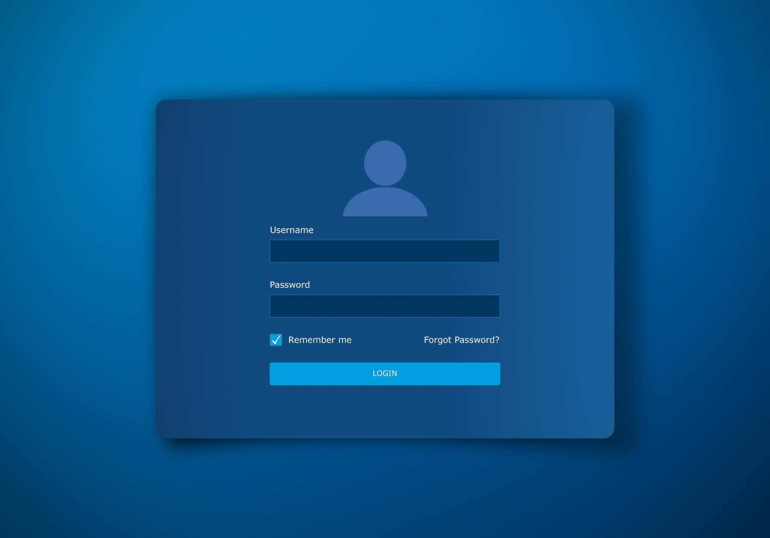
Creating an Account
Creating an account on Github is a simple process that involves signing up with your email address and creating a password. Once you have signed up, you will receive a verification email that you will need to confirm in order to activate your account.
Notes:
Creating an account on Github is easy and free. We will walk through the steps of creating an account, verifying your email address, and setting up your profile.

Slide 4

Creating a Repository
Creating a New Repository
To create a new repository, you need to go to the 'New' button on the GitHub home page and follow the prompts to set up a new repository. You will need to choose a name for your repository and decide whether it should be public or private.
Customizing Repository Settings
After creating a repository, you can customize its settings to suit your needs. This includes setting permissions for different users, adding collaborators, and choosing the license under which you want to share your code.
Notes:
A repository is a place where you can store and manage your code. We will demonstrate how to create a new repository and customize its settings, including setting permissions and adding collaborators.

Slide 5

Installing and Using Github
Installing Github
Installing Github on your computer is easy and allows you to manage your code locally. We will demonstrate how to install Github and set up your local environment. https://github.com/git-guides/install-git
Cloning a Repository
Cloning a repository is the process of creating a local copy of a Github repository on your computer. We will cover how to clone a repository in Github.
Making Changes and Uploading to Github
Making changes to a Github repository and uploading those changes is an important part of using Github. We will demonstrate how to make changes and upload them to Github.
Notes:
Installing Github on your computer is easy and allows you to manage your code locally. We will demonstrate how to install Github and set up your local environment. We will also cover how to clone a repository, make changes to it, and upload it to Github.

Slide 6

Clone Deck
Cloning a repository is the process of creating a copy of the repository on your local computer. This allows you to make changes to the code and push them back to the remote repository. Cloning can be done using the command line or Github Desktop.
Notes:
After installing Github, the first step is to clone a repository to your local computer. We will show you how to do this using the command line or Github Desktop.

Slide 7

Push Deck
The process of uploading your code to Github involves using the Git push command either in the command line or Github Desktop. It is a simple process that involves selecting the files to be uploaded, entering the Git push command, and monitoring the upload progress.
Notes:
After making changes to your code, you need to upload it to Github. We will demonstrate how to do this using the push command in the command line or Github Desktop.

Slide 8
Conclusion
Github is a powerful and essential platform for managing and collaborating on code. To get started, create an account, set up a repository, and start managing your code with ease.
Notes:
Github is an essential platform for managing and collaborating on code. By following these basic steps, you can create an account, set up a repository, and start managing your code with ease.

