Slide 1
IX: A Protected Dataplane Operating System for High Throughput and Low Latency
Adam Belay, George Prekas,
Samuel Grossman, Ana Klimovic,
Christos Kozyrakis, Edouard Bugnion
Notes:
Christos: edited the slide

Slide 2
HW is fast, but SW is a Bottleneck
64-byte TCP Echo:
Notes:
HW in black, Linux in Red, White for IX (or Tan)
Making it a build: 1.) Hardware is fast 2.) Software is a bottleneck

Slide 3
HW is fast, but SW is a Bottleneck
64-byte TCP Echo:
4.8x
Gap
8.8x
Gap
Notes:
HW in black, Linux in Red, White for IX (or Tan)
Making it a build: 1.) Hardware is fast 2.) Software is a bottleneck

Slide 4
IX Closes the SW Performance Gap
64-byte TCP Echo:
Notes:
HW in black, Linux in Red, White for IX (or Tan)
Making it a build: 1.) Hardware is fast 2.) Software is a bottleneck
Just say #2 on the slide

Slide 5
Two Contributions
#1: Protection and direct HW access through virtualization
#2: Execution model for low latency and high throughput
Notes:
HW in black, Linux in Red, White for IX (or Tan)
Making it a build: 1.) Hardware is fast 2.) Software is a bottleneck
Just say #2 on the slide
Christos: edited the slide

Slide 6
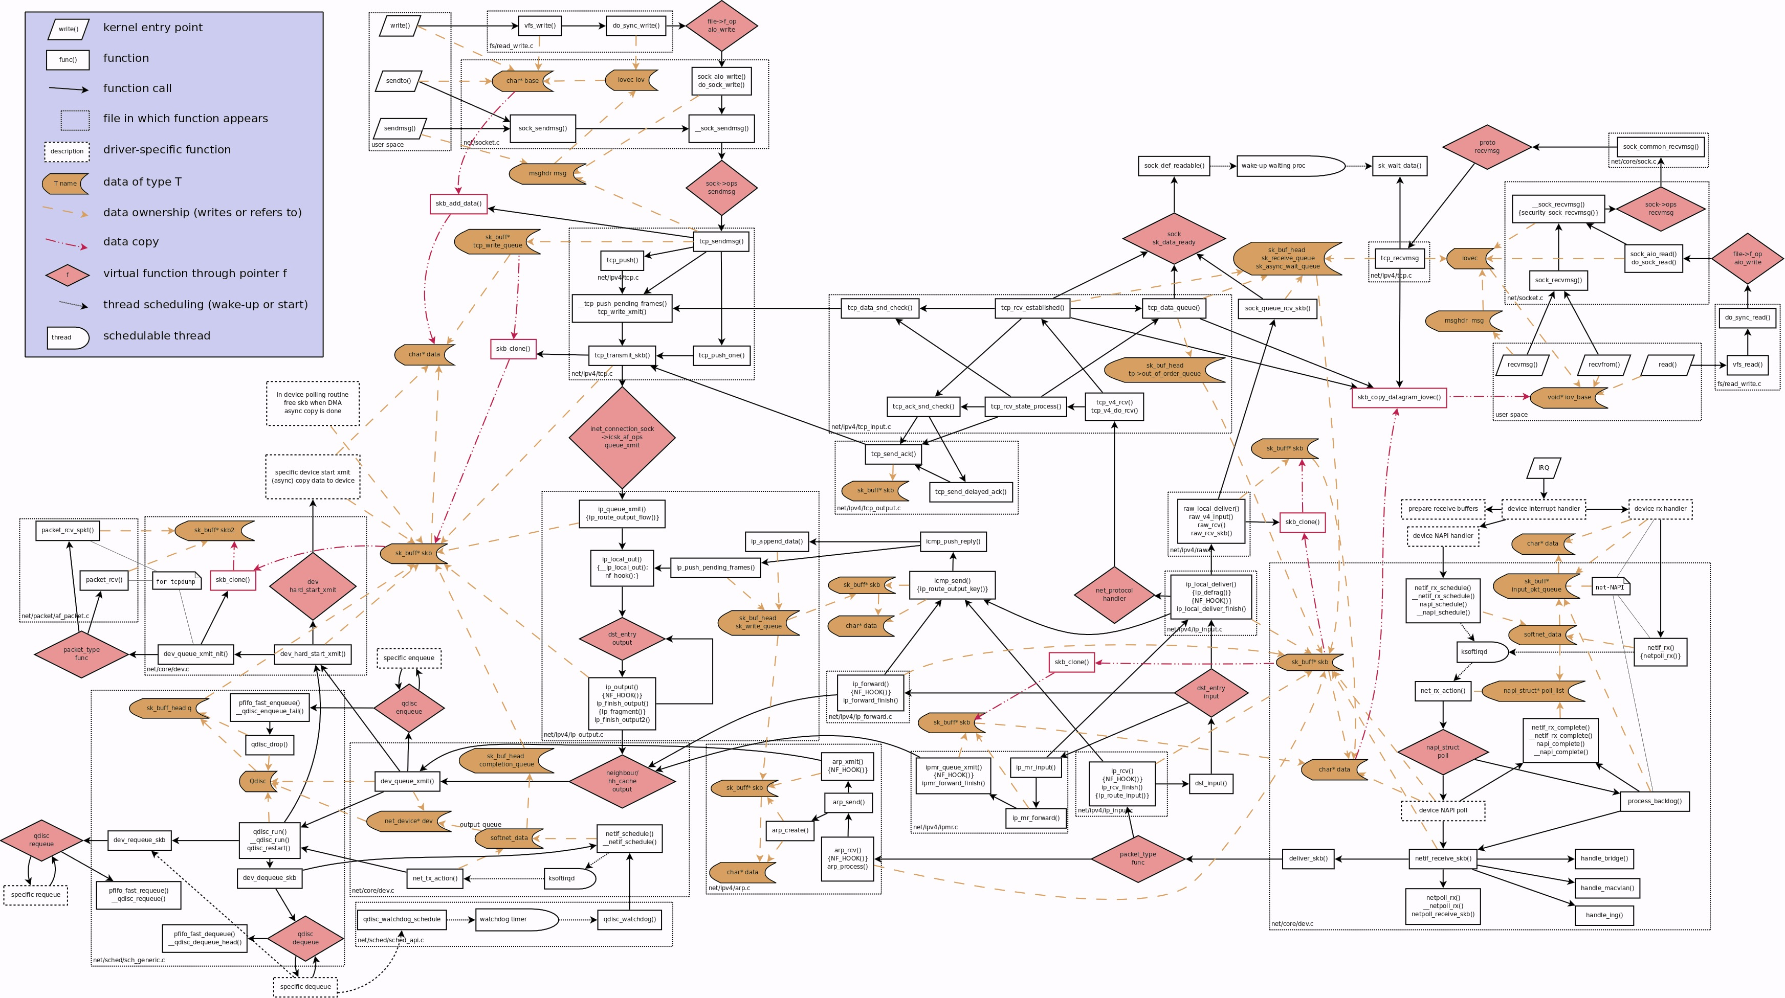
Why is SW Slow?
Complex Interface
Code Paths Convoluted by Interrupts and Scheduling
Created by: Arnout Vandecappelle
http://www.linuxfoundation.org/collaborate/workgroups/networking/kernel_flow
Notes:
Show asynchronous behavior

Slide 7
Problem: 1980s Software Architecture
Berkeley sockets, designed for CPU time sharing
Today’s large-scale datacenter workloads:
Hardware: Dense Multicore + 10 GbE (soon 40)
API scalability critical!
Gap between compute and RAM -> Cache behavior matters
Packet inter-arrival times of 50 ns
Scale out access patterns
Fan-in -> Large connection counts, high request rates
Fan-out -> Tail latency matters!
Notes:
Large scale data center workloads
Memory access latencies have changed
Very general unifying abstraction
Tradeoffs back then were such that you could do this without hurting performance
Easy intuitive explanation of quantitative trends
Don’t emphasize berkenely sockets

Slide 8
Conventional Wisdom
Bypass the kernel
Move TCP to user-space (Onload, mTCP, Sandstorm)
Move TCP to hardware (TOE)
Avoid the connection scalability bottleneck
Use datagrams instead of connections (DIY congestion management)
Use proxies at the expense of latency
Replace classic Ethernet
Use a lossless fabric (Infiniband)
Offload memory access (rDMA)
Common thread: Give up on systems software
Notes:
Just say what we do, push this to discussion end of paper
Shown how IX does it, this turns out to be very different from how people have done it in the past
TOE might be in the wrong place

Slide 9
Our Approach
Robust Protection
Between App
and Netstack
Bypass the kernel
Move TCP to user-space (Onload, mTCP, Sandstorm)
Move TCP to hardware (TOE)
Avoid the connection scalability bottleneck
Use datagrams instead of connections (DIY congestion management)
Use proxies at the expense of latency
Replace classic Ethernet
Use a lossless fabric (Infiniband)
Offload memory access (rDMA)
Tackle the problem head on…
Connection
Scalability
Commodity 10Gb
Ethernet

Slide 10
Separation of Control and Data Plane
DP
DP
CP
Userspace
Host Kernel
Kernelspace
C
C
C
C
C
Notes:
1.) Well this is not new, we separate the controlplane from the dataplane and the host operating system is really just used to allocate resources in a course-grained manner
At this point the diagram is actually not very different from arrakis or userspace TCP
2.) Show queues
3.) click in extra protection layer
4.) Rather than building a hypervisor we use the dune kernel module
5.) Reveal dataplane internals and library

Slide 11
Separation of Control and Data Plane
DP
DP
CP
Userspace
Host Kernel
Kernelspace
RX
TX
RX
TX
RX
TX
RX
TX
C
C
C
C
C
Notes:
1.) Well this is not new, we separate the controlplane from the dataplane and the host operating system is really just used to allocate resources in a course-grained manner
At this point the diagram is actually not very different from arrakis or userspace TCP
2.) Show queues
3.) click in extra protection layer
4.) Rather than building a hypervisor we use the dune kernel module
5.) Reveal dataplane internals and library

Slide 12
Separation of Control and Data Plane
IX DP
IX DP
IX CP
Ring 3
Guest
Ring 0
Host Kernel
Host
Ring 0
RX
TX
RX
TX
RX
TX
RX
TX
C
C
C
C
C
Notes:
1.) Well this is not new, we separate the controlplane from the dataplane and the host operating system is really just used to allocate resources in a course-grained manner
At this point the diagram is actually not very different from arrakis or userspace TCP
2.) Show queues
3.) click in extra protection layer
4.) Rather than building a hypervisor we use the dune kernel module
5.) Reveal dataplane internals and library

Slide 13
Separation of Control and Data Plane
IX DP
IX DP
IX CP
Ring 3
Guest
Ring 0
Linux kernel
Host
Ring 0
Dune
RX
TX
RX
TX
RX
TX
RX
TX
C
C
C
C
C
Notes:
1.) Well this is not new, we separate the controlplane from the dataplane and the host operating system is really just used to allocate resources in a course-grained manner
At this point the diagram is actually not very different from arrakis or userspace TCP
2.) Show queues
3.) click in extra protection layer
4.) Rather than building a hypervisor we use the dune kernel module
5.) Reveal dataplane internals and library

Slide 14
Separation of Control and Data Plane
IX CP
Memcached
HTTPd
Ring 3
libIX
libIX
IX
IX
Guest
Ring 0
Linux kernel
Host
Ring 0
Dune
RX
TX
RX
TX
RX
TX
RX
TX
C
C
C
C
C
Notes:
1.) Well this is not new, we separate the controlplane from the dataplane and the host operating system is really just used to allocate resources in a course-grained manner
At this point the diagram is actually not very different from arrakis or userspace TCP
2.) Show queues
3.) click in extra protection layer
4.) Rather than building a hypervisor we use the dune kernel module
5.) Reveal dataplane internals and library

Slide 15
The IX Execution Pipeline
Ring 3
3
event-driven app
Event
Conditions
libIX
Batched
Syscalls
Guest
Ring 0
2
4
TCP/IP
TCP/IP
5
Timer
RX
FIFO
6
1
RX
TX
Notes:
Synchronous not asynchronous

Slide 16

Design (1): Run to Completion
Ring 3
3
event-driven app
Event
Conditions
libIX
Batched
Syscalls
Guest
Ring 0
2
4
TCP/IP
TCP/IP
5
Timer
RX
FIFO
6
1
RX
TX
Improves Data-Cache Locality
Removes Scheduling Unpredictably
Notes:
Design is for event-based application
Asychronous, non-blocking, batched system calls

Slide 17
Design (2): Adaptive Batching
Ring 3
3
event-driven app
Event
Conditions
libIX
Batched
Syscalls
Guest
Ring 0
2
4
TCP/IP
TCP/IP
Adaptive Batch
Calculation
5
Timer
RX
FIFO
6
1
RX
TX
Improves Instruction-Cache Locality and Prefetching
Notes:
Okay I fixed latency, now I need to fix throughput. But batching kills latency, how do I do this, by using “adaptive batching”
Animate a packet a second bubble, each phase animated
Show scratch pad between stages

Slide 18
See the Paper for more Details
Design (3): Flow consistent hashing
Synchronization & coherence free operation
Design (4): Native zero-copy API
Flow control exposed to application
Libix: Libevent-like event-based programming
IX prototype implementation
Dune, DPDK, LWIP, ~40K SLOC of kernel code
Notes:
Christos: edited the slide

Slide 19
Evaluation
Comparison IX to Linux and mTCP [NSDI ’14]
TCP microbenchmarks and Memcached
~ 25 Linux Hosts
10GbE Switch
1x10GbE
4x10GbE
w/ L3+L4 bond
IX
IX
Notes:
Bonding 4x10gbe makes for a logical 40gbe NIC

Slide 20
TCP Netpipe
½ Bandwidth
@ 20 KB
½ Bandwidth
@ 135 KB
5.7 us ½ RTT

Slide 21
TCP Echo: Multicore Scalability for Short Connections
IX 10GbE
IX 4x10GbE
Linux 10GbE
Linux 4x10GbE
mTCP 10GbE
Saturates
1x10GbE
Notes:
IX saturates at 3 cores
mTCP can saturate but it needs all the cores
Linux never gets anywhere close
Minimal message size for 50% of bandwidth

Slide 22
Connection Scalability
~10,000 Connections
Limited by L3

Slide 23
Memcached over TCP
IX (p99)
IX (avg)
Linux (p99)
Linux (avg)
3.6x More RPS
2x Less Tail Latency
6x Less Tail Latency
With IX clients
Notes:
Using Linux clients, we’ve experimented with IX on the client
If we change the client we can get another 6x tail latency improvement

Slide 24
IX Conclusion
A protected dataplane OS for datacenter applications with an event-driven model and demanding connection scalability requirements
Efficient access to HW, without sacrificing security, through virtualization
High throughput and low latency enabled by a dataplane execution model
Notes:
Thank you for your attention and I’ll take any questions
Immediately have unanimated figures next

Slide 25
Separation of Control and Data Plane
IX CP
Memcached
HTTPd
Ring 3
libIX
libIX
IX
IX
Guest
Ring 0
Linux kernel
Host
Ring 0
Dune
RX
TX
RX
TX
RX
TX
RX
TX
C
C
C
C
C
Notes:
1.) Well this is not new, we separate the controlplane from the dataplane and the host operating system is really just used to allocate resources in a course-grained manner
At this point the diagram is actually not very different from arrakis or userspace TCP
2.) Show queues
3.) click in extra protection layer
4.) Rather than building a hypervisor we use the dune kernel module
5.) Reveal dataplane internals and library

Slide 26
The IX Execution Pipeline
Ring 3
3
event-driven app
Event
Conditions
libIX
Batched
Syscalls
Guest
Ring 0
2
4
TCP/IP
TCP/IP
5
Timer
RX
FIFO
6
1
RX
TX
Notes:
Synchronous not asynchronous

Slide 27
Adaptive Batching w/ Memcached

Slide 28
Connection Scalability Counters

Slide 29
Another Memcached Workload

Slide 30
TCP Echo: Long Connections
IX 10GbE
IX 4x10GbE
Linux 10GbE
Linux 4x10GbE
mTCP 10GbE
Notes:
IX is the black line

Slide 31
TCP Echo: Message Size
IX 10GbE
IX 4x10GbE
Linux 10GbE
Linux 4x10GbE
mTCP 10GbE

Slide 32
TCP Echo
Multicore Scalability
IX 10GbE
IX 4x10GbE
Linux 10GbE
Linux 4x10GbE
mTCP 10GbE
Baseline parameters:
8 cores (1 socket)
1 echo per connection
64 byte message size
Connection Duration
Message Size

