Slide 1


IX A Dataplane OS for Web-Scale Apps
Adam Belay, George Prekas, Ana Klimovic, Sam Grossman, Edouard Bugnion, Christos Kozyrakis
Stanford + EPFL

Slide 2

How I learned to Stop Worrying and Love the Operating System

Slide 3
This Talk is About
Parallelism in system SW
Locality management in system SW
Specialization in system SW
Matching system SW to modern HW
Low latency I/O + high throughput I/O + elasticity

Slide 4
Hardware is Fast
10 GbE is widely deployed
40 and 100 GbE right around the corner
>10 cores per server
With large caches
Goal: low tail latency
10-20 us RTT easily achievable
Goal: high throughput for small RPC messages
Millions of QPS easily achievable

Slide 5
But Software is the Bottleneck
Mostly Unloaded
Peak Load
Example: Linux + memcached w/ 200 bytes values
Single-socket SandyBridge + 10GbE NIC

Slide 6
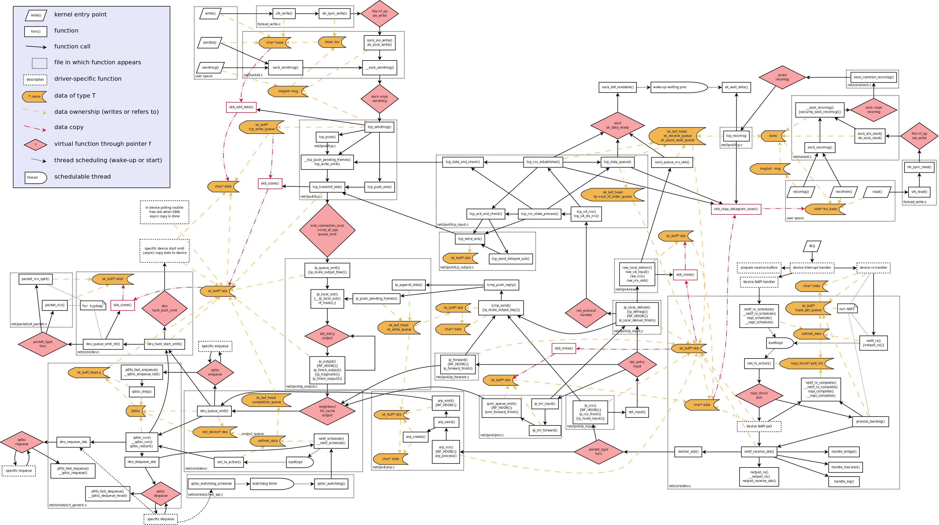
Network I/O in Linux
System Calls
And VFS
Complex Interface
Packet
Scheduling
TCP/IP
Ethernet + ARP
Interrupts
And
Deferred
Work
Scheduling and Buffering
Created by: Arnout Vandecappelle
http://www.linuxfoundation.org/collaborate/workgroups/networking/kernel_flow

Slide 7
Conventional Wisdom
Bypass the kernel
Move TCP to user-space
Avoid protection domain crossings
Replace TCP
Offload to hardware (TOE)
Use a different transport protocol (UDP, new)
Replace Ethernet
Use a different fabric (Infiniband)
Offload I/O processing to HW (rDMA)
Common thread: give up on system SW

Slide 8
Problem: 1980s System SW Architecture
We’re basically still using Berkeley Sockets
Frequent protection domain crossings
Copying and buffering
Poor D-cache behavior
Poor I-cache behavior
Jitter from process scheduling
Jitter from interrupts
None of this is inherent to system SW stacks!

Slide 9
IX
A clean-slate kernel-level I/O stack
Close to HW performance limits
10x throughput improvement for small message RPC
3x reduction in unloaded latency
Tightly bounded tail latency at high packet rates
Maintains key benefits of socket interface
TCP and UDP over commodity 10+GbE
Kernel-enforced security and isolation
Elastic resource management
High performance + high HW utilization

Slide 10
IX Design Principles
Run to Completion
Adaptive Batching
Flow-consistent Hashing
Zero Copy
Inspired by similar techniques in middle-boxes
Switches, routers, load balancers, firewalls, …
Our dataplane OS applies them to system SW
Notes:
Pipeline based vs dataplane based

Slide 11
Run to Completion
Process each packet all the way to completion
Polling, not interrupts, in the common case
Improves throughput and reduces tail latency
Better d-cache behavior, no scheduling or buffering
Idle
Timer
Free
RX Queue
Recv
App
Send
TX Queue

Slide 12
Run to Completion
Some packets may arrive out of order
That’s ok, they’re infrequent
Cold Path
Hot Path
Timer
Recv
App
Send
Free

Slide 13
Adaptive Batching
Process packets in adaptive batches during congestion
Bounded batch size (<128 packets)
Batching throughout the I/O pipeline
Improves throughput and latency during congestion
Better i-cache behavior, better prefetching, …
Timer
Free
RX Queue
Recv
App
Send
TX Queue
Notes:
Explain how we batch at every stage instead of just the API-level

Slide 14
Flow Consistent Hashing
Spread packets evenly across queues and cores
Rebalancing by adjusting hash targets or reassigning queues
Improves multicore scalability
No synchronization or coherence traffic on hot-path
RX Queue
TX Queue
Core 1
RX Queue
TX Queue
Core 2
Hash
RX Queue
TX Queue
Core 3
RX Queue
TX Queue
Core 4

Slide 15
Zero Copy
Receive buffers mapped read-only in user-space app
Sent buffers scatter-gathered directly from userspace
Reduces cache footprint, better connection/request scalability
App
Packet
Packet
Buffer
Buffer
Kernel
Packet
Packet
RX Queue
NIC
TX Queue

Slide 16
Clean-slate API
Cannot use Berkeley sockets
Incompatible with run to completion, batching, flow-consistent hashing, and zero-copy!
Our API: two low-level mechanisms
Event Conditions: notification of state changes
Batched System Calls: perform I/O and manage buffers
Implemented as simple memory arrays
Shared between the kernel and user-space app

Slide 17
API Overview
Event Conditions
Type | Description
Knock | A remotely initiated connection was opened
Connected | A locally initiated connection finished opening
Recv | A message buffer was received
Sent | A send completed and/or the window size changed
Dead | A connection was terminated
Batched System Calls
Type | Description
Connect | Opens a connection
Accept | Accepts a connection
Send | Sends data
Recv_done | Advances the receive window and frees memory buffers
Close | Closes or rejects a connection

Slide 18
IX API Operation
TCP/IP
In
Event Conditions
Recv
RX Queue
Memcached
TX Queue
TCP/IP
Out + Timer
System Calls
Send
Recv_done

Slide 19
High-level API
void event_handler(struct ixev_ctx *ctx)
{
while(work_to_do) {
if (state == INPUT) {
ret = ixev_recv(ctx, buf, len);
// request + error handling
ixev_set_handler(ctx, event_handler, EVENT_OUT);
} else if (state == OUTPUT) {
ret = ixev_send(ctx, buf, len);
// error handling
ixev_set_handler(ctx, event_handler, EVENT_IN);
}
}
}
Event-based programming models
Similar to non-blocking sockets and libevent
Investigating other programming models
Light weight threads, async I/O, futures, …

Slide 20
IX System Architecture
3-way protection
C
C
C
C
C
C
C
VMX
Non-Root
CPL 3
Domain-specific
I/O stack
httpd
memcached
libIX
libIX
Custom Runtime
VMX
Non-Root
CPL 0
IX
(Driver+TCP/IP)
IX
(Driver+TCP/IP)
IX
Custom Transport
VMX
Root
Linux
Kernel
Dune Module
Control plane for coarse-grain resource assignment
Full API compatibility
NICs
Notes:
Talk about protection
Add another slide control plane

Slide 21
IX Implementation
TCP support is based on LWIP
Not yet optimized
Kernel built on top of Dune [OSDI’12]
Privileged HW access inside a normal Linux process
Currently supports Intel 10 GbE
Working on additional drivers
37K SLOC
43% driver, 23% LWIP TCP, 16% Dune, 18% new

Slide 22
Evaluation Methodology
System Configuration
Six-core Intel SandyBridge E5-2630 @ 2.3 GHZ
Intel 82599EB 10GbE NIC
Arista 7050S-64 switch
Comparison
Linux Kernel 3.11carefully tuned for performance
Thread pinning, flow-affinity interrupt distribution
mTCP, a high performance kernel-bypass stack [NSDI’14]

Slide 23
Unloaded TCP Latency: 64B Messages
92.0
Kernel bypass not a panacea
3x reduction over Linux
22.2
6.1

Slide 24
TCP Throughput: 64B Messages
Kernel bypass not a panacea
7.07
>10x increase over Linux
3.25
0.54

Slide 25
Memcached Performance (TCP)
7x Improvement
@ 100 us 99.9th SLA

Slide 26
Conclusion
IX dataplane OS
Kernel-level I/O with great throughput and latency
Elasticity and protection
Future work
Elastic resource management
Performance improvements
Better programming models for high-performance I/O

Slide 27
Latency: NetPipe

Slide 28
Multicore Scaling: TCP Connections

