Slide 1

An incentivized, blockchain-based, forex trade platform
Whitepaper
V 0.0.1
Tutusfx Team
1/46

Slide 2
NOTICE
NOTHING IN THIS WHITEPAPER CONSTITUTES LEGAL, FINANCIAL, BUSINESS OR TAX
ADVICE AND YOU SHOULD CONSULT YOUR OWN LEGAL, FINANCIAL, TAX OR OTHER
PROFESSIONAL ADVISER BEFORE ENGAGING IN ANY ACTIVITY IN CONNECTION HEREWITH.
NEITHER Tutusfx Group. (THE COMPANY), ANY OF THE PROJECT TEAM MEMBERS WHO
HAVE WORKED ON THE TUTUSFX COMMUNITY (AS DEFINED HEREIN) OR PROJECT TO
DEVELOP THE TUTUSFX COMMUNITY IN ANY WAY WHATSOEVER (THE TUTUSFX TEAM)
NOR ANY SERVICE PROVIDER SHALL BE LIABLE FOR ANY KIND OF DIRECT OR INDIRECT
DAMAGE OR LOSS WHATSOEVER WHICH YOU MAY SUFFER IN CONNECTION WITH
ACCESSING THIS WHITEPAPER, MATERIALS PRODUCED BY THE COMPANY, OR ACCESSING
THE WEBSITE AT HTTPS://WWW.TUTUSFX.COM OR ANY OTHER MATERIALS PUBLISHED
BY THE COMPANY.
All contributions will be applied towards the Company's objects, including without
limitation promoting the research, design and development of, and advocacy for the
application of blockchain technology to trade applications through the development of an
open and dependable forex trade platform, continuous improvements to its blockchain
technology, and the building of the largest and most active forex trade platform in the
blockchain digital world.
This Whitepaper is intended for general informational purposes only and does not
constitute a prospectus, an offer document, an offer of securities, a solicitation for
investment, or any offer to sell any product, item or asset (whether digital or otherwise).
The information herein below may not be exhaustive and does not imply any elements of a
contractual relationship. There is no assurance as to the accuracy or completeness of such
information and no representation, warranty or undertaking is or purported to be
provided as to the accuracy or completeness of such information. Where this Whitepaper
includes information that has been obtained from third party sources, the Group and/or
the Tutusfx team have not independently verified the accuracy or completion of such
information.
This Whitepaper does not constitute any offer by the Group or the Tutusfx team to sell
any TT (as defined herein) nor shall it or any part of it nor the fact of its presentation form
the basis of, or be relied upon in connection with, any contract or investment decision.
Nothing contained in this Whitepaper is or may be relied upon as a promise,
2/45

Slide 3
representation or undertaking as to the future performance of the Tutusfx Community.
The agreement between the Group (or its affiliate) and you, in relation to any sale and
purchase of TT is to be governed by only the separate terms and conditions of such
agreement.
By accessing this Whitepaper or any part thereof, you represent and warrant to the
Company, its affiliates and the Tutusfx team as follows:
(a)
you acknowledge, understand and agree that Tutusfx Trade Tokens (hereinafter
referred to as TT or TTs) may have no value, there is no guarantee or representation of
value or liquidity for TT, and TT is not for speculative investment;
(b)
you will and shall at your own expense ensure compliance with all laws, regulatory
requirements and restrictions applicable to you (as the case may be);
(c)
you acknowledge, understand and agree that you are not eligible to purchase any
TT if you are a citizen, national, resident (tax or otherwise), domiciliary and/or green card
holder of a geographic area or country (i) where it is likely that the sale of TT would be
construed as the sale of a security (howsoever named) or investment product and/or (ii)
in which access to or participation in the TT token sale or the Tutusfx Community is
prohibited by applicable law, decree, regulation, treaty, or administrative act;
(d)
none of the Company, its affiliates, and/or the Tutusfx team members shall be
responsible for or liable for the value of TT, the transferability and/ or liquidity of TT
and/or the availability of any market for TT through third parties or otherwise; and
(e)
in any decision to purchase any TT, you have not relied on any statement set out in
this Whitepaper.
The Group and the Tutusfx team do not and do not purport to make, and hereby disclaims,
all representations, warranties or undertaking to any entity or person. Prospective
purchasers of TT should carefully consider and evaluate all risks and uncertainties
(including financial and legal risks and uncertainties) associated with the TT token sale, the
Group and the Tutusfx team.
The information set out in this Whitepaper is for Network discussion only and is not legally
binding. The agreement for sale and purchase of TT shall be governed by a separate Token
3/45

Slide 4
Purchase Agreement setting out the terms and conditions of such agreement (the Token
Purchase Agreement), which shall be separately provided to you or made available at
https://www.tutusfx.com. In the event of any inconsistencies between the Token
Purchase Agreement and this Whitepaper, the Token Purchase Agreement shall prevail.
All statements contained in this Whitepaper, statements made in press releases or in any
place accessible by the public and oral statements that may be made by the Group and/or
the Tutusfx team may constitute forward-looking statements (including statements
regarding intent, belief or current expectations with respect to market conditions, business
strategy and plans, financial condition, specific provisions and risk management practices).
You are cautioned not to place undue reliance on these forward-looking statements given
that these statements involve known and unknown risks, uncertainties and other factors
that may cause the actual future results to be materially different from that described by
such forward-looking statements. These forward-looking statements are applicable only as
of the date of this Whitepaper and the Group and the Tutusfx team expressly disclaims any
responsibility (whether express or implied) to release any revisions to these forward-
looking statements to reflect events after such date.
This Whitepaper may be translated into a language other than English and in the event of
conflict or ambiguity between the English language version and translated versions of this
Whitepaper, the English language version shall prevail. You acknowledge that you have
read and understood the English language version of this Whitepaper.
No part of this Whitepaper is to be copied, reproduced, distributed or disseminated in any
way without the prior written consent of the Company.
4/45

Slide 5
Background...................................................................................................................... 7
1.1 An introduction to blockchain application...................................................... 7
1.2 Trading applications will be the most important application of blockchain..7
1.3 Currency/commodities trading in recent times..............................................8
1.4 Cryptocurrency trading in blockchain application.......................................... 8
The Solution Tutusfx Community Provides..................................................................... 9
Product scheme............................................................................................................. 10
3.1 What’s Tutusfx Community?......................................................................... 10
3.2 Network form of Tutusfx............................................................................... 10
3.3 App store of Tutusfx...................................................................................... 11
3.4 Exchange market of Tutusfx Network........................................................... 11
3.5 Product architecture of Tutusfx.................................................................... 11
3.6 Product elements of Tutusfx......................................................................... 12
Reward mechanism....................................................................................................... 18
4.1 Reward pool................................................................................................... 18
4.2 Network reward distribution--- Proof of Activity......................................... 19
4.3 Users reward distribution--- Proof of Contribution...................................... 19
Ecosystem...................................................................................................................... 21
5.1 Tutusfx Group................................................................................................ 21
5.2 Site-master/management team (Trade Network account holder).............. 21
5.3 User................................................................................................................ 21
5.4 Developer....................................................................................................... 22
5.5 Advertiser....................................................................................................... 22
Outlook.......................................................................................................................... 23
5/45

Slide 6
6.1 Sales and transactions of virtual goods.........................................................23
6.2 Application and tools revenue sharing......................................................... 23
6.3 Advertising revenue.......................................................................................23
Technical realization...................................................................................................... 25
7.1 Client.............................................................................................................. 25
7.2 Network platform.......................................................................................... 26
7.3 Underlying architecture.................................................................................26
Issuance plan..................................................................................................................31
8.1 TT.................................................................................................................... 31
8.2 Distribution plan............................................................................................ 33
8.3 Distribution of tokens.................................................................................... 35
8.4 Commitment to freeze TT............................................................................. 35
8.5 Utilization of sale proceeds........................................................................... 35
Planned development roadmap....................................................................................38
Team...............................................................................................................................40
Advisors, Strategic & Cooperative Partners.................... Error! Bookmark not defined.
Strategic partners................................................................................................ 41
Cooperative partners........................................................................................... 42
Risks................................................................................................................................43
Contact us...................................................................................................................... 45
6/45

Slide 7
Background
1.1 An introduction to blockchain application
Blockchain is an immutable, decentralized, distributed database that is used to
maintain a continuously growing list of records. Each block contains a timestamp and
a link to a previous block. Every transaction is carefully hashed and signed onto the
block.
Blockchain was invented in 2013 by Satoshi Nakamoto and has seen growing
adoption over the years. Most executives and experts in the field expect the
technology to take till 2024 to gain widespread adoption. However, quite a few
applications have very recently begun to emerge with variations to the original
application of Satoshi Nakamoto.
In his work, Nakamoto used Proof of Work to determine which of miner can find a
block and how. Miners were to attempt to solve a random mathematical problem
and the result would determine who enters the block into the blockchain. In more
recent applications, more verification techniques have emanated including Proof of
Activity, Proof of Brain, Proof of Stake, Proof of Contribution, Delegated Proof of
Stake, and so on.
1.2 Trading applications will be the most important application of blockchain
As at December 2018, blockchain applications around the world had grown
considerably. Blockchain has been applied can be applied in voting systems, loans
and obligation, supply systems, financial systems, social systems, etc. Blockcoin
implements Proof of Stake, Steemit uses Delegated Proof of Stake, Qunqun
implements Proof of Contribution, etc.
The security of blockchain applications make them the perfect model for financial
transactions. Its decentralized nature makes each user independent and allows the
user the freedom to place trust of funds in the hands of someone of choice, rather
than any central administrator.
7/45

Slide 8
1.3 Instrument trading in recent times
1.4 Instrument trading in blockchain
8/45

Slide 9
The Solution Tutusfx Community Provides
In order to enrich the Forex trade applications of blockchain, on the one hand, the
threshold for the formulation and operation of blockchain applications should be lowered;
on the other hand, useful and product experiences which exceeds expectations should be
provided for trade and Network applications.
The first issue is that not everyone is capable of independently developing a blockchain-
based Internet Network. The threshold to create and operate a Trade Network is quite
high. Therefore, a one-stop solution is provided by the Tutusfx Community for anyone to
create a unique Network without any thresholds. Meanwhile, with the help of TT Token
Reward Mode, the operation threshold can be reduced effectively, with a short startup
period.
In view of the application experience in blockchain, the solution provided by the Tutusfx
Community comprises a bottom layer using a decentralized blockchain accounting-book to
record the ownership information of trade products, and deal with the transaction of trade
products by virtue of Smart Contracts so that the ecosystem economy of Network will be
transparent and clear; while the application layer shall make use of efficient centric
development architecture so as to fully guarantee the good performance of all read and
write operations as well as to effectively avoid the problems of long confirmation duration,
high cost and congestion-inducing, thus the smooth and interactive experience of Network
products can be guaranteed at the extreme.
Tutusfx Community is conceptualized by the members of The Tutusfx Team, with the
original members from the Steemit Nigeria and RedFishPillar Teams. The team is good at
9/45

Slide 10
blockchain application and creation of blockchain tools.
Product scheme
3.1 What’s Tutusfx Community?
Tutusfx Community is a blockchain-based incentivized Instrument Trade Network platform
with a range of currency/commodity/cryptocurrency instruments. Users may create their
own Trade Network on the Tutusfx Community without any coding or deployment. Users
can obtain TT rewards from the Tutusfx reward pool by operating their own Network on
the Tutusfx Community, or participating in the contributions of other Networks.
In order to promote the Network ecosystem, a new Network will be generated every 10
minutes after the formal online opening of the Tutusfx Community, and anyone can create
an initiatory Network by paying to the Tutusfx Community a Network platform toll in TT
(the initial price for such toll would be 10 TT). Each Network has a unique tag, which is
convenient for the access and memory of Network members. The ownership of Network
will be recorded on the blockchain and cannot be tampered. Networks and assets can be
traded freely in the Tutusfx Marketplace.
3.2 Network form of Tutusfx
Tutusfx Community provides an innovative Trade Network. Like an autonomous “Facebook
for trades”, each Network is independent of each other. Members of a Network can
perform dynamic releases, and follow each other. All dynamic releases of members can be
collected on the in-site Public Network.
In order to prevent Network isolation, promote content circulation and inter-Network
interaction, and ease information sourcing and distribution on the Tutusfx Community, the
Tutusfx Community will provide a unique cross-site interaction mechanism which allows
users reach other Networks and attract other users with interest in their own Networks, as
well as synchronously read the dynamic releases and perform interactions with the off-site
Network.
10/45

Slide 11
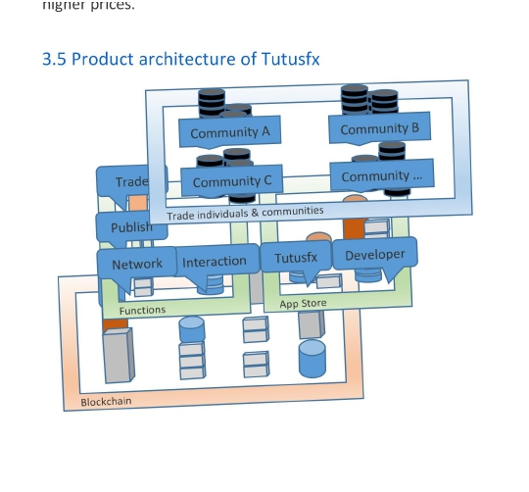
3.3 App store of Tutusfx
The Tutusfx Community will offer a Network App Store that would provide abundant trade
tools and functions for all Networks. The App Store will be made available to third-party
developers, who may develop apps and sell them on the Tutusfx Community, and receive
TT through the revenue sharing model. All transaction will be recorded on the blockchain
to ensure open and transparent accounting.
3.4 Exchange market of Tutusfx Network
Network managers will be able to obtain TT daily by managing and operating their own
Network. The value of a Network would grow with the increase in number of users. The
Tutusfx Community would also provide a Network exchange market. The key information
of each Network, such as proof of activity, revenue information, number of users and
activity of users will be recorded on the public blockchain as evidence of the value
developed by each Network. Networks with high stakes and activity are expected to fetch
higher prices.
3.5 Product architecture of Tutusfx
Figure 1 business model
11/45

Slide 12
3.6 Product elements of Tutusfx
3.6.1 Account system
The Tutusfx Community provides a complete account system. Users can join the blockchain
on Tutusfx via mobile (phone) or online (PC) registration.
Each user will be equipped with an exclusive digital identity and the Tutusfx digital wallet,
with this information recorded on the blockchain in the Tutusfx Trade Network.
Through the use of digital identity, users can access the ecosystem on the Tutusfx
Community without restrictions, and enjoy various blockchain-based Network functions
provided by the Tutusfx Community.
When entering a Network, users are required to add their identity in the Network, which
indicates that users can join multiple Networks and have a standalone identity in each
Network, and they can also participate in the construction of Networks, and at the same
time trade in currencies, cryptocurrency and commodities. Eventually, all identities can be
mapped to the exclusive digital identity that the Tutusfx Community has provided for users.
12/45

Slide 13
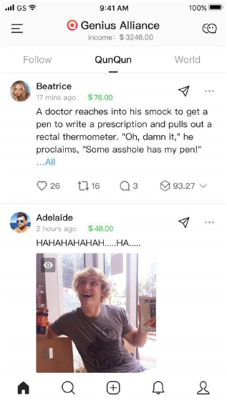
3.6.2 Timeline
Figure 2 Timeline (a timeline model from Qunqun)
As a basic function of the Tutusfx Community, all content published by a user will be
collated and presented on a “Network”. There are three types of Networks in each
Network: Favorite, site and off-site.
Favorite: It is used to display the contents collated from other users in areas which the user
has indicated previous interest.
Site: It is used to show the real-time dynamic release of all users in the Network and the
information is arranged in reverse chronological order.
Off-site: It is used to show the content of user Network communities, transferred by
members of the Network.
13/45

Slide 14
3.6.3 Content distribution
Tutusfx allows users to publish the contents in different media formats: text, images,
videos and even live broadcast. A greater variety of media formats will be available in the
future, such as links, long text, sign-in, Q&A, item transaction, etc.
3.6.4 Interaction function
Interaction module includes: Trade, buy, sell, upvote, downvote, comment, reward,
forward, add network, share, etc.
1. Trade
Users can trade on a range of trade instruments. Each trade transaction is secured on a
“Smart Contract”. The off-site content in this Network is equipped with the function of
comment and interaction.
2. Buy/Sell
To place trade, users can request to buy or sell any available cryptocurrency, currency,
commodity or other instrument. The off-site Timeline allows users to give likes on their
favorite trade contents. The information is added to the disseminating data of the original
content.
3. Upvote/Downvote
When consuming content in Timeline, users can give their favorite contents “thumbs up”
according to personal preference. These are referred to as upvotes. The off-site Timeline
also allows users to give likes on their favorite contents, and the information can be
accumulated into the disseminating data of the original content.
Likewise, users can express their dissatisfaction with poor content according to personal
preference by a “thumbs down”. In this case, it is called a downvote.
4. Comment
When trading or browsing content, users can interact with the trader, content creator or
other users based on the content through the comments section. The off-site content in
this Network is also equipped with the function of comment and interaction.
14/45

Slide 15
5. Reward
Users can directly incentivize creators of high-quality content with TT. The amount of TT
reward (less small transaction network transaction cost) will be owned by the content
creator; neither the Tutusfx Community nor Network site-master/management team will
get a share of this direct TT reward. In order to improve the reward function (as compared
to a blockchain transfer), users of the Tutusfx Community will have a “Reward Now”
function through the use of a preloaded, built-in, offline wallet.
6. Forward
Users can forward any content of interest to fans/followers, so as to reinforce trade
relationship amongst Network members.
7. Add Network
The “Add Network” function is a basic function aimed at realizing cross-site function.
As members of a Network, users may view contents of other Networks. After finding other
Networks on the Tutusfx Community, users may browse through the Networks and access
the content. Users who are interested in contents from a Network and want to share it
with other members of their own Networks may use the “Add Network” function to share
the content and creator to their own Networks.
The Networked contents will be displayed on the off-site Timeline.
The “Remove Network” function detaches a previously added Network from the user’s
Networks.
8. Share
When consuming content in the Network, users may share high-quality content to third-
party trade platforms for their friends on other trade platforms.
The third-party sharing function on the Tutusfx Community supports several mainstream
trade platforms such as Facebook, Twitter, Wechat, etc.
15/45

Slide 16
9. Services
3.6.5 Find
With growth in the Network and ecosystem, the increase in number of site-
masters/managers and users will definitely result in a larger number of Networks.
Therefore, users should have certain mechanisms to assist them in finding other users or
Networks of interest. The Tutusfx Community will incorporate a “Find” mechanism to allow
users connect with interesting content, users and Networks.
3.6.6 App Center
There are two categories of applications in the App Center. The first category comprises
various functions and applications developed by the Tutusfx Community, while the other
comprises applications developed by third-party developers with the tools provided by the
Tutusfx Community.
To enrich the functions of Network, create more marketing channels, as well as to activate
the Network, the site-master/management team may add or open the necessary
applications according to the Network’s requirements.
1. Applications developed by the Tutusfx Community
With the purpose of improving the operational efficiency of Networks, the Tutusfx
Community provides each Network with abundant tools used for Network construction
and operation. For example, a “Network Stats” App provides the statistical analysis
function for new user data, held-out data, user behavior data and all content-related core
data that has received interest during Network operation.
Meanwhile, the Tutusfx Community will provide a variety of Network robots (Bot) to assist
the site-master/management team. For example, the @netfinder Bot can automatically
generate the key contents (content topics) of the Network, as well as assist the site-
master/management team to monitor the build of the Network. It is envisaged that the
variety of Bots will play a vital role in development of marketing networks, public content
and Network activation on the Tutusfx Community.
16/45

Slide 17
2. Applications provided by third-party developers
In line with the decentralization concept of blockchain technology, the Tutusfx Community
will launch an open platform for third-party developers, while gradually improving its
blockchain technology. Any competent developer may develop and provide a variety of
third-party applications (e.g. various tools, trade and marketing networks, and tools for
Network) based on the open API provided by the Tutusfx Community.
17/45

Slide 18

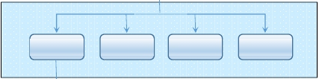
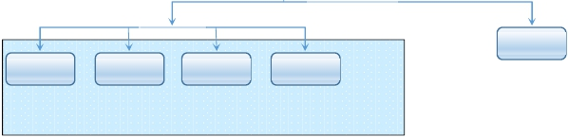
Reward mechanism
Tutusfx has set up a special ecosystem reward mechanism which uses the native Trade
Token (TT) of the Tutusfx Community as the only mechanism for the payment of rewards.
A double-layer reward mechanism based on the unique product of members’ POA (Proof
of Activity) and DPOS (Decentralized Proof of Stake) algorithm is formulated on the
platform and used to incentivize the participants who make contributions to development
of the Network and ecosystem.
The Reward Pool system would perform a calculation of reward distribution every 24 hours.
According to the calculation result, TT rewards will be automatically distributed to the
personal wallet of each participant.
Reward
Network A
Network B
Network…
Network X
DPOS
Site-master
User A
User B
User …
User Z
POA
Figure 2 Schematic diagram for double-layer reward mechanism
4.1 Reward pool
Reward Pool is a Token pool exclusively used to incentivize users who contribute towards
development of the ecosystem. Reward Pool will be replenished daily according to the
reward elastic coefficient.
18/45

Slide 19
4.2 Network reward distribution--- Delegated Proof of Stake
Reward Pool will perform the first-layer of reward distribution using a Delegated Proof of
Stake (DPOS) algorithm. 10% of distribution is distributed to the delegated network
witnesses who witness the network’s activities. This distribution is done according to a
Delegated Proof of Stake algorithm (defined below).
The calculation of DPOS is as follows: Reward Pool will calculate value of each activity and
the corresponding time taken by the witness to find the block. The witness reward (Wm) is
defined as:
k
Wm = ∑(ai /bi) i=1
Herein, ai is the value of activity i in the block, while bi is the time taken by the witness to
find the block and k is the total number of activities.
4.3 Users reward distribution--- Proof of Activity
After DPOS distribution to the Network witnesses from the Reward Pool, the remaining TT
will be distributed to the site-master/management team and users participating in the
development
of
the
Network,
based
on
a
certain
percentage.
The
site
master/management team may be entitled to adjust the distribution ratio with users
participating in the development of the Network, so long as the ratio apportioned to the
site-master/management team does not fall short of 5% and does not exceed 50%. The
initial distribution ratio of site-master/management team to users would be 50%:50%. At
this ratio, 10% is returned to the Network witnesses, 45% is returned to site-
master/administrator and the other 45% received is returned to users participating in the
Network according to a Proof of Activity algorithm (described below).
POA (Proof of Activity), implies that TT in the Reward Pool shall be distributed to each
Network and its contributors, based on its activity.
19/45

Slide 20
The calculation of POA is as follows: Reward Pool will calculate the valid DAU, valid posts,
valid number of post, valid page views, valid number of page view, valid likes, valid number
of like, valid comments, valid number of comment, the average number of posts view, the
average online duration, peak concurrent users and number of new users of each Network
every 24 hours. The activity (Am) of each Network is defined as:
k
Am ∑aiFi i=1
Herein, k is the number of factors, while Fi stands for the value of all factors proving the
Network activity obtained by using normalization algorithm,
ai is the weight of different
factors.
The daily allocation is new currency of R. All existing Networks shall be included in the
distribution. Accordingly, the overall reward Rm obtained by each Network shall be:
Rm = ∑njA=m1Aj*R
Herein n is the number of Networks within the whole ecosystem by the end of distribution.
20/45

Slide 21
Ecosystem
5.1 Tutusfx Group
The Tutusfx Group. (the Company) is the entity which develops and maintains the Tutusfx
Community.
The Group will continuously promote the application of blockchain technology to Forex
trade applications through the development of an open and dependable trade application
platform, continuously improve blockchain technology, and build the largest and most
active Network platform in the blockchain digital world, and at the same time provide a
greater selection of better Network tools and products for the whole ecosystem, and
enlarge user experience so as to create continuous user activity in the Network on the
Tutusfx Community.
5.2 Site-master/management team (Trade Network account holder)
A site-master/management team is the owner of a single Tutusfx Network.
Anyone or any institution may subscribe to an initiatory Network on Tutusfx and become
the owner of the Network simply by paying 9.99 TT.
As the operator of a Network, the site-master/management team shall be responsible for
the content and activity of the Network. Site-master/ management team shall be in charge
of user acquisition, maintenance of users, Network activation, production of high-quality
contents, enabling positive discussions, and creation of compliant communication
atmosphere.
As the solid basis of all site-master in the ecosystem, the Tutusfx Community will
incentivize site-master/management teams with TT according to the operation of all
Networks, and based on the unique POA (Proof of Activity) mechanism.
5.3 User
Users can be regarded as the cornerstone around which the ecosystem and Network on
the Tutusfx Community is built. They are the building blocks of the ecosystem.
21/45

Slide 22
After registering on the Tutusfx Community, users may join any Network that they are
interested in. Users may trade currencies, cryptocurrencies, commodities, publish analysis
and other content of interest as text, images and videos, participate in the Network
construction, as well as interact with other users in the Network. Users who create high-
quality content will be able to receive Proof of Content (POC) rewards (paid in TT) daily.
Users are the major driving force of consumption in the ecosystem, and will be required to
pay TT in exchange for various products and services on the Tutusfx Community (e.g.
payment of reward, purchase of content, purchase of apps, purchase and/or using of
online tools).
5.4 Developer
Developers play an important role in the diversified ecosystem on the Tutusfx Community.
The Company’s goal is to drive the whole Network ecosystem based on blockchain
technology and build an open and dependable trade application platform. Not only will the
Group provide basic technical support, anyone or institution possessing developmental
capability can develop the third-party applications for the ecosystem on the Tutusfx
Community.
5.5 Advertiser
Advertisers are an important part of the economy on the Tutusfx Community.
With the growth of various Networks, the Tutusfx Community will gradually introduce eco-
friendly advertisers into the Network. Part of the advertising revenue will go to the Group
and applied in accordance with its objects, while the rest will be paid to the Reward Pool in
the form of TT.
22/45

Slide 23
Outlook
The Tutusfx Community aims to become the largest and most active trade platform in the
blockchain digital world. With the rapid promotion of digital currency users and
penetration of the market, it is envisaged that the Tutusfx Community model will gradually
fulfill its potential and exceed geometric growth.
In order to continuously support the development of Networks on the Tutusfx Community,
it is planned that the commercial revenue of the Tutusfx Community will mainly come from
the following ways:
6.1 Sales and transactions of virtual goods
The Tutusfx Community Tutusfx will develop and design various virtual goods on the
Network platform (e.g. forms of Network themes, skins, paid virtual items, as well as
various personal virtual images for individuals). Some of these virtual goods may be
obtained for free, while the rest will be sold in exchange for TT.
There will be a transaction market on the Tutusfx Community which is able to support
transfers between users, as well as the transaction of various virtual goods. The Tutusfx
Community will charge a commission in TT for these transaction costs.
6.2 Application and tools revenue sharing
The Tutusfx Community will provide tools for third-party developers to provide
applications and SNS tools for the Network, and charge a portion of the revenues of these
applications and tools as fees.
6.3 Advertising revenue
Advertising is one of the critical revenue streams for the Tutusfx Community. With the help
of intelligent and reliable blockchain advertising and value analysis systems, the Tutusfx
Community combines advertising with a blockchain reward model, effectively connecting
the advertisers with users so as to maximize the interests of all parties.
23/45

Slide 24
The average revenue per user (ARPU) metric for digital currency users is several times that
of traditional mobile Internet users, which is expected to assist the rapid development of
the Tutusfx Community.
24/45

Slide 25
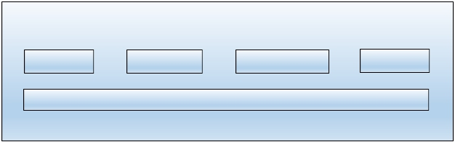
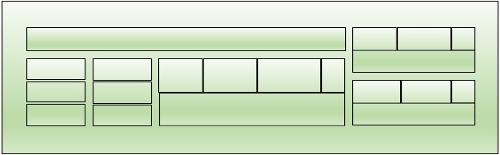

Technical realization
There are three layers included in the overall technical architecture of the
Tutusfx Community: client, blockchain platform and underlying architecture.
Client
iOS
Android
PC Browser
…
RESTful API
Tutusfx Platform
Load Balance
Tools
Themes
…
MQ
Log
Trade
Reward
Comment
…
Developer Platform
Auth
Statistic
Account
Monitor
Community Modules
Portal Policy …
Advertiser Platform
Distributed Network
Accounts
Tokens
Contracts
…
Videos
Images
Files
…
Blockchain
IPFS
Figure 3 Architecture diagram of overall technology
7.1 Client
Client refers to various terminal products which the Tutusfx Community has provided for
users to meet their different demands (including iOS, Android, etc). The Tutusfx
Community will also provide a full-featured RESTful API.
Any developer may develop tools based on these API.
25/45

Slide 26
When fully developed, the Tutusfx Community will provide a site-master/management
team with a Network management tool (Dashboard) which includes themes, functions,
application plugin tools, etc.
7.2 Network platform
Clients can access the services provided by the Tutusfx Community via RESTful API. In order
to provide RESTful API with high availability, high concurrence and high performance, the
components such as load balancing, log storage, service monitoring, message queue,
authorization checking, account unification and data statistics will be established within
the Tutusfx Community.
Account module provides basic accounting service for the ecosystem on the Tutusfx
Community. Such a unified Tutusfx account will be able to ensure security of funds, as well
as allow users to trade and enjoy all accompanying services, quickly and easily. Users may
view information of other Networks within the ecosystem, and also interact with users
from other Networks (e.g. liking, commenting and adding Networks).
Statistics module aims to record and save all core operations of the Tutusfx Community so
as to perform various data analysis. The data analysis includes calculation of blockchain
activity, trade profits and losses, user contribution, developer sharing, etc.
The Tutusfx Community will provide various tools for developers to develop the third-party
applications that are suitable for the ecosystem on the Tutusfx Community based on the
various interfaces provided by the Tutusfx Community. After the launch of the developer
platform, the Tutusfx Community will offer technical documentation and sample programs
so as to help developers get started quickly.
7.3 Underlying architecture
The underlying technology architecture of blockchain + IPFS will be adopted by the Tutusfx
Community.
26/45

Slide 27
7.3.1 Blockchain
Part of Tutusfx's core services is formulated on the blockchain technology. The native
Network of the Tutusfx Community (Tutusfx Blockchain), which is designed to be more
suitable for Trade Networks, will be launched in the future.
1. Account
Mark of user's sole digital identity;
2. Token
The native cryptographic token designed to be used on the Tutusfx Community (TT) is
based on ERC-20 standard. Users may check their TT balance through the Tutusfx
Community or any application which supports ERC-20 standard. Before the launch of
Tutusfx Blockchain, to get around the technical barrier, the Tutusfx Community will issue
the representative token on the Steem blockchain, and perform a transfer once the
development of the Tutusfx Blockchain is complete. This transfer will have no effect on the
usage and digital assets of users.
3. Smart Contract
A “Smart Contract” is issued on request to users for creation of Network, financial and
several other transactions. Various constraints shall be written into the Smart Contract in
the Tutusfx ecosystem. The realization of some blockchain-related contracts is as follows:
① Network information
Anyone can establish a Network by paying certain amounts of TT to the Tutusfx
Community. In order to mark the uniqueness and ownership of that Network, Network
information and ownership will be written into the Smart Contract of the Tutusfx
Community.
The creation and transferring of Network are shown as follows:
‣ Create a Network
Anyone can establish a Network by paying TT. Network information and ownership will be
written into Smart Contract of Tutusfx. The sample code of contract is as follows:
27/45

Slide 28
//Network data structure struct
siteInfo { string name; string
status; bool is_exist; address
owner; uint32 price;
}
uint32 SITE_CREATE_PRICE = 10;
mapping (address => uint256) public balanceOf; // account balance
mapping
(bytes32 => siteInfo) public site_info; // Network list event Transfer(address indexed
from, address indexed to, uint256 value); /**
* Create a Network
*/
function createSite(address owner, bytes32 site_key, string name)
public returns (bool success) {
//Check whether the identity is already taken. require(site_info[site_key].is_exist ==
false);
//Check balance, ORIGIN_PRICE refers to the cost of creating a Network. The initial price is
9.99TT
require(balanceOf[owner] >= SITE_CREATE_PRICE);
//Set
the
Network
ownership
site_info[site_key].is_exist
=
true;
site_info[site_key].owner = owner; //Set the
status as running site_info[site_key].status =
"running";
//Set
the
Network
name
site_info[site_key].name = name;
// Deduct expenses, TUTUSFX_ACCOUNT refers to the account of Network platform
_transfer(owner, TUTUSFX_ACCOUNT, SITE_CREATE_PRICE); return true;
28/45

Slide 29
}
‣ Purchase a Network
If users want to purchase a Network available for sale, they can perform the fee purchasing
and ownership transferring independently by virtue of calling Smart Contract. The sample
code of contract is shown as follows:
/**
* Purchase a Network
*/
function buySite(bytes32 site_key) public returns (bool success) { //Check whether
the Network is for sale. require(sha3(site_info[site_key].status) == sha3("for_sale"));
// Check whether the account balance of contract caller is adequate.
require(balanceOf[msg.sender] >= site_info[site_key].price);
//Account transfer
_transfer(msg.sender, site_info[site_key].owner, site_info[site_key].price);
//Ownership transfer
site_info[site_key].owner = msg.sender; return true;
}
Apart from the above functions, the Smart Contract of Tutusfx will also save the core
operational data such as user scale, active reservation, eco-reward, etc.;
②Ecosystem rules
The shared proportion of POA rewards that is shared by site-master/ management team
and Network users.
Rules for revenue sharing between the Tutusfx Community and third-party developers of
applications.
Rules for sharing of advertising revenue between the Tutusfx Community, site-
master/management team and users of the Tutusfx Community.
29/45

Slide 30
Quantity of TT required to create a Network.
Minimum quantity of TT required to place a trade.
Other ecosystem rules that shall be included with the development of the Tutusfx
Community.
7.3.2 IPFS
IPFS network is a fine-grained, distributed and highly compatible content distribution
network. The photos, videos, documents and “Smart Contracts” generated by users on the
Tutusfx Community will be stored on IPFS. The Tutusfx Community will record statistics to
the resources usage of each Network, and take measures (e.g. warnings and account
suspension) against users found to have abused resources.
30/45

Slide 31
Issuance plan
8.1 TT
In order to motivate developers of the blockchain and participants, and improve the
ecosystem on the Tutusfx Community, the native cryptographic token designed to be used
on the Tutusfx Community (TT) is a major component of the ecosystem on the Tutusfx
Community.
TT is a non-refundable functional utility token which will be used as the unit of exchange
between participants on the Tutusfx Community. TT does not in any way represent any
shareholding, participation, right, title, or interest in the Company, its affiliates, or any
other company, enterprise or undertaking, nor will TT entitle token holders to any promise
of fees, revenue, profits or investment returns, and are not intended to constitute
securities in Nigeria or any relevant jurisdiction. TT may only be utilized on the Tutusfx
Community, and ownership of TT carries no rights, express or implied, other than the right
to use TT as a means to enable usage of and interaction with the Tutusfx Community.
In particular, you understand and accept that TT:
(a)is non-refundable cannot be exchanged for cash (or its equivalent value in any other
virtual currency) or any payment obligation by the Group or any affiliate;
(b)does not represent or confer on the token holder any right of any form with respect to
the Group (or any of its affiliates) or its revenues or assets, including without limitation
any right to receive future revenue, shares, ownership right or stake, share or security,
any voting, distribution, redemption, liquidation, proprietary (including all forms of
intellectual property), or other financial or legal rights or equivalent rights, or
intellectual property rights or any other form of participation in or relating to the
Tutusfx Community, the Group and/or its service providers;
(c)is not intended to be a representation of money (including electronic money), security,
commodity, bond, debt instrument or any other kind of financial instrument or
investment;
31/45

Slide 32
(d)is not a loan to the Group or any of its affiliates, is not intended to represent a debt
owed by the Group or any of its affiliates, and there is no expectation of profit; and
(e)does not provide the token holder with any ownership or other interest in the Group or
any of its affiliates.
The contributions in the token sale will be held by the Group (or its affiliate) after the
token sale, and contributors will have no economic or legal right over or beneficial interest
in these contributions or the assets of that entity after the token sale.
To the extent a secondary market or exchange for trading TT does develop, it would be run
and operated wholly independently of the Company, the sale of TT and the Tutusfx
Community. The Group will not create such secondary markets nor will it act as an
exchange for TT.
8.1.1 Application scenario of TT
Application scenarios of TT include but not limited to:
1.
Purchase a Network: Users can purchase an initiatory Network from the official
platform of Tutusfx, or they may purchase a mature Network which is on sale via the
market on the Tutusfx Community.
2.
3.
Purchase paid content: Users can purchase paid content prepared by other users.
Purchase third-party applications: Some third-party applications are not for free,
therefore, users shall purchase them by paying TT.
4.
Purchase virtual goods or tools, instruments and items: Users can purchase various
on-sale virtual goods or participate in Network activities, or purchase tools and/or items.
5.
Placing trade: Users can initiate trade activity with TT. Profits from trades are added
and losses are subtracted in TT.
6.
Advertisements: Advertisers may advertise effectively through the blockchain
advertising system on the Tutusfx Community through the payment of TT.
7.
Tutusfx Reward: The Tutusfx Community will incentivize users and site-masters that
make contributions to the Network with TT.
32/45

Slide 33
8.
Network Reward: Users may use TT to incentivize creators of high-quality content
on the Tutusfx Community.
9.
Trade Reward: Users may get TT on closing a trade on profit margin.
8.1.2 Methods to obtain TT
1. Participate in the supporting programs of private placement and purchase TT with
Bitcoin, Steem or any other approved, available purchase option on Tutusfx
(http://www.tutusfx.com/approved/sellers).
2. Participate in the development of the ecosystem on the Tutusfx Community to obtain
TT as a reward.
3. Participate in trade of cryptocurrency, currency or commodity and close the trade at
profit margin.
4. Publish high-quality content and obtain TT rewards from other users.
5. Purchase TT from third-party transaction platforms.
8.2 Distribution plan
The initial issuance of Tutusfx is 1 billion TT, based on the following distribution plan:
8.2.1 Presale
The proceeds of the presale of TT will be applied towards technological research and
development, cost of hardware and bandwidth, project operation, and market promotion
of projects on Tutusfx Community.
8.2.2 Funding for the Group
The project to develop the Tutusfx Community is a long term project. In order to ensure
continuous development of the Tutusfx Community, it is necessary for the Group to
continuously recruit excellent talents to work on the project. At the same time, as part of
the development process, some important nodes will be reached and more partners will
be needed to complete it. This portion of the supply of TT will be applied towards
33/45

Slide 35
8.3 Distribution of tokens
Table 1: Token distribution plan of Tutusfx
The amount of TT sold at the presale will account for 45% of the initial (450 million TT), and
is only open to specific purchaser. The goal is to raise approximately $1 million worth of
STEEM. The presale is only available to specific overseas buyers (i.e. for countries where it
is not against laws, regulatory requirements and applicable restrictions).
8.4 Commitment to freeze TT
The 10% of TT held by the Tutusfx team will be frozen after the presale, for a total period
of 33 months. The first unlocking event is within 6 months after the completion of the
presale, later on, the unlocking part of each quarter will be not more than 10% of the total
amount of the holdings of the Tutusfx team.
8.5 Utilization of sale proceeds
8.5.1 Utilization of sale proceeds
The sale proceeds will mainly be used in the following aspects to support the development
and operation of the Tutusfx Community:
35/45

Slide 36
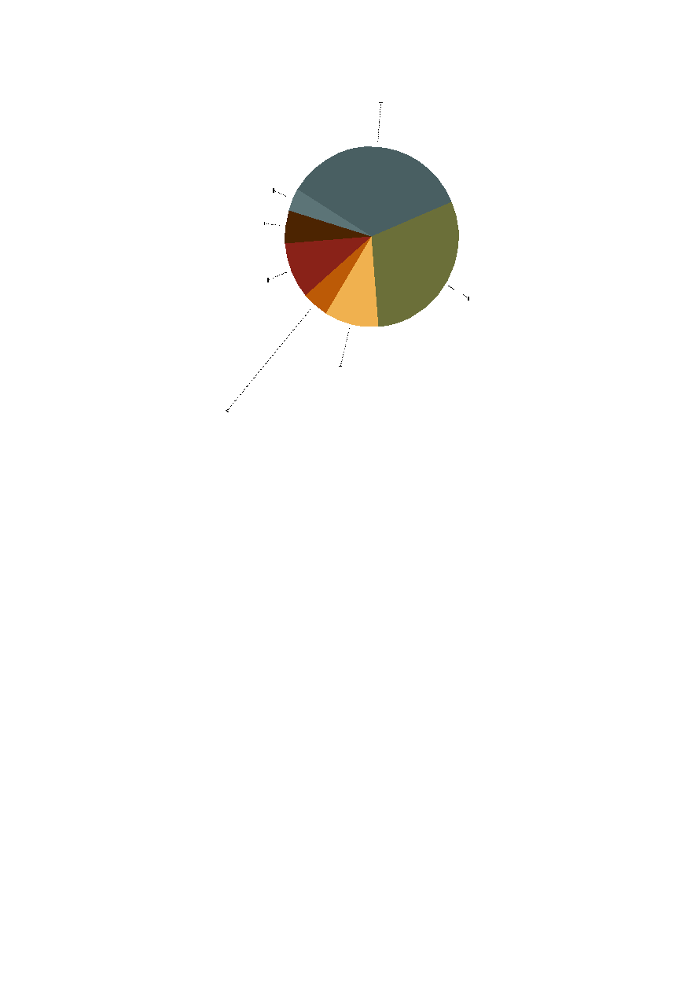
Human cost
35%
Legal and compliance
4%
Consultation
6%
Marketing
10%
Commercial development
10%
Group operation
5%
Figure 4: Distribution ratio
Risk funds
30%
36/45

Slide 38
Planned development roadmap
September 2018
Formulation of preliminary project concept
October 2018
Fulfilled requirement collection and analysis of integration of blockchain and forex Trade
Networks
Early in November, 2018
Formed the startup team
Mid-November, 2018
Finish technology research and model selection, and establish the system structure and
scheme
Late in November, 2018
Validate the project name, “Tutusfx”
February, 2019
Finish the first version of product prototype
July, 2019
Finish the second version of product prototype
September, 2019
Finish the third version of product prototype
Early in November, 2019
Finish the fourth version of product prototype
Mid-November, 2019
Final prototype analysis, evaluation and testing
38/45

Slide 39
Late in November, 2019
Marketing and presale of TT
January, 2020
Accomplish the development of the rock - bottom framework
February, 2020
Accomplish the primary function, reward system and WEB client for the Network on the
Tutusfx Community
March, 2020
Make alpha test and develop the iOS and Android App
2nd quarter of 2020
Open beta version will launch
3rd quarter of 2020
App Store and tools system will launch; migrate to the best Public Network
4th quarter of 2020
Networks over 5,000 and users over 1 million
1st quarter of 2021
Advertising system will launch, and users over 2 million.
39/45

Slide 40
Team
Tutusfx Community is conceptualized by members of Tutusfx Group (The Company). The
Group is focused on developing products which exceed expectations.
40/45

Slide 41
Advisors, Strategic & Cooperative Partners
Prof. F. E. Aburime
Advisor
Head of Department, Mathematics, Madonna University.
Dr. Ogini (Ph.D)
Advisor
ICT Director, Delta State University.
Strategic partners
41/45

Slide 42
Cooperative partners
42/45

Slide 43
Risks
You acknowledge and agree that there are numerous risks associated with cryptocurrency
trading, currency trading, commodities trading, purchasing TT, holding TT, and using TT for
participation in the Tutusfx Community.
1. Uncertain Regulations and Enforcement Actions
The regulatory status of trading (including and not limited to currency, commodities and
cryptocurrency trading), TT and distributed ledger technology is unclear or unsettled in
many jurisdictions. It is impossible to predict how, when or whether regulatory agencies
may apply existing regulations or create new regulations with respect to such technology
and its applications, including TT and/or the Tutusfx Community. Regulatory actions could
negatively impact TT and/or the Tutusfx Community in various ways. The Group (or its
affiliates) may cease operations in a jurisdiction in the event that regulatory actions, or
changes to law or regulation, make it illegal to operate in such jurisdiction, or commercially
undesirable to obtain the necessary regulatory approval(s) to operate in such jurisdiction.
After consulting with a wide range of legal advisors and continuous analysis of the
development and legal structure of virtual currencies, the Group will apply a cautious
approach towards the sale of TT. Therefore, for the presale, the Group may constantly
adjust the sale strategy in order to avoid relevant legal risks as much as possible. For the
presale, the Group is working with ____________, a boutique corporate law firm in Nigeria
with a good reputation in the blockchain space.
2. Loss of Talent
The development of the Tutusfx Community depends on the continued cooperation of the
existing technical team and expert consultants, who are highly knowledgeable and
experienced in their respective sectors. The loss of any member may adversely affect the
Tutusfx Community or its future development.
3. Competitors
It is possible that alternative networks could be established that utilize the same or similar
code and protocol underlying TT and/or the Tutusfx Community and attempt to re-create
43/45

Slide 44
similar facilities. The Tutusfx Community may be required to compete with these
alternative networks, which could negatively impact TT and/or the Tutusfx Community.
4. Security weaknesses
Hackers or other malicious groups or organizations may attempt to interfere with TT
and/or the Tutusfx Community in a variety of ways, including, but not limited to, malware
attacks, denial of service attacks, consensus-based attacks, Sybil attacks, smurfing and
spoofing. Furthermore, there is a risk that a third party or a member of the Group or its
affiliates may intentionally or unintentionally introduce weaknesses into the core
infrastructure of TT and/or the Tutusfx Community, which could negatively affect TT
and/or the Tutusfx Community.
5. Failure to develop
There is the risk that the development of the Tutusfx Community will not be executed or
implemented as planned, for a variety of reasons, including without limitation the event of
a decline in the prices of any digital asset, virtual currency or TT, unforeseen technical
difficulties, and shortage of development funds for activities.
6. Other risks
In addition to the aforementioned risks, there are other risks (as more particularly set out
in the Token Purchase Agreement and Trade Placement Agreement) associated with your
purchase, holding and use of TT, including any which the Group might not anticipate. Such
risks may further materialize as unanticipated variations or combinations of the
aforementioned risks. You should conduct full due diligence on Tutusfx Group. (and its
affiliates), the Tutusfx team, understand the overall framework and vision for the Tutusfx
Trade Community prior to purchasing TT.
44/45

Slide 45
Contact us
Official website: https://www.tutusfx.com
Email address: contact@www.tutusfx.com
Social Media
Facebook：https://www.facebook.com/tutusfx
Steemit：https://www.steemit.com/@tutusfx
Telegram：https://t.me/tutusfx
Twitter：https://twitter.com/tutusfx
Medium：https://medium.com/tutusfx
LinkedIn：https://linkedin.com/tutusfx
45/45

