Slide 1
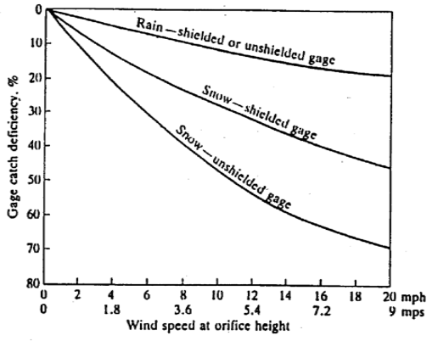
January 7, 2019
Rain: 0.40 inches
Windspeed: 10.2 mph
Catch Deficiency: 12%
Corrected Precip: 0.45 inches
January 22, 2019
Snow: 0.22 inches
Windspeed: 8.7 mph
Catch Deficiency: 42%
Corrected Precip: 0.38 inches

