Slide 1

Jay Humphreys | Greg Hansell | Alex Elias | Chris Sweet

Slide 2


Vision
Accessibility in Education
“To provide all students with rooms to study in across campus based on accessibility requirements and preference”

Slide 3
Sensor and Static Data Requirements
Displayed room properties were based on accessibility
Sensor Requirement (Dynamic Properties)
PIR Sensor
Acoustic Sensor
Light Sensor
Occupancy Switch
Air quality sensor
Room Requirement
Room size
Ground floor / elevator accessibility
Noise level
Sunlight / Window / Window angle
Tutoring
Food, garbage bin, vending machine
Bathroom
Air quality
Black board, white board, projector
Student Disability
Immobility
ADD / ADHD, Anxiety
Depression, SAD
Learning Disabilities
Veisalgia (Hangover)
Diabetes
Allergies
Static Properties
Floor, location, dimensions
Windows
Tutoring
Food, garbage bin, vending machine
Bathroom
Black / white board, projector

Slide 4
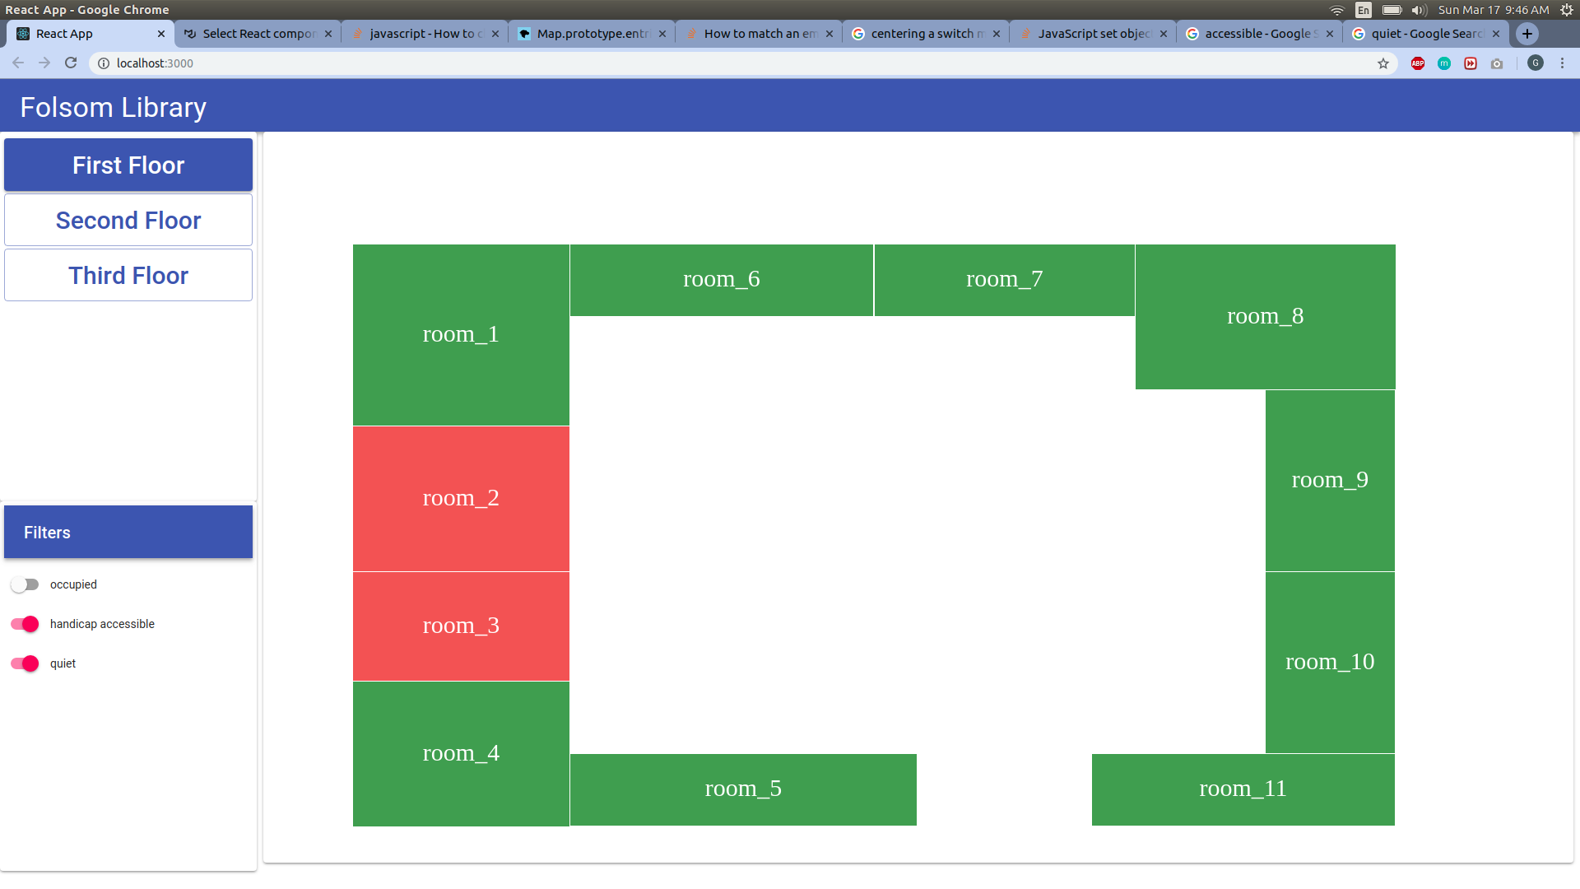
The HiveMap Solution
A web dashboard combining dynamic IoT sensor data with static room information
Map designed with custom graphical generator tool
Filter based on accessibility requirements
Rooms update with live sensor data

Slide 5
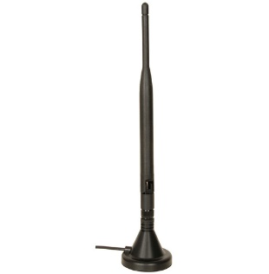
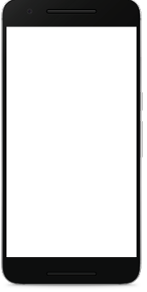
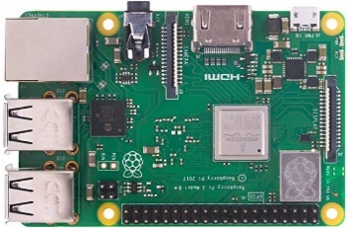
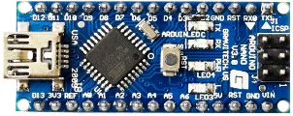
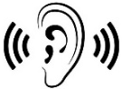








Network Topology
Sensor information is moved through 2 layers of a wireless network
nRF24
Randomized load balancing
nRF24
nRF24
http
http
nRF24
http
Sensor Data
Sensor and Static Data
A Layer
π Layer

Slide 6


Next Steps
Routing
Optimization
Administrator
Control Panel
Network
Security

Slide 7









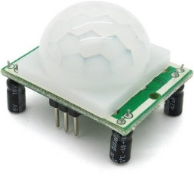
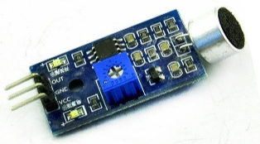


Technologies Used for Implementation
A-Layer Sensor Nodes
π-Layer Intercommunication
π Layer Web Front End
Arduino Nano
Python 3.7
AIOHTTP
Node.js
asyncio
nRF24
Material-UI
Acoustic
Sensors
PIR Sensors
React

