Slide 1

Alex Elias • Greg Hansell • Ethan Rambacher • Ethan Cantlin

Slide 2
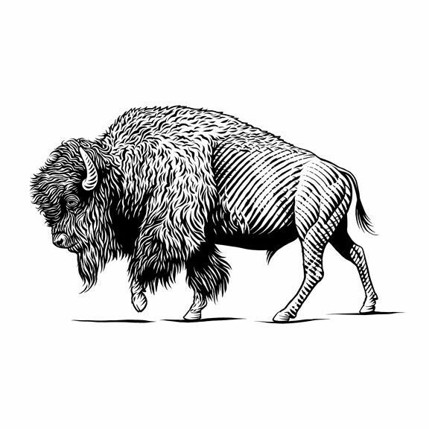

Vision
Increase safety
Real time information
GPS denied
Private
Distributed
Decentralized
Road safety
Anonymous
No more private than looking at the road

Slide 3
The Country Roads Solution

Slide 4
Next Steps

