Slide 1

Alex Elias • Greg Hansell • Ethan Rambacher • Ethan Cantlin

Slide 2


Vision
Increase driving safety using real-time, non-invasive, and anonymous data communicated between cars and distributed relay centers.

Slide 3

Our Pledge
Country Road strives to ensure collected data is no more specific than someone could collect standing on the side of the road.

Slide 4
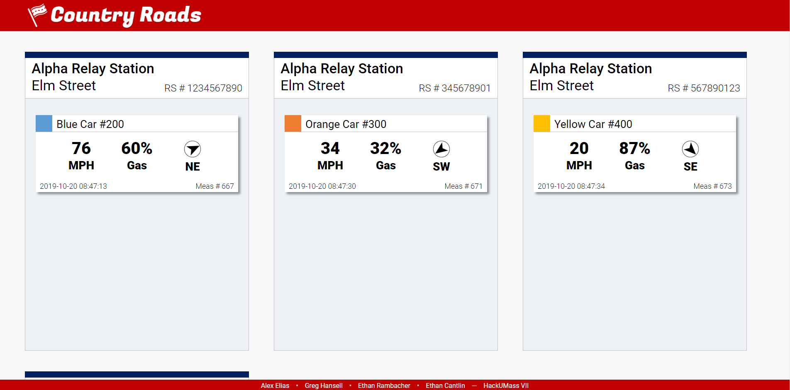
The Country Roads Way
Relay Location:
Station Name
Station Number
Street Name
Car Info:
Color
ID
Speed
Fuel Level
Travel Direction
Timestamp

Slide 5
Our Secret Recipe
Car
Car
Relay
Relay
Relay
Requester
Database
GUI

Slide 6

Larger Impacts
Communication between self-driving and human operated cars
Increases user privacy and data security
Reduces reliance on GPS enabled phones

Slide 7









Technology Used

Slide 8
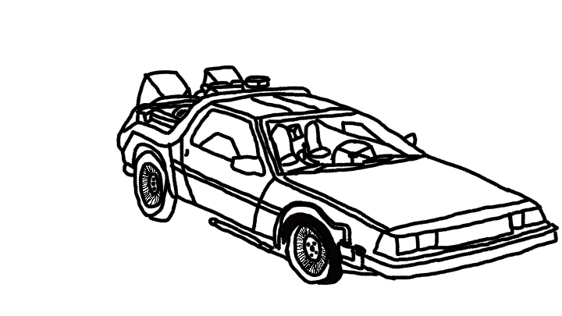
Future Work
Interface directly with car ECU through OBD port
Broaden data spectrum
User customizable alerts
Peer-to-peer sharing

