Slide 1

A CONUS-wide crown-width library for FVS-CONUS
One defensible per-species estimator of maximum (MCW) and largest (LCW) crown width
Aaron Weiskittel · David Marshall · Greg Johnson
Center for Research on Sustainable Forests, University of Maine · 22 July 2026
Status: form settled, both fits converged
Notes:
Technical update to David Marshall and Greg Johnson for the variant-free FVS-CONUS project. The deliverable is one continental estimator of maximum crown width, the near open-grown envelope that anchors crown competition factor, and largest crown width, the crown a tree actually carries under competition, for every FVS-CONUS species. Since the last update three things closed. The functional form is settled: a single power family for both clades, and the earlier softwood saturating Mitscherlich is retired. Both hierarchical fits have converged, which took a non-centered parameterization of the variance components rather than any change to the model. And the stochastic frontier cross-check is complete in both clades. What is still pending is the library export now running on Cardinal, and with it the row counts, the per-species coefficient ranges, and the cross-validated coverage and pinball numbers. Those are flagged as pending and no final number is stated until the run supplies it.

Slide 2

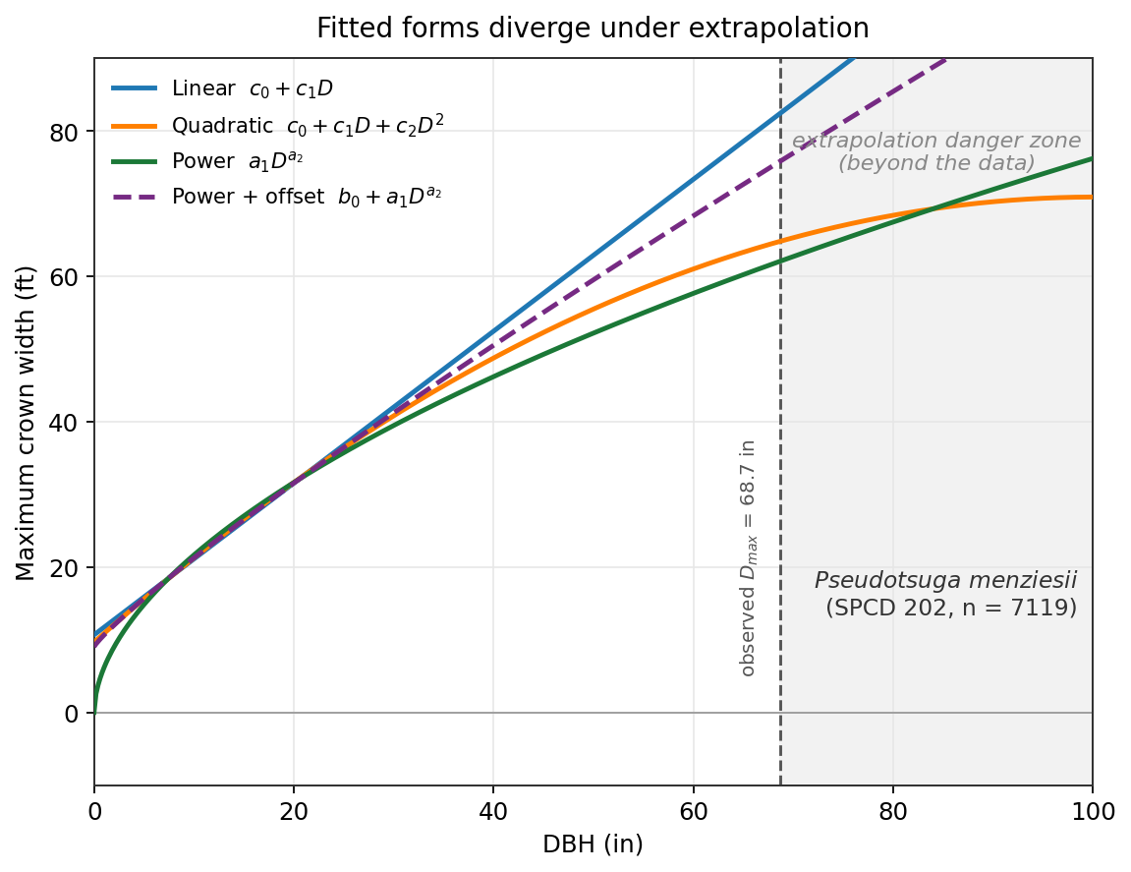
FVS crown-width equations extrapolate badly beyond their fitted range
Per variant, not continental.
Each geographic variant fits its own form to its own sample, and the maximum is often a bolted-on cap.
Forms that misbehave outside the data:
Linear keeps widening without bound: the variant equations fan from 69 to 198 ft at a DBH of 100 in.
Quadratic peaks, turns over, then goes negative.
We want one defensible per-species estimator that behaves across the full diameter range.
2
Notes:
This is the problem the project exists to solve. FVS carries crown width as a patchwork of variant-specific equations, and the maximum is frequently a hard cap rather than an estimated quantity, with species mapped by hand to a surrogate group. The forms behave inside their calibration window and poorly outside it. The figure is David Marshall's Douglas-fir case. A linear maximum keeps widening without bound, so a large stem gets an implausible crown: across the six variant Douglas-fir equations the predictions fan from 69 to 198 ft at a diameter of 100 inches, and they already diverge by up to 2.8-fold inside the fitted range. The quadratic peaks at a finite diameter and then turns down toward negative widths. Neither is acceptable in an operational library that FVS will evaluate beyond a species' calibration window. The power form, in green, rises monotonically and decelerates. The variant-free FVS-CONUS project removes the geographic seams and needs a single estimator that spans the contiguous United States.

Slide 3
One dataset, read at two heights of the same crown-width cloud
MCW is the τ = 0.95 near open-grown envelope. LCW is the median stand-grown crown, bounded below MCW by construction.
A hierarchical Bayesian quantile model on one power family, CW = exp(la1) · DBH^{a2}: species and EPA Level III ecoregion as random effects, plus functional-trait slopes that carry data-poor species. One fit per clade returns a species-dependent and a trait-based prediction for the full CONUS list.
127,710
221
58
33
crown-measured trees
crown-measured species; 211 enter the models, 32 families
EPA Level III ecoregions
states
The same FHM / FIA Phase 3 detailed-crown records Bechtold (2003, 2004) modeled species by species.
3
Notes:
The trick is that we do not need two datasets. Every field record is a stand-grown tree, so each is in effect an observation of largest crown width. Maximum crown width is not separate data; it is the upper envelope of the same cloud, the well-expressed trees in low-density patches near the top of the crown-width-on-diameter distribution. Quantile regression reads one relationship at a chosen height: the 0.95 quantile for the near open-grown MCW and the median for LCW. This dissolves the champion-tree problem, because the envelope is estimated from thousands of well-expressed trees rather than anchored to one or two registry stems. A species random effect with a crossed ecoregion effect replaces the hand species-group mapping through partial pooling, and in hardwoods four trait slopes carry species with little or no crown data. Both clades now sit on the same power family; they differ only in how deep a taxonomic hierarchy each sample can identify, which slide 13 spells out. LCW is built as a bounded ratio of observed crown to predicted MCW, so it cannot exceed MCW, and the ratio fit came back with zero violations of that constraint across the 119,511 trees that carry a usable crown ratio. On the species counts: the crown-measured sample carries 221 species, and 211 of them enter the fitted models. The ten that do not have no EPA Level III ecoregion label on any of their trees, so brms drops them; they total 1,312 trees and the library serves them from the clade population equation, flagged as population_fallback.

Slide 4
We started with two clade forms and ended with one
What we assumed
What the data said
A clade split on functional form.
Softwoods on a saturating Mitscherlich with an estimated asymptote.
Hardwoods on a power form.
Motivated by a binned envelope that appeared to flatten for softwoods and keep climbing for hardwoods.
The softwood asymptote never converged: R-hat up to 2.1, effective sample sizes near 5.
One power family for both clades.
Per-species exponents are the same in each clade, 0.610 and 0.626, both below one.
The fitted Mitscherlich asymptote sits BELOW the observed crown maximum, 0.84 of it in softwoods and 0.76 in hardwoods.
Power carries the lower paired blocked cross-validated loss in both clades, and the Mitscherlich is not better in any of the 5 folds.
A sub-linear power already produces the flattening the diagnostic showed.
The asymptote was never estimable. Retiring it removed a parameter the data could not locate and cost nothing in held-out accuracy.
4
Notes:
This is the before and after, and it is the biggest change since the last update. We started from a clade split on functional form, softwoods on a saturating Mitscherlich with an estimated asymptote and hardwoods on a power, because a binned 95th-percentile envelope appeared to flatten for softwoods and keep climbing for hardwoods. That specification never converged on the softwood side; the whole log-asymptote block was unidentified with R-hat as high as 2.1 and effective sample sizes near five. We then tested the assumption directly rather than around it. Three things came back. The per-species exponents are the same in both clades and both well below one. The Mitscherlich, fit directly to the envelope, settles on an asymptote that sits below the observed crown maximum, at 0.84 of it in softwoods and 0.76 in hardwoods, so it is describing the bulk of the cloud rather than bounding it. And in paired ecoregion-blocked cross-validation the power form carries the lower held-out loss in both clades and the Mitscherlich does not win a single fold. The resolution is arithmetic once you see it: a power with an exponent below one already has a declining envelope slope, so the flattening that motivated the split is a property of any sub-linear power and implies no ceiling. Both clades now ship on one power family.

Slide 5
An independent per-species check points to the same power form
Marshall's approach, replicated at scale.
Per-species frequentist quantile fits at τ = 0.95 on Douglas-fir and on every species with at least 200 crown trees, 88 species in all, across four candidate forms.
The power form is the best-behaved of the four.
Pseudotsuga menziesii (Mirb.) Franco lands at an exponent of 0.56.
“The power form wins on AIC and the FVS variant equations extrapolate absurdly for large stems.”
Confirms Russell and Weiskittel (2010), who reached the same power form for MCW and LCW in Maine over this diameter range.
Douglas-fir, 7,119 crown trees. Marshall's independent benchmark, run in parallel.
5
Notes:
The pivotal new evidence is a per-species frequentist benchmark that replicates David Marshall's approach directly. For every species with at least 200 crown trees, 88 in all, we fit David's four forms, linear, quadratic, power, and power with a free offset, by quantile regression at the 0.95 quantile. David's own Douglas-fir starting point was the tension: it is a softwood, yet his best fit is a decelerating power with an exponent near 0.56 and no asymptote, which is what first put the softwood Mitscherlich in question. That question is now closed, and the softwood Mitscherlich has been retired. Reaching the same power form as Russell and Weiskittel 2010 in Maine, and doing it species by species across the continent, is strong corroboration. This is the slide that sets up the exponent-parity finding on the next slide.

Slide 6
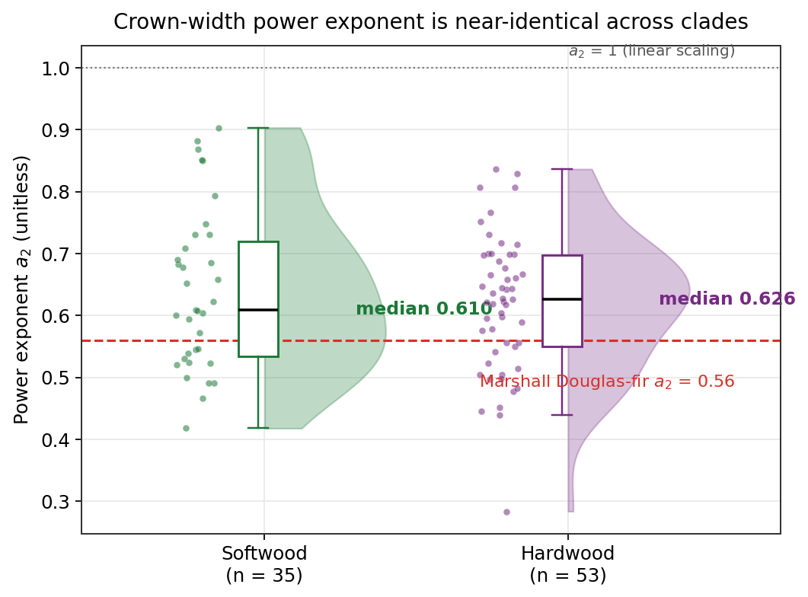
Softwood and hardwood exponents are the same, and both below one
The finding
Softwood a₂ median 0.610.
Hardwood a₂ median 0.626.
Both well below 1, so both decelerate.
Final hierarchical fits agree: 0.605 and 0.587.
Softwoods do not saturate distinctly in range. This is what retired the clade split.
6
Notes:
This is the pivot. The power exponent is the diagnostic quantity: below one means a decelerating, concave curve; at or above one means an accelerating one. The softwood median is 0.610 across 35 species and the hardwood median is 0.626 across 53, the distributions overlap almost completely, and both sit well below one. David's Douglas-fir at 0.56 sits squarely inside the softwood cluster. The two final hierarchical fits, from a completely different estimator, land at 0.605 and 0.587, right inside these distributions, which is the cross-check that matters most. Read one species at a time, softwoods follow the same decelerating power as hardwoods and show no distinct in-range saturation. That is direct empirical support for the single power family, and together with the envelope reconciliation on the next slide it is what retired the clade split. It is worth being careful about the two separate diagnoses here: the Mitscherlich asymptote failed because the data never identified it, a mean-structure problem that removing the asymptote fixed, while the later convergence trouble under the power family was a funnel in the variance components that the non-centered parameterization fixed. The global gymnosperm-versus-angiosperm shape contrast that Katabuchi and colleagues reported from the Tallo database is driven by very large open-grown trees; a Phase 3 stand-grown sample capped at ordinary inventory diameters, carrying only 52 softwood stems above 40 inches, does not include the stems that would bend the softwood curve to its ceiling. The plateau is plausibly real but off the top of our cloud, and the per-species diameter cap in the library is where we mark that boundary.

Slide 7
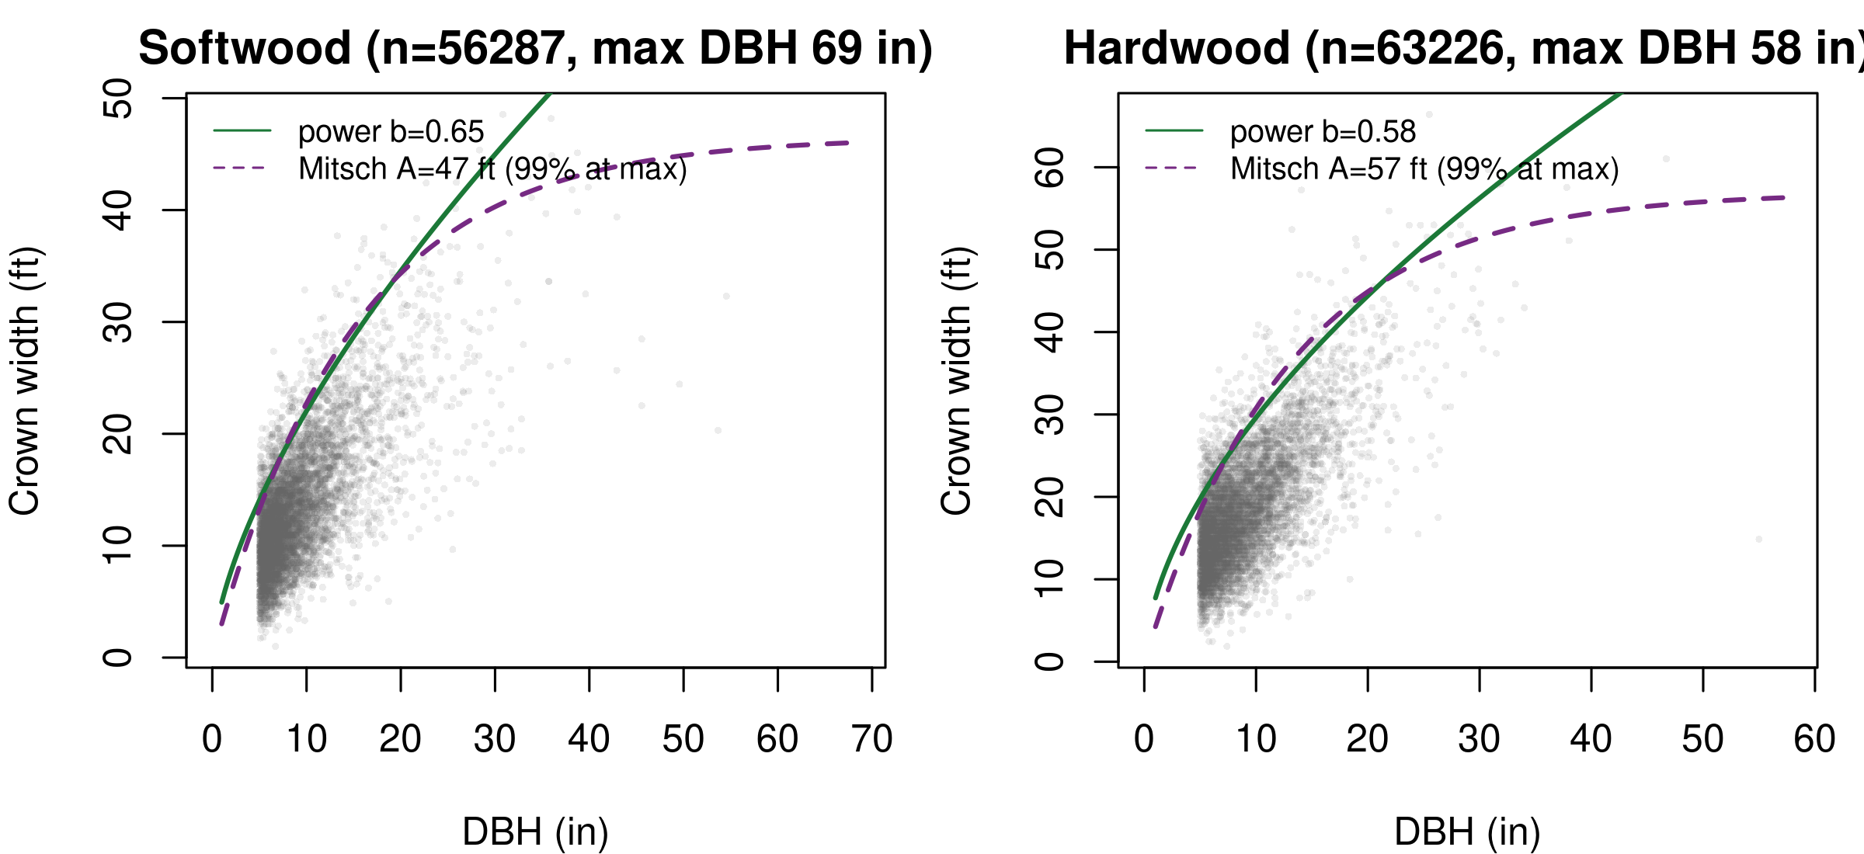
The saturating form plateaus below the trees it is meant to bound
0.84 / 0.76
0 of 5
0.65 / 0.58
Mitscherlich asymptote as a fraction of the observed maximum crown width (softwood / hardwood)
blocked cross-validation folds where the Mitscherlich beats the power form, in either clade
power exponent, unchanged when refit on stems 30 in DBH and under
Softwood flattening near 69 in rests on about 13 trees. A sub-linear power produces that flattening on its own.
7
Notes:
This is the slide that closes the form question, and it is new since the last update. Rather than argue from convergence behavior, we fit the competing forms directly to the 0.95 envelope in each clade and scored them on a single shared ecoregion block map, so the comparison is paired fold by fold. Three results. First, the Mitscherlich does run out its curvature inside the data, reaching about 99 percent of its nominal asymptote at the largest observed diameter, but the asymptote it settles on sits below the observed crown maximum, at 0.84 of it in softwoods and 0.76 in hardwoods. A saturating form that plateaus beneath the trees it is meant to bound is describing the bulk of the envelope, not a ceiling. Second, the power form carries the lower held-out pinball loss in both clades, and the Mitscherlich does not win a single one of the five blocked folds, so the extra asymptote parameter buys no accuracy. Third, refitting on stems 30 inches and under leaves the exponent unchanged at 0.65 and 0.58, which tells us the apparent softwood flattening lives entirely in the sparse large-diameter tail. That tail is thin: the softwood signal near 69 inches rests on roughly 13 trees. Put together, softwood does not distinctly saturate, and one power family is the form the data support.

Slide 8
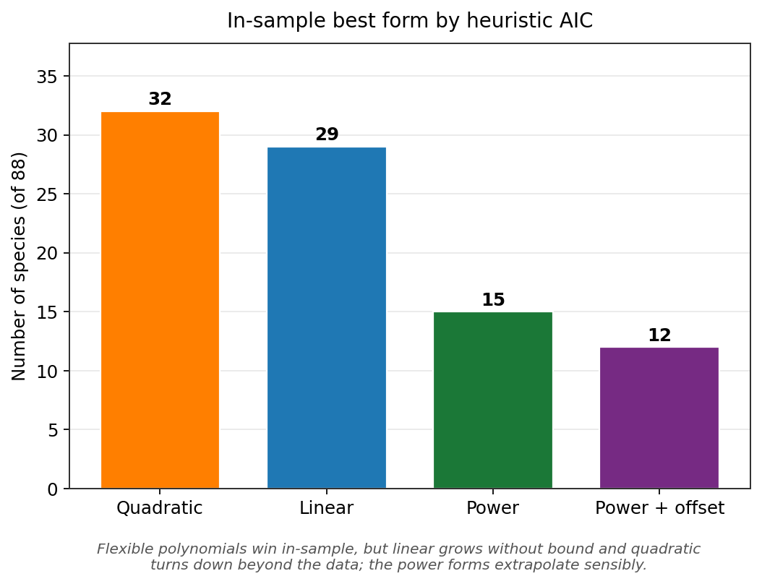
AIC likes the polynomials; extrapolation behavior says use power
In sample, the flexible polynomials win the tally (quadratic 32, linear 29 of 88). Out of sample, the linear runs away and the quadratic turns over and goes negative. Power is the honest choice: it fits in range and behaves out of range.
8
Notes:
Here the in-sample criterion and the behavioral criterion point in different directions, and the difference is the crux of the form choice. By a heuristic AIC per species, the quadratic is best for 32 species and the linear for 29, with power 15 and power-with-offset 12; read naively that favors a polynomial. The behavioral criterion overturns it. The linear extrapolates without bound and the quadratic peaks and then predicts shrinking, eventually negative, crowns beyond the fitted range. Neither is acceptable operationally. The power form is monotone and concave, rises without turning over, and its exponent below one keeps the rise decelerating. So we prefer power for its extrapolation behavior even where a polynomial edges it in sample, consistent with Russell and Weiskittel 2010. The extrapolation screen overrides the in-sample tally.

Slide 9
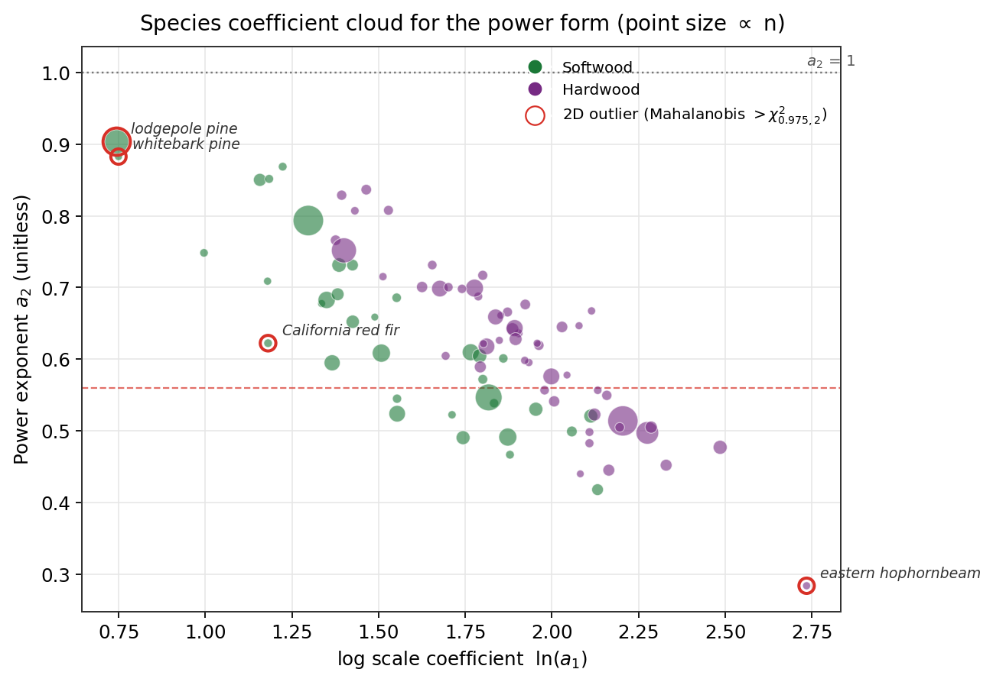
The two clades occupy one coefficient cloud, not two
Exponent against scale.
Softwoods and hardwoods share the same region of coefficient space rather than separating.
A handful of species sit off the main cloud; these outliers get flagged and reviewed before they enter the operational library.
9
Notes:
Plotting each species in exponent-against-scale space makes the parity concrete: the two clades occupy the same region rather than separating into a softwood cluster and a hardwood cluster. That is the coefficient-space view of the same finding. It also surfaces the per-species outliers, a handful of species whose exponent or scale sits well off the main cloud, usually low-sample or ecologically unusual species. Those get flagged, Mahalanobis-style, and reviewed so a poorly determined single-species fit does not ship into the operational library unchecked. Partial pooling in the hierarchical model already shrinks the worst of these toward family and ecoregion.

Slide 10
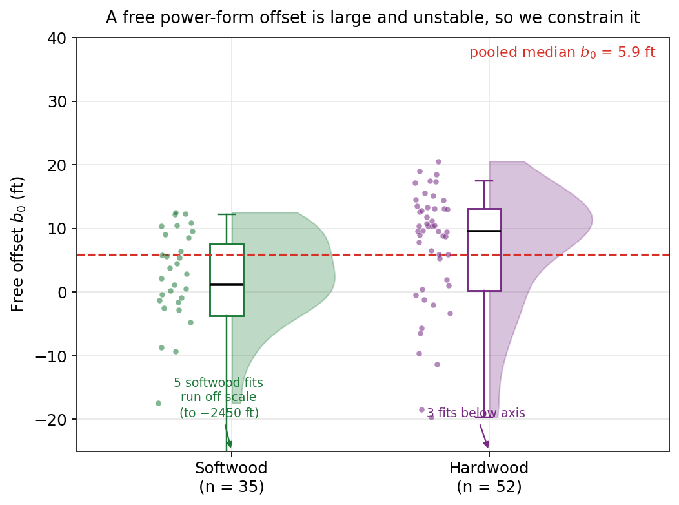
A free small-tree offset wanders, so we hold it with a prior
The tradeoff
A free offset b₀ improves the small-diameter fit (median 5.92 ft) but trades off against scale and exponent, wandering to absurd values in some species.
Tested as a candidate form. It matched the plain power on held-out loss and cost a parameter, so the library ships the plain power.
10
Notes:
David's power-with-offset form fixes the crown at a positive value when diameter is zero, which the plain power cannot do because it passes through the origin. The offset helps at small diameters, but when we let it float its median across species is 5.92 ft and in a number of species it wanders hard, from minus 17 to plus 12 ft, dragging the exponent with it across a range of 0.23 to 1.60. That is exactly the concern David raised, that a free B0 will run off. Fixing or tightly constraining it collapses that wander and settles the exponent back into the decelerating 0.44 to 0.72 band. We carried the constrained-offset form through the form comparison as a candidate. It came out indistinguishable from the plain power on held-out loss while costing a parameter that has to be held up by a prior, so the shipped library uses the plain power and we document the offset as tested and not needed.

Slide 11
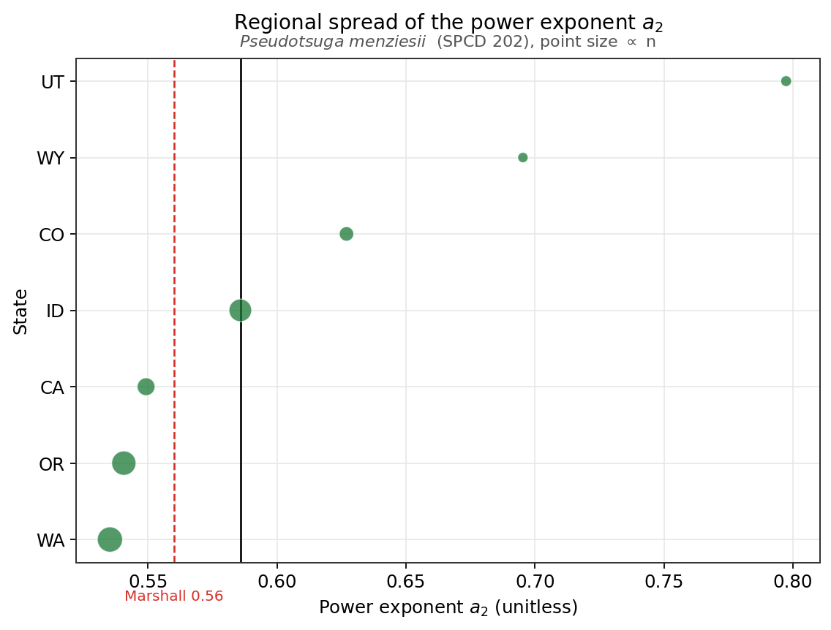
Regional variation is modest; the design separates data from environment
Data or environment?
The exponent shifts only modestly across states for wide-ranging species.
Fitted sd(ecoregion) on the level is 0.082 softwood and 0.131 hardwood, against species at 0.338 and 0.156. Regional, but secondary to species.
The ClimateNA productivity slope is still PENDING and will finish separating a true environmental gradient from a shortage of large open-grown stems.
11
Notes:
A deeper question underlies the form choice: is the softwood non-saturation a property of the data or of the environment. If the sample simply lacks the large open-grown conifers that express the plateau, the flat exponent is a data limitation. If crown-width potential genuinely varies with site and climate, that variation should be modeled rather than forced into a single asymptote. Two pieces of the answer are now in. The exponent varies only modestly across states, which argues against a strong geographic signal, and the restricted-range refit at 30 inches and under leaves the exponent unchanged, which says the flattening is a tail artifact rather than an environmental gradient. The fitted ecoregion standard deviation on the level parameter is real but secondary, 0.082 in softwoods and 0.131 in hardwoods, against species standard deviations of 0.338 and 0.156. So species identity dominates region, which is exactly the result that justifies replacing the hand species-group mapping with partial pooling. What is still pending is the ClimateNA productivity slope, which will tell us how much of the regional variation survives once continuous productivity is in the model. One caveat: the county-representative coordinate linkage induces some pseudo-replication, so read the ecoregion shifts as directions more than precise magnitudes.

Slide 12
Resolved: one power family, CW = exp(la1) · DBH^{a2}, for both clades
Mitscherlich
Power
Power + offset
OUT. Its asymptote is unidentified in the hierarchical fit and settles below the observed crown maximum. Wins 0 of 5 blocked folds.
SELECTED. Monotone, concave, one fewer parameter, lower paired held-out loss in both clades, and survives the extrapolation screen.
OUT. Not distinguishable from the plain power on held-out loss, and the extra offset has to be held up by a prior.
Scored per clade by pinball loss at τ = 0.95 under paired ecoregion-blocked cross-validation, screened for extrapolation behavior. The clades share the form and differ only in the hierarchy each sample identifies. Production coverage and pinball numbers are PENDING the validation job.
Notes:
This was the open decision at the last update and it is now closed. Two readings were consistent with the early evidence: either softwoods genuinely saturate above the largest diameters this stand-grown sample reaches, or a single decelerating power describes them as well as the Mitscherlich does and the asymptote is an artifact. We resolved it by out-of-sample scoring rather than assertion. The Mitscherlich is out on three counts: its asymptote is unidentified in the hierarchical fit, it settles below the observed crown maximum when fit directly to the envelope, and it does not win a single blocked fold in either clade. The power-with-offset is out because it is not distinguishable from the plain power on held-out loss while costing a parameter that only a prior holds in place. The plain power is selected: monotone, concave, one fewer parameter, lower paired held-out loss in both clades, and it survives the extrapolation screen that eliminates the linear and quadratic. Both clades ship on it. They differ only in the hierarchy each sample can identify, which is the next slide. The production coverage and pinball numbers from the full validation run are still pending and I am not quoting them until they land.

Slide 13
Two failures in sequence: an unidentified asymptote, then a funnel
Failure 1 was in the mean structure.
Under the Mitscherlich the log-asymptote intercept sat at R-hat 1.21 and its trait slopes at 1.6 to 2.1 with ESS 5 to 7. Those are population mean parameters: the data do not pin the plateau. Removing the asymptote fixed it.
Failure 2 was in the variance components.
Across about eight power-family fits we dropped traits, changed the grouping (nested, crossed, species-only), ran longer chains, raised adapt_delta to 0.997, lifted the tree-depth ceiling.
Every power-family fit: population means rock stable and biologically sane, 0 divergences, sigma clean.
Every power-family fit: a variance component would not mix, sd(ecoregion) on the level or sd(family) on the exponent.
A stable mean with an unmixed hyperparameter is a funnel, not a misspecification. Writing the variance components NON-CENTERED, and changing nothing else, cleared both clades on the first attempt.
Softwood
la1 ~ 1 + (1|spcd) + (1|eco_l3)
a2 ~ 1 + (1|spcd)
No trait slopes, no family level: 3 families cannot identify them.
exp(la1) = 4.86 ft, a2 = 0.605
Max R-hat 1.010, 0 divergences of 5000, ESS > 700 except a2 intercept at 396
Hardwood
la1 ~ 1 + 4 trait slopes + (1|family/spcd) + (1|eco_l3)
a2 ~ 1 + (1|family/spcd)
29 families support the full nested hierarchy.
exp(la1) = 6.66 ft, a2 = 0.587
Max R-hat 1.003, min ESS 928, 0 divergences of 5000
13
Notes:
This slide is the methods lesson, and the key point is that there were two different failures in sequence, not one. The first was in the mean structure. Under the saturating Mitscherlich the whole log-asymptote block was unidentified: the asymptote intercept at R-hat 1.21, its trait slopes between 1.6 and 2.1 with effective sample sizes of five to seven. Those are population mean parameters, and when they will not mix the diagnosis is that the data do not contain the quantity, not that the geometry is awkward. No reparameterization would have fixed that. Removing the asymptote did, and the envelope reconciliation later confirmed independently that the asymptote was never estimable from this sample. The second failure appeared only after the form settled on the power family, and it is a different animal. Now the population means were stable and biologically sensible in every fit, divergences were absent, and the residual scale sampled cleanly, yet the chains still stalled, always on a variance component, either sd(ecoregion) on the level or the family standard deviation on the exponent. Against that we dropped the trait slopes, changed the grouping structure from nested to crossed to species-only, ran longer chains, pushed adapt_delta to 0.997, and lifted the tree-depth ceiling. None of it worked, and none of it could have, because a stable mean with an unmixed hyperparameter is a funnel and none of those moves changes the geometry. We refit both clades with the variance components non-centered, changed nothing else, and both cleared on the first attempt. Two things follow. Reading which parameters fail, rather than only whether the fit failed, is what separates the two diagnoses: an unmixed mean parameter means the form is wrong, an unmixed hyperparameter over stable means is a funnel. And the fact that the population means never moved across the roughly eight power-family attempts, once the asymptote was out, is reassurance about the numbers we are shipping. The cards on the right are the two final models. Note that softwood ends at species plus ecoregion with no family term and no trait slopes, because three softwood families cannot identify them, while hardwood with 29 families supports the full nested hierarchy and the traits. The one diagnostic still short of the house bar is the softwood exponent intercept at an effective sample size of 396 against 400, a one percent miss, and a top-up run on the identical specification is closing it.

Slide 14
The stochastic frontier undercovers in both clades; the quantile holds
Marshall raised stochastic frontier analysis, so we ran it in both clades. It lost.
A per-clade Bayesian stochastic frontier estimates the boundary of the cloud directly, rather than a high quantile of it.
Against the 0.95 target it covers only 0.87 or less under a half-normal inefficiency term and 0.76 or less under an exponential one, in BOTH clades.
A frontier that covers 0.75 to 0.87 is sitting below the envelope it is meant to bound, so the straight 0.95 quantile is the more faithful upper envelope and stays the operational estimator.
Coverage vs the 0.95 target
Softwood
Hardwood
Half-normal
0.869
0.866
Exponential
0.750
0.756
0.95 quantile
target
target
COMPLETE, both clades
14
Notes:
David was wary that stochastic frontier analysis might be less robust than a 0.95 quantile at small sample sizes, and we shared that instinct. So we ran it as a robustness check rather than as the primary estimator, and both clades are now complete. Both undercover. Against the 0.95 target the softwood frontier covers 0.869 under a half-normal inefficiency distribution and 0.750 under an exponential one; hardwood comes in at 0.866 and 0.756. The agreement across clades is close enough that this is a property of the estimator, not of either sample. A frontier that covers three quarters to seven eighths of the observed crowns is sitting below the envelope it is supposed to bound. The reason is structural: the frontier separates a deterministic boundary from a one-sided inefficiency term, and with stand-grown data where competitive compression is neither small nor symmetric, that decomposition is doing more work than the data can support. The quantile makes no such decomposition, which is why it holds up. So David's instinct was right, and we have now settled it empirically in both clades rather than by argument. This item is closed.

Slide 15
Status and next steps
Complete
Pending the export and validation run
Data ingest and quality control (119,513 modeled trees of 127,710 crown-measured).
Marshall per-species benchmark, 88 species.
Exponent-parity finding across clades.
Saturation reconciliation: form settled on one power family.
BOTH MCW fits converged under a non-centered parameterization.
LCW Beta ratio fit: 0 violations of LCW ≤ MCW across 119,511 trees.
Stochastic frontier cross-check, both clades.
Library row counts by clade and species.
Per-species coefficient ranges for the scale and exponent.
Cross-validated coverage and pinball loss by clade.
ClimateNA productivity slope and the ecoregion variance share.
Bechtold RMSD and the head-to-head against Marshall's fits.
Softwood ESS top-up (a2 intercept 396 vs the 400 bar).
Trait-based equation for the hardwood population_fallback species, and an ecoregion label for all 10.
Then: the operational FVS-CONUS coefficient library, per-clade validation, a Zenodo archive, and the Pseudotsuga menziesii side-by-side against Marshall's Model 3.
15
Notes:
Where things stand, and the Complete column is much longer than it was last time. Done: data ingest and quality control on 119,513 modeled trees drawn from 127,710 crown-measured; David's per-species benchmark across 88 species; the exponent-parity finding; the saturation reconciliation that settled the form on a single power family; both MCW fits converged under the non-centered parameterization; the LCW Beta ratio fit with zero violations of the LCW-below-MCW constraint; and the stochastic frontier cross-check in both clades. What is still pending is now narrow and entirely downstream of the export job running on Cardinal: the library row counts, the per-species coefficient ranges, the cross-validated coverage and pinball loss, the ClimateNA productivity slope and the ecoregion variance share, the Bechtold root-mean-squared differences and the head-to-head against David's fits, and the softwood effective-sample-size top-up that closes a 396-versus-400 miss on one hyperparameter. None of those numbers is stated until the run supplies it. After that comes the operational FVS-CONUS coefficient library with a form-and-clade column, per-species coefficients, the hardwood trait-based fallback equation, a per-species diameter cap, and the LCW ratio parameters, then validation, a reproducible Zenodo deposit, and the Douglas-fir side-by-side for David against his Model 3.

Slide 16
One clean per-species CONUS MCW and LCW library
Well behaved on extrapolation, honest about its maximum, and ready to drop into FVS-CONUS.
Questions? Comments?
Weiskittel, Marshall, Johnson · Center for Research on Sustainable Forests · 22 July 2026
Notes:
The close, and the bottom line. The deliverable is one continental crown-width library, per species, that returns both operational products, the near open-grown MCW envelope and the bounded LCW, for every species on the FVS-CONUS list, including data-poor hardwoods carried by the trait layer. Three things to take away. The functional form is settled and it is simpler than we expected: one power family for both clades, with the softwood saturating asymptote retired because the data never located it. Both fits have converged, and what fixed them was a non-centered parameterization of the variance components rather than any change to the model, which is a result worth reporting in its own right. And the library behaves sensibly across the full observed diameter range, unlike the linear and quadratic variant forms it replaces, and is honest about its maximum rather than bolting on a cap. The library coefficients and cross-validation numbers land with the export run, and then it drops into the FVS-CONUS coefficient slot. Happy to take questions, and David, the Douglas-fir side-by-side is coming as soon as the library lands.

