Slide 1


Kontribute
Greg Kelly | 19398263
Jesse Keogh | 19491194
Staff consulted: Silvana MacMahon

Slide 2






Introduction
Web3 Creative writing application
Collector
Author
Artist
+
Build audiences
Monetization
Engaging experience

Slide 3
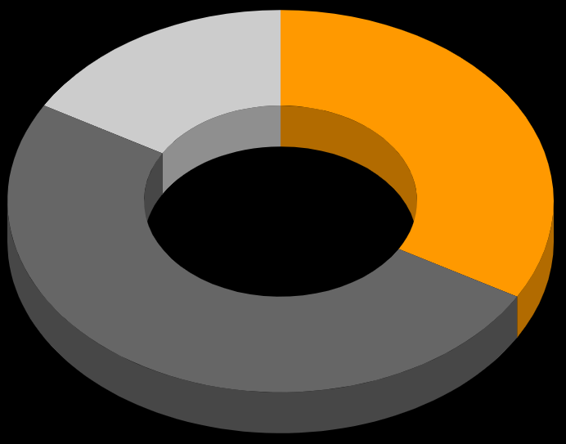
Market Rationale
Target Market Size
Kontribute taps into three markets:
Blockchain Creative writing/Fanfiction Digital Publishing
Digital publishing industry valued at USD 41 billion in 2022[1]
The global blockchain market was valued at USD 4.67 billion in 2021 and is expected to grow to a staggering USD 163.83 billion in 2029[2]
There are over 100 million people around the world that read and write fanfiction[3]
1
2
3

Slide 4
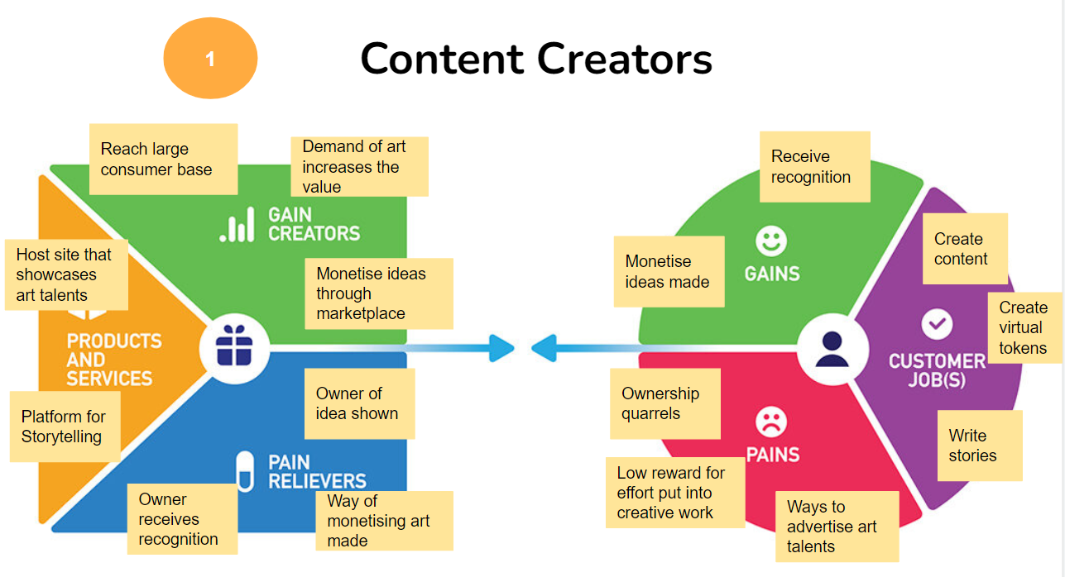
Market Rationale
Value Propositions

Slide 5
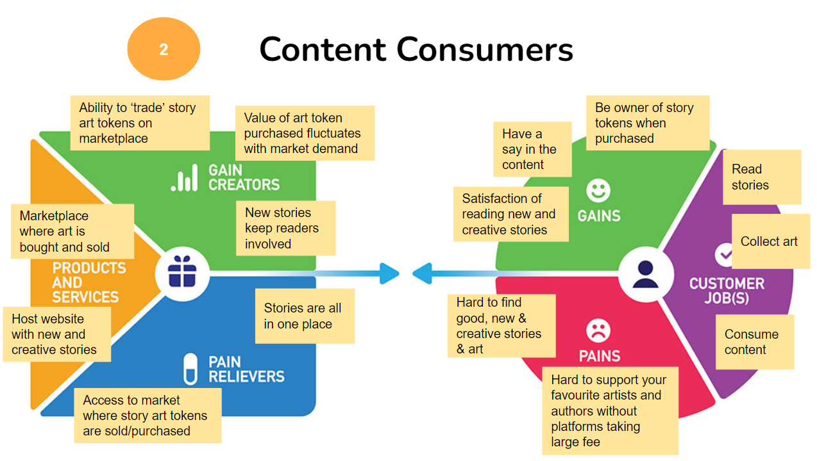
Market Rationale
Value Propositions

Slide 6
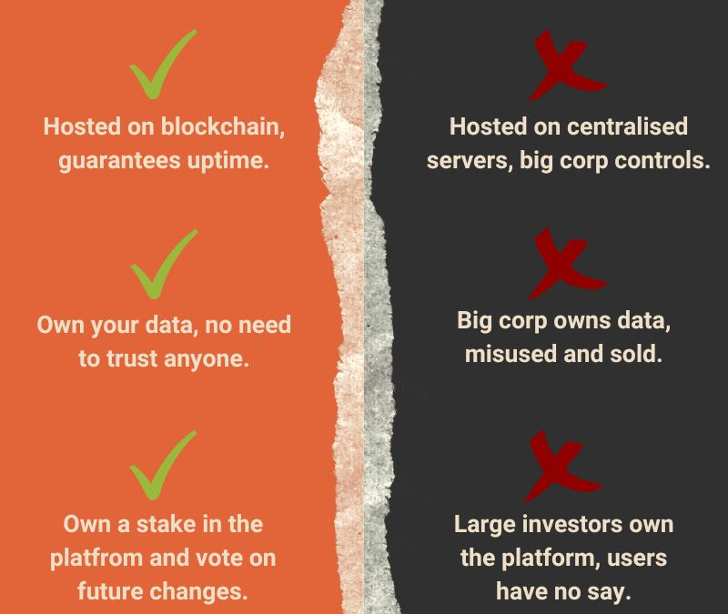
Why web3 / blockchain
Security and transparency
Data ownership
Own a stake
Faster payments and better UX

Slide 7
Primary and Secondary Research
Providing creators a new way to monetize their content
Patreon charges $0.30 per transaction for creators[4]
Over 250,000 readers, writer and artists that use creative writing platforms use apps like patreon[5]
Tapping into the competitions market
Wattpad (a creative writing and storytelling platform) has over 8 million users, lacks meaningful competition[6]

Slide 8
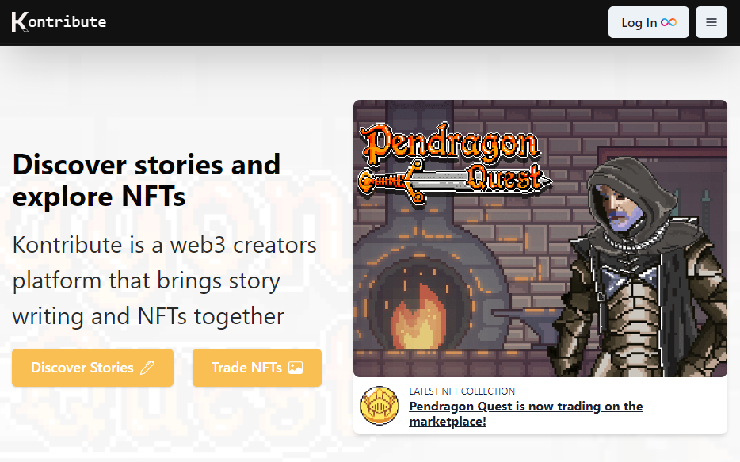
Expected Technical Delivery
A fully working application hosted on the ICP Blockchain
Tokens will be traded on the built-in marketplace

Slide 9

Proposed Timeline of Activities
October
December
February
April
Planning
Team
Project proposal and ethical documentation are submitted and presented
Frontend
Greg
Backend will hopefully be functional and we can begin working on UI design and frontend
Mid-term Delivery
Team
Mid-term delivery documentation will be submitted on project repo
Trial Run
Team
Users will be encouraged to use whole site and all features before project expo
Backend
Jesse
We begin creating the backend and frontend for the application using ReactJS framework
User Feedback
Greg
Survey potential users and get understanding of where to improve
Testing
Jesse
Functionality will be tested using Unit-testing to make sure all works correctly
Project Expo
Team
Fully running app will be on show for anyone who attends
November
January
March
May
*Regular meetings with advisor will take place throughout project

Slide 10
References
[1] Digital Publishing Market Size 2022 and growth analysis (no date) The Business Research Company. Available at: https://www.thebusinessresearchcompany.com/report/digital-publishing-global-market-report#:~:text=The%20global%20digital%20publishing%20market,least%20in%20the%20short%20term. (Accessed: October 19, 2022).
[2] N/A, Blockchain Market, fortunebusinessinsights.com. Available at: https://www.fortunebusinessinsights.com/industry-reports/blockchain-market-100072 (Accessed: October 18, 2022)
[3] Sharma, Mahika, Fanfiction leaves its mark on pop culture, chantillynews.org. Chantilly. Available at: https://chantillynews.org/6608/arts-and-entertainment/fanfiction-leaves-its-mark-on-pop-culture/ (Accessed: October 18, 2022).
[4] My earnings fees (founding creator) – patreon help center (no date). Available at: https://support.patreon.com/hc/en-us/articles/204606125-My-earnings-fees-founding-creator- (Accessed: October 25, 2022).
[5] Molenaar, K. (2022) 20+ patreon statistics you need to know, Influencer Marketing Hub. Available at: https://influencermarketinghub.com/patreon-stats-revenue-users/ (Accessed: October 25, 2022).
[6] Smith, C. (2022) 25 interesting Wattpad statistics and facts, DMR. Available at: https://expandedramblings.com/index.php/wattpad-statistics-facts/ (Accessed: October 25, 2022).

