Slide 1
Linux Kernel Development
Greg Kroah-Hartman
gregkh@linuxfoudation.org
github.com/gregkh/kernel-development
Notes:
I'm going to discuss the how fast the kernel is moving, how we do it all, and how you can get involved.

Slide 2
38,566 files
15,384,000 lines
2.6.20 to 2.6.24-rc8
Kernel release 3.4.0
Notes:
This was for the 3.2 kernel release, which happened January 4, 2012.

Slide 3
2,833 developers
373 companies
Kernel releases 3.0.0 – 3.4.0
May 2011 – May 2012
Notes:
This makes the Linux kernel the largest contributed body of software out there that we know of.
This is just the number of companies that we know about, there are more that we do not, and as the responses to our inquiries come in, this number will go up.

Slide 4
10,500 lines added
8,400 lines removed
2,300 lines modified
Kernel releases 3.0.0 – 3.4.0
May 2011 – May 2012
2.6.20 to 2.6.24-rc8

Slide 5
10,500 lines added
8,400 lines removed
2,300 lines modified
Kernel releases 3.0.0 – 3.4.0
May 2011 – May 2012
2.6.20 to 2.6.24-rc8

Slide 6
5.79 changes per hour
Kernel releases 3.0.0 – 3.4.0
May 2011 – May 2012
2.6.20 to 2.6.24-rc8
Notes:
This is 24 hours a day, 7 days a week, for a full year.
We went this fast the year before this as well, this is an amazing rate of change.
Interesting note, all of these changes are all through the whole kernel.
For example, the core kernel is only 5% of the code, and 5% of the change was to the core kernel. Drivers are 55%, and 55% was done to them, it's completely proportional all across the whole kernel.

Slide 7
How we stay sane
Time based releases
Incremental changes
2.6.20 to 2.6.24-rc8
Notes:
This is 24 hours a day, 7 days a week, for a full year.
We went this fast the year before this as well, this is an amazing rate of change.
Interesting note, all of these changes are all through the whole kernel.
For example, the core kernel is only 5% of the code, and 5% of the change was to the core kernel. Drivers are 55%, and 55% was done to them, it's completely proportional all across the whole kernel.

Slide 8

New release every
2¾ months
Kernel releases 2.6.20 – 3.4.0
Notes:
84 days to be exact, very regular experience.

Slide 9
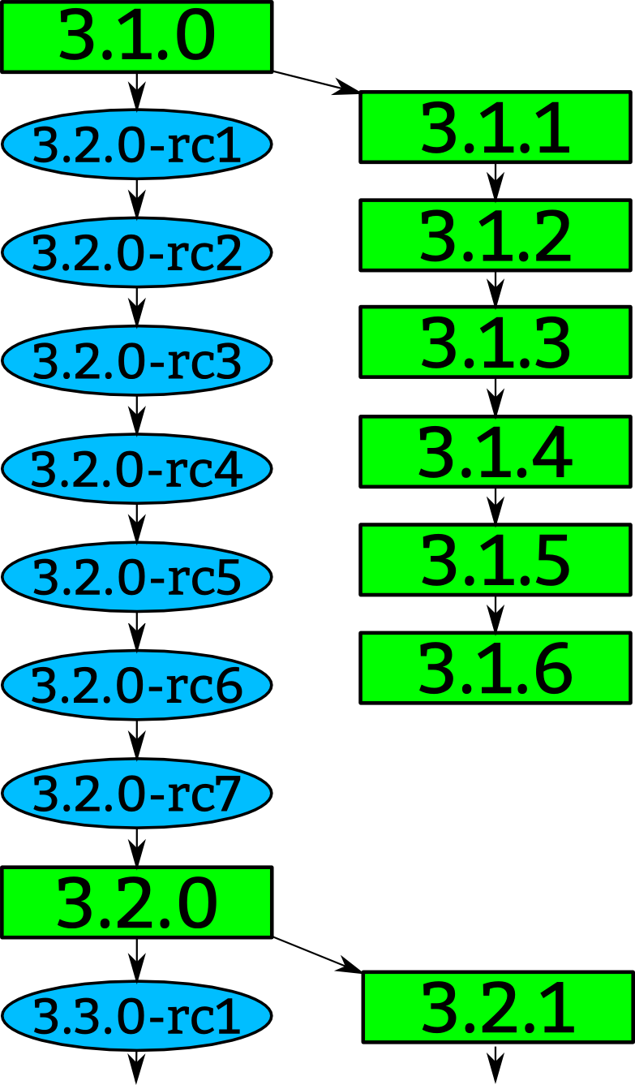
Notes:
How a kernel is developed.
Linus releases a stable kernel
- 2 week merge window from subsystem maintainers
- rc1 is released
- bugfixes only now
- 2 weeks later, rc2
- bugfixes and regressions
- 2 weeks later,rc3
And so on until all major bugfixes and regressions are resolved and then the cycle starts over again.

Slide 10
Notes:
Greg takes the stable releases from Linus, and does stable releases with them, applying only fixes that are already in Linus's tree.
Requiring fixes to be in Linus's tree first ensures that there is no divergence in the development model.
After Linus releases a new stable release, the old stable series is dropped.
With the exception of “longterm” stable releases, those are special, the stick around for much longer...

Slide 11

Notes:
Like mentioned before, we have almost 2900 individual contributors. They all create a patch, a single change to the Linux kernel. This change could be something small, like a spelling correction, or something larger, like a whole new driver.
Every patch that is created only does one thing, and it can not break the build, complex changes to the kernel get broken up into smaller pieces.

Slide 12
Notes:
The developers send their patch to the maintainer of the file(s) that they have modified.
We have about 700 different driver/file/subsystem maintainers

Slide 13
commit ecf85e481a716cfe07406439fdc7ba9526bbfaeb
Author: Robert Jarzmik <robert.jarzmik@free.fr>
AuthorDate: Tue Apr 21 20:33:10 2009 -0700
Commit: Greg Kroah-Hartman <gregkh@suse.de>
CommitDate: Thu Apr 23 14:15:31 2009 -0700
USB: otg: Fix bug on remove path without transceiver
In the case where a gadget driver is removed while no
transceiver was found at probe time, a bug in
otg_put_transceiver() will trigger.
Signed-off-by: Robert Jarzmik <robert.jarzmik@free.fr>
Acked-by: David Brownell <dbrownell@users.sourceforge.net>
Signed-off-by: Greg Kroah-Hartman <gregkh@suse.de>
--- a/drivers/usb/otg/otg.c
+++ b/drivers/usb/otg/otg.c
@@ -43,7 +43,8 @@ EXPORT_SYMBOL(otg_get_transceiver);
void otg_put_transceiver(struct otg_transceiver *x)
{
- put_device(x->dev);
+ if (x)
+ put_device(x->dev);
}
Notes:
This is an example of a patch.
It came from Robert, was acked by David, the maintainer at the time of the usb on-the-go subsystem, and then signed off by by me before it was commited to the kernel tree.
The change did one thing, it checked the value of the pointer before it was dereferenced, fixing a bug that would have crashed the kernel if it had been hit.
This is also a “blame” trail, showing who changed each line in the kernel, and who agreed with that change.
If a problem is found, these are the developers that you can ask about it.
Because of this, every line in the Linux kernel can be traced back to at least two developers who are responsible for it.
This is better than any other body of code.

Slide 14
Developer's Certificate of Origin
(a) I created this change; or
(b) Based this on a previous work with a
compatible license; or
(c) Provided to me by (a), (b), or (c) and not
modified
(d) This contribution is public.
Notes:
This is what “Signed-off-by:” means.
All contributions to the Linux kernel have to agree to this, and every single patch has at least one signed-off-by line, usually all have at least two.
This is also a “blame” trail, showing who changed each line in the kernel, and who agreed with that change.
If a problem is found, this is the developers that you can ask about it.
Because of this, every line in the Linux kernel can be traced back to at least two developers who are responsible for it.
This is better than any other body of code.

Slide 15
Notes:
After reviewing the code, and adding their own signed-off-by to the patch, the file/driver maintainer sends the patch to the subsystem maintainer responsible for that portion of the kernel.
We have around 150 subsystem maintainers

Slide 16
Notes:
Linux-next gets created every night from all of the different subsystem trees and build tested on a wide range of different platforms.
We have about 150 different trees in the linux-next release.
Andrew Morton picks up patches that cross subsystems, or are missed by others, and releases his -mm kernels every few weeks. This includes the linux-next release at that time.

Slide 17
Notes:
Every 3 months, when the merge window opens up, everything gets sent to Linus from the subsystem maintainers and Andrew Morton.
The merge window is 2 weeks long, and thousands of patches get merged in that short time.
All of the patches merged to Linus should have been in the linux-next release, but that isn't always the case for various reasons.
Linux-next can not just be sent to Linus as there are things in there that sometimes are not good enough to be merged just yet, it is up to the individual subsystem maintainer to decide what to merge.

Slide 18

Top developers by quantity
Mark Brown 1026
Axel Lin 723
K. Y. Srinivasan 626
Al Viro 607
Takashi Iwai 517
Mauro Chehab 507
Russell King 419
Johannes Berg 469
Ben Skeggs 405
Jonathan Cameron 396
Kernel releases 3.0.0 – 3.4.0
Notes:
Mark – embedded sound
Thomas – x86 maintainer
KY – hyperv
David – networking
Joe – janitorial
Alexl – janitorial
Al – vfs and filesystem
Russell – ARM maintainer
Takashi – sound maintainer
Ben – nouveau developer

Slide 19
QCA developers by quantity
62. Rajkumar Manoharan 177
74. Luis Rodriguez 162
82. Vasanthakumar Thiagarajan 151
123. Sujith Manoharan 113
163. Mohammed Shajakhan 87
225. Jouni Malinen 66
256. Kalle Valo 57
398. Senthil Balasubramanian 35
426. Vivek Natarajan 31
524. Vipin Mehta 23
909. Naveen Singh 9
1658. Ruiyi Zhang 2
1658. Bala Shanmugam 2
1658. Suraj Sumangala 2
2030. Haijun Lui 1
Kernel releases 3.0.0 – 3.4.0
Notes:
15 QCA developers that I could identify.
(with atheros.com email addresses, I might have missed those that have started to use qualcomm email addresses.)

Slide 20
Top Signed-off-by:
Greg Kroah-Hartman 4767
David S. Miller 3857
John Linville 3252
Mauro Carvalho Chehab 2412
Mark Brown 2230
Linus Torvalds 1984
Andrew Morton 1573
James Bottomley 1089
Takashi Iwai 953
Russell King 930
Kernel releases 3.0.0 – 3.4.0
Notes:
Greg – driver core, usb, staging
David – networking
John – wireless networking
Mauro - v4l
Linus – everything
Mark - embedded
Andrew – everything
James – SCSI
Takashi – sound
Russell - ARM

Slide 21

Who is funding this work?
1. “Amateurs” 14.2%
2. Red Hat 10.1%
3. Intel 8.6%
4. Unknown Individuals 5.2%
5. Novell 4.0%
6. IBM 3.7%
7. Texas Instruments 3.6%
8. Broadcom 3.0%
9. Consultants 2.3%
10. Wolfson Micro 2.1%
Kernel releases 3.0.0 – 3.4.0
Notes:
So you can view this as either 20% is done by non-affiliated people, or 80% is done by companies.
Now to be fair, if you show any skill in kernel development you are instantly hired.
Why this all matters: If your company relies on Linux, and it depends on the future of Linux supporting your needs, then you either trust these other companies are developing Linux in ways that will benefit you, or you need to get involved to make sure Linux works properly for your workloads and needs.

Slide 22
Who is funding this work?
11. Samsung 1.9%
12. Google 1.8%
13. Oracle 1.7%
14. Freescale 1.5%
15. MiTAC 1.4%
16. Qualcomm 1.4%
17. Microsoft 1.3%
18. Linaro 1.2%
19. Nokia 1.2%
20. AMD 1.1%
Kernel releases 3.0.0 – 3.4.0
Notes:
Samsung 980 patches
Qualcomm 707 patches

Slide 23
Who is funding this work?
...
27. Marvell 369
28. Renesas 364
29. Nvidia 344
...
38. Atheros 259
...
42. Code Aurora Forum 208
Kernel releases 3.0.0 – 3.4.0
Notes:
So you can view this as either 20% is done by non-affiliated people, or 80% is done by companies.
Now to be fair, if you show any skill in kernel development you are instantly hired.
Why this all matters: If your company relies on Linux, and it depends on the future of Linux supporting your needs, then you either trust these other companies are developing Linux in ways that will benefit you, or you need to get involved to make sure Linux works properly for your workloads and needs.

Slide 24
Getting involved
Run the kernel.org release on your machine
2.6.20 to 2.6.24-rc8
10,900 lines added
5,500 lines removed
2,200 lines modified
per day 2008 - 2009

Slide 25

Getting involved
2.6.20 to 2.6.24-rc8
10,900 lines added
5,500 lines removed
2,200 lines modified
per day 2008 - 2009
Notes:
This book tells you how to build and install a kernel on your machine.
Free online

Slide 26
Getting involved
Documentation/HOWTO
Documentation/development-process
2.6.20 to 2.6.24-rc8
Notes:
These documents in the kernel source directory are the best place to start if you want to understand how the development process works, and how to get involved.
The HOWTO file has links to almost everything else you ever wanted..

Slide 27

Getting involved
kernelnewbies.org
2.6.20 to 2.6.24-rc8
Notes:
http://www.kernelnewbies.org

Slide 28
Getting involved
Google “write your first kernel patch”
2.6.20 to 2.6.24-rc8
Notes:
This is a video of a talk I gave at FOSDEM, going through the steps, showing exactly how to create, build, and send a kernel patch.

Slide 29
Getting involved
kernelnewbies.org/KernelJanitors/Todo
2.6.20 to 2.6.24-rc8
Notes:
So you know how to create a patch, but what should you do? The kernel janitors has a great list of tasks to start with in cleaning up the kernel and making easy patches to be accepted.

Slide 30
Getting involved
Linux Driver Project
drivers/staging/*/TODO
2.6.20 to 2.6.24-rc8
Notes:
The staging tree also needs a lot of help, here are lists of things to do in the kernel for the drivers to be able to move out of the staging area.
Please always work off of the linux-next tree if you want to do these tasks, as sometimes they are already done by others by the time you see them in Linus's tree.

Slide 31

github.com/gregkh/kernel-development
Notes:
Obligatory Penguin Picture

