Slide 1
Last year in the Linux Kernel
Greg Kroah-Hartman
Notes:
I'm going to discuss what the Linux kernel community did over the past year, provide some example features, and some guesses as to what will be done in the future.

Slide 2
47,000 files
18,900,000 lines
Kernel release 3.17.0
Notes:
This is for the 3.17 kernel release, which happened on October 5, 2014.
This kernel is one of only 2 kernel releases that went down in size. Usually we grow at the constant rate of 1.5%, but this release shrunk due to 200 thousand lines being removed by one of the OPW interns, deleting a number of unused and unneeded device drivers.

Slide 3
3,483 developers
439 companies
Kernel releases 3.12.0 – 3.17.0
November 2013 – October 2014
Notes:
This is for the past year's worth of development, from the 3.12 through the 3.17 kernel release.
This makes the Linux kernel the largest software project ever.
This is just the number of companies that we know about, there are more that have contributed, I have not kept up to date with tracking the number of companies.
We have surpassed over 400 different companies for the past 2 years. These numbers keep getting larger.

Slide 4
8,300 lines added
4,650 lines removed
1,900 lines modified
Kernel releases 3.12.0 – 3.17.0
November 2013 – October 2014
Notes:
This is our current rate of change, which doesn't seem all that bad.
Untill...

Slide 5
8,300 lines added
4,650 lines removed
1,900 lines modified
Every Day
Kernel releases 3.12.0 – 3.17.0
November 2013 – October 2014
Notes:
You relealize the unite of change.
This happens every day, and it keeps going up.

Slide 6
7.8 changes per hour
Kernel releases 3.12.0 – 3.17.0
November 2013 – October 2014
Notes:
This is 24 hours a day, 7 days a week, for the past year.
We have increased this rate every year, an amazing rate of change.
All of these changes are for the whole kernel.
For example, the core kernel is only 5% of the code size, and 5% of the changes made were to the core kernel. Drivers make up 55% of the code, and 55% of the changes were to drivers.
Our rate of change is proportional across the whole kernel, this isn't just drivers that are changing.

Slide 7
9.5 changes per hour
3.16 release
Notes:
The 3.16 kernel release was the fastest we have ever created. This shows just how well the Linux kernel development model is working. We are growing in developers, companies, and how well we are accepting changes.
Note, this is just the number of patches that we have accepted, not all of the ones that have been actually submitted. Lots of patches are rejected, as anyone who has ever tried to submit a patch can attest to.

Slide 8
Notable Changes
Notes:
Let us look at some changes that have gone into the kernel over the past year.
I just want to highlight a few, there were over 92 thousand different changes during the past year, so here are just a few of them.

Slide 9
Notable Changes
btrfs offline
AMD Radeon boost
GPU switching
separate GPU device nodes
timerless multiasking
RAID5 multithreading
lockref
better OOM
XFS recursion
tty lock rework
IPC lock rework
seqlock
idr
inittmpfs
restricted sysfs
Cachefiles
soft module dependancies
aio ring page migration
aio deferred completion
fair zone allocator
hugepage node migration
ssd block allocation
swap per-cpu allocation
swap discard async
detect hybrid MBRs
dm cache block size limits
btrfs compressed extents
btrfs UUID rework
ext4 pre-cacheing
ext4 external journal
ext4 corrupt marking
ext3 external journal
xfs object readahead
f2fs inline xattrs
f2fs garbage control
pstore compression
pstore decompression
pstore extensions
ceph punch hole
hfs ACLS
isofs RW rework
udf RW rework
TCP_NOTSENT_LOWAT
TSO autosizing
tcp_syncookies
tcp throughput increase
TS-ECR for RTT
use RTT for RTO
ipv6 UDP tunnel segment
ipv6 RFC 6980 & 3810
bridge multicast snoop
macvland fdb
physical port sysfs
igmp unsolicited report
tcp_probe ipv6
netfilter ipv6 SYNPROXY
reduced txpower 5/10Mhz
5/10Mhz scanning IBSS
openvswitch SCTP
pkt_sched fair queueing
usbnet USB3 throughput
OMAP SHAM
OMAP SHA384/SHA512
NEON XOR
vfio-pci hot reset
64bit PV guest NMIs
Notes:
Here is just a tiny partial list of some of the changes that went into just the 3.12 kernel release. These aren't even getting into all of the driver changes that happened. To try to summarize a single kernel release is almost impossible. The kernelnewbiews site has a great list of everything that has changed if you want to know the details.
So let's just pick a very tiny number of feature that might be relevant to you in the releases this year.

Slide 10
3.12 release
Faster low-level locks
November 12, 2013
Notes:
The 3.12 kernel got a rewrite of the very low-level locks in the kernel. Linus did this work with some of the other core kernel developers. This is very unusual for an operating system. Once something like the basic locks are written, no one wants to ever touch them again, as it's one of the basic things that the whole kernel is based on.
This shows that the changes in Linux are at the very basic level at times, kernel developers are not afraid to revisit previously working code and make it better.
This also means if you are using an older kernel than 3.12, your machines could be running faster.

Slide 11
3.13 release
nftables
January 19, 2014

Slide 12
3.14 release
Antibufferbloat
packet scheduler
March 30, 2014

Slide 13
3.15 release
Faster resume
June 8, 2014

Slide 14
3.16 release
CONFIG_USB_DEBUG
August 3, 2014

Slide 15
3.16 release
32bit VDSO on 64bit
August 3, 2014

Slide 16
3.17 release
File sealing - memfd
October 5, 2014

Slide 17
3.18 release
unionfs
Sometime in 2014

Slide 18
3.18 release
Major network speedup
Sometime in 2014

Slide 19
future release?
Live kernel patching
Sometime in 2015

Slide 20
future release?
kdbus
Sometime in 2015

Slide 21
future release?
kselftests
Sometime in 2015

Slide 22
future release?
O_BENEATH
Sometime in 2015

Slide 23
future release?
cgroup namespaces
Sometime in 2015

Slide 24
Who is funding this work?
1. Intel 10.6%
2. “Amateurs” 10.3%
3. Red Hat 8.4%
4. Unknown Individuals 7.3%
5. Linaro 5.6%
6. Samsung 4.4%
7. IBM 3.0%
8. SuSE 3.0%
9. Consultants 2.6%
10. Texas Instruments 2.4%
Kernel releases 3.12.0 – 3.17.0
Notes:
So you can view this as either 17% is done by non-affiliated people, or 83% is done by companies.
Now to be fair, if you show any skill in kernel development you are instantly hired.
Why this all matters: If your company relies on Linux, and it depends on the future of Linux supporting your needs, then you either trust these other companies are developing Linux in ways that will benefit you, or you need to get involved to make sure Linux works properly for your workloads and needs.

Slide 25
Who is funding this work?
11. Vision Engraving 2.0%
12. Google 2.0%
13. Renesas 2.0%
14. Freescale 1.8%
15. Free Electrons 1.6%
16. Nvidia 1.2%
17. FOSS OPFW 1.2%
18. Oracle 1.2%
19. AMD 1.0%
20. Huawei 0.9%
Kernel releases 3.12.0 – 3.17.0
Notes:
Vision Engraving is just one developer who has done 1519 patches last year. Google had about 1500 patches for the whole company.
FOSS Outreach Program for Women 900 patches. 20 women interns / students.
The appliation process for the next round of OPW just happened last month which resulted in 515 patches being accepted into the kernel tree for the 3.19 kernel release.

Slide 26

©¡WOUW!

Slide 27
How we stay sane
Time based releases
Incremental changes

Slide 28
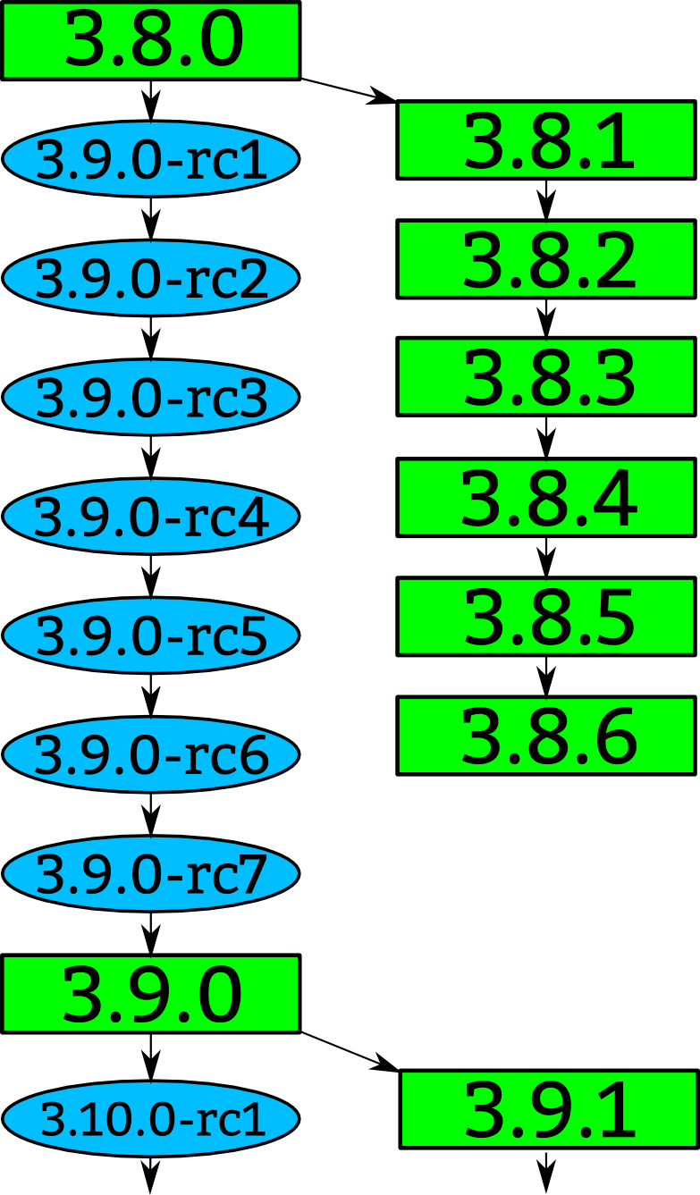

Slide 30
“Longterm kernels”
One picked per year
Maintained for two years
3.4 3.10

Slide 31


Slide 35
3.12 release
Timerless multitasking
November 12, 2013
Notes:
This feature lets your multiprocessor machine not have a timer tick constantly handled by a cpu just to determine that nothing else needs to be done. This can help with power management issues so that all processors can be properly shut down, as well as systems that do not have extra jobs other than the number of processors, allowing them to complete their tasks faster.
Again, a very low-level feature that lets you save power and go faster.

Slide 36
3.13 release
Multi-queue block layer
January 19, 2014

Slide 37
3.13 release
nfc payment support
January 19, 2014

Slide 38
3.14 release
Deadline scheduler
March 30, 2014

Slide 39
3.14 release
Kernel address space randomization
March 30, 2014

Slide 40
3.15 release
Faster erase and zero
portions of a file
June 8, 2014

Slide 41
3.15 release
File cross-rename
June 8, 2014

Slide 42
3.15 release
FUSE write improvements
June 8, 2014

Slide 43
3.16 release
Unified control group
heirachy
August 3, 2014

Slide 44
3.16 release
TCP fast open on IPV6
August 3, 2014

Slide 45
3.17 release
Thunderbolt on Apple
hardware
October 5, 2014

Slide 46
3.17 release
getrandom()
October 5, 2014

Slide 47
3.17 release
Signed kexec kernels
October 5, 2014

Slide 48
3.18 release
bfp() syscall
Sometime in 2014

