Slide 1
The Linux Kernel Community
How it works, why it matters, and how to get involved
Greg Kroah-Hartman
SuSE Labs / Novell

Slide 2


Slide 3

Development or Stable tree?

Slide 4
Development or Stable tree?
Everything is “stable”

Slide 5


Slide 6

New release every
2½ months

Slide 7
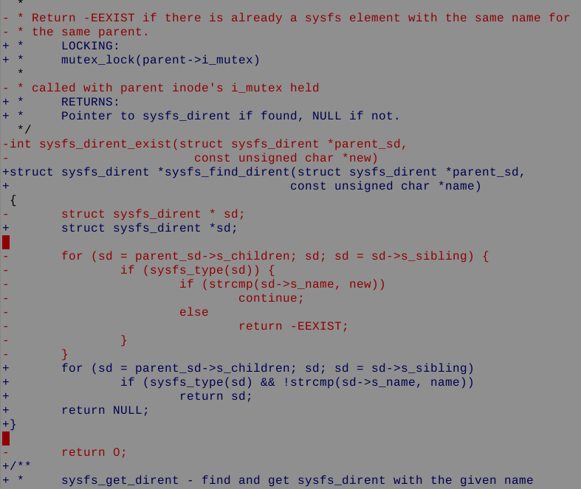
3.31 changes per hour
2.6.18 to 2.6.22

Slide 8

8.5 million lines
as of the 2.6.22 release

Slide 9
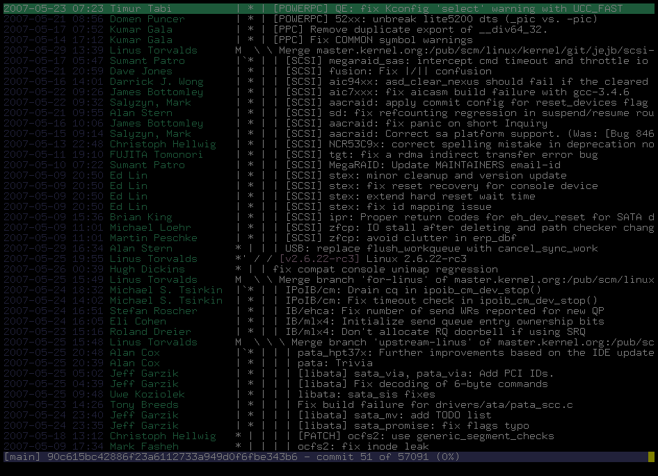
2330 lines added every day
2800 lines modified every day
24 hours a day
7 days a week
2.6.18 to 2.6.22

Slide 10

2383 Developers
Kernel releases 2.6.18 - 2.6.23-rc8

Slide 11

Top developers by quantity
Al Viro 778
David S. Miller 637
Ralf Baechle 575
Andrew Morton 556
Tejun Heo 537
Adrian Bunk 501
Patrick McHardy 421
Stephen Hemminger 404
Andi Kleen 361
Ingo Molnar 396
Kernel releases 2.6.18 - 2.6.23-rc8

Slide 12
Top Signed-off-by:
Andrew Morton 9130
Linus Torvalds 8291
David S. Miller 3526
Jeff Garzik 2328
Greg Kroah-Hartman 2087
Paul Mackerras 1515
Mauro Carvalho Chehab 1433
Russell King 1175
James Bottomley 1139
Andi Kleen 1125
Kernel releases 2.6.18 - 2.6.23-rc8

Slide 13
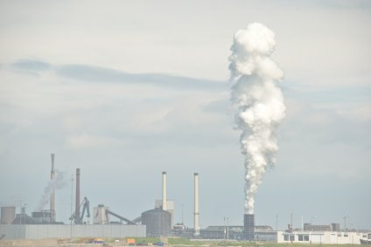
Who is funding this work?
1.
2.
3. Red Hat 12.6%
4. IBM 8.5%
5. Novell 7.2%
6. Linux Foundation 6.8%
7. Intel 4.1%
8. SGI 1.6%
9. MIPS 1.5%
10. Consultants 1.5%
Kernel releases 2.6.18 - 2.6.23-rc8

Slide 14
Who is funding this work?
1.Unknown Individuals 18.1%
2. “Amateurs” 13.3%
3. Red Hat 12.6%
4. IBM 8.5%
5. Novell 7.2%
6. Linux Foundation 6.8%
7. Intel 4.1%
8. SGI 1.6%
9. MIPS 1.5%
10. Consultants 1.5%
Kernel releases 2.6.18 - 2.6.23-rc8

Slide 15
Who is funding this work?
...
139. Motorola 0.0%
Kernel releases 2.6.18 - 2.6.23-rc8

Slide 16
Who is funding this work?
...
15. MontaVista 1.1%
...
139. Motorola 0.0%
Kernel releases 2.6.18 - 2.6.23-rc8

Slide 17
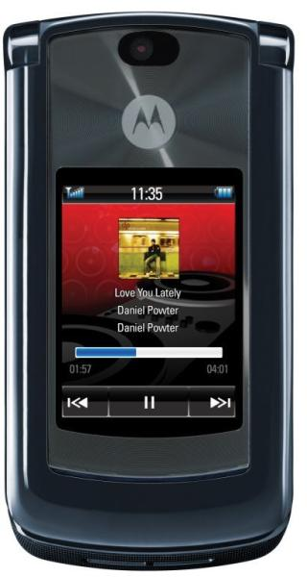
Linux will comprise over 60% of our
mobile portfolio in the near future.
- Christy Wyatt

Slide 18

Destiny is no matter of chance.
It is a matter of choice.
-William Jennings Bryan

Slide 19

Documentation/HOWTO

Slide 20

Kernel Newbies

Slide 21
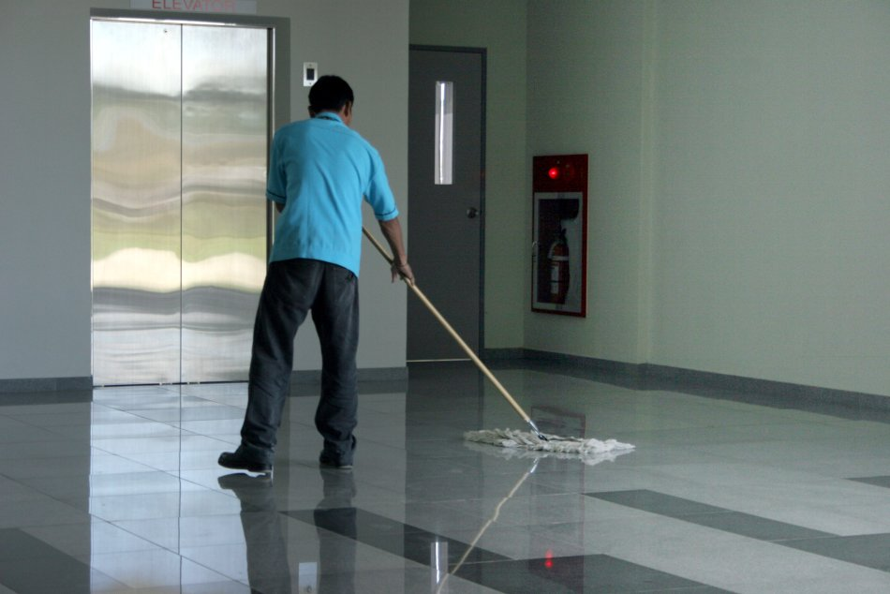
Kernel Janitors

Slide 22
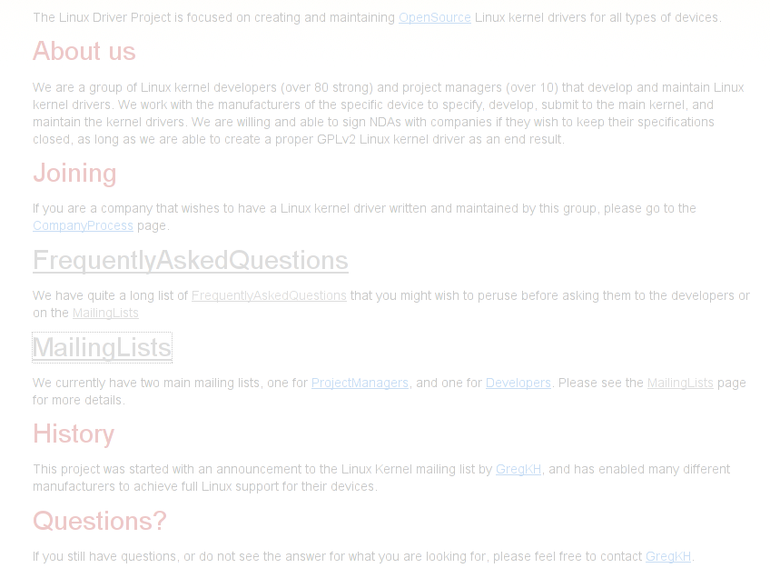
Linux Driver Project
www.linuxdriverproject.org

Slide 23


