Slide 1
Linux Kernel Development
How, What, How Fast, and Who
Greg Kroah-Hartman
SuSE Labs / Novell

Slide 2


Slide 3

Development or Stable tree?

Slide 4
Development or Stable tree?
Everything is “stable”

Slide 5


Slide 6

New release every
2½ months

Slide 7
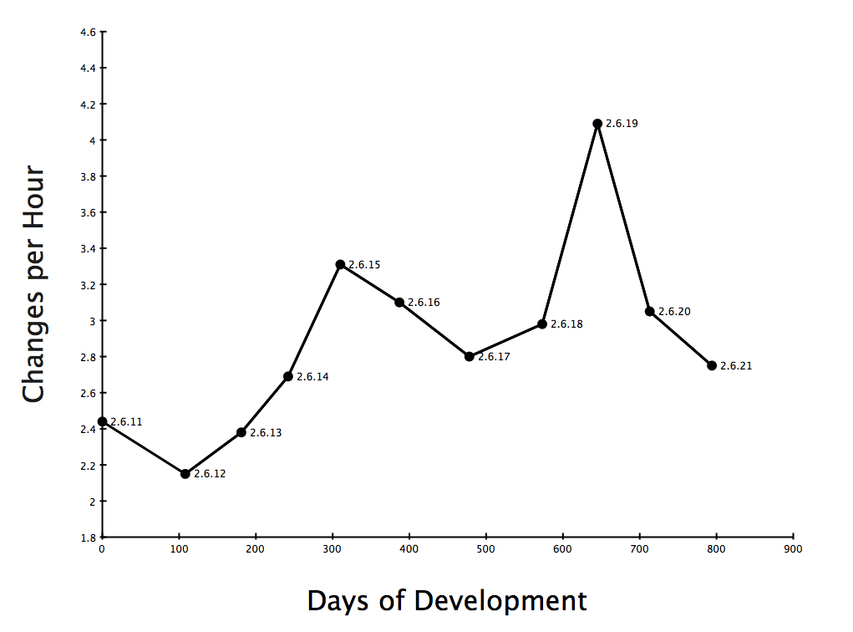

Slide 8
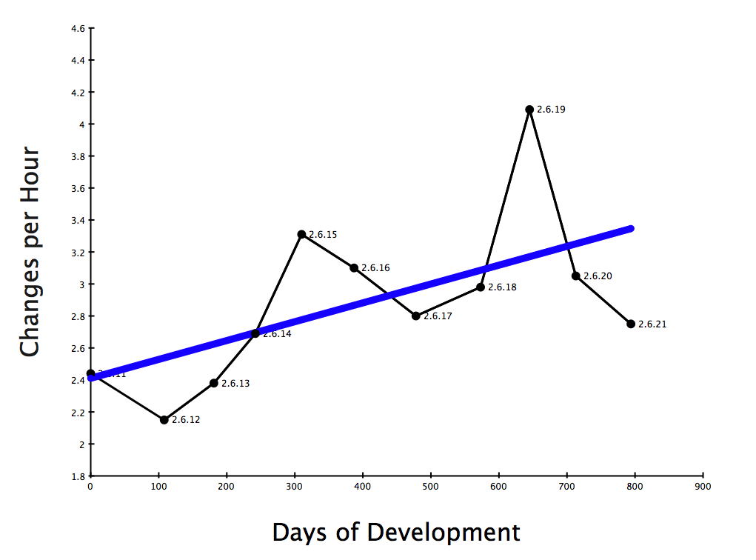

Slide 9
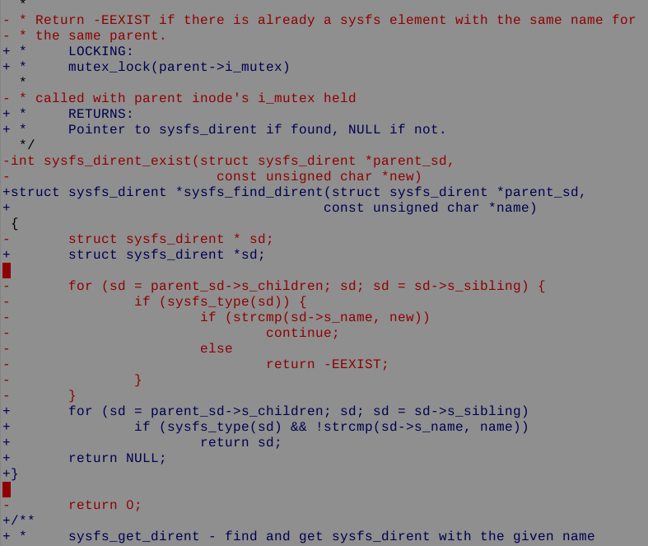
2.89 changes per hour
as of the 2.6.21 release

Slide 10
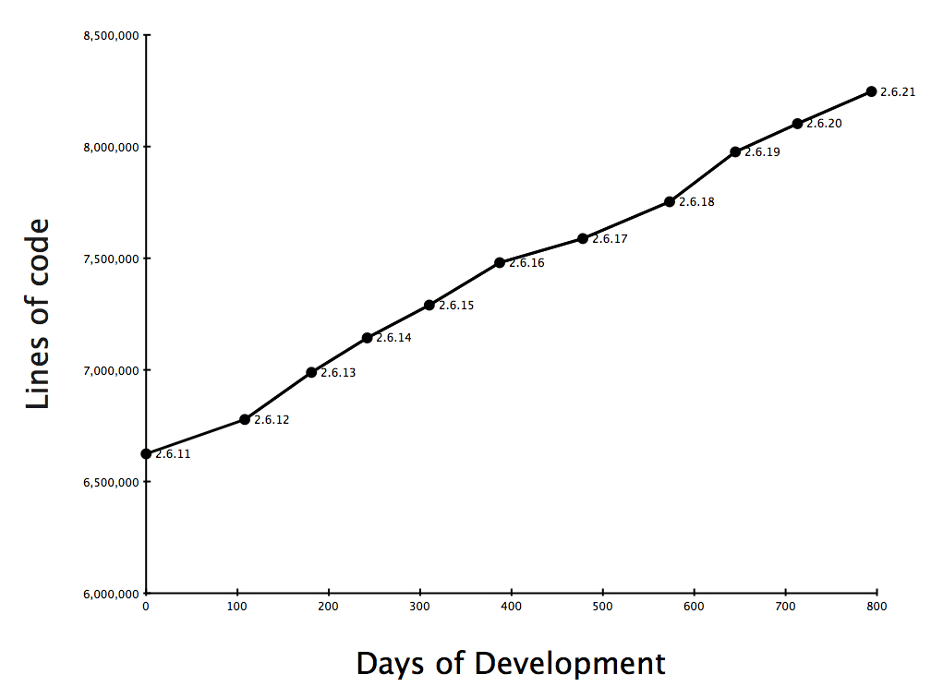
10% growth

Slide 11

8.2 million lines
as of the 2.6.21 release

Slide 12
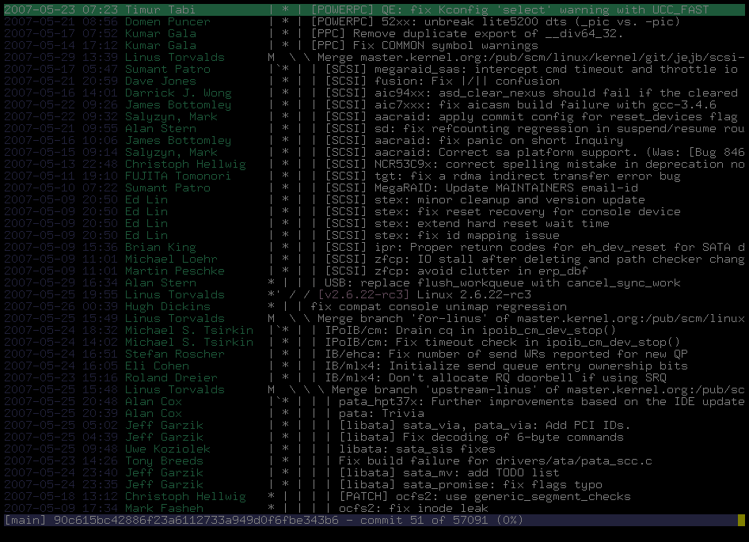
2000 lines added every day
2800 lines modified every day
24 hours a day
7 days a week

Slide 13
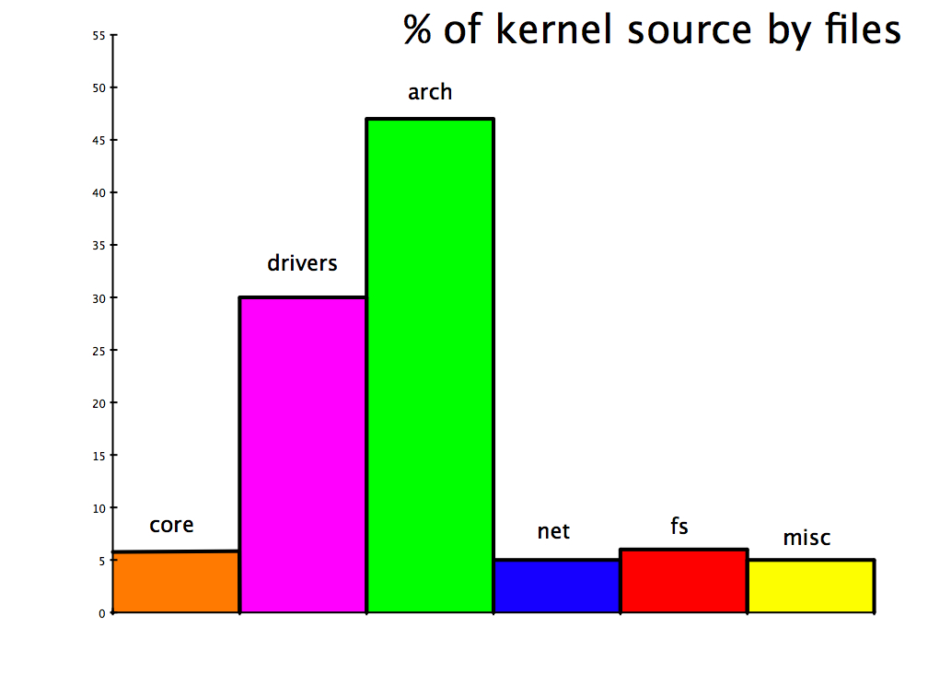

Slide 14
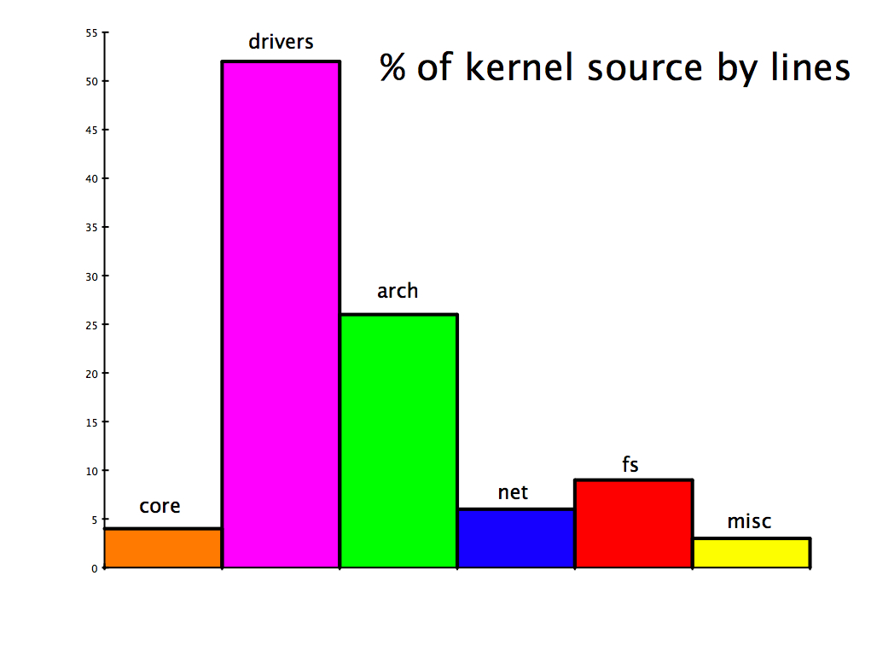

Slide 15
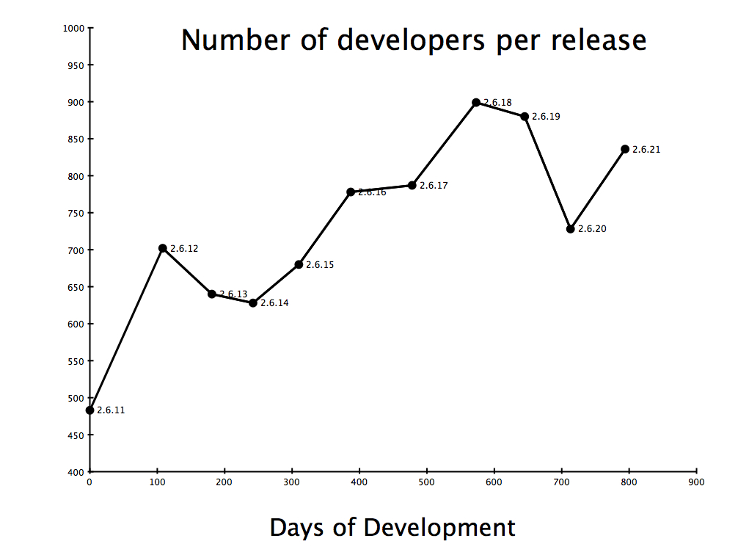

Slide 16
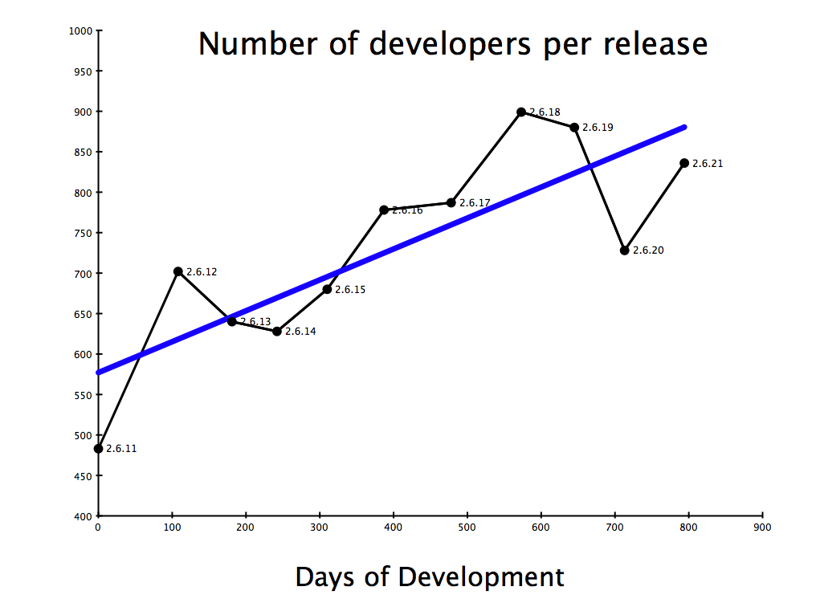

Slide 17
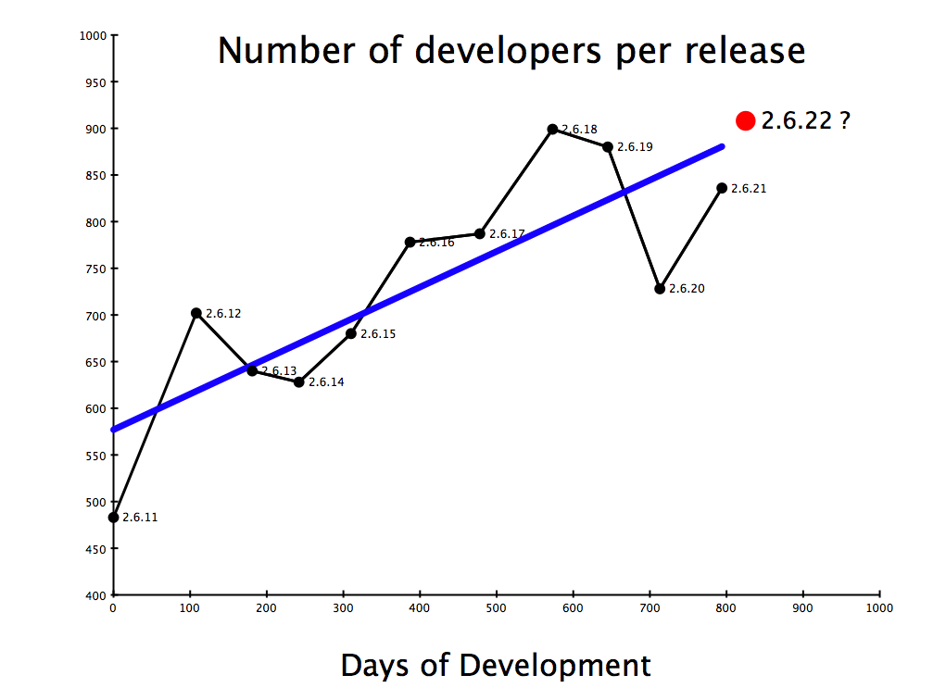

Slide 18

3200 Developers over 2½ years
Kernel releases 2.6.11 - 2.6.22-rc5

Slide 19

Top developers by quantity
Al Viro 1339
David S. Miller 1279
Adrian Bunk 1150
Andrew Morton 1071
Ralf Baechle 1013
Andi Kleen 922
Russell King 874
Takashi Iwai 816
Stephen Hemminger 755
Tejun Heo 670
Kernel releases 2.6.11 - 2.6.22-rc5

Slide 20
Top Signed-off-by:
Linus Torvalds 19890
Andrew Morton 18622
David S. Miller 6097
Greg Kroah-Hartman 4064
Jeff Garzik 3383
Russell King 2607
Paul Mackerras 2460
Mauro Carvalho Chehab 2124
James Bottomley 2048
Andi Kleen 1692
Kernel releases 2.6.11 - 2.6.22-rc5

Slide 21

Who is funding this work?
2. Red Hat 11.8%
3. Novell 9.7%
4. Linux Foundation 8.1%
5. IBM 7.9%
6. Intel 4.3%
8. SGI 2.2%
9. MIPS 1.5%
10. HP 1.3%

Slide 22
Who is funding this work?
1. Unknown Individuals 33.2%
2. Red Hat 11.8%
3. Novell 9.7%
4. Linux Foundation 8.1%
5. IBM 7.9%
6. Intel 4.3%
7. “Amateurs” 3.9%
8. SGI 2.2%
9. MIPS 1.5%
10. HP 1.3%

Slide 23


