Slide 1
The Linux Kernel
Greg Kroah-Hartman
SuSE Labs / Novell

Slide 2
3,800 lines added
1,700 lines removed
1,300 lines modified
per day for all of 2007
2.6.20-2.6.23
2.6.20 to 2.6.24-rc8

Slide 3
4,200 lines added
1,500 lines removed
1,500 lines modified
per day for 2.6.24
2.6.20 to 2.6.24-rc8

Slide 4
7,000 lines added
2,500 lines removed
2,400 lines modified
per day for 2.6.25
2.6.20 to 2.6.24-rc8

Slide 5
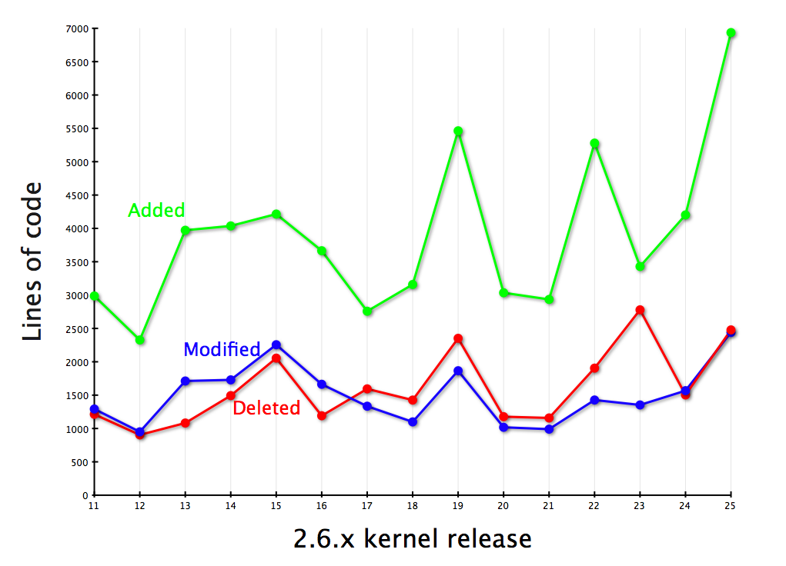

Slide 6
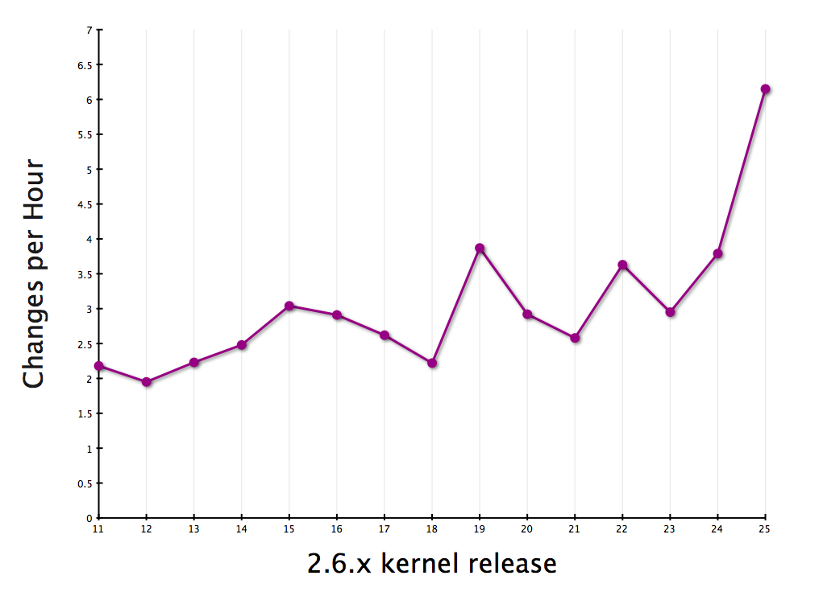

Slide 7


Slide 8


Slide 9

New release every
2¾ months

Slide 10

9.2 million lines
as of the 2.6.25 release

Slide 11

2598 Developers
Kernel releases 2.6.20 - 2.6.25

Slide 12

Top developers by quantity
Adrian Bunk 754
Al Viro 698
Thomas Gleixner 656
David S. Miller 655
Bart Zolnierkiewicz 330
Paul Mundt 610
Ralf Baechle 604
Ingo Molnar 596
Patrick McHardy 554
Tejun Heo 530
Kernel releases 2.6.20 - 2.6.25

Slide 13
Top Signed-off-by:
Andrew Morton 9086
Linus Torvalds 8960
David S. Miller 4926
Jeff Garzik 2960
Ingo Molnar 2489
Greg Kroah-Hartman 2098
Thomas Gleixner 1098
Mauro Carvalho Chehab 1822
Paul Mackerras 1675
John Linville 1461
Kernel releases 2.6.20 - 2.6.25

Slide 14

Who is funding this work?
1.
2. Red Hat 11.6%
3. IBM 7.5%
4.
5. Novell 6.6%
6. Intel 4.1%
7. Oracle 2.2%
8. Consultants 2.2%
9. Academia 1.5%
10. Renesas Technology 1.5%
Kernel releases 2.6.20 - 2.6.25

Slide 15
Who is funding this work?
1. “Amateurs” 17.8%
2. Red Hat 11.6%
3. IBM 7.5%
4. Unknown Individuals 7.2%
5. Novell 6.6%
6. Intel 4.1%
7. Oracle 2.2%
8. Consultants 2.2%
9. Academia 1.5%
10. Renesas Technology 1.5%
Kernel releases 2.6.20 - 2.6.25

Slide 16
New stuff in 2.6.25
sc26xx serial ports
dallas timekeeping chips
realtime clock devices
marvell memory controllers
nand flash interfaces
marvel flash controllers
zaurus keyboards
lifebook panel buttons
ipwireless pcmcia cards
storage device enclosuers
winbond sensor chips
ti adc devices
sony memory stick cards
globe trotter wireless cards
crypto accelerator chips
xceive tuners
cirrus logic a/d converters
beholder tv tuners
syntek cameras
marvel orion soc
marvel feroceon processors
superH processor updates
Broadcom 10Gb network adaptors
rtd8180 and 8185 wireless network
microchip en28j60 ethernet chips
atheros wireless network drivers
usb printer gadget
rdc soc
onkyo sound devices
nilinx and ti codecs
realteck codecs
via codecs
SiS audio accelerators
oxygen audio chipsets
conexant codecs
fantasia sound cards
wireless RNDIS
neteffect 1/10Gb ethernet
salsa20 stream cipher support
realtime scheduler work
preempt rcu added
latencytop support
kprobes for arm
CLONE_IO flag added to clone()
idle i/o scheduler changes
ext4 new features
CAN network protocol
network traffic shaper removed
network namespace rework
Chinese translations of documentation
kobject/kset rework and cleanup
LSM mount/umount operations
sg_table addition
block request completion API changed
alsa sequencer removed
selinux updates
netfilter hashlimit mechanism added
flow network classifier
pci hotplug not experimental
futex added bitset wait
virtio baloon
kvm pci driver
timerfd() syscall is back
page map patches
PM QOS
per-process capability bounding sets
SMACK LSM added
smbfs deprecated
x86 merge continues
flatmem and discontigmem removed
ticket spinlock
fastcall removed for x86
bidrectional scsi commands
TASK_KILLABLE added
early boot for firewire
hires timers
more disk I/O stats
s390 can do dynamic page tables
dma_parameters added to struct device
intel video driver updates
amd vide driver updates
oss sound drivers removed
inotify_init() support signals
memory use controller for containers
acpi thermal regulation
acpi dsdt override
xfs supports fallocate()
multipath AoE
MN10300 arch merge
a.out support removed from ELF loader
ext4 development flag
nopage() replaced with fault()
BKL removals
generic resource counter
reserve_bootmem() new flags
new string functions
x86 page manipulation functions
sunrpc and USB gpl-only
kobject sample code and documentation

Slide 17


