Slide 1
Linux Kernel Development
Going faster than you think
Greg Kroah-Hartman
gregkh@linuxfoundation.org
github.com/gregkh/kernel-development
Notes:
I'm going to discuss the how fast the kernel is moving, how we do it all, and how you can get involved.

Slide 2
53,000 files
21,150,000 lines
Kernel release 4.5.0
Notes:
This was for the 3.19 kernel release, which happened February 8, 2015.
The 3.17 kernel is the only release we have had in the past 4 years that we went down in size, this has only happened twice in the past 10 years.

Slide 3
3,974 developers
387 companies
Kernel releases 4.0.0 – 4.5.0
April 2015 – March 2016
Notes:
This makes the Linux kernel the largest contributed body of software out there that we know of.
This is just the number of companies that we know about, there are more that we do not, and as the responses to our inquiries come in, this number will go up.
Have surpassed 400 companies for 2 years now.

Slide 4
10,800 | lines added
5,300 | lines removed
1,875 | lines modified
Kernel releases 4.0.0 – 4.5.0
April 2015 – March 2016

Slide 5
10,800 | lines added
5,300 | lines removed
1,875 | lines modified
Every day
Kernel releases 4.0.0 – 4.5.0
April 2015 – March 2016

Slide 6
7.8 changes per hour
Kernel releases 4.0.0 – 4.5.0
April 2015 – March 2016
Notes:
This is 24 hours a day, 7 days a week, for a full year.
We went this fast the year before this as well, this is an amazing rate of change.
Interesting note, all of these changes are all through the whole kernel.
For example, the core kernel is only 5% of the code, and 5% of the change was to the core kernel. Drivers are 55%, and 55% was done to them, it's completely proportional all across the whole kernel.

Slide 7
8.1 changes per hour
4.3 release
2.6.20 to 2.6.24-rc8
Notes:
We are going slowly faster with every release.
10 years ago, 2 changes / hour
5 years ago 5 changes / hour
We hit 9.5 changes / hour for the 3.16 release 2 years ago.

Slide 8
How we stay sane
Time based releases
Incremental changes
2.6.20 to 2.6.24-rc8

Slide 9

New release every
2½ months
Kernel releases 3.10.0 – 3.14.0
Notes:
70 - 63 days to be exact, very regular experience.

Slide 10
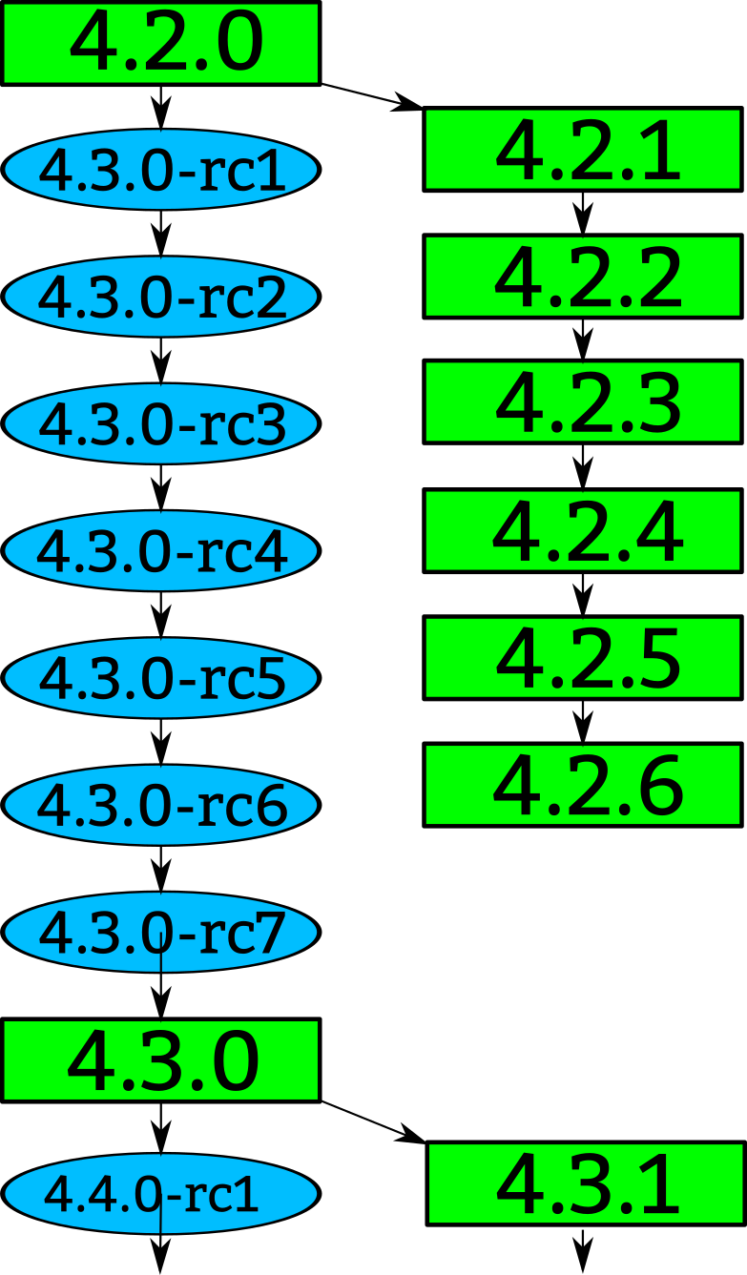
Notes:
How a kernel is developed.
Linus releases a stable kernel
- 2 week merge window from subsystem maintainers
- rc1 is released
- bugfixes only now
- 2 weeks later, rc2
- bugfixes and regressions
- 2 weeks later,rc3
And so on until all major bugfixes and regressions are resolved and then the cycle starts over again.

Slide 11
Notes:
Greg takes the stable releases from Linus, and does stable releases with them, applying only fixes that are already in Linus's tree.
Requiring fixes to be in Linus's tree first ensures that there is no divergence in the development model.
After Linus releases a new stable release, the old stable series is dropped.
With the exception of “longterm” stable releases, those are special, the stick around for much longer...

Slide 12
“Longterm kernels”
One picked per year
Maintained for two years
3.14 4.1 4.4
2.6.20 to 2.6.24-rc8
Notes:
I pick one kernel release per year to maintain for longer than one release cycle. This kernel I will maintain for at least 2 years.
This means there are 2 longterm kernels being maintained at the same time.
3.10 and 3.14 are the longterm kernel releases I am maintaining.
3.10 will stop being maintained in October.
Ben Hutchings is maintaining the 3.2 kernel as a longterm kernel for the Debian project.
The LTSI project is based on the longterm kernels.

Slide 13

Notes:
Like mentioned before, we have almost 4000 individual contributors. They all create a patch, a single change to the Linux kernel. This change could be something small, like a spelling correction, or something larger, like a whole new driver.
Every patch that is created only does one thing, and it can not break the build, complex changes to the kernel get broken up into smaller pieces.

Slide 14
Notes:
The developers send their patch to the maintainer of the file(s) that they have modified.
We have about 1000 different driver/file/subsystem maintainers

Slide 15
commit ecf85e481a716cfe07406439fdc7ba9526bbfaeb
Author: Robert Jarzmik <robert.jarzmik@free.fr>
AuthorDate: Tue Apr 21 20:33:10 2009 -0700
Commit: Greg Kroah-Hartman <gregkh@suse.de>
CommitDate: Thu Apr 23 14:15:31 2009 -0700
USB: otg: Fix bug on remove path without transceiver
In the case where a gadget driver is removed while no
transceiver was found at probe time, a bug in
otg_put_transceiver() will trigger.
Signed-off-by: Robert Jarzmik <robert.jarzmik@free.fr>
Acked-by: David Brownell <dbrownell@users.sourceforge.net>
Signed-off-by: Greg Kroah-Hartman <gregkh@suse.de>
--- a/drivers/usb/otg/otg.c
+++ b/drivers/usb/otg/otg.c
@@ -43,7 +43,8 @@ EXPORT_SYMBOL(otg_get_transceiver);
void otg_put_transceiver(struct otg_transceiver *x)
{
- put_device(x->dev);
+ if (x)
+ put_device(x->dev);
}
Notes:
This is an example of a patch.
It came from Robert, was acked by David, the maintainer at the time of the usb on-the-go subsystem, and then signed off by by me before it was commited to the kernel tree.
The change did one thing, it checked the value of the pointer before it was dereferenced, fixing a bug that would have crashed the kernel if it had been hit.
This is also a “blame” trail, showing who changed each line in the kernel, and who agreed with that change.
If a problem is found, these are the developers that you can ask about it.
Because of this, every line in the Linux kernel can be traced back to at least two developers who are responsible for it.
This is better than any other body of code.

Slide 16
Developer's Certificate of Origin
(a) I created this change; or
(b) Based this on a previous work with a
compatible license; or
(c) Provided to me by (a), (b), or (c) and not
modified
(d) This contribution is public.
Notes:
This is what “Signed-off-by:” means.
All contributions to the Linux kernel have to agree to this, and every single patch has at least one signed-off-by line, usually all have at least two.
This is also a “blame” trail, showing who changed each line in the kernel, and who agreed with that change.
If a problem is found, this is the developers that you can ask about it.
Because of this, every line in the Linux kernel can be traced back to at least two developers who are responsible for it.
This is better than any other body of code.

Slide 17
Notes:
After reviewing the code, and adding their own signed-off-by to the patch, the file/driver maintainer sends the patch to the subsystem maintainer responsible for that portion of the kernel.
We have around 200 subsystem maintainers

Slide 18
Notes:
Linux-next gets created every night from all of the different subsystem trees and build tested on a wide range of different platforms.
We have about 250 different trees in the linux-next release.
Andrew Morton picks up patches that cross subsystems, or are missed by others, and releases his -mm kernels every few weeks. This includes the linux-next release at that time.

Slide 19
0-day bot
All-seeing and all-testing
Notes:
Tests all the things!

Slide 20
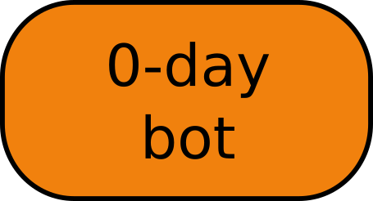
Notes:
0-day bot
Pulls all trees, tests all commits
Response within an hour, if not faster.
Auto-generates patches for common problems.
Also tests patches on mailing lists!

Slide 21

Notes:
Every 3 months, when the merge window opens up, everything gets sent to Linus from the subsystem maintainers and Andrew Morton.
The merge window is 2 weeks long, and thousands of patches get merged in that short time.
All of the patches merged to Linus should have been in the linux-next release, but that isn't always the case for various reasons.
Linux-next can not just be sent to Linus as there are things in there that sometimes are not good enough to be merged just yet, it is up to the individual subsystem maintainer to decide what to merge.

Slide 22

github.com/gregkh/kernel-development
Notes:
Obligatory Penguin Picture

Slide 23

Top developers by quantity
H. Hartley Sweeten 1772
Jes Sorensen 838
Malcolm Priestley 753
Lars-Peter Clausen 638
Takashi Iwai 612
Geert Uytterhoeven 661
Fabian Frederick 568
Laurent Pinchart 515
Johan Hedberg 508
Daniel Vetter 498
Kernel releases 3.15.0 – 4.0.0
Notes:
Hartley – comedi
Jes – wireless driver
Malcom – wireless driver
Laurent – video camera drivers
Geert – janitorial
Lars – sound
Fabian -
Johan -
Daniel – intel graphics
Takashi – sound core and drivers

Slide 24
Top Signed-off-by:
Greg Kroah-Hartman 10511
David S. Miller 5652
Mark Brown 3127
Linus Torvalds 2750
Andrew Morton 2629
Mauro Carvalho Chehab 2228
Daniel Vetter 2049
John Linville 1352
Rafael Wysocki 1011
Marcel Holtmann 971
Kernel releases 3.15.0 – 4.0.0
Notes:
Greg – driver core, usb, staging
David – networking, isa
Mark – embedded sound
Linus – everything
Andrew – everything
Daniel – Intel graphics
Mauro – v4l
John – wireless networking
Rafael – ACPI / power management
Marcel - Bluetooth

Slide 25
Who is funding this work?
1. “Amateurs” 12.8%
2. Intel 11.0%
3. Red Hat 8.4%
4. Unknown Individuals 5.6%
5. Samsung 4.0%
6. Linaro 3.9%
7. SuSE 3.5%
8. Consultants 3.2%
9. IBM 2.7%
10. Vision Engraving 2.4%
Kernel releases 3.15.0 – 4.0.0
Notes:
So you can view this as either 18% is done by non-affiliated people, or 82% is done by companies.
Now to be fair, if you show any skill in kernel development you are instantly hired.
Why this all matters: If your company relies on Linux, and it depends on the future of Linux supporting your needs, then you either trust these other companies are developing Linux in ways that will benefit you, or you need to get involved to make sure Linux works properly for your workloads and needs.

Slide 26
Who is funding this work?
11. Texas Instruments 2.2%
12. Google 2.1%
13. Renesas 2.0%
14. Free Electrons 1.9%
15. Freescale 1.7%
16. Oracle 1.1%
17. AMD 1.1%
18. FOSS OPFW 1.0%
19. Nvidia 0.9%
20. ARM 0.9%
Kernel releases 3.15.0 – 4.0.0
Notes:
Vision Engraving (Hartley 1519 patches)
Google, 1700 patches
FOSS Outreach Program for Women 966 patches
20 women interns / students

Slide 27
“Working upstream
saves time and money”
Dan Frye – VP Open Systems, IBM
Dirk Hohndel – Chief Technologist, Intel
2.6.20 to 2.6.24-rc8

Slide 28
Getting involved
Run the kernel.org release on your machine
2.6.20 to 2.6.24-rc8
10,900 lines added
5,500 lines removed
2,200 lines modified
per day 2008 - 2009

Slide 29
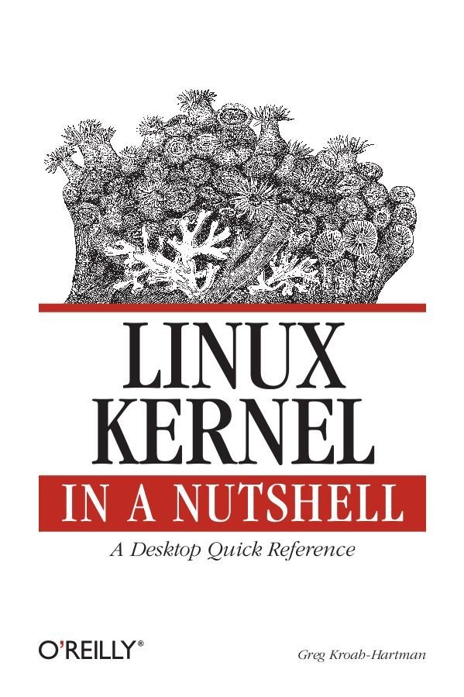
Getting involved
2.6.20 to 2.6.24-rc8
10,900 lines added
5,500 lines removed
2,200 lines modified
per day 2008 - 2009
Notes:
This book tells you how to build and install a kernel on your machine.
Free online

Slide 30
Getting involved
Documentation/HOWTO
Documentation/development-process
2.6.20 to 2.6.24-rc8
Notes:
These documents in the kernel source directory are the best place to start if you want to understand how the development process works, and how to get involved.
The HOWTO file has links to almost everything else you ever wanted..

Slide 31

Getting involved
kernelnewbies.org
2.6.20 to 2.6.24-rc8
Notes:
http://www.kernelnewbies.org

Slide 32
Getting involved
Google “write your first kernel patch”
2.6.20 to 2.6.24-rc8
Notes:
This is a video of a talk I gave at FOSDEM, going through the steps, showing exactly how to create, build, and send a kernel patch.

Slide 33
Getting involved
kernelnewbies.org/KernelJanitors/Todo
2.6.20 to 2.6.24-rc8
Notes:
So you know how to create a patch, but what should you do? The kernel janitors has a great list of tasks to start with in cleaning up the kernel and making easy patches to be accepted.

Slide 34
Getting involved
Linux Driver Project
drivers/staging/*/TODO
2.6.20 to 2.6.24-rc8
Notes:
The staging tree also needs a lot of help, here are lists of things to do in the kernel for the drivers to be able to move out of the staging area.
Please always work off of the linux-next tree if you want to do these tasks, as sometimes they are already done by others by the time you see them in Linus's tree.

Slide 35
Getting involved
Eudyptula Challenge
(little penguin)
http://eudyptula-challenge.org/
2.6.20 to 2.6.24-rc8
Notes:
Google “Linux kernel challenge” to find the site, if you can't remember Eudyptula.
It is a series of programming challenges, all run through email that starts out with a “Hello World” kernel module, and gets more complex from there. Over 4000 people are currently taking the challenge, and is a lot of fun if you don't know where to start out.
You need knowledge of C, but that's about it.

Slide 37
Product Development
time
Design Bringup Integration Testing Release

Slide 38
Product Development
time
Design Bringup Integration Testing Release
Kernel code
submission
Kernel code
accepted
Ideal

Slide 39
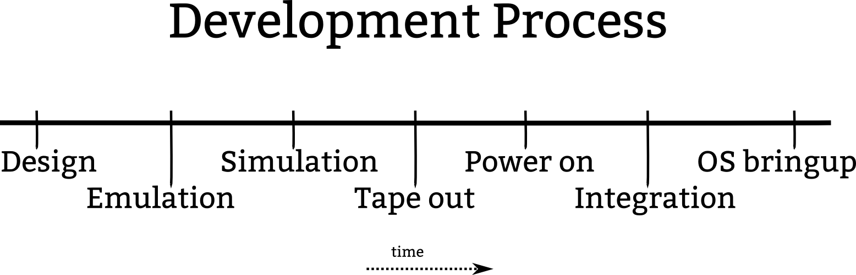

Slide 40
Kernel code
submission
Kernel code
accepted
Ideal

Slide 41
How to change
2.6.20 to 2.6.24-rc8
Notes:
“Change or die”

Slide 42
How to change
Submit code early and often
2.6.20 to 2.6.24-rc8
Notes:
No big code dumps.
They are hard to review, and even harder for you to modify and resend, slowing everything down and delaying any potential acceptance.

Slide 43
How to change
Send small pieces
2.6.20 to 2.6.24-rc8

Slide 44
How to change
Ask community for feedback
2.6.20 to 2.6.24-rc8
Notes:
Some companies get Linux kernel community members together and discuss products and technologies directly with the senior engineers, no managers in the way.
Great feedback circle, the community gets to understand your products better, and no long explanation is needed when showing the code later, and the community gets to tell your engineers what they are doing wrong.

Slide 45
How to change
Act on it
2.6.20 to 2.6.24-rc8
Notes:
Change products / roadmaps / features based on feedback. This makes Linux work better on your platforms which makes your platform better.

Slide 46
How to change
Remove legal hurdles
2.6.20 to 2.6.24-rc8
Notes:
Let them contribute whatever they want and can.
Legal is to support the business, change the hurdles to be on the legal side, not the developers.

Slide 47
How to change
Force them to work in public
2.6.20 to 2.6.24-rc8
Notes:
No internal mailing lists
All communication is done publicly
Let them argue in public

Slide 48
How to change
Allow them to be the community
2.6.20 to 2.6.24-rc8
Notes:
Your developers will become the maintainers, driving the future of Linux forward, always keeping your products in mind as things evolve and change.

Slide 49
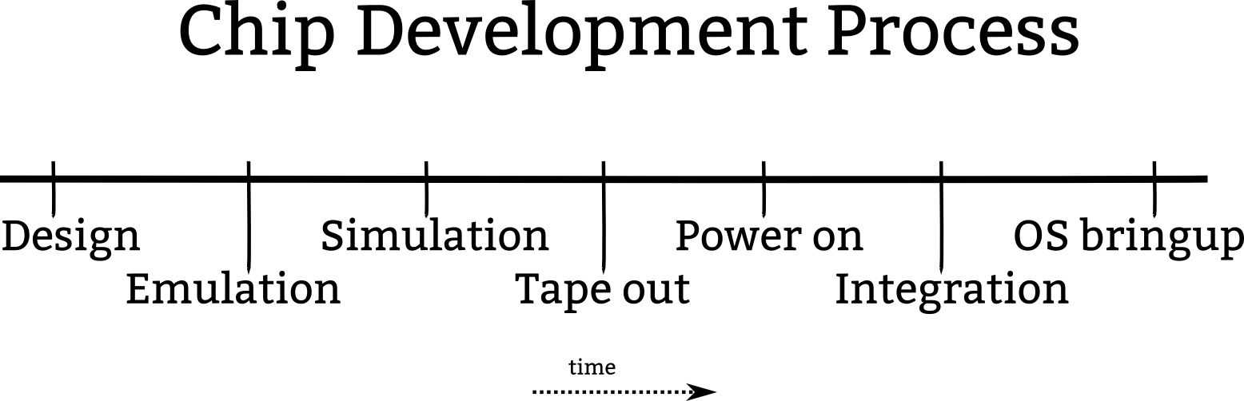

Slide 50
Kernel code
submission
Today

Slide 51
Kernel code
submission
Kernel code
accepted
Today

Slide 52
Kernel code
submission
Ideal

Slide 53
Kernel code
submission
Kernel code
accepted
Ideal

