Slide 1
The Linux Kernel Community
How it works, why it matters, and how to get involved
Greg Kroah-Hartman
SuSE Labs / Novell

Slide 2
4,000 lines added
1,900 lines removed
1,300 lines modified
per day for all of 2007
2.6.20 to 2.6.24-rc8

Slide 3
3.44 changes per hour
2.6.20 to 2.6.24-rc8

Slide 4


Slide 5


Slide 6

New release every
2¾ months

Slide 7

8.9 million lines
as of the 2.6.24-rc8 release

Slide 8

2198 Developers
Kernel releases 2.6.20 - 2.6.24-rc8

Slide 9

Top developers by quantity
Ralf Baechle 560
Al Viro 556
David S. Miller 523
Adrian Bunk 518
Thomas Gleixner 489
Tejun Heo 454
Paul Mundt 403
Andrew Morton 395
Ingo Molnar 382
Bart Zolnierkiewicz 330
Kernel releases 2.6.20 - 2.6.24-rc8

Slide 10
Top Signed-off-by:
Andrew Morton 7366
Linus Torvalds 7321
David S. Miller 3265
Jeff Garzik 2405
Greg Kroah-Hartman 1571
Paul Mackerras 1351
Mauro Carvalho Chehab 1224
Ingo Molnar 1106
Ralf Baechle 1029
James Bottomley 975
Kernel releases 2.6.20 - 2.6.24-rc8

Slide 11
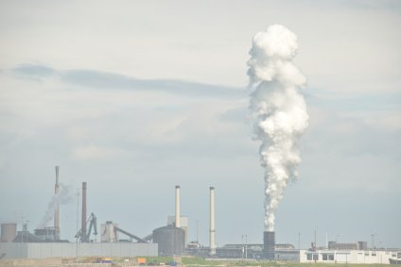
Who is funding this work?
1.
2.
3. Red Hat 11.1%
4. IBM 7.9%
5. Novell 7.0%
6. Linux Foundation 6.7%
7. Intel 4.8%
8. Consultants 1.9%
9. Oracle 1.7%
10. MIPS 1.6%
Kernel releases 2.6.18 - 2.6.23-rc8

Slide 12
Who is funding this work?
1. “Amateurs” 14.4%
2. Unknown Individuals 11.3%
3. Red Hat 11.1%
4. IBM 7.9%
5. Novell 7.0%
6. Linux Foundation 6.7%
7. Intel 4.8%
8. Consultants 1.9%
9. Oracle 1.7%
10. MIPS 1.6%
Kernel releases 2.6.20 - 2.6.24-rc8

Slide 13
No known contribution by
Amazon to the Linux kernel
Kernel releases 2.6.11 - 2.6.24-rc8

Slide 14



Slide 15

Destiny is no matter of chance.
It is a matter of choice.
-William Jennings Bryan

Slide 16

Documentation/HOWTO

Slide 17

Kernel Newbies

Slide 18

Kernel Janitors

Slide 19
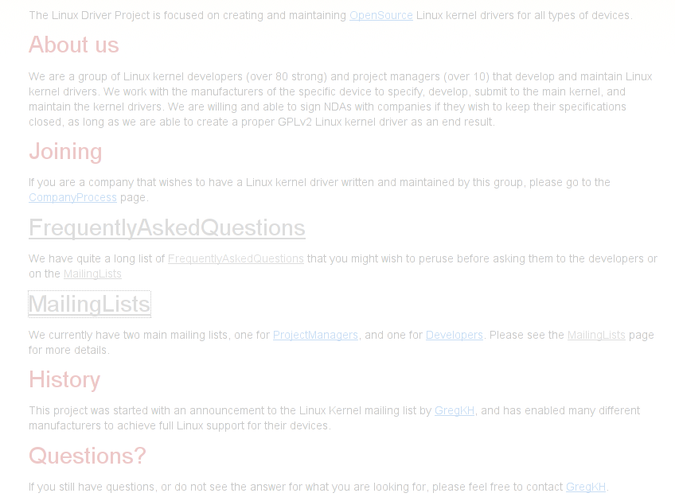
Linux Driver Project
www.linuxdriverproject.org

Slide 20


