Slide 1
The Linux Kernel
Who is developing it,
how they are doing it,
and why you should care
Greg Kroah-Hartman
SuSE Labs / Novell

Slide 2
4,300 lines added
1,800 lines removed
1,500 lines modified
per day 2007 - 2008
2.6.20 to 2.6.24-rc8

Slide 3
3.69 changes per hour
2.6.20 to 2.6.24-rc8

Slide 4
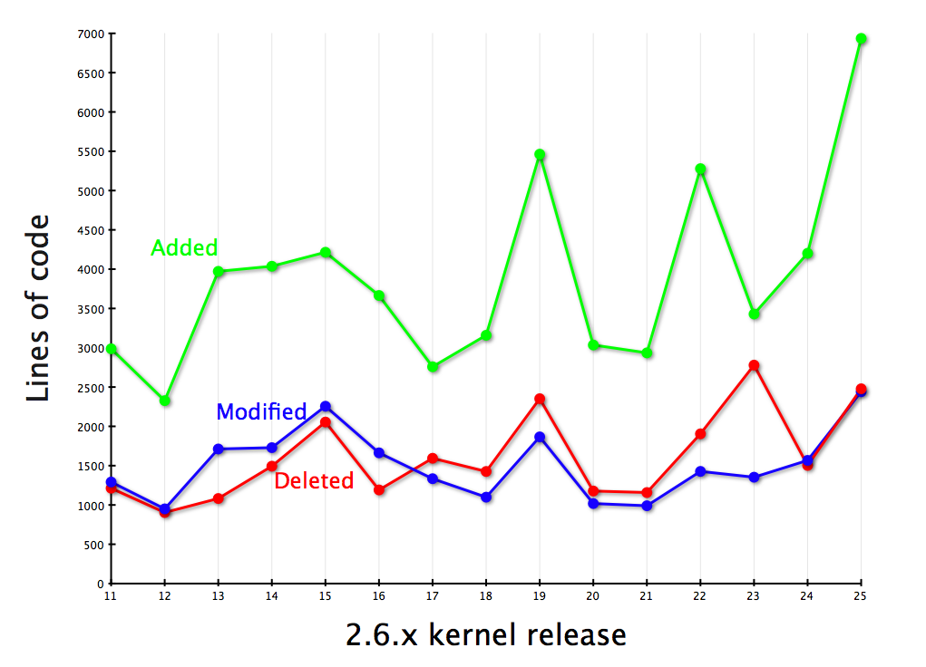

Slide 5
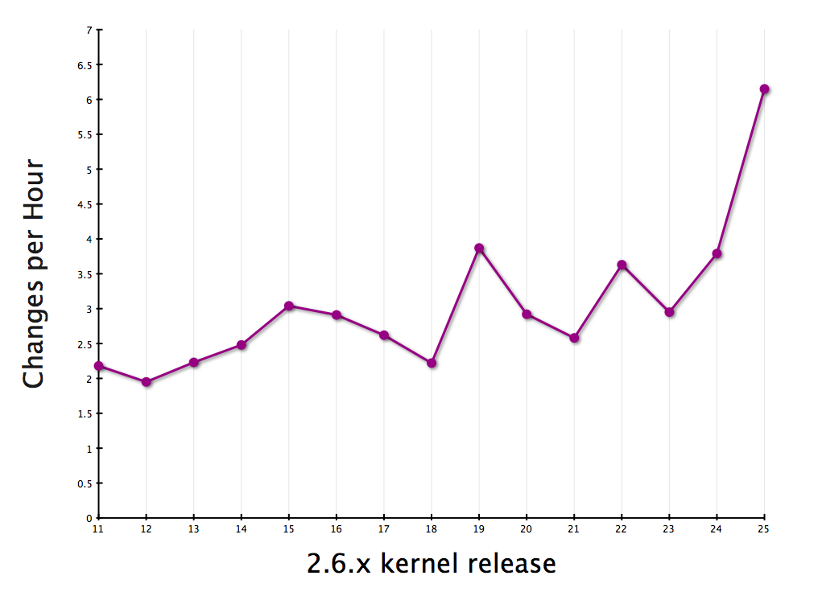

Slide 6


Slide 7
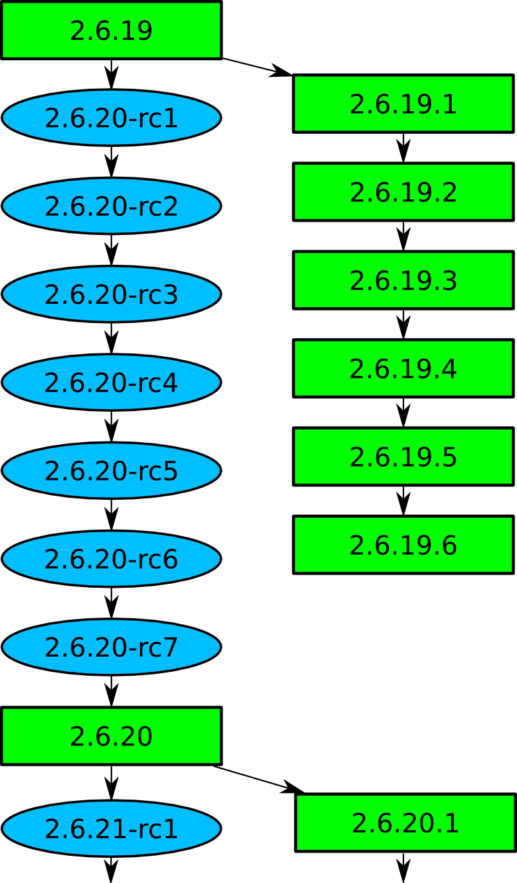

Slide 8

New release every
2¾ months

Slide 9

9.2 million lines
as of the 2.6.25 release

Slide 10

2399 Developers
Kernel releases 2.6.20 - 2.6.25

Slide 11

Top developers by quantity
Adrian Bunk 754
Al Viro 698
Thomas Gleixner 656
David S. Miller 655
Bart Zolnierkiewicz 637
Paul Mundt 610
Ralf Baechle 604
Ingo Molnar 596
Patrick McHardy 554
Tejun Heo 530
Kernel releases 2.6.20 - 2.6.25

Slide 12
Top Signed-off-by:
Andrew Morton 9086
Linus Torvalds 8960
David S. Miller 4926
Jeff Garzik 2960
Ingo Molnar 2489
Greg Kroah-Hartman 2098
Thomas Gleixner 1098
Mauro Carvalho Chehab 1822
Paul Mackerras 1675
John Linville 1461
Kernel releases 2.6.20 - 2.6.25

Slide 13

Who is funding this work?
1.
2. Red Hat 11.6%
3. IBM 7.5%
4. Novell 6.6%
5.
6. Intel 4.1%
7. Oracle 2.2%
8. Consultants 2.2%
9. Academia 1.5%
10. Renesas Technology 1.5%
Kernel releases 2.6.20 - 2.6.25

Slide 14
Who is funding this work?
1. “Amateurs” 18.5%
2. Red Hat 11.6%
3. IBM 7.5%
4. Novell 6.6%
5. Unknown individuals 5.5%
6. Intel 4.1%
7. Oracle 2.2%
8. Consultants 2.2%
9. Academia 1.5%
10. Renesas Technology 1.5%
Kernel releases 2.6.20 - 2.6.25

Slide 15
Who is funding this work?
...
13. Google 1.4%
Kernel releases 2.6.18 - 2.6.23-rc8

Slide 16
Without Andrew
...
40. Google
Kernel releases 2.6.18 - 2.6.23-rc8

Slide 17
27 Google employees
contributed to the kernel
in 2007-2008
Kernel releases 2.6.20 - 2.6.25

Slide 18
Google employee contributions
11. Andrew Morton 507
149. David Rientjes 67
324. Paul Menage 24
398. Ken Chen 18
658. Matt LaPlante 7
770. Aaron Durbin 5
770. Oleg Ryjkov 5
852. Tim Hockin 4
958. Martin Bligh 3
958. Suleiman Souhlal 3
Kernel releases 2.6.20 - 2.6.25

Slide 19
Google employee contributions
1127. Arve Hjønnevåg 2
1127. Brian Swetland 2
1127. Gwendal Grignou 2
1417. Al Borchers 1
1417. David Smith 1
1417. Ethan Solomita 1
1417. Jeff Bailey 1
1417. Joshua Wise 1
1417. Maciej Zenczykowski 1
Kernel releases 2.6.20 - 2.6.25

Slide 20
Google employee contributions
1417. Masoud Asgharifard Sharbiani 1
1417. Mike Chan 1
1417. Ollie Wild 1
1417. Priyanka Gupta 1
1417. Ranjit Manomohan 1
1417. Rohit Seth 1
1417. Sam Jansen 1
1417. Warren Turkal 1
Kernel releases 2.6.20 - 2.6.25

Slide 21
New stuff in 2.6.26
Korina driver
superH MX-G
SH-MobileR2 CPU support
Solution Engine SH7721
ARM YL9200
Kwikbyte KB9260
Olimex SAM9-L9260
emQbit ECB_AT91
Digi ns921x processor
Nias SMX crypto
AMCC PPC460EX
Emerson KSI8560
WindRiver SBC8641D
Logitech Rumblepad 2
Renesas SH7760 I2c
SuperH Mobile I2C
PCI Express ASPM
security= boot option
NAT for SCTP, SCCP and UDP-lite
network window scaling w/ syncookies
network namespace work
mesh networking for mac80211
SELinux permisive types
realtime group scheduler work
SunOS binary support removed
read-only bind mounts
kbdb
PAT for x86
inode_getsecid()
ipc_getsecid()
ieee80211 MAC removed
generic semaphores
ata_port_operations inheritance
ns_to_ktime()
struct class_device removed
SEQ_SKIP allowed from show()
Wolfson WM9713 codecs
TI DAVINCI AC97
Emagic Audiowerk 2
x86 PC speakers
Asus AV100 (Xonar DX)
Micron MT9M001
Micron MT9V022
PXA27x Quick Capture
Kworld ATSC 120 tuners
cx23417 MPEG encoders
Integrant ITD1000 tuners
Philips TDA10048HN demodulators
Philips SAA7171/3/4 a/v decoders
Auvitek AU8522 demodulators
Samsung S5H1411-based tuners
Xen framebuffer
Xen keyboard
Xen mouse
Wolfson Microelectronics touchscreens
wireless Xbox 360 controller
Zhen Hua PPM-4CH transmitters
SPCP8x5 USB to serial
NCR 53c9x SCSI controller
Freescale 8610 and 5121 display
Intel 965G/965GM
TI OMAP sound controller
Eee PC function keys
Intel IXP4xx Ethernet
basic braille screen reader support
OLPC XO architecture support
virtual files in /proc/pid/mountinfo
/proc/vmallocinfo
NUMA for SPARC Niagra
Xen baloon driver
/dev/mem support removed
KVM for s390
KVM for PowerPC 440
KVM for ia64
perprocess secure bits
getrusage() RUSAGE_THREAD
partions with NBD
audit open file tests
/sys/class/bdi
shared writable mappings for FUSE
ioremap() always uncached on x86
/sys/kernel/slab/NAME/order
WARN_ON taints kernel
get_info() for /proc removed
proc_create_data()
object debugging infrastructure
Solarflare Comm Solarstorm SFC4000
Hauppauge HVR-1600 TV tuner card
WTF are you doing reading this
ISP 1760 USB host controller
Cypress c67x00 OTG controller
Intel PXA 27x USB controller
DEFINE_KLIST()
KLIST_INIT()
klist_add_after()
klist_add_before()
div_u64 and friends
sysfs_streq
MODULE_FORCE_LOAD

Slide 22


