Slide 1
Linux Kernel Development model
i.e. semi-controled chaos
Greg Kroah-Hartman
SuSE Labs / Novell

Slide 2
27,900 files
11,560,000 lines
2.6.20 to 2.6.24-rc8
Kernel release 2.6.30

Slide 3
2,868 developers
340 companies
Kernel releases 2.6.25 - 2.6.30

Slide 4
10,900 lines added
5,500 lines removed
2,200 lines modified
2.6.20 to 2.6.24-rc8
Kernel releases 2.6.25 - 2.6.30

Slide 5
10,900 lines added
5,500 lines removed
2,200 lines modified
per day 2008 - 2009
2.6.20 to 2.6.24-rc8
Kernel releases 2.6.25 - 2.6.30
10,900 lines added
5,500 lines removed
2,200 lines modified

Slide 6
5.44 changes per hour
2.6.20 to 2.6.24-rc8
Kernel releases 2.6.25 - 2.6.30
Notes:
Last year this was 3.69, crazy...

Slide 7

Notes:
2800 developers last year

Slide 8
commit ecf85e481a716cfe07406439fdc7ba9526bbfaeb
Author: Robert Jarzmik <robert.jarzmik@free.fr>
AuthorDate: Tue Apr 21 20:33:10 2009 -0700
Commit: Greg Kroah-Hartman <gregkh@suse.de>
CommitDate: Thu Apr 23 14:15:31 2009 -0700
USB: otg: Fix bug on remove path without transceiver
In the case where a gadget driver is removed while no
transceiver was found at probe time, a bug in
otg_put_transceiver() will trigger.
Signed-off-by: Robert Jarzmik <robert.jarzmik@free.fr>
Acked-by: David Brownell <dbrownell@users.sourceforge.net>
Signed-off-by: Greg Kroah-Hartman <gregkh@suse.de>
--- a/drivers/usb/otg/otg.c
+++ b/drivers/usb/otg/otg.c
@@ -43,7 +43,8 @@ EXPORT_SYMBOL(otg_get_transceiver);
void otg_put_transceiver(struct otg_transceiver *x)
{
- put_device(x->dev);
+ if (x)
+ put_device(x->dev);
}

Slide 9
Developer's Certificate of Origin
(a) I created this change; or
(b) Based this on a previous work with a
compatible license; or
(c) Provided to me by (a), (b), or (c) and not
modified
(d) This contribution is public.

Slide 10
Notes:
590 different driver/file/subsystem maintainers

Slide 11
Notes:
Around 120 subsystem maintainers

Slide 12
Notes:
125 trees in -next

Slide 14

New release every
2¾ months
Kernel releases 2.6.20 - 2.6.30
Notes:
86 days to be exact.

Slide 15
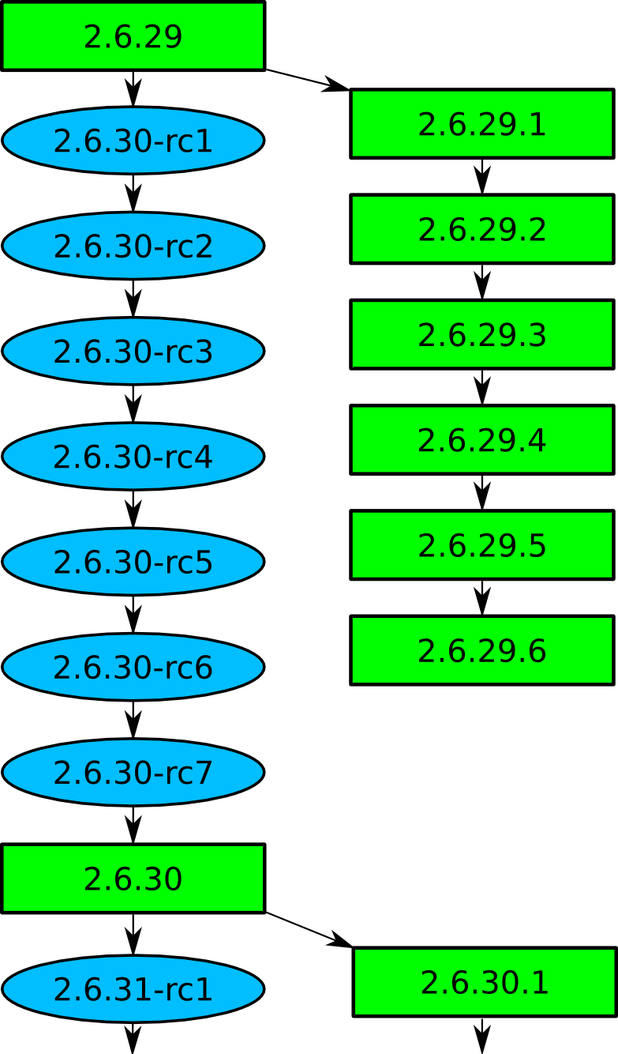

Slide 17

Top developers by quantity
Bart Zolnierkiewicz 1169
Ingo Molnar 1164
David S. Miller 851
Chris Mason 717
Takashi Iwai 711
Adrian Bunk 708
Harvey Harrison 669
Yinghai Lu 609
Greg Kroah-Hartman 608
Paul Mundt 570
Kernel releases 2.6.30 - 2.6.35

Slide 18
Top Signed-off-by:
Ingo Molnar 7314
Linus Torvalds 7200
Andrew Morton 6811
David S. Miller 6800
Mauro Carvalho Chehab 3867
John Linville 3820
Greg Kroah-Hartman 2999
Thomas Gleixner 2100
Jeff Garzik 1955
Takashi Iwai 1803
Kernel releases 2.6.30 - 2.6.35

Slide 19

Who is funding this work?
1.
2. Red Hat 11.4%
3.
4. IBM 6.0%
5. Novell 5.8%
6. Intel 5.6%
7. Oracle 2.9%
8. Consultants 2.0%
9. Parallels 1.6%
10. Academia 1.3%
Kernel releases 2.6.25 - 2.6.30

Slide 20
Who is funding this work?
1. “Amateurs” 18.9%
2. Red Hat 11.4%
3. Unknown individuals 7.0%
4. IBM 6.0%
5. Novell 5.8%
6. Intel 5.6%
7. Oracle 2.9%
8. Consultants 2.0%
9. Parallels 1.6%
10. Academia 1.3%
Kernel releases 2.6.25 - 2.6.30

Slide 21
Getting involved
2.6.20 to 2.6.24-rc8
10,900 lines added
5,500 lines removed
2,200 lines modified
per day 2008 - 2009

Slide 22
Getting involved
Documentation/HOWTO
Documentation/development-process
2.6.20 to 2.6.24-rc8

Slide 23

Getting involved
Kernel Newbies
2.6.20 to 2.6.24-rc8

Slide 24
Getting involved
Linux Driver Project
drivers/staging/*/TODO
2.6.20 to 2.6.24-rc8

Slide 25

Total world domination is
proceeding as planned.

Slide 26


