Slide 1
2007 State of the Linux Kernel
Greg Kroah-Hartman
SuSE Labs / Novell

Slide 2


Slide 3

Development or Stable tree?

Slide 4
Development or Stable tree?
Everything is “stable”

Slide 5


Slide 6

New release every
2½ months

Slide 7
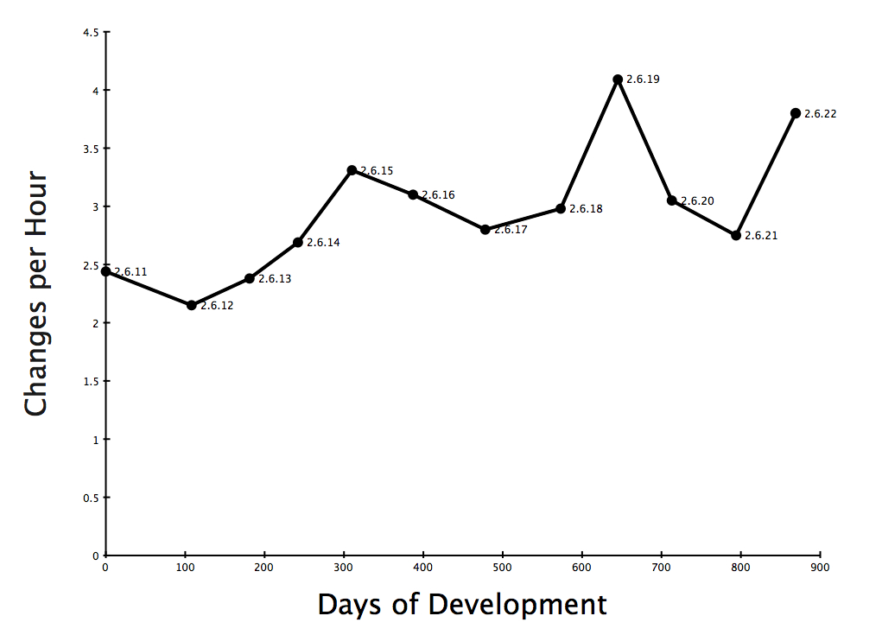

Slide 8
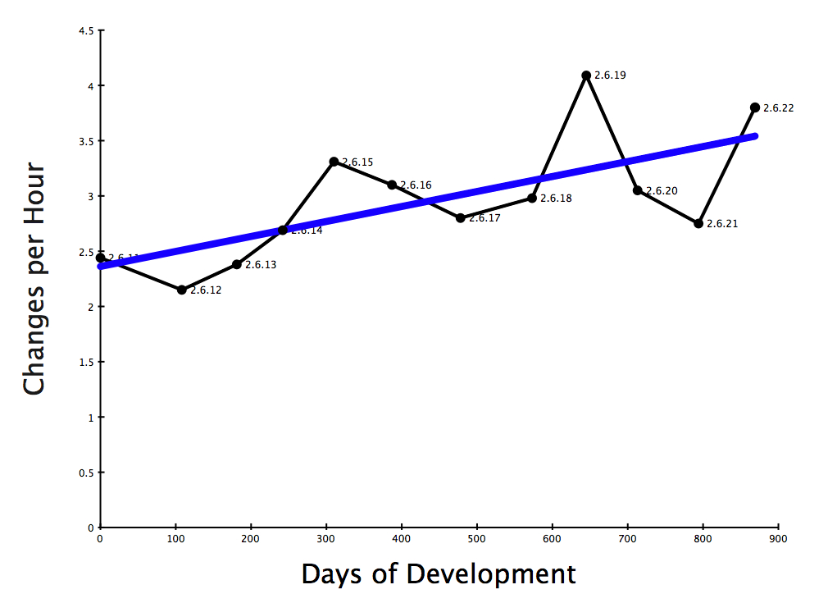

Slide 9
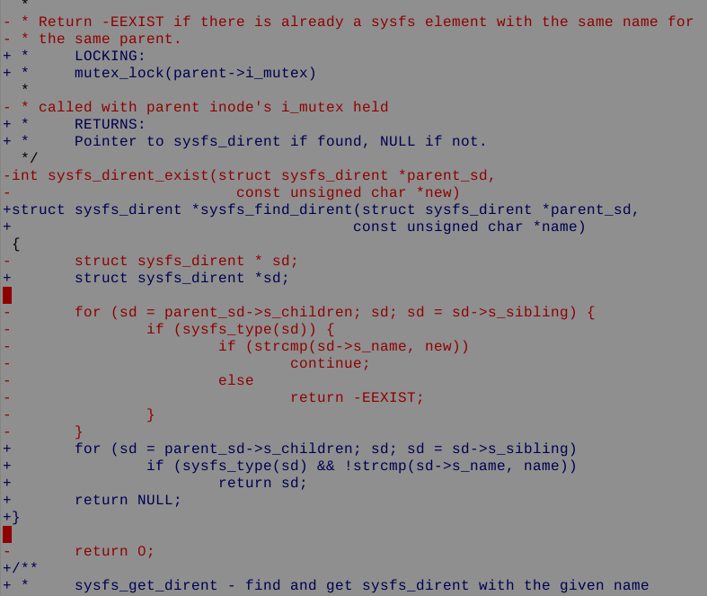
3.31 changes per hour
2.6.18 to 2.6.22

Slide 10
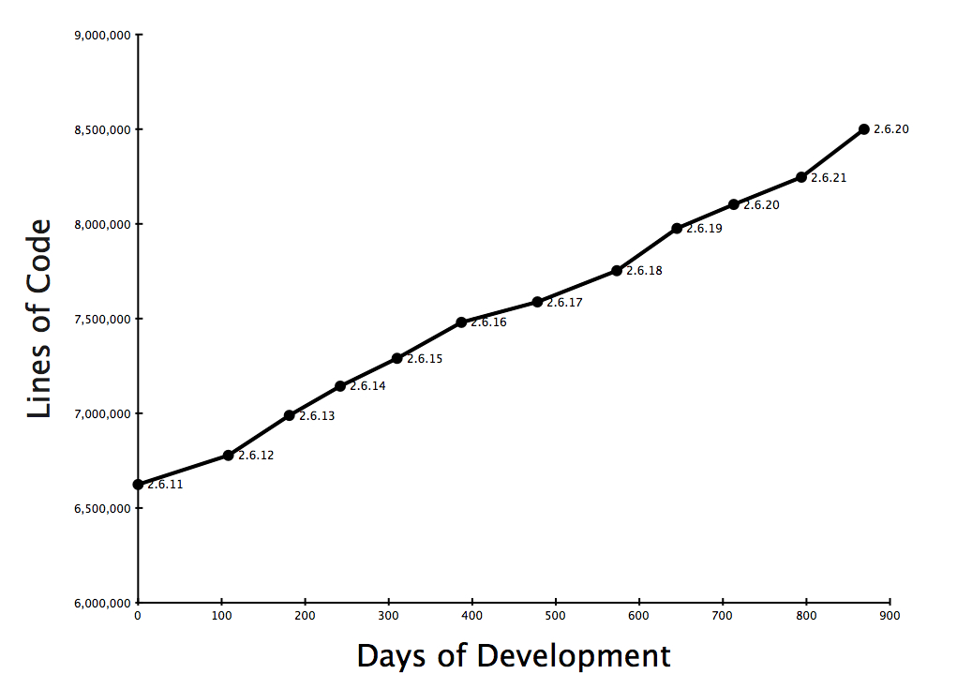
10% growth

Slide 11

8.5 million lines
as of the 2.6.22 release

Slide 12
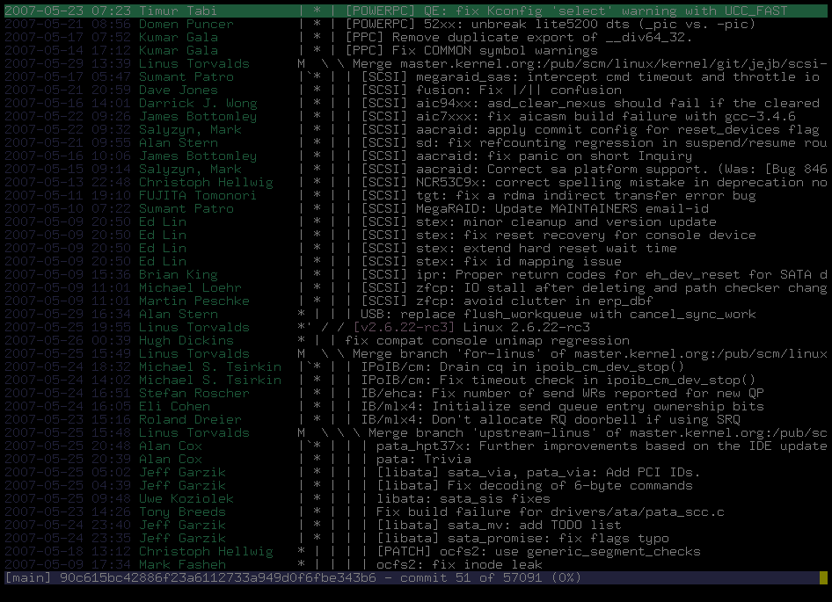
2330 lines added every day
2800 lines modified every day
24 hours a day
7 days a week
2.6.18 to 2.6.22

Slide 13
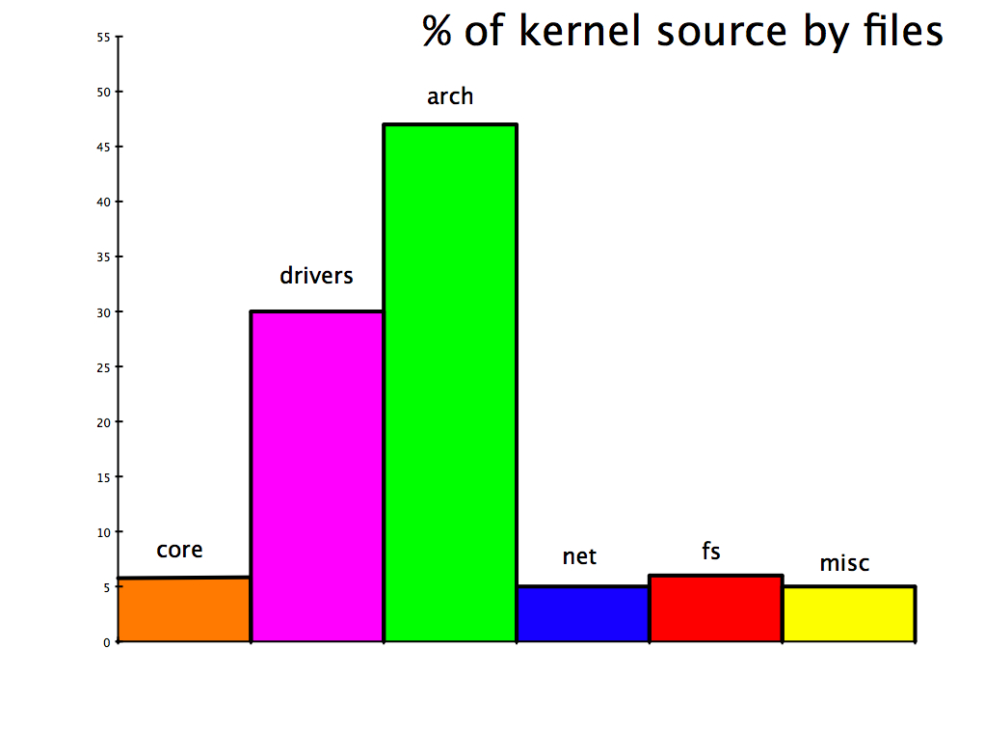

Slide 14
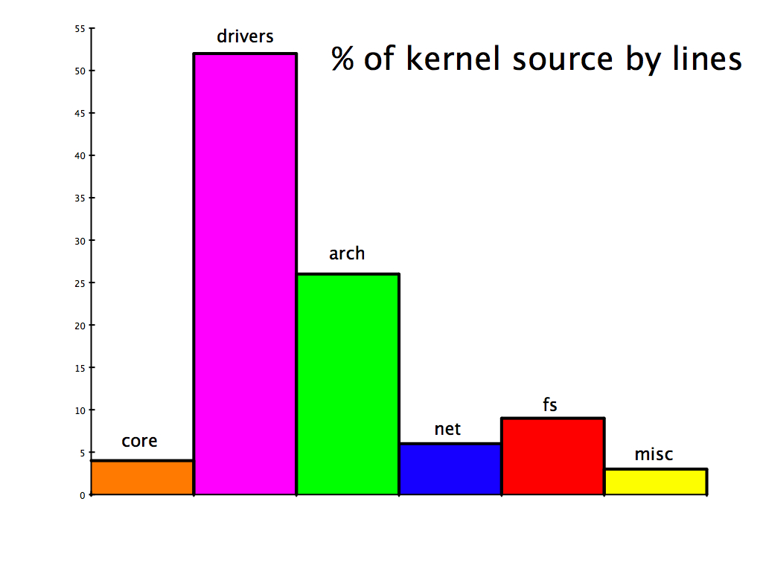

Slide 15
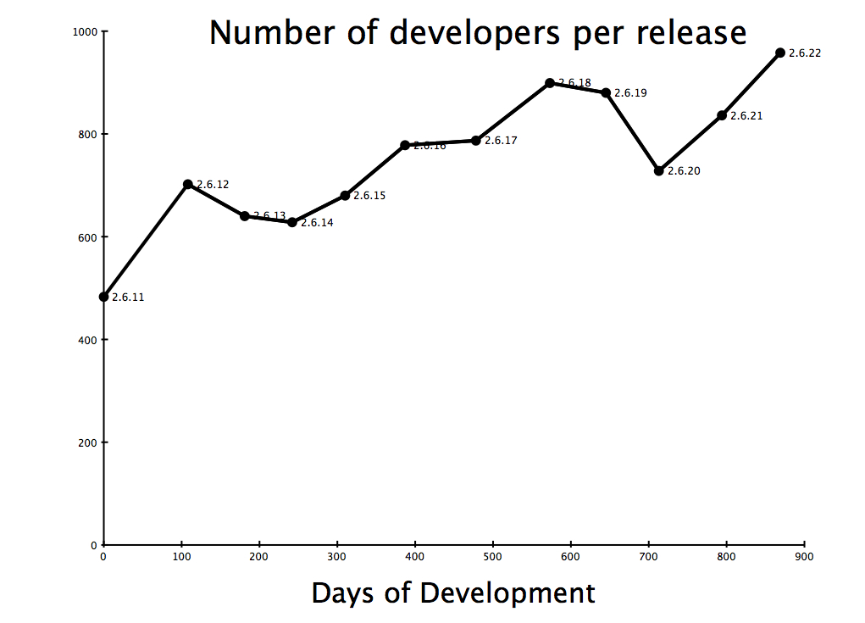

Slide 16
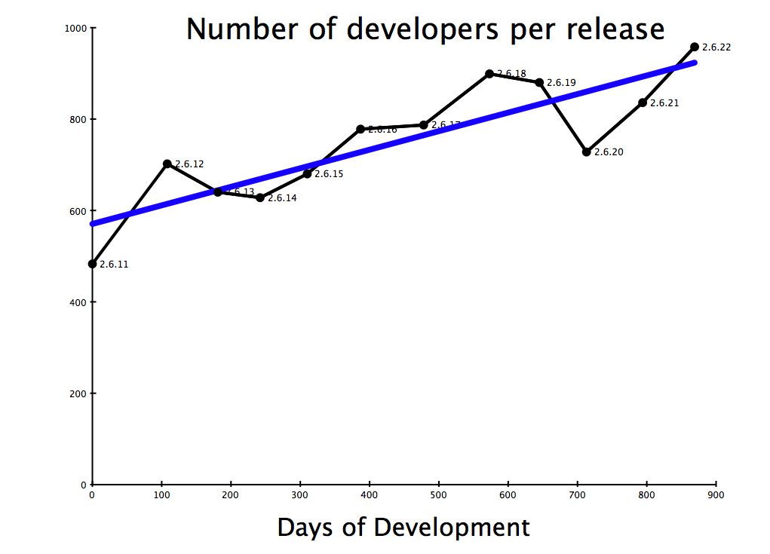

Slide 17

2110 Developers
Kernel releases 2.6.18 - 2.6.22

Slide 18

Top developers by quantity
Al Viro 681
David S. Miller 523
Andrew Morton 482
Ralf Baechle 440
Tejun Heo 434
Adrian Bunk 408
Andi Kleen 361
Stephen Hemminger 341
Patrick McHardy 323
David Woodhouse 310
Kernel releases 2.6.18 - 2.6.22

Slide 19
Top Signed-off-by:
Andrew Morton 7756
Linus Torvalds 7592
David S. Miller 2996
Jeff Garzik 1965
Greg Kroah-Hartman 1674
Paul Mackerras 1279
Mauro Carvalho Chehab 1254
Russell King 1024
Andi Kleen 972
James Bottomley 841
Kernel releases 2.6.18 - 2.6.22

Slide 20

Who is funding this work?
1.
2.
3. Red Hat 12.9%
4. IBM 8.7%
5. Novell 7.5%
6. Linux Foundation 6.8%
7. Intel 4.2%
8. SGI 1.7%
9. Consultants 1.4%
10. MIPS 1.4%
Kernel releases 2.6.18 - 2.6.22

Slide 21
Who is funding this work?
1. Unknown Individuals 18.1%
2. “Amateurs” 13.3%
3. Red Hat 12.9%
4. IBM 8.7%
5. Novell 7.5%
6. Linux Foundation 6.8%
7. Intel 4.2%
8. SGI 1.7%
9. Consultants 1.4%
10. MIPS 1.4%
Kernel releases 2.6.18 - 2.6.22

Slide 22
2.6.22
1. “Amateurs” 17.6%
2. Red Hat 12.8%
3. IBM 10.1%
4. Unknown Individuals 8.3%
5. Linux Foundation 6.8%
6. Novell 6.7%
7. Consultants 3.4%
8. Intel 3.1%
9. Oracle 2.2%
10. SGI 1.7%

Slide 23


