Slide 1
Linux Kernel Development, how it all works
Greg Kroah-Hartman
gregkh@linuxfoundation.org
git.sr.ht/~gregkh/kernel-development

Slide 2

Disclaimer
All of this is just my personal opinion, based on
being a Linux kernel developer since 1999 and
part of the Linux kernel security team since it
was created in 2005.
Nothing in here reflects the opinion of the Linux Foundation or any other Linux kernel developer.
But hopefully I can convince them to agree with me.

Slide 3
Linux Developer Community
5,221 developers
375+ employers
78,209 changes accepted
2025

Slide 4
Linux runs the world
Some icons Attribution CC License, svgrepo.com
Notes:
4 billion Android devices
100 million servers
20 million chromebooks a year

Slide 5
Linux size – overall
94,700 files
43,200,000 lines
Kernel release 7.2.0

Slide 6
Linux size – what you use
5%-10%

Slide 7
~10.9 changes per hour
Kernel release 7.2.0

Slide 8
New* release model
Release every 2-3 months
All releases are stable
* As of January, 2004

Slide 9
“Cambridge promise”
We will not break userspace
– July 2007

Slide 10
“Cambridge promise”
We will not break userspace on purpose
– July 2007

Slide 11
Version numbers mean nothing
2.6.x → 3.x 2011
3.x → 4.x 2015
4.x → 5.x 2019
5.x → 6.x 2022
6.x → 7.x 2026

Slide 12
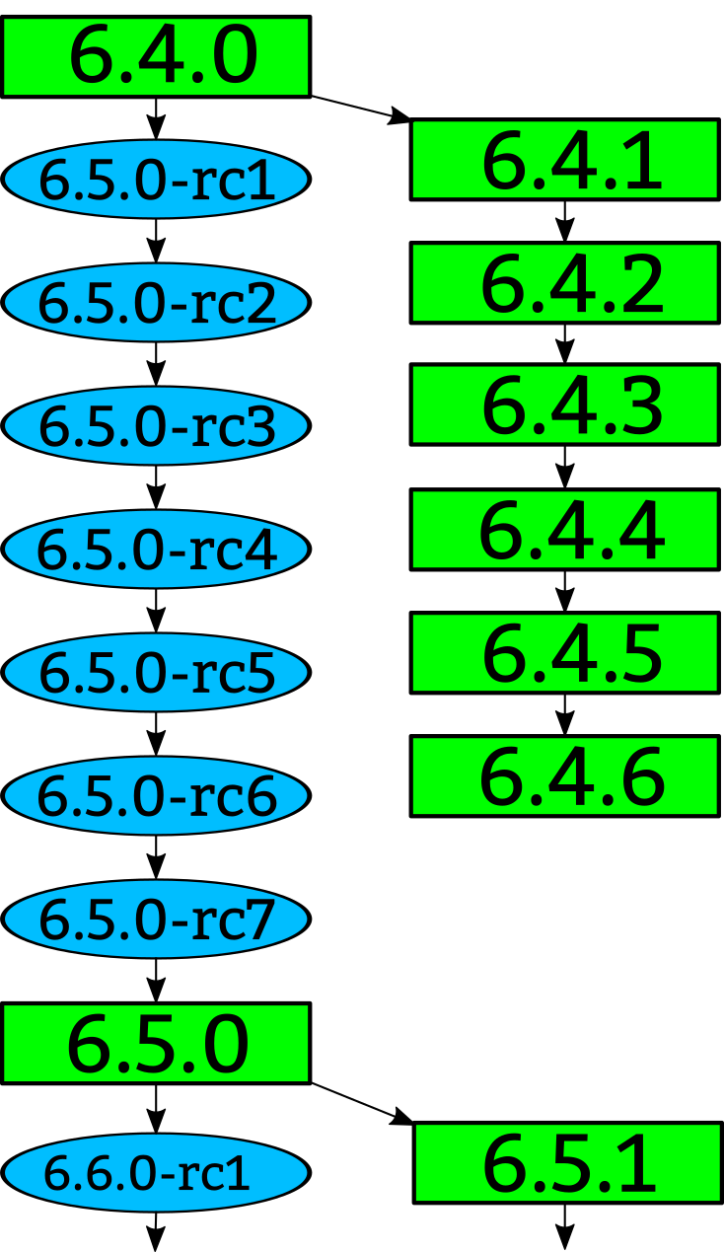

Slide 14
Stable kernel rules
Bugfix
Less than 100 lines
New ids or quirks
Must be in Linus’s tree
https://www.kernel.org/doc/html/latest/process/stable-kernel-rules.html

Slide 15
Longterm kernels
One picked per year
Maintained for at least 2 years*
5.10 5.15 6.1 6.6 6.12 6.18
* sometimes longer

Slide 16
Longterm kernels
5.10 18 changes / day
5.15 21 changes / day
6.1 25 changes / day
6.6 29 changes / day
6.12 37 changes / day
6.18 55 changes / day

Slide 17
Kernel rate of change
5.10 18 changes / day
5.15 21 changes / day
6.1 25 changes / day
6.6 29 changes / day
6.12 37 changes / day
6.18 55 changes / day
7.2 100 changes / day

Slide 18
Kernel releases
Every release is stable
18+ year old guarantee to not break things
No fear to ever upgrade

Slide 19
More release information in greater detail:
http://www.kroah.com/log/blog/2018/02/05/linux-kernel-release-model/

Slide 20


Slide 22
commit ecf85e481a716cfe07406439fdc7ba9526bbfaeb
Author: Robert Jarzmik <robert.jarzmik@free.fr>
AuthorDate: Tue Apr 21 20:33:10 2009 -0700
Commit: Greg Kroah-Hartman <gregkh@suse.de>
CommitDate: Thu Apr 23 14:15:31 2009 -0700
USB: otg: Fix bug on remove path without transceiver
In the case where a gadget driver is removed while no
transceiver was found at probe time, a bug in
otg_put_transceiver() will trigger.
Signed-off-by: Robert Jarzmik <robert.jarzmik@free.fr>
Acked-by: David Brownell <dbrownell@users.sourceforge.net>
Signed-off-by: Greg Kroah-Hartman <gregkh@suse.de>
--- a/drivers/usb/otg/otg.c
+++ b/drivers/usb/otg/otg.c
@@ -43,7 +43,8 @@ EXPORT_SYMBOL(otg_get_transceiver);
void otg_put_transceiver(struct otg_transceiver *x)
{
- put_device(x->dev);
+ if (x)
+ put_device(x->dev);
}

Slide 23
Developer’s Certificate of Origin
(a) I created this change; or
(b) Based this on a previous work with a
compatible license; or
(c) Provided to me by (a), (b), or (c) and not modified
(d) This contribution is public.

Slide 27
The world has changed
80%+ of the world’s servers runs non-commercial distribution kernels*
inter-company interactions achieve nothing
The “community” does not sign NDAs
* Embedded it is like 99%, look at
what is in your pocket or in your
home

Slide 28
Kernel security team

Slide 29
Kernel security team
  Reactive security, not proactive

Slide 30
Kernel security team
  Other groups do proactive security

Slide 31
Kernel security team
security@kernel.org
Small group of kernel developers
Do not represent any companies

Slide 32
Kernel security team
Triage reports
Drag in responsible developers
Work to create a fix as soon as possible
Get it merged into Linus’s and stable trees

Slide 33
Kernel security team
If you are brought in enough times, you are added to the alias to reduce the round-trip.

Slide 34
Kernel security team
Fix the issue as soon as possible
No embargoes longer than 7 days
Do not do any kind of announcements

Slide 35
Kernel security policy
Almost all bugs can be a “security” issue

Slide 36
Kernel security policy
A fix for a known bug is better than the potential of a fix causing a future problem as future problems, when found, will be fixed then.

Slide 37
Kernel security policy
We do NOT know your use case!

Slide 38
Kernel security policy
We do NOT know your use case!
We do NOT know what code you use!

Slide 39
Kernel security policy
We do NOT know your use case!
We do NOT know what code you use!
We do NOT want to know any of this!

Slide 40
“It's hard to capture the fact that a bug can be
super serious in one type of deployment, somewhat
important in another, or no big deal at all -- and that
the bug can be all of this at the same time.
Vulnerability remediation is hard.”
– Ben Hawkes
https://blog.isosceles.com/what-is-a-good-linux-kernel-bug/

Slide 41
Kernel security policy
Fix known bugs as soon as possible
Get releases out to users quickly
Does not work for hardware bugs*
* Hardware vendors think they are special,
They are not, they are just slow...

Slide 42
Hardware security issues
Handled separately
Encrypted restricted email list
No NDAs
Cross company / OS coordination
Embargoes are tolerated*
* for now...

Slide 43
Hardware security issues
How this works:
https://www.kernel.org/doc/html/latest/process/embargoed-hardware-issues.html

Slide 44
Kernel security team
Does not do any kind of announcements
Can not assign CVEs*
No early announcement list
* This is on purpose

Slide 45
No pre-disclosure at all!
All “early notice” lists are leaks and should be considered public.

Slide 46
No pre-disclosure at all!
All “early notice” lists are leaks and should be considered public.
Unless your project is not used by anyone.

Slide 47
No pre-disclosure at all!
All “early notice” lists are leaks and should be considered public.
Unless your project is not used by anyone.
Otherwise, why would your government allow it to exist?

Slide 48
Security fixes
Happen at least once a week
Look like any other bugfix
Many not known to be security related until years later
No differentiation between bug types
No CVEs for anything

Slide 49
CVEs used to mean nothing for Linux
https://kernel-recipes.org/en/2019/talks/cves-are-dead-long-live-the-cve/

Slide 50
CVEs now mean something!
https://www.cve.org/Media/News/item/news/2024/02/13/kernel-org-Added-as-CNA
http://www.kroah.com/log/blog/2024/02/13/linux-is-a-cna/

Slide 51
kernel.org is now a CNA!
Responsible for all kernel CVEs
Community is in control
CVEs assigned for all “vulnerabilities” fixed

Slide 52
Linux CVE resources
Contact us:
      cve@kernel.org
Process documentation:
      https://docs.kernel.org/process/cve.html
Public git repo:
      https://git.kernel.org/pub/scm/linux/security/vulns.git/
List of all assigned CVEs:
      https://lore.kernel.org/linux-cve-announce/

Slide 53
What is a vulnerability?
“An instance of one or more weaknesses in a Product that can be exploited, causing a negative impact to confidentiality, integrity, or availability; a set of conditions or behaviors that allows the violation of an explicit or implicit security policy.”

Slide 54
What is a kernel vulnerability?
Any user-triggerable crash
Memory use-after-free / leak / overflow
Incorrect boundary checks
Denial of service
Logic errors
Lots of other things

Slide 55
Why is triggering WARN_ON a CVE?
If panic_on_warn is enabled, reboot happens
Billions of Linux systems have this enabled
Android is slowly moving away from this.
Some want any warning to reboot

Slide 56
What is a not a kernel vulnerability?
Data corruption / loss
Performance issues
Bugfixes that are not externally triggered

Slide 57
How are they assigned
CVE team reviews every stable commit
Votes if is, or is not, a vulnerability
Each team member uses different methods
Commits that are agreed get assigned
Commits that are disagreed are discussed
Review happens in public

Slide 58
How are they assigned
Community requests

Slide 59
CVEs for everyone!
Averaging 61 CVEs per day!
Every CVE says what files are affected
Every CVE says what versions are affected
Very few CVEs are applicable for you!

Slide 60
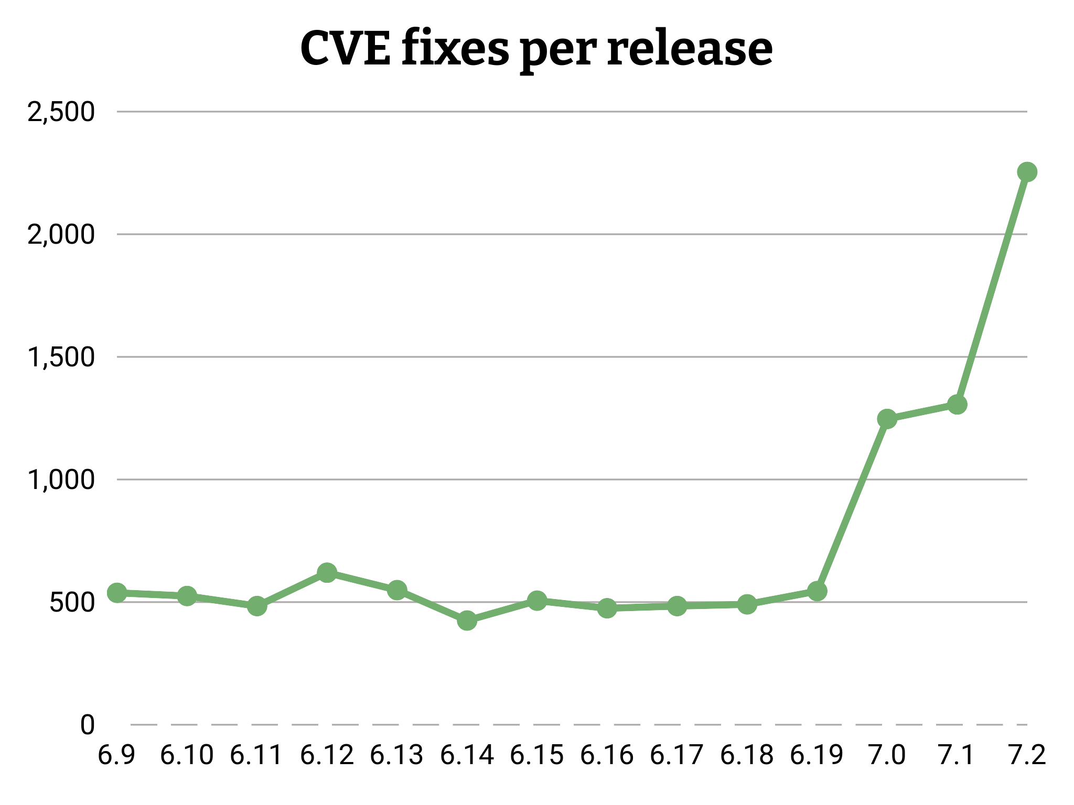

Slide 61
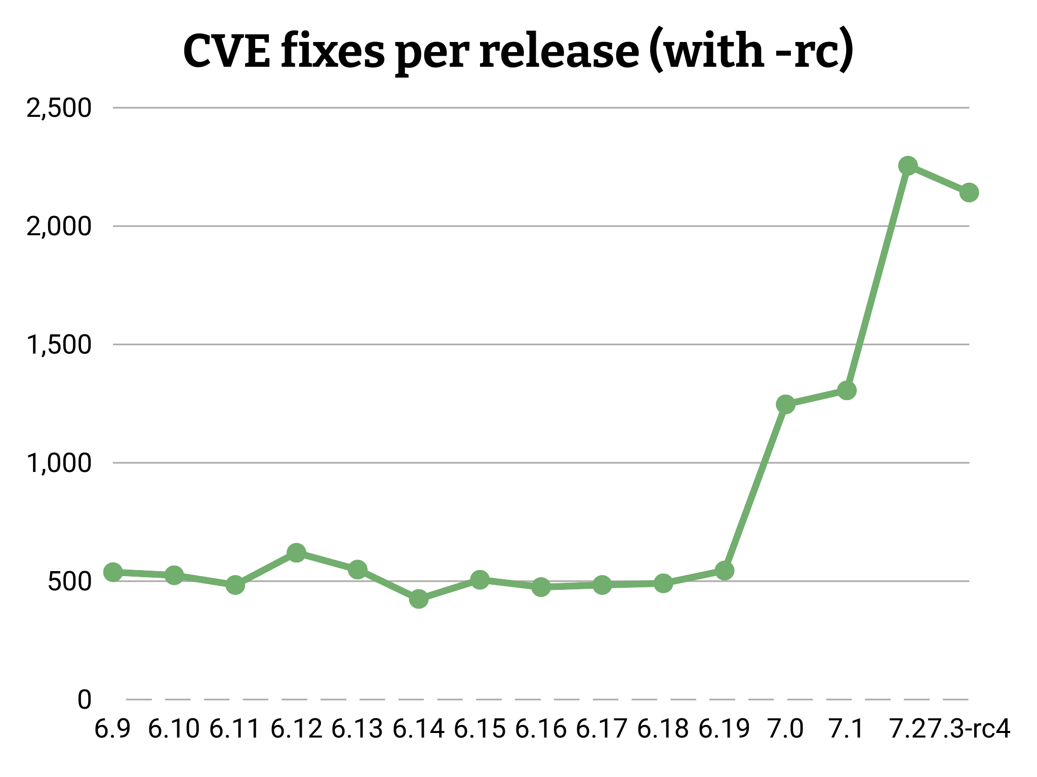

Slide 62
Most CVEs are not for you!
Only you know your usecase!
Only you know what files you use!

Slide 63
Some CVEs are for you!
Real issues get fixed every week
Ignoring them will affect your security

Slide 64
CVEs are assigned after-the-fact
Usually 1-2 week delay
Allows systems to be updated before public announcements
CVEs only reference specific fix, not any previous changes needed.
CVE fixes are NOT tested independently

Slide 65
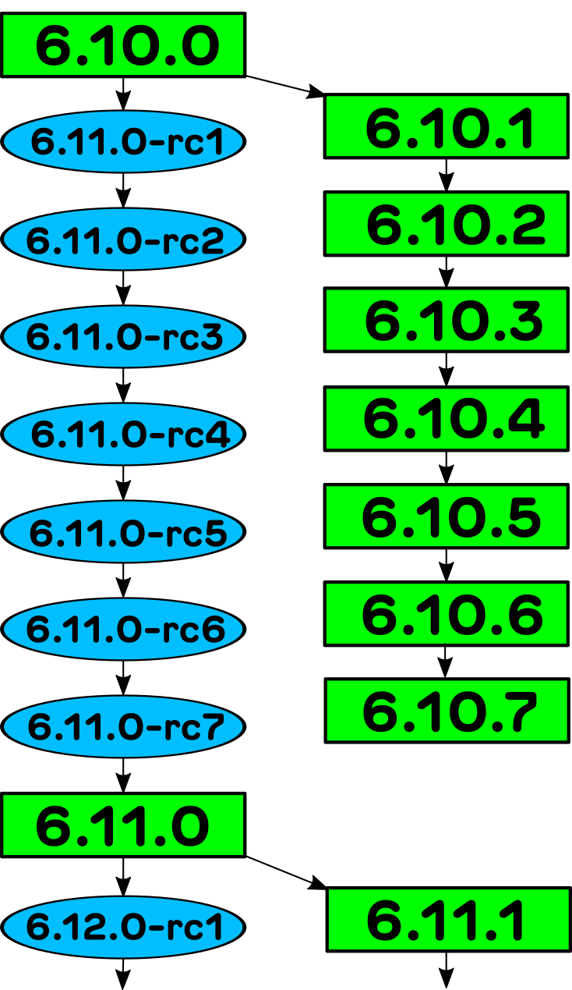
CVE review is here
Developers are here
You are here

Slide 66
Staying secure
Take all stable/longterm updates
Community supported and tested as a whole
Bonus is you get data corruption fixes and performance improvements for free!

Slide 67
“If you are not using the latest
stable / longterm kernel, your
system is insecure”
– me

Slide 68
Linux Kernel Development, how it all works
Greg Kroah-Hartman
gregkh@linuxfoundation.org
git.sr.ht/~gregkh/kernel-development

Slide 69
Bonus Slides!

Slide 70
LLMs are now “good enough”
Security bug reports / fixes are real
All open source projects are flooded
Everyone is reevaluating how to handle this

Slide 71
Network LLMs are “public”
Any “found” bug will be seen by others.
Network LLMs want to “please” you.
Projects are treating them as public

Slide 72
“If AI can find vulnerabilities, it can fix them.
The only thing scarce now is collective will.”
– Jim Zemlin

Slide 73
“I’m condemned to use the tools of my enemy
to defeat them.”
– Andor

Slide 74
How to fix a problem
llm --dangerously-skip-permissions \
-p "Fix this code" \
--verbose \
&> ~/tmp/fix.log

Slide 75
Use open models locally
They are all “good enough”.
Will find/fix almost all issues.
Keeps everything private.
Worry about the next model when you get it.
Companies wasted $25 billion not doing this.

Slide 76
What you can do today
Ignore the doom marketing

Slide 77
What you can do today
Ignore the doom marketing
Know what software you use/rely on

Slide 78
What you can do today
Ignore the doom marketing
Know what software you use/rely on
Be able to update your systems on a continuous basis

Slide 79
What you can do today
Ignore the doom marketing
Know what software you use/rely on
Be able to update your systems on a continuous basis
Update your dependancy chains

Slide 80
What you can do today
Run local models internally

Slide 81
What you can do today
Run local models internally
NEVER upload any non-public information

Slide 82
What you can do today
Run local models internally
NEVER upload any non-public information
Fix the bugs you find today

Slide 83
What you can do today
Run local models internally
NEVER upload any non-public information
Fix the bugs you find today
Send the fix upstream to be merged
Ignore the “model of tomorrow”

Slide 84
What you can do today
Run local models internally
NEVER upload any non-public information
Fix the bugs you find today
Send the fix upstream to be merged
Ignore the “model of tomorrow”

Slide 85
What you can do today
Securing Open Source in the Age of AI
https://openssf.org/resources/securing-open-source-in-the-age-of-ai-a-practical-guide/

Slide 86
Whose side has more will?
It’s going to be a rocky 18 months...

Slide 87
From: Steve Bergman <steve@rueb.com>
To: linux-kernel@vger.kernel.org
Subject: Proper procedure for reporting possible security vulnerabilities?
Date: Mon, 10 Jan 2005 10:46:57 -0600
There seems to be some confusion in certain quarters as to the proper
procedure for reporting possible kernel security issues.
REPORTING-BUGS says send bug reports to the maintainer of that area of
the kernel. However, what about areas for which a maintainer is not
listed? (e.g. VM) It seems that some take that to mean send it
directly to Linus and if you don't hear something back quickly, release
an exploit to the wild.
So what is the preferred procedure and is it documented somewhere?
Should it be made more prominent?
Thanks for any information,
Steve Bergman
https://lore.kernel.org/lkml/41E2B181.3060009@rueb.com/

Slide 88
From: Chris Wright <chrisw@osdl.org>
To: torvalds@osdl.org
Cc: akpm@osdl.org, alan@lxorguk.ukuu.org.uk,
marcelo.tosatti@cyclades.com, linux-kernel@vger.kernel.org
Subject: [PATCH] Security contact info
Date: Wed, 9 Mar 2005 01:05:50 -0800
Add security contact info and relevant documentation.
Signed-off-by: Chris Wright <chrisw@osdl.org>
MAINTAINERS | 5 +++++
REPORTING-BUGS | 4 ++++
Documentation/SecurityBugs | 38 ++++++++++++++++++++++++++++++++++++++
3 files changed, 47 insertions(+)
https://lore.kernel.org/all/20050309090550.GW28536@shell0.pdx.osdl.net/

Slide 89
From: Chris Wright <chrisw@osdl.org>
To: torvalds@osdl.org
Cc: akpm@osdl.org, alan@lxorguk.ukuu.org.uk,
marcelo.tosatti@cyclades.com, linux-kernel@vger.kernel.org
Subject: [PATCH] Security contact info
Date: Wed, 9 Mar 2005 01:05:50 -0800
Add security contact info and relevant documentation.
Signed-off-by: Chris Wright <chrisw@osdl.org>
...
+3) Non-disclosure agreements
+
+The Linux kernel security team is not a formal body and therefore unable
+to enter any non-disclosure agreements.
https://lore.kernel.org/all/20050309090550.GW28536@shell0.pdx.osdl.net/

Slide 90
Linus in 2008
On Wed, 16 Jul 2008, pageexec@freemail.hu wrote:
>
> you should check out the last few -stable releases then and see how
> the announcement doesn't ever mention the word 'security' while fixing
> security bugs
Umm. What part of "they are just normal bugs" did you have issues with?
I expressly told you that security bugs should not be marked as such,
because bugs are bugs.
> in other words, it's all the more reason to have the commit say it's
> fixing a security issue.
No.

Slide 91
> > I'm just saying that why mark things, when the marking have no meaning?
> > People who believe in them are just _wrong_.
>
> what is wrong in particular?
You have two cases:
- people think the marking is somehow trustworthy.
People are WRONG, and are misled by the partial markings, thinking that
unmarked bugfixes are "less important". They aren't.
- People don't think it matters
People are right, and the marking is pointless.
In either case it's just stupid to mark them. I don't want to do it,
because I don't want to perpetuate the myth of "security fixes" as a
separate thing from "plain regular bug fixes".
They're all fixes. They're all important. As are new features, for that
matter.

Slide 92
> when you know that you're about to commit a patch that fixes a security
> bug, why is it wrong to say so in the commit?
It's pointless and wrong because it makes people think that other bugs
aren't potential security fixes.
What was unclear about that?
Linus
Above email:
https://lore.kernel.org/lkml/alpine.LFD.1.10.0807151620450.2867@woody.linux-foundation.org/
Whole thread:
https://lore.kernel.org/lkml/20080703035807.GA8190@kroah.com/
Reporting Security bugs:
https://www.kernel.org/doc/html/latest/admin-guide/security-bugs.html

Slide 93
Reporting security issues
On Wed, 16 Jul 2008, pageexec@freemail.hu wrote:
>
> we went through this and you yourself said that security bugs are *not*
> treated as normal bugs because you do omit relevant information from such
> commits
Actually, we disagree on one fundamental thing. We disagree on
that single word: "relevant".
I do not think it's helpful _or_ relevant to explicitly point out how to
tigger a bug. It's very helpful and relevant when we're trying to chase
the bug down, but once it is fixed, it becomes irrelevant.
You think that explicitly pointing something out as a security issue is
really important, so you think it's always "relevant". And I take mostly
the opposite view. I think pointing it out is actually likely to be
counter-productive.

Slide 94
Reporting security issues
For example, the way I prefer to work is to have people send me and the
kernel list a patch for a fix, and then in the very next email send (in
private) an example exploit of the problem to the security mailing list
(and that one goes to the private security list just because we don't want
all the people at universities rushing in to test it). THAT is how things
should work.
Should I document the exploit in the commit message? Hell no. It's
private for a reason, even if it's real information. It was real
information for the developers to explain why a patch is needed, but once
explained, it shouldn't be spread around unnecessarily.
Linus
Above email:
https://lore.kernel.org/lkml/alpine.LFD.1.10.0807151716510.2867@woody.linux-foundation.org/

Slide 95
Why talk about this now?
European Union Cyber Resiliance Act (CRA)
  https://www.linuxfoundation.org/blog/understanding-the-cyber-resilience-act
  https://linuxfoundation.eu/cyber-resilience-act

Slide 96
Why talk about this now?
European Union Cyber Resiliance Act (CRA)
  https://www.linuxfoundation.org/blog/understanding-the-cyber-resilience-act
  https://linuxfoundation.eu/cyber-resilience-act
Companies keep asking to join the “security team”

Slide 97
Why talk about this now?
European Union Cyber Resiliance Act (CRA)
  https://www.linuxfoundation.org/blog/understanding-the-cyber-resilience-act
  https://linuxfoundation.eu/cyber-resilience-act
Companies keep asking to join the “security team”
Companies keep asking for “early security notices”

Slide 98
Why talk about this now?
European Union Cyber Resiliance Act (CRA)
  https://www.linuxfoundation.org/blog/understanding-the-cyber-resilience-act
  https://linuxfoundation.eu/cyber-resilience-act
Companies keep asking to join the “security team”
Companies keep asking for “early security notices”
Hardware embargoed issues are a pain

