Slide 1

Linux Kernel Development
Greg Kroah-Hartman
gregkh@linuxfoundation.org
github.com/gregkh/kernel-development
Notes:
I'm going to discuss the how fast the kernel is moving, how we do it all, and how you can get involved.

Slide 2
61,000 files
25,380,000 lines
Kernel release 4.17.0
Notes:
This was for the 4.14 kernel release, which happened November 12, 2017.

Slide 3
4,461 developers
≈530 companies
Kernel releases 4.12.0 – 4.17.0
July 2017 – June 2018
Notes:
This makes the Linux kernel the largest contributed body of software out there that we know of.
This is just the number of companies that we know about, there are more that we do not, and as the responses to our inquiries come in, this number will go up.
Have surpassed 400 companies for 4 years now.

Slide 4
9,900 | lines added
4,300 | lines removed
2,200 | lines modified
Kernel releases 4.12.0 – 4.17.0
July 2017 – June 2018

Slide 5
9,900 | lines added
4,300 | lines removed
2,200 | lines modified
Every day
Kernel releases 4.12.0 – 4.17.0
July 2017 – June 2018

Slide 6
8.7 changes per hour
Kernel releases 4.12.0 – 4.17.0
July 2017 – June 2018
Notes:
This is 24 hours a day, 7 days a week, for a full year.
We went this fast the year before this as well, this is an amazing rate of change.
Interesting note, all of these changes are all through the whole kernel.
For example, the core kernel is only 5% of the code, and 5% of the change was to the core kernel. Drivers are 55%, and 55% was done to them, it's completely proportional all across the whole kernel.

Slide 7
9.6 changes per hour
4.9 and 4.12 release
2.6.20 to 2.6.24-rc8
Notes:
4.9 was the “largest” in number of changes that we have ever accepted, 16000. 4.12 was not far behind with 14500
Now this is just the patches we accepted, not all of the patches that have been submitted, lots of patches are rejected, as anyone who has ever tried to submit a patch can attest to.

Slide 8
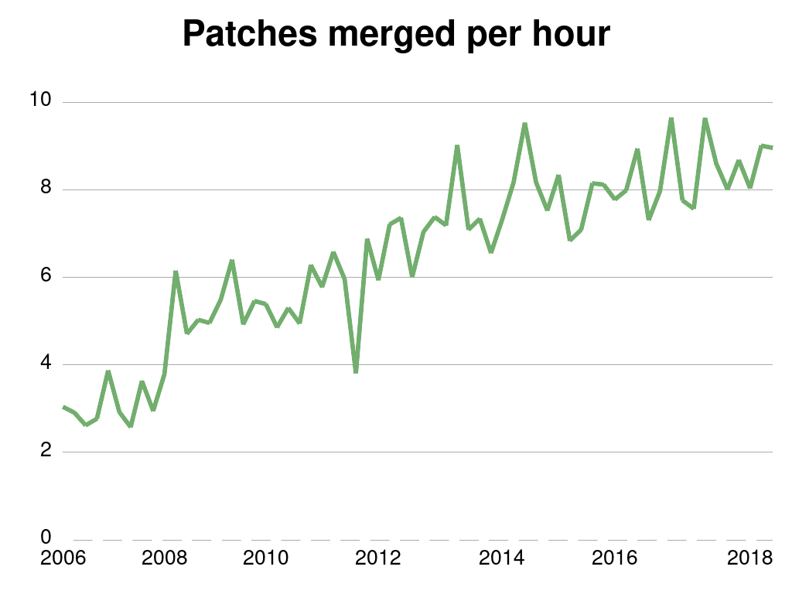
2.6.20 to 2.6.24-rc8
Notes:
4.9 was the “largest” in number of changes that we have ever accepted, 16000. 4.12 was not far behind with 14500
Now this is just the patches we accepted, not all of the patches that have been submitted, lots of patches are rejected, as anyone who has ever tried to submit a patch can attest to.
Over time, we are going faster, so if you stay out of the kernel tree, it takes you more work to just stay in sync with upstream

Slide 9
How we stay sane
Time based releases
Incremental changes
2.6.20 to 2.6.24-rc8

Slide 10

New release every
2½ months
Notes:
67 days to be exact, very regular experience.

Slide 11
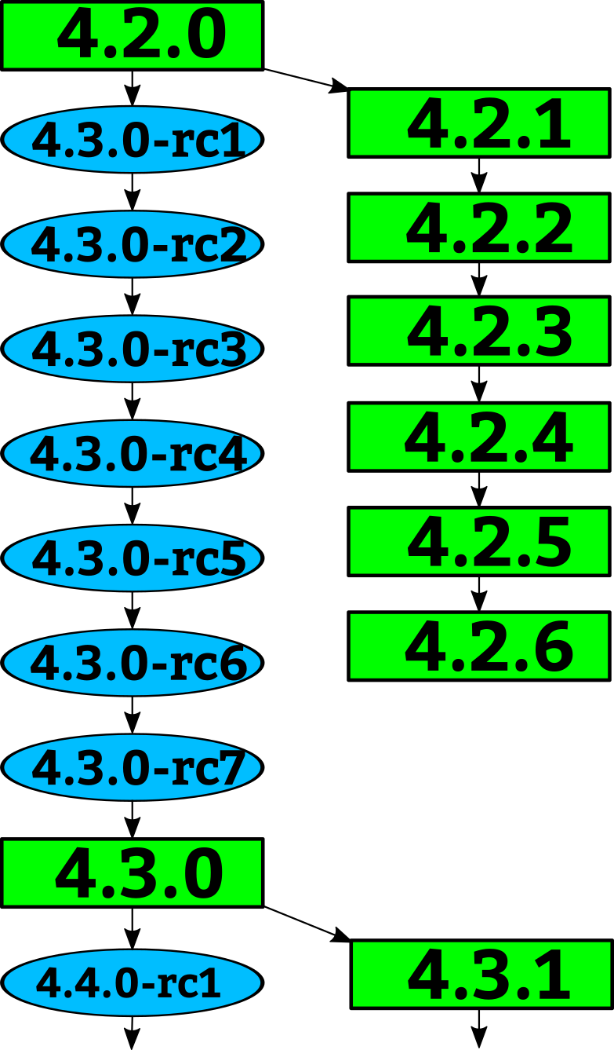
Notes:
How a kernel is developed.
Linus releases a stable kernel
- 2 week merge window from subsystem maintainers
- rc1 is released
- bugfixes only now
- 2 weeks later, rc2
- bugfixes and regressions
- 2 weeks later,rc3
And so on until all major bugfixes and regressions are resolved and then the cycle starts over again.

Slide 12
Notes:
Greg takes the stable releases from Linus, and does stable releases with them, applying only fixes that are already in Linus's tree.
Requiring fixes to be in Linus's tree first ensures that there is no divergence in the development model.
After Linus releases a new stable release, the old stable series is dropped.
With the exception of “longterm” stable releases, those are special, the stick around for much longer...

Slide 13
“Longterm kernels”
One picked per year
Maintained for two years
4.4 4.9 4.14
2.6.20 to 2.6.24-rc8
Notes:
I pick one kernel release per year to maintain for longer than one release cycle. This kernel I will maintain for at least 2 years.
This means there are 2 longterm kernels being maintained at the same time.
4.4 and 4.9 and 4.14 are the longterm kernel releases I am currently maintaining
The LTSI project is based on the longterm kernels.

Slide 14

Notes:
Like mentioned before, we have almost 3000 individual contributors. They all create a patch, a single change to the Linux kernel. This change could be something small, like a spelling correction, or something larger, like a whole new driver.
Every patch that is created only does one thing, and it can not break the build, complex changes to the kernel get broken up into smaller pieces.

Slide 15
Notes:
The developers send their patch to the maintainer of the file(s) that they have modified.
We have about 700 different driver/file/subsystem maintainers

Slide 16
commit ecf85e481a716cfe07406439fdc7ba9526bbfaeb
Author: Robert Jarzmik <robert.jarzmik@free.fr>
AuthorDate: Tue Apr 21 20:33:10 2009 -0700
Commit: Greg Kroah-Hartman <gregkh@suse.de>
CommitDate: Thu Apr 23 14:15:31 2009 -0700
USB: otg: Fix bug on remove path without transceiver
In the case where a gadget driver is removed while no
transceiver was found at probe time, a bug in
otg_put_transceiver() will trigger.
Signed-off-by: Robert Jarzmik <robert.jarzmik@free.fr>
Acked-by: David Brownell <dbrownell@users.sourceforge.net>
Signed-off-by: Greg Kroah-Hartman <gregkh@suse.de>
--- a/drivers/usb/otg/otg.c
+++ b/drivers/usb/otg/otg.c
@@ -43,7 +43,8 @@ EXPORT_SYMBOL(otg_get_transceiver);
void otg_put_transceiver(struct otg_transceiver *x)
{
- put_device(x->dev);
+ if (x)
+ put_device(x->dev);
}
Notes:
This is an example of a patch.
It came from Robert, was acked by David, the maintainer at the time of the usb on-the-go subsystem, and then signed off by by me before it was commited to the kernel tree.
The change did one thing, it checked the value of the pointer before it was dereferenced, fixing a bug that would have crashed the kernel if it had been hit.
This is also a “blame” trail, showing who changed each line in the kernel, and who agreed with that change.
If a problem is found, these are the developers that you can ask about it.
Because of this, every line in the Linux kernel can be traced back to at least two developers who are responsible for it.
This is better than any other body of code.

Slide 17
Developer's Certificate of Origin
(a) I created this change; or
(b) Based this on a previous work with a
compatible license; or
(c) Provided to me by (a), (b), or (c) and not
modified
(d) This contribution is public.
Notes:
This is what “Signed-off-by:” means.
All contributions to the Linux kernel have to agree to this, and every single patch has at least one signed-off-by line, usually all have at least two.
This is also a “blame” trail, showing who changed each line in the kernel, and who agreed with that change.
If a problem is found, this is the developers that you can ask about it.
Because of this, every line in the Linux kernel can be traced back to at least two developers who are responsible for it.
This is better than any other body of code.

Slide 18
Notes:
After reviewing the code, and adding their own signed-off-by to the patch, the file/driver maintainer sends the patch to the subsystem maintainer responsible for that portion of the kernel.
We have around 150 subsystem maintainers

Slide 19
Notes:
Linux-next gets created every night from all of the different subsystem trees and build tested on a wide range of different platforms.
We have about 150 different trees in the linux-next release.
Andrew Morton picks up patches that cross subsystems, or are missed by others, and releases his -mm kernels every few weeks. This includes the linux-next release at that time.

Slide 20

Notes:
Every 3 months, when the merge window opens up, everything gets sent to Linus from the subsystem maintainers and Andrew Morton.
The merge window is 2 weeks long, and thousands of patches get merged in that short time.
All of the patches merged to Linus should have been in the linux-next release, but that isn't always the case for various reasons.
Linux-next can not just be sent to Linus as there are things in there that sometimes are not good enough to be merged just yet, it is up to the individual subsystem maintainer to decide what to merge.

Slide 21

Top developers by quantity
Chris Wilson 1064
Colin Ian King 933
Arnd Bergmann 868
Arvind Yadav 823
Christoph Hellwig 775
Mauro Carvalho Chehab 714
Geert Uytterhoeven 590
Kees Cook 589
Kuninori Morimoto 529
Masahiro Yamada 523
Kernel releases 4.12.0 – 4.17.0
Notes:
Chris – intel graphics drivers
Johan – greybus, usb-serial, drivers
Mauro – Video 4 Linux (media drivers)
Arnd – janitorial cleanups and arch-generic
Viresh – greybus
Christoph – vfs, filesystems, xfs, everywhere
Colin - janitorial
Arvind - janitorial
Geert - janitorial
Greg – greybus, staging, lots of other messes

Slide 22
Top Signed-off-by:
David S. Miller 9831
Greg Kroah-Hartman 6030
Alex Deucher 4105
Mauro Carvalho Chehab 2952
Mark Brown 2375
Linus Torvalds 2116
Andrew Morton 2088
Martin Petersen 1643
Jens Axboe 1537
Michael Ellerman 1515
Kernel releases 4.12.0 – 4.17.0
Notes:
David – networking, isa
Greg – driver core, usb, staging, greybus
Mauro – video 4 linux (media)
Mark – embedded sound
Linus – everything
Alex – radeon graphics
Andrew – everything
Ingo – x86
Martin – scsi / block
Chris – intel graphics
Kalle – wireless drivers

Slide 23
Who is funding this work?
1. Intel | 11.5%
2. “Amateurs” | 8.0%
3. Red Hat | 6.9%
4. AMD | 5.1%
5. IBM | 4.3%
6. Google | 3.7%
7. Linaro | 3.7%
8. SUSE | 2.9%
9. Renesas Electronics | 2.6%
10. Mellanox | 2.6%
Kernel releases 4.12.0 – 4.17.0
Notes:
So you can view this as either 12% is done by non-affiliated people, or 88% is done by companies.
Now to be fair, if you show any skill in kernel development you are instantly hired.
Why this all matters: If your company relies on Linux, and it depends on the future of Linux supporting your needs, then you either trust these other companies are developing Linux in ways that will benefit you, or you need to get involved to make sure Linux works properly for your workloads and needs.

Slide 24
Who is funding this work?
11. Consultants | 2.1%
12. Oracle | 2.1%
13. Samsung | 2.0%
14. ARM | 1.9%
15. Huawei Technologies | 1.6%
16. Broadcom | 1.5%
17. Bootlin | 1.5%
18. Linux Foundation | 1.4%
19. Canonical | 1.4%
20. Texas Instruments | 1.1%
Kernel releases 4.12.0 – 4.17.0
Notes:
Intel – 10000 patches
Huawei - 1200 patches (almost half done by one developer!!!)
Canonical 896
Siemens – 51 patches, rank: 111

Slide 25
“Working upstream
saves time and money”
Dan Frye – VP Open Systems, IBM
Dirk Hohndel – Chief Technologist, Intel
2.6.20 to 2.6.24-rc8

Slide 26
How to change
2.6.20 to 2.6.24-rc8
Notes:
“Change or die”

Slide 27
How to change
Submit code early and often
2.6.20 to 2.6.24-rc8
Notes:
No big code dumps.
They are hard to review, and even harder for you to modify and resend, slowing everything down and delaying any potential acceptance.

Slide 28
How to change
Send small pieces
2.6.20 to 2.6.24-rc8

Slide 29
How to change
Ask community for feedback
2.6.20 to 2.6.24-rc8
Notes:
Some companies get Linux kernel community members together and discuss products and technologies directly with the senior engineers, no managers in the way.
Great feedback circle, the community gets to understand your products better, and no long explanation is needed when showing the code later, and the community gets to tell your engineers what they are doing wrong.

Slide 30
How to change
Act on it
2.6.20 to 2.6.24-rc8
Notes:
Change products / roadmaps / features based on feedback. This makes Linux work better on your platforms which makes your platform better.

Slide 31
How to change
Remove legal hurdles
2.6.20 to 2.6.24-rc8
Notes:
Let them contribute whatever they want and can.
Legal is to support the business, change the hurdles to be on the legal side, not the developers.

Slide 32
How to change
Force them to work in public
2.6.20 to 2.6.24-rc8
Notes:
No internal mailing lists
All communication is done publicly
Let them argue in public

Slide 33
How to change
Allow them to be the community
2.6.20 to 2.6.24-rc8
Notes:
Your developers will become the maintainers, driving the future of Linux forward, always keeping your products in mind as things evolve and change.

Slide 34
Kernel Security
Notes:
Let’s talk about kernel security.

Slide 35
Kernel Security
Almost all bugs can be a “security” issue.
Notes:
Anything that goes wrong in the kernel can usually be turned into a “security” problem.
Be it a DoS, or a reboot, or local root exploit, or worst case, a remote root exploit (very rare, thankfully.)

Slide 36
Kernel Security
Almost all bugs can be a “security” issue.
Fix them as soon as possible.
Notes:
Because it’s really hard to determine if a bug is a “security” issue, our response is that we fix all bugs as soon as possible once we learn about them.
TTY bug in RH

Slide 37
Kernel Security
Averaging 21 fixes per day
Notes:
If you look at the number of patches flowing into the stable tree, we are averaging 21 patches a day, every single day.
Now not all of them are “security” fixes. But some small percentage is.
This is for the latest kernel release, the 4.4 kernel is averaging 9 fixes a day, and 4.9 is still running at 13½ fixes a day!

Slide 38
“If you are not using a stable /
longterm kernel, your machine
is insecure”
– me
Notes:
Your infrastructure HAS to support updating the kernel. If you can’t do that, you are insecure.
Even the “enterprise” kernels aren’t keeping up with this rate of change, the exception being Debian.
If you use these kernels, you HAVE to keep up to date.
Android example.

Slide 39
“The kernel needs airbags”
– Konstantin Ryabitsev
slides.com/mricon/giant-bags-of-mostly-water#/
Notes:
kernel.org sysadmin, in charge of the LF sysadmin team, Fedora infrastructure developer.
Great presentation on how you, as a sysadmin, can implement secure practices for your network. Full checklist and guide has been published.
But, even with those practices, we need low-level changes in order to save ourselves from the accidents that will happen.
We need “airbags” in the kernel, and elsewhere.
Things like SELinux, grsec, openwall we need them.

Slide 40
“We will always have bugs,
we must stop their exploitation”
– Kees Cook
outflux.net/slides/2015/ks/security.pdf
Notes:
Kees Cook, kernel security developer, presentation at kernel summit last year.
We need to start doing things to make the kernel more “robust” from a security standpoint.
Even if it makes things harder for the developers.
Everyone agreed.

Slide 41
Kernel Hardening
kernsec.org/wiki/index.php/Kernel_Self_Protection_Project
Core Infrastructure Initiative
Notes:
Kernel hardening project.
New security features are being added in each release, but if you don’t upgrade, you don’t get those features, and protection.
CII is helping to fund this, if you want to work on it, we need developers, and we will pay for it.

Slide 42
“Ceaseless change is the only
constant thing in Nature.”
– John Candee Dean
Notes:
1911 astronomer.
If your operating system isn’t constantly changing, then it is dead. The world doesn’t stop changing, learn to embrace the change in order to survive.
“static systems” die.

Slide 43

github.com/gregkh/kernel-development
Notes:
Obligatory Penguin Picture

Slide 45
Getting involved
Run the kernel.org release on your machine
2.6.20 to 2.6.24-rc8
10,900 lines added
5,500 lines removed
2,200 lines modified
per day 2008 - 2009

Slide 46
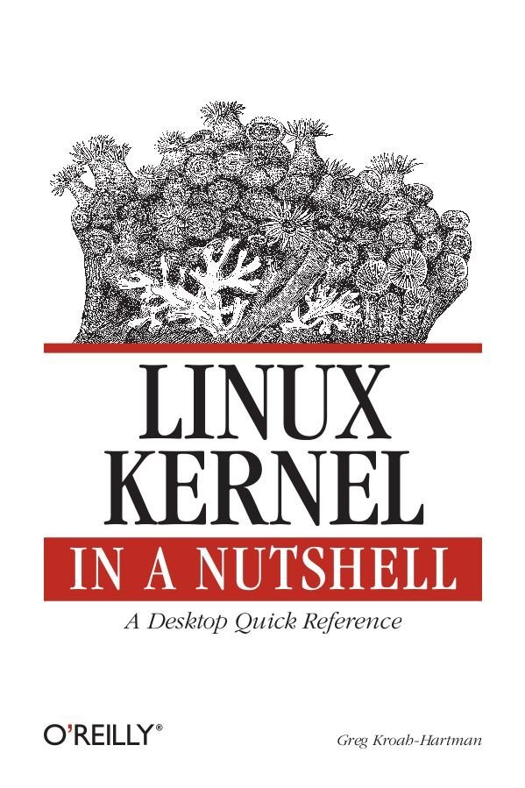
Getting involved
2.6.20 to 2.6.24-rc8
10,900 lines added
5,500 lines removed
2,200 lines modified
per day 2008 - 2009
Notes:
This book tells you how to build and install a kernel on your machine.
Free online

Slide 47
Getting involved
Documentation/HOWTO
Documentation/development-process
2.6.20 to 2.6.24-rc8
Notes:
These documents in the kernel source directory are the best place to start if you want to understand how the development process works, and how to get involved.
The HOWTO file has links to almost everything else you ever wanted..

Slide 48

Getting involved
kernelnewbies.org
2.6.20 to 2.6.24-rc8
Notes:
http://www.kernelnewbies.org

Slide 49
Getting involved
Google “write your first kernel patch”
2.6.20 to 2.6.24-rc8
Notes:
This is a video of a talk I gave at FOSDEM, going through the steps, showing exactly how to create, build, and send a kernel patch.

Slide 50
Getting involved
kernelnewbies.org/KernelJanitors/Todo
2.6.20 to 2.6.24-rc8
Notes:
So you know how to create a patch, but what should you do? The kernel janitors has a great list of tasks to start with in cleaning up the kernel and making easy patches to be accepted.

Slide 51
Getting involved
Linux Driver Project
drivers/staging/*/TODO
2.6.20 to 2.6.24-rc8
Notes:
The staging tree also needs a lot of help, here are lists of things to do in the kernel for the drivers to be able to move out of the staging area.
Please always work off of the linux-next tree if you want to do these tasks, as sometimes they are already done by others by the time you see them in Linus's tree.

Slide 52
Getting involved
Eudyptula Challenge
(little penguin)
http://eudyptula-challenge.org/
2.6.20 to 2.6.24-rc8
Notes:
Google “Linux kernel challenge” to find the site, if you can't remember Eudyptula.
It is a series of programming challenges, all run through email that starts out with a “Hello World” kernel module, and gets more complex from there. Over 4000 people are currently taking the challenge, and is a lot of fun if you don't know where to start out.
You need knowledge of C, but that's about it.

Slide 53
Product Development
time
Design Bringup Integration Testing Release

Slide 54
Product Development
time
Design Bringup Integration Testing Release
Kernel code
submission
Kernel code
accepted
Ideal

Slide 55
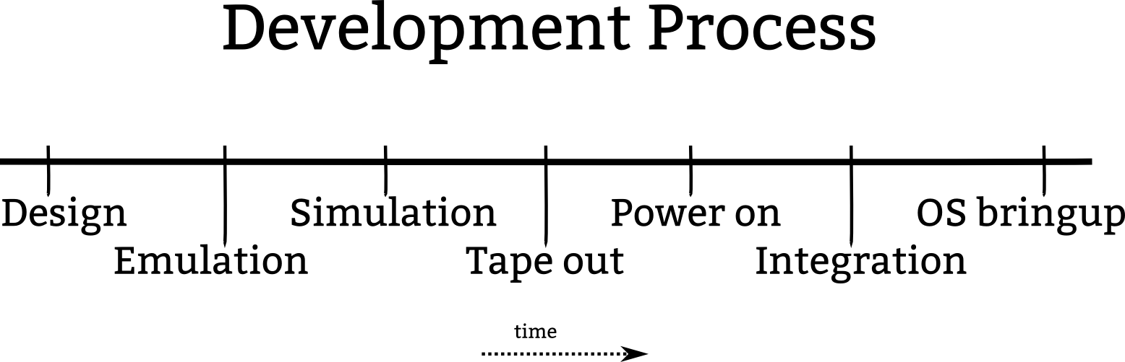

Slide 56
Kernel code
submission
Kernel code
accepted
Ideal

Slide 57
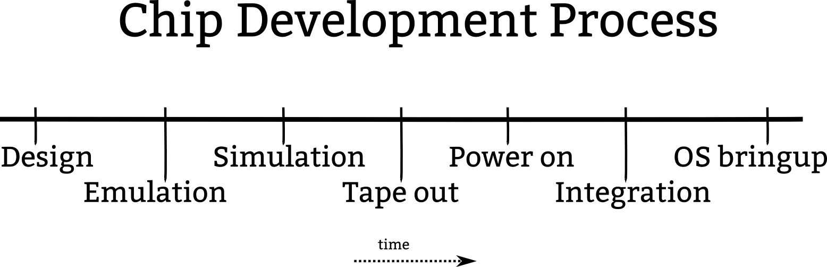

Slide 58
Kernel code
submission
Today

Slide 59
Kernel code
submission
Kernel code
accepted
Today

Slide 60
Kernel code
submission
Ideal

Slide 61
Kernel code
submission
Kernel code
accepted
Ideal

