Slide 1
Linux Kernel Community
Greg Kroah-Hartman
gregkh@linuxfoundation.org

Slide 2
44,600 files
17,730,000 lines
Kernel release 3.12.0

Slide 3
3,061 developers
433 companies
Kernel releases 3.8.0 – 3.12.0
October 2012 – November 2013

Slide 4
8,600 lines added
3,900 lines removed
2,000 lines modified
Kernel releases 3.8.0 – 3.12.0
October 2012 – November 2013

Slide 5
8,600 lines added
3,900 lines removed
2,000 lines modified
Every Day
Kernel releases 3.8.0 – 3.12.0
October 2012 – November 2013

Slide 6
7.59 changes per hour
Kernel releases 3.8.0 – 3.12.0
October 2012 – November 2013

Slide 7
9.02 changes per hour
3.10.0 release

Slide 8
How we stay sane
Time based releases
Incremental changes

Slide 9
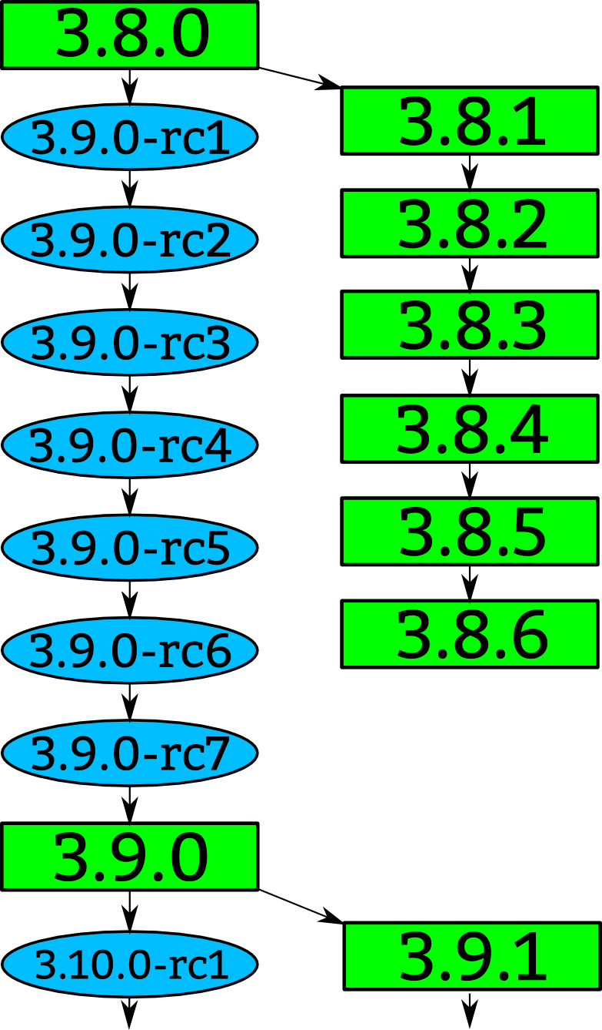

Slide 11
“Longterm kernels”
One picked per year
Maintained for two years
3.4 3.10

Slide 12


Slide 17
Who is funding this work?
1. “Amateurs” 11.6%
2. Intel 9.3%
3. Red Hat 8.7%
4. Linaro 5.9%
5. Samsung 4.0%
6. Texas Instruments 3.7%
7. Unknown Individuals 3.6%
8. IBM 3.1%
9. SuSE 3.1%
10. Vision Engraving 2.7%
Kernel releases 3.8.0 – 3.12.0

Slide 18
Who is funding this work?
11. Google 2.4%
12. Renesas 1.9%
13. Freescale 1.4%
14. Broadcom 1.3%
15. Oracle 1.3%
16. Consultants 1.3%
17. NVidia 1.2%
18. AMD 1.2%
19. LINBIT 1.1%
20. Free Electrons 1.1%
Kernel releases 3.8.0 – 3.12.0

Slide 20
3.8 release
F2FS
February 18, 2013

Slide 21
3.12 release
some tty locks removed
November 3, 2013

Slide 22
3.12 release
Major ipc speedups
November 3, 2013

Slide 23

©¡WOUW!

